Slide 1

Advanced Biometric detection system using platform drivers with the help of serial communication and the display
By:
1.Anvitha K P
2.K.Naga Prasanna

Slide 2
Objective:
The main objective of this project is to develop an advanced biometric authentication system using a platform drivers for real-time fingerprint acquisition and verification through serial (UART) communication and display the outcome on SPI interfaced Display(ILI9225).
Tools and technologies used:
Linux Kernel Drivers (SPI,UART)
Sockets
UART fingerprint Sensor , SPI ILI9225 TFT Display,
DTS, Makefile,
Raspberry Pi

Slide 3
WORKFLOW:
Server is waiting for client,Client connected
& sends msg
Module
loaded
Uart,spi,Lcd Initialized, server starts
If msg
Is I a
If msg
is Place
finger
no
yes
Play
audio
Captured
Image?
Invalid
no
no
yes
yes
yes
Displaying
NOT
MATCHED
no
Match
found
no
First
scan
yes
Registered
fingerprint?
Displaying
REGISTERED
Search for
fingerprint
yes
no
Displaying
MATCHED
Displaying NOT
REGISTERED
Close
connection

Slide 4
WORKING PRINCIPLE:
• When the driver module loads, LCD and UART are initialized.
• The server waits for a request from the client.
• When the client1 is connected and sends “PLACE_FINGER” messege, the fingerprint registration process starts.
• The system sends capture command to the fingerprint sensor through UART.
• The sensor captures and processes the fingerprint data.
• If it is first time it registers the finger print ,if it is not first time it tries to search.
• When searched ,if the fingerprint matches , Success message is displayed like ‚matched‘ on LCD.
• If the fingerprint does not match ,Failure message is displayed like ‚not matched‘.
• The system returns to idle state and waits for the next request.
• If the unregistered client comes,and sends message „NEW“ then it will search for the finger print ,since it is not registered it will display not matched on display and system returns to idle state and waits for next request.

Slide 5
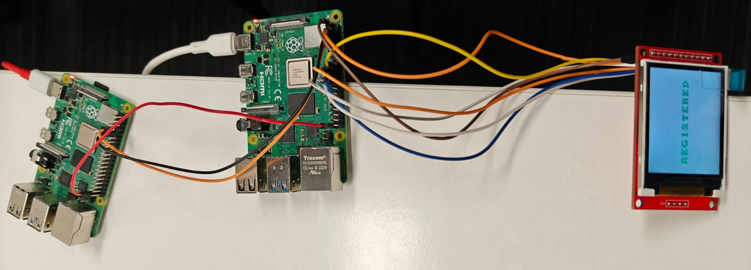
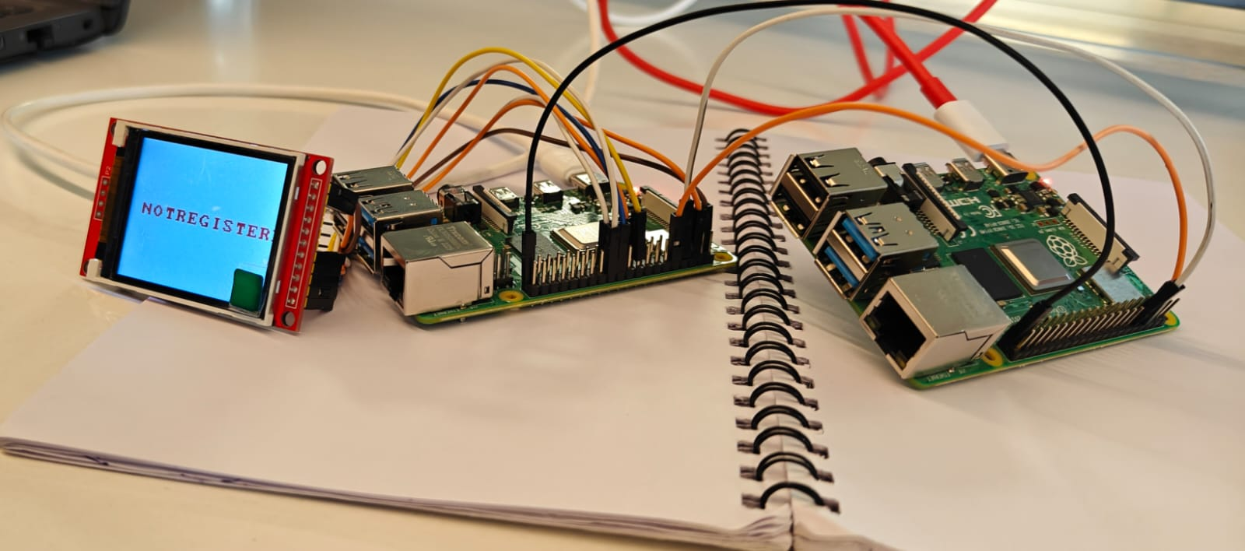
OUTCOME:
Real-time fingerprint capture and verification using UART communication.
Secure biometric authentication with successful match/mismatch indication on LCD.
Reliable client-server communication through kernel TCP server.
Demonstrates integration of UART, SPI LCD platform drivers in Linux.

Slide 6
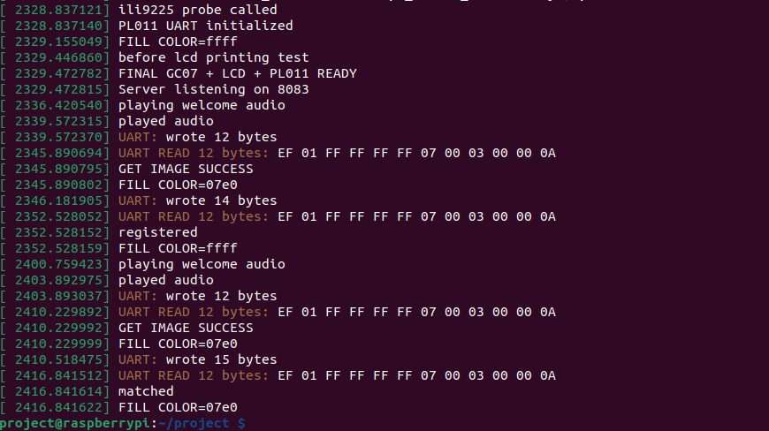
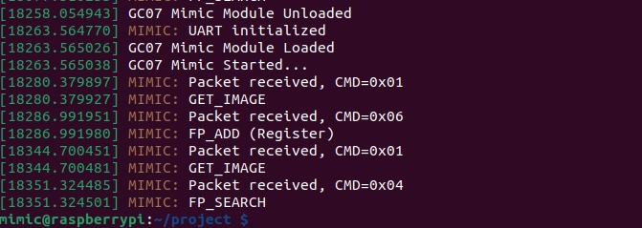

Slide 7
CONCLUSION:
By implementing a custom platform drivers and kernel-level TCP server, the system achieves secure and reliable fingerprint authentication.
The seamless interaction between the fingerprint sensor, LCD display (ILI9225), and serial communication ensures stable real-time biometric verification.

