Slide 1
Kernel-Level Driver Implementation for Sensor-Driven Communication and SPI Display Control
JEFF THOMAS
UDAYA BHASKAR

Slide 2
Overview
Objective
To build an event-driven embedded Linux system that can detect sensor events in real time and communicate them reliably between boards using kernel-space drivers.
Problem
Polling-based designs lead to unnecessary CPU usage and increased latency.
Embedded peripherals require efficient handling at the kernel level.
Implementation
Developed a GPIO platform driver with interrupt (IRQ) support to detect IR sensor events
Implemented a UART platform driver for communication between the Linux board and Raspberry Pi
Designed an SPI platform driver to control the LCD display
Exposed device functionality through a character device interface for user–kernel interaction
Used standard Linux system calls for data exchange and control.

Slide 3
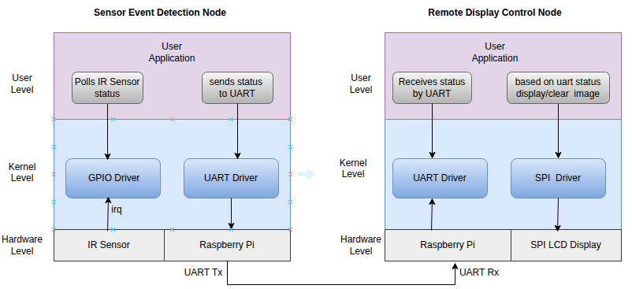
Workflow

Slide 4
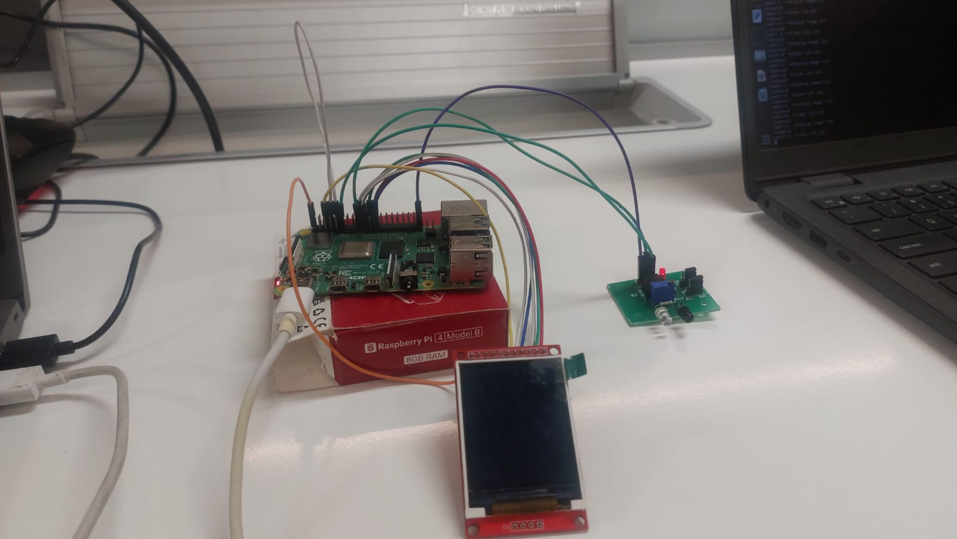
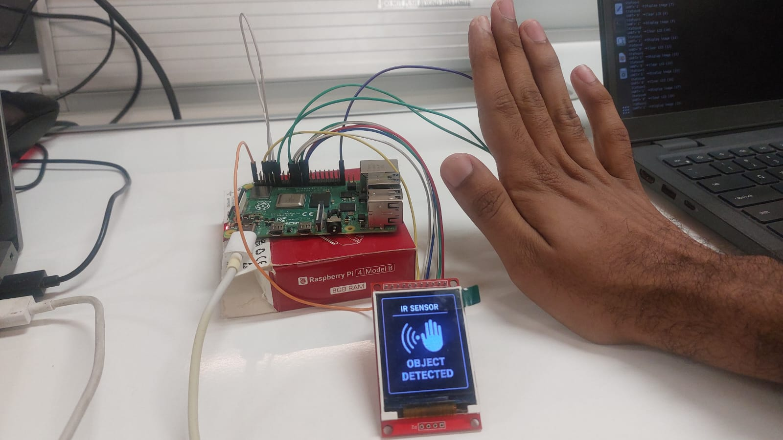
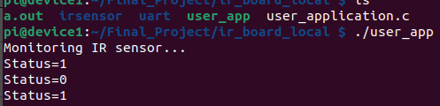
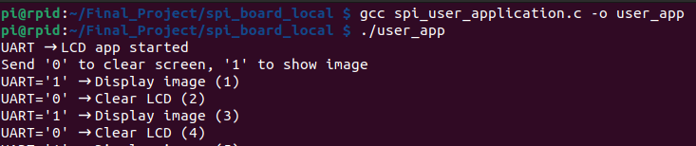
Results

Slide 5
Thank you

