Slide 1
Outline
File systems under Linux
File systems in Unix / Linux
Symbolic links
Mounting of file systems
Virtual file system
Superblock
Inode
Dentry object
File object
Example implementation of a file system in Linux based on ext2

Slide 2
Unix file systems
Hierarchical
Tree structure
File catalogues as internal nodes
Files as leaves
No restrictions regarding width and depth
Consistent
Nearly all system objects are represented as files and can be used via the file interface (files, catalogues, communication objects, devices, ...)
Syntactically equal treatment of all types, semantically as far as possible
Hence: Applications are independent from the object type
Simple
Only a few, but ﬂexible file operations
Simple file structure
Slide based on Lecture Operating Systems by Prof. Dr. U. Heiss

Slide 4
Files in Unix
Byte string
Arbitrarily addressable
Content has no predefined properties
Form and content created by user
Restricted to a single logical medium
Protected by access rights
r (read)
w (write)
x (execute)
defined for user, group, others
Slide based on Lecture Operating Systems by Prof. Dr. U. Heiss

Slide 5
Inode (Index node)
Each file is represented by an Inode
It contains
Owner (UID, GID)
Access rights
Time of last modification / access
Size
Type (file, directory, device, pipe, ...)
Pointers to data blocks that store file's content
Slide based on Lecture Operating Systems by Prof. Dr. U. Heiss

Slide 6
Directories (file catalogues)
Directories are handled as normal files, but are marked in Inode-­‐ type as directory
A directory entry contains
Length of the entry
Name (variable length up to 255 characters)
Inode number
Multiple directory entries may reference the same Inode number (hard link)
Users identify files via pathnames ("/path/to/file") that are mapped to Inode numbers by the OS
If the path starts with "/", it is absolute and is resolved up from the root directory
Otherwise the path is resolved relative to the current directory
Slide based on Lecture Operating Systems by Prof. Dr. U. Heiss

Slide 8
Directories
Each directory contains an entry "." that represents the Inode of the current directory
The second entry "..” references parent directory
The path is resolved from left to right and the respective name is looked up in the directory
As long as the current name is not the last in the path, it has to be a directory. Otherwise, the lookup terminates with an error
Slide based on Lecture Operating Systems by Prof. Dr. U. Heiss

Slide 9
Symbolic Links
To improve shared access to files, UNIX allows use of symbolic links to reference single files and directories via multiple diﬀerent paths
symlink(bisheriger_name, neuer_name) creates an additional path to the resource
Example
after symlink("/usr/src/uts/sys","/usr/include/sys")
and symlink("/usr/include/realfile.h", "/usr/src/uts/sys/testfile.h")
there exist three paths to the same file
usr
src
include
uts
sys
realfile.h
sys
inode.h
testfile.h
Slide based on Lecture Operating Systems by Prof. Dr. U. Heiss

Slide 10
Hard and Symbolic Links
A hard link is an additional file name
There exists another directory entry that points to the same file
All hard links point to the same Inode
Each new hard link increments the link counter of the Inode
As long as the link counter ≠ 0, the file "survives" a remove() and only the link counter is decremented
If the last link is removed, the file is deleted and the Inode can be reused
Hard links can only be created for files in the same file logical file system
A symbolic link (soft link) is a file that contains the path of another file or directory
Symbolic links are interpreted and resolved on every access
If the target of a symbolic link is deleted, the link becomes invalid but remains existent
Symbolic links to files and directories can be created for files that do not exist (yet)
Slide based on Lecture Operating Systems by Prof. Dr. U. Heiss

Slide 11
Logical and Physical File System
A logical file system may consist of multiple physical file systems
A file system can be hooked into any path of the virtual file system tree with the "mount" command
Mounted file systems are managed by the OS in a "mount table" that connects paths to mount points
This allows to identify the root Inodes of mounted file systems
/
bin
etc
usr
mount-point
cc
sh
getty
passwd
/
bin
include
src
awk
yacc
stdio.h
uts
Slide based on Lecture Operating Systems by Prof. Dr. U. Heiss

Slide 12
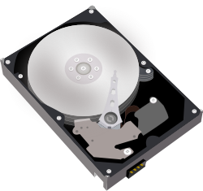



Virtual File System
The Virtual File System (VFS) implements a generic file system interface between the actual file system implementation (in kernel) and accessing applications to provide interoperability
➔Applications can access diﬀerent file systems on diﬀerent media via a homogeneous set of UNIX system calls
HDD with ext4
VFS
cp
DVD with UDF
Slide based on R. Love: Linux Kernel Development

Slide 13




Virtual File System
Example: write(f, &buf, len);
Write of len Bytes in file with descriptor f from Buﬀer buf is translated into system call
The system call is forwarded to the actual file system implementation
The file system executes the write command
write()
sys_write()
file system write method
User-space
VFS
File system
Disk drive
Slide based on R. Love: Linux Kernel Development

Slide 14
VFS Objects and Data Structures
VFS is object oriented
Four base objects
Super block: Represents specific properties of a file system
Inode: File description
Dentry: The directory entry represents a single component of a path
File: Representation of an open file that is associated with a process
VFS handles directories like files
Dentry object represents component of a path that may be a file
Directories are handled like files as Inodes
Each object provides a set of operations
Slide based on R. Love: Linux Kernel Development

Slide 16
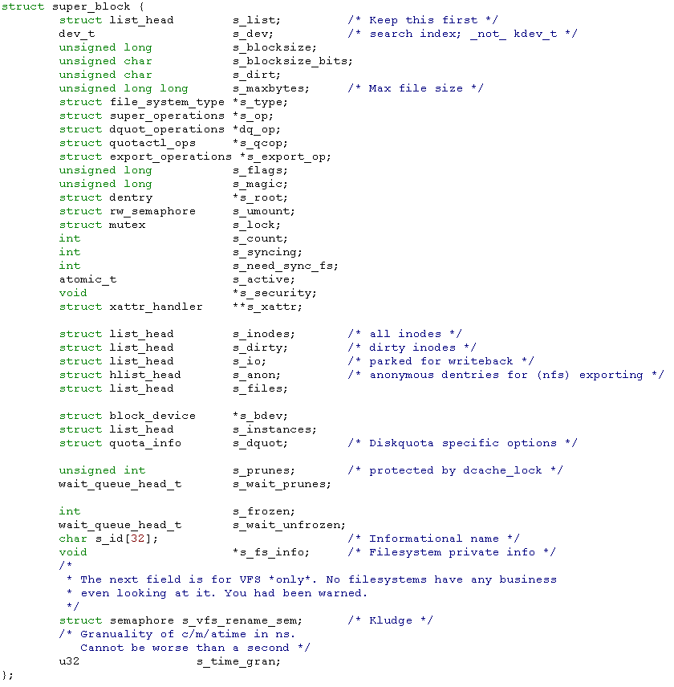
Superblock
Each file system must provide a superblock
Contains properties of the file system
Is stored on special sectors of disk or is created dynamically (i.e. by sysfs)
Structure is created by alloc_super()when the file system is mounted
Slide based on R. Love: Linux Kernel Development

Slide 17
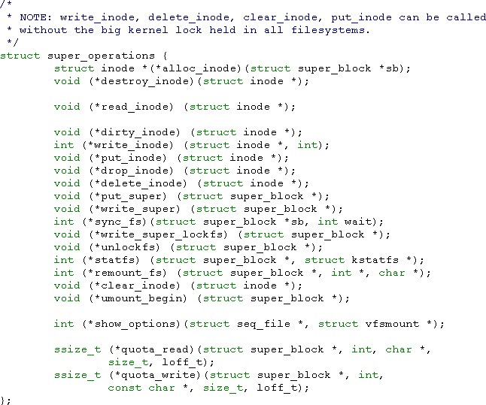
Superblock Operations
Each entry contains pointer to a function
File system provides implementation for the operations
Example:
Write superblock sb:
sb->s_op->write_super(sb)
Slide based on R. Love: Linux Kernel Development

Slide 18
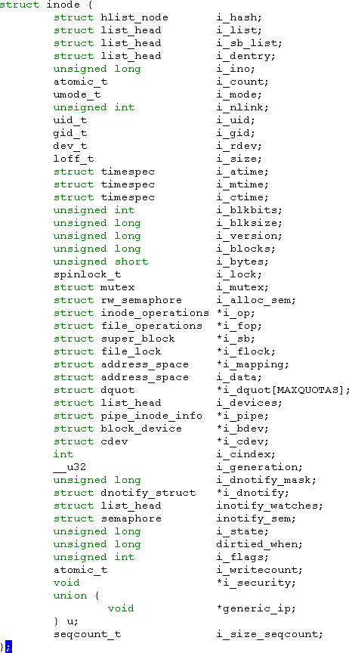
Inode Object
Contains information specific to a file
For typical Unix file systems, an Inode can directly be read from disk
Other file systems hold this information as part of a file or in a database
➔ Inode has to be created by the file system
Special Entries for non-­‐data files
– i.e. i_pipe, i_bdev, or i_cdev are reserved for pipes, block and character devices
Some entries are not supported by all file systems and may therefore be set to Null
Slide based on R. Love: Linux Kernel Development

Slide 19
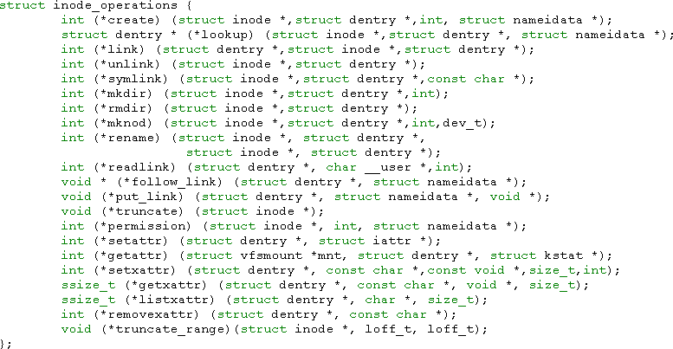
Inode Operations
Inode Operations describe the set of operations that are implemented by the file system and are accessed via VFS
Slide based on R. Love: Linux Kernel Development

Slide 20
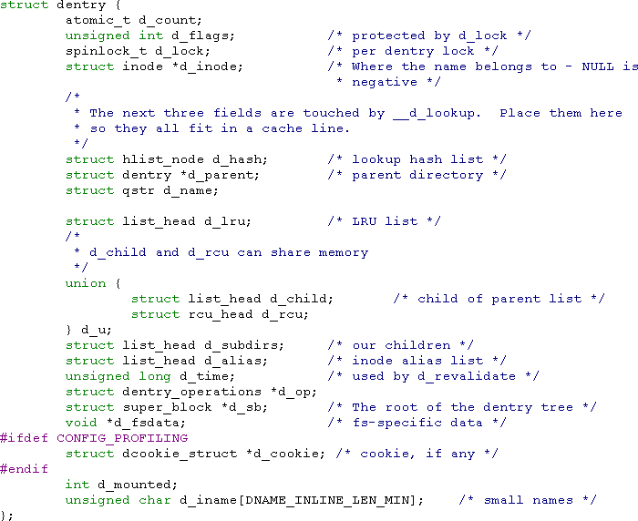
Dentry Objects
Unix directories are handled like files
The path /bin/vi contains the directories / and bin as well as the file vi
Resolution of paths requires introduction of dentry objects
Each part of a path is dentry
object
VFS creates dentry objects on the ﬂy
No equivalent on disk drive
Are stored in dentry cache (handled by OS)
– Frontend of Inode cache
Slide based on R. Love: Linux Kernel Development

Slide 21
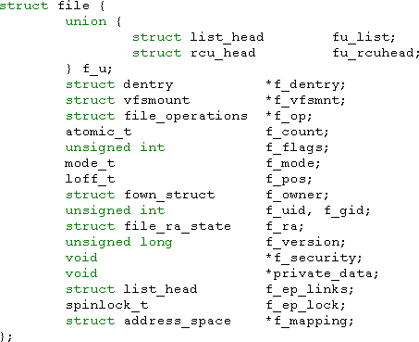
File Object
File object represents open file
Interface to applications
Is created as reply to open()system call
Is removed on close()
Diﬀerent processes can open a file multiple times ➔ diﬀerent file objects
The file object is an in-­‐memory data structure of the OS
Slide based on R. Love: Linux Kernel Development

Slide 22
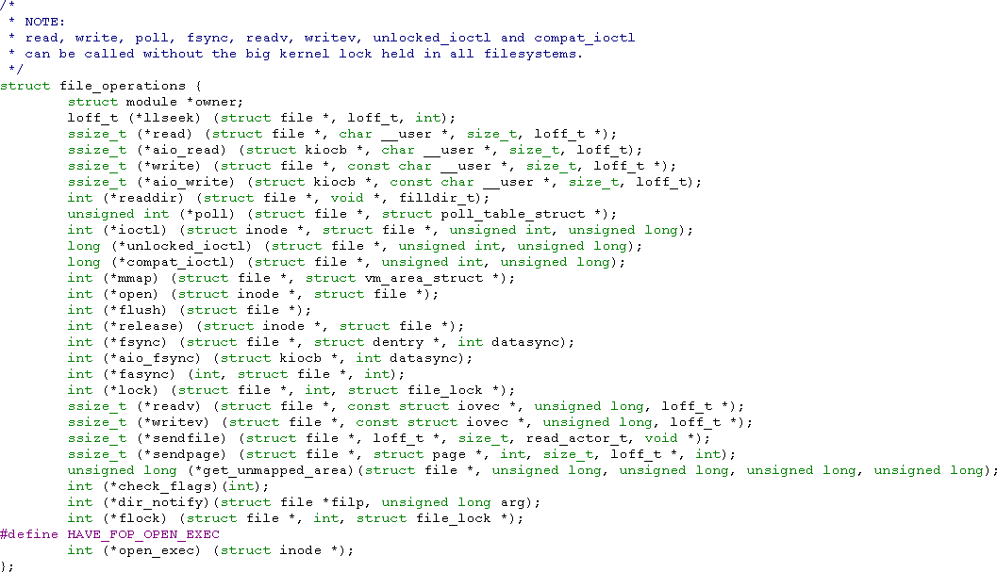
File operations

Slide 23
File systems in Linux -­‐ EXT 2
First linux file system has been derived from Minix
Limitations of Minix-­‐FS couldn‘t be tolerated for long
Only 14 characters for file names
Paritions had to be smaller 64 Mbyte
No symbolic links
Minix-­‐FS has been the file system under linux until the introduction of EXT
EXT has been inﬂuenced by the Fast File System from the BSD world
Aims of EXT2
Variable block sizes to better support big AND small files
Fast symbolic links
Extending the file system without reformatting
Decrease the harm of crashes (fsck)
Introduction of unchangable files
Slide based on W. Maurer: Linux Kernelarchitektur

Slide 25



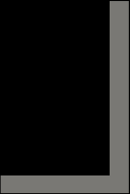








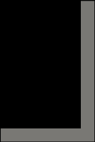
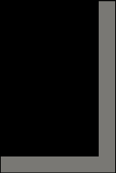

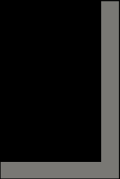

Physical Architecture
Block based devices have sectors as smallest addressable unit
EXT2 is block based file system that partitions the hard disk into blocks (clusters) of the same size
Blocks are used for metadata and data
Blocks lead to internal fragmentation
Optimale Packungsdichte
Datei A
Datei B Datei C
Datenverteilung in EXT 2
Slide based on W. Maurer: Linux Kernelarchitektur

Slide 26


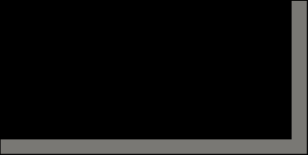

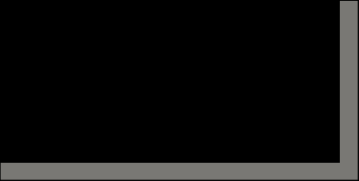

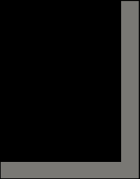

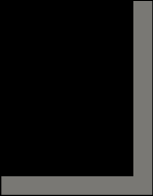
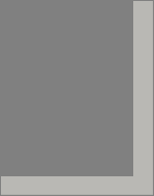





Structural Architecture of EXT 2
EXT2 divides storage system into block groups
Boot- block | Block Group 1 | Block Group 2 | … | Block Group n
Boot block is equivalent to first sector on hard disk
Block group is basic component, which contains further file system components
Super- block
Group Descriptor
Data Bitmap
Inode bitmap
Inode Tables
Data blocks
1 block
k blocks
1 block
1 block
n blocks
m blocks
Slide based on W. Maurer: Linux Kernelarchitektur

Slide 27
Metadata
Superblock: Central structure, which contains number of free and allocated blocks, state of the file system, used block size, …
Group descriptor contains the state, number of free blocks and inodes in each block group. Each block group contains group descriptor!
Data bitmap: 1/0 allocation representation for data blocks
Inode bitmap: 1/0 allocation representation for inode blocks
Inode table stores all inodes for this block group
Data blocks store user data
Slide based on W. Maurer: Linux Kernelarchitektur

Slide 28
Data Structures
EXT2 stores metadata in each block group
Basic idea:
If a system crash corrupts the superblock, then there are enough redundant copies of it
Distance between metadata and data is small ➔ fewer head movements
Implementations work diﬀerently:
Kernel only works with in RAM copy of the first superblock, which is written back to redundant super blocks during file system checks
Later versions of EXT2 include Sparse Superblock option, where superblocks are only stored in group 0, 1 as well in groups, which are a power of 3, 5, or 7
Slide based on W. Maurer: Linux Kernelarchitektur

Slide 29
Limitations
Size of a file is restricted by the number of block entries in an inode
Assumption:
– 700 Mbyte file size and 4 Kbyte block size
➔ 179.200 block entries are necessary and each entry needs 32 / 64 Bit
➔ 700 KByte storage space within one Inode are necessary
➔ If the inode size is fixed, the you also need 700 KByte inodes for
4 Kbyte files
EXT2 supports direct and indirect blocks
There is one pointer each for one-­‐time, tweo-­‐time, and three-­‐time indirect blocks
Indirektionsblöcke
Datenblöcke
Inode
12 direkte Blöcke
12 direkte
Blöcke
Slide based on W. Maurer: Linux Kernelarchitektur

Slide 30
Calculation of maximum file site
Blockgröße / Kbyte | 1 | 2 | 4 | 8
Blöcke erste Stufe | 12 | 12 | 12 | 12
Blöcke über erste Indirektion | 256 | 512 | 1.024 | 2.048
Blöcke über zweite Indirektion | 65.536 | 262.144 | 1.048.576 | 4.194.304
Blöcke über dritte Indirektion | 16.777.216 | 134.217.728 | 1.073.741.824 | 8.589.934.592
Maximal darstellbare Zahl | 4.294.967.296 | 4.294.967.296 | 4.294.967.296 | 4.294.967.296
max. Dateigröße / Gbyte | 16 | 257 | 4.100 | 32.768
Increasing the block size increases maximum file size quadratically
High file capacities are mostly ensured by third level of indirection
Most applications only work with files up to 2 Tbyte
64 bit addressing only works with half as much pointers per block, but helps to overcome 2 Tbyte limit

Slide 31
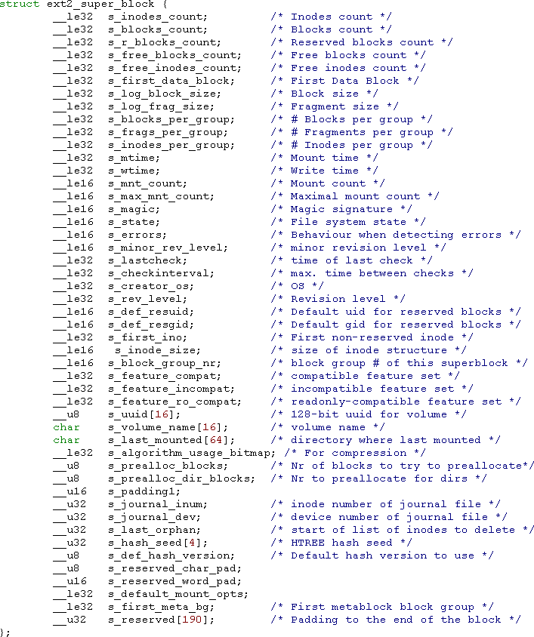
EXT 2-­‐Superblock
Read in using ext2_read_super()
Meaning is typically part of the name ...
s_log_block_size stores size of a block in Kbyte as its logarithm
s_blocks_per_group defines number of blocks per group
s_magic stores magic value for EXT2
s_feature_compat, … define compatibility requirements
Slide based on W. Maurer: Linux Kernelarchitektur

Slide 32
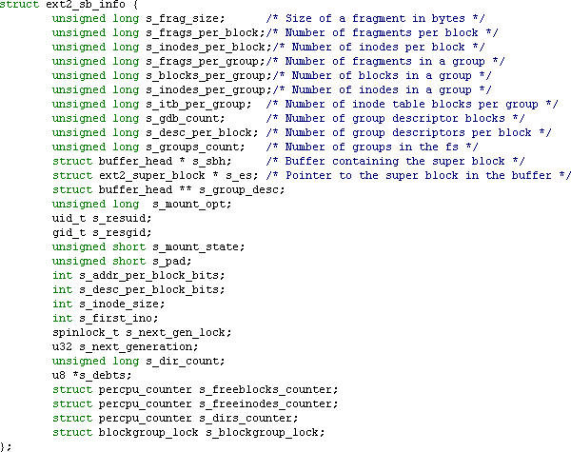
EXT 2-­‐Superblock-­‐Info
VFS-­‐superblock gets pointer to file system specific elements via *s_fs_info
Data is read from superblock and/or created from the file system
Most important:
s_mount_opt: Mount options
s_mount_state: Current state
s_dir_count: Number of directories
Slide based on W. Maurer: Linux Kernelarchitektur

Slide 33
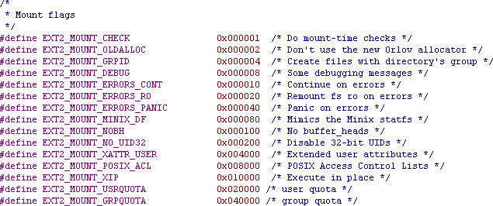
EXT 2 Mount Options

Slide 34
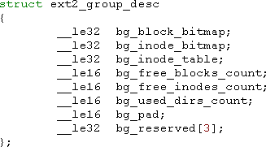
Group descriptor
One copy of the descriptor for each block group in the kernel
Block descriptor for each block group in each block group
➔ Bitmaps can be accessed from everywhere
Pointer to bitmaps with allocation information of blocks and inodes
➔ Number of blocks in each block group restricted by block size
Position of free blocks can be directly calculated from position in bitmap
Counter for free structures
Slide based on W. Maurer: Linux Kernelarchitektur

Slide 35
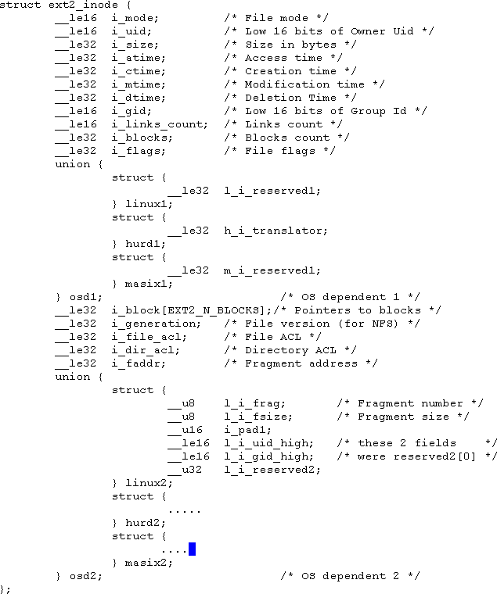
EXT2 Inodes
i_mode stores access permissions for and type of file
Several time stamps
i_size and i_blocks store size in bytes, resp. blocks
i_block contains pointer to direct and indirect block links
i_links_count counts hard links
Slide based on W. Maurer: Linux Kernelarchitektur

Slide 36
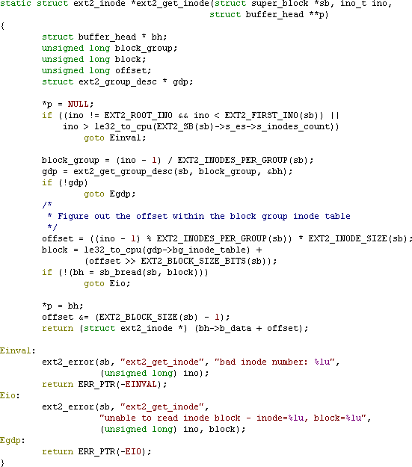
How does OS find an Inode?
Is it a valid Inode address?
In which group resides Inode
Information about the group
Offset within the group
Read data from disk / from Cache

Slide 37
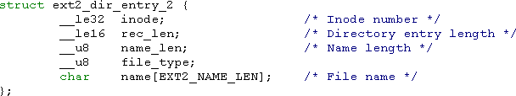
Directory entries in EXT2
Directories are handled as standard inodes
ext2_dir_entry marks directory entry
Inode contains associated inode number
name_len stores length of directory name
Has to be multiple of four
Can be filled with /0
rec_len points to next entry
Slide based on W. Maurer: Linux Kernelarchitektur

Slide 38
Directory entries in EXT2
inode | rec_len | name_len | file_type | name
 | 12 | 1 | 2 | . | \0 | \0 | \0
 | 12 | 2 | 2 | . | . | \0 | \0
 | 16 | 8 | 4 | h | a | r | d | d | i | s | k
 | 32 | 5 | 7 | l | i | n | u | x | \0 | \0 | \0
 | 16 | 6 | 2 | d | e | l | d | i | r | \0 | \0
 | 16 | 6 | 1 | s | a | m | p | l | e | \0 | \0
 | 16 | 7 | 2 | s | o | u | r | c | e | \0 | \0
Corresponds to the following directory:
drwxr—xr-x | 3 | brinkman | users | 4096 | Dec | 10 | 19:44 | .
drwxrwxrwx | 13 | brinkman | users | 8192 | Dec | 10 | 19:44 | ..
brw-r—r-- | 1 | brinkman | users | 3, 0 | Dec | 10 | 19:44 | harddisk
lrwxrwxrwx | 1 | brinkman | users | 14 | Dec | 10 | 19:44 | linux->/usr/src/linux
-rw-r--r-- | 1 | brinkman | users | 13 | Dec | 10 | 19:44 | sample
drwxr-xr-x | 2 | brinkman | users | 4096 | Dec | 10 | 19:44 | source
Slide based on W. Maurer: Linux Kernelarchitektur

Slide 39
How does the os find a file?
Example: Opening the file /home/user/.profile:
/ is always stored in Inode 2 of the root file system
– (Exception: Process was chroot'ed)
Open Inode 2, read data of Inode, lookup entry home and read its inode number
Open Inode for home, read its data, lookup entry for user and read its inode number
Open Inode for user, read its data, lookup entry for .profile and read its inode number
Open Inode for .profile, read its data, create a struct file
A pointer to the file is added to the file pointer table of the OS
➔ The file descriptor table of the calling process is updated with the new pointer
Slide based on presentation from M. J. Dominus

Slide 40
Allocation of data blocks
Allocation of data blocks always necessary if the file becomes bigger
Aim: Map successive addresses sequentially to the storage system
Approach of ex2_get_block()
If there is a logical block directly before address of current block ➔ take next physical block
Else take physical block number of the block with the logical block number directly before the logical block number of the current block
Else take block number of first block in block group, where inode is stored
Target block can be already occupied
Task of ext2_alloc_branch(): Allocate nearby block based on goal-­‐block
ext2_alloc_block() includes options for the preallocation of blocks
Orlov-­‐Allokator: typically no relationship between subdirectories in root directory ➔ if there a new subdirectory is created in the root directory, just place it somewhere

Slide 41
Journaling File Systems
“A journaling file system is a file system that logs changes to a journal (usually a circular log in a specially-­‐allocated area) before actually writing them to the main file system”
Problem description without Journaling:
A crashed computer or file system might lead to inconsistent data on a file system
Full file system needs to be checked and repaired
➔This process might take multiple hours!
➔Idea:
Write all data to a journal first, then to its final destination on disk
On a crash, only the journal has to be checked for unfinished transactions
Operations can be executed atomically
Slide based on Wikipedia

Slide 42
Journaling File Systems
„Full Journaling“ writes all data twice
➔ degraded performance
Idea of „Metadata Journaling“:
– Only write metadata of a file to the journal, actual file data is directly written to disk
File data should be written before the metadata is committed to the journal to prevent file inconsistencies
Example
Resize file in Inode
Allocate space for file extension in the free space map
Write data to the newly allocated area
What happens if the computer crashes after step 2?
Slide based on Wikipedia

Slide 43
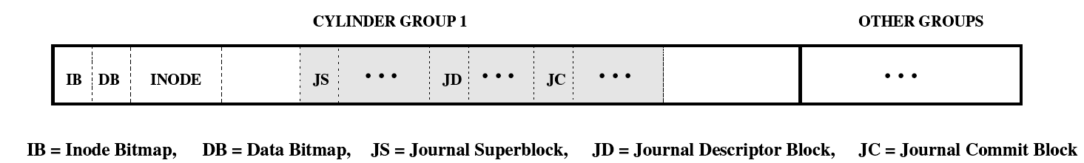
EXT 3 Journaling File System
EXT 3 extends EXT 2 by journaling
Journal is stored as a file on the file system but may also be stored on a separate partition
Journal is implemented as a ring buﬀer. If the operations are committed to disk, the journal is reused
Journal superblock stores information like block size and pointers to the beginning and the end of the journal
Journal descriptor block marks the beginning of a transaction and contains information about following blocks, i.e. their storage location
Journal commit block is written to the end of a transaction. If the JCB was written, the transaction can be recovered without data loss
Slide based on V. Prabhakaran et al.: Analysis and Evolution of Journaling File Systems

Slide 44
EXT 3 Journaling Modes
EXT 3 provides three diﬀerent journaling modes
Write-­‐back
Only the metadata is written to the journal
Data blocks are directly written to disk
No clear ordering of writes of data blocks or the journal
A crash may lead to an inconsistent state
Ordered
Only metadata is written to the journal
Data blocks are written to disk, before metadata is written to the journal
If metadata write commits, then the data is consistent after crash
Data
Data and metadata are written to the journal
Slide based on V. Prabhakaran et al.: Analysis and Evolution of Journaling File Systems

Slide 45
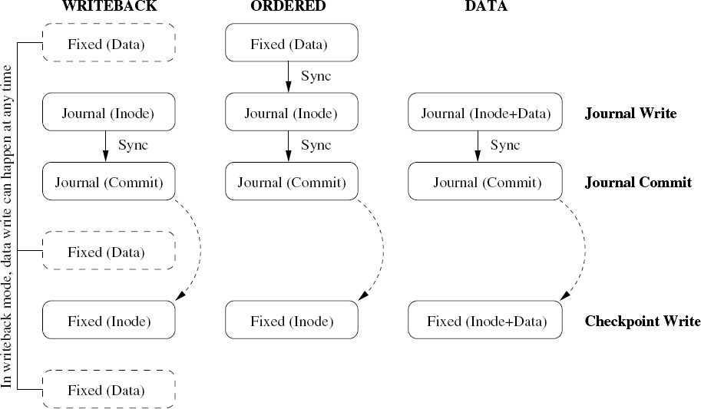
EXT 3 Journaling Modes

Slide 46
EXT 3 Transactions
Transactions
EXT 3 groups multiple file system updates into a single transaction
Goal: Performance improvement if a structure is updated multiple times
Example: Free space bitmap is updated regularly
Checkpointing
Flushes journaling information to be written to their destination blocks
Triggered by a timer, if file system buﬀers become to small, or the journal reaches its maximum size

Slide 47
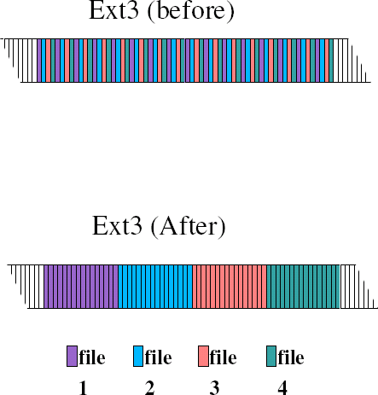
Reservation of Blocks in EXT3
Pre-­‐allocation of blocks helps to reduce fragmentation of files
EXT3 supports reservation of areas in the main memory
Each Inode has its own reservation window
Windows do not overlap
Windows can grow and shrink dynamically
Windows are removed if the file is closed
➔Improved throughput

Slide 48
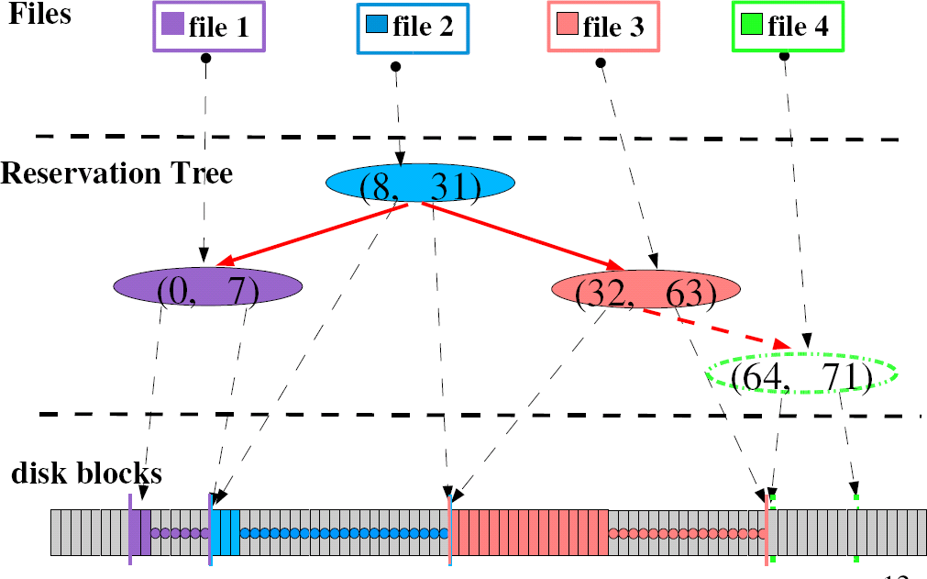
Reservation of Blocks in EXT3

Slide 49
Virtual File Systems in Linux
Linux provides several virtual file systems like procfs, sysfs, and debugfs for interacting with kernel data structures, debugging, and system configuration. These file systems are mounted in the Linux namespace and provide user-space access to kernel information in a file-like hierarchy.

Slide 50
The Virtual File System (VFS) in Linux is an abstraction layer that allows the kernel to interact with different types of file systems in a uniform way. It provides a consistent API for managing files, directories, and their associated metadata, regardless of the underlying file system type (e.g., ext4, procfs, debugfs). Special Virtual File Systems procfs: A virtual file system mounted at /proc. Provides information about processes and system resources in real-time. Examples: /proc/cpuinfo, /proc/meminfo. debugfs:

Slide 51
1. procfs (Process File System) Purpose: Provides information about processes and other system resources. Mount Point: /proc Structure: Process-specific directories (e.g., /proc/<PID>/) contain details about individual processes. System-wide files like /proc/cpuinfo, /proc/meminfo, and /proc/uptime give information about CPU, memory, and uptime. Use Case: Useful for system monitoring and debugging. Kernel modules can add custom entries under /proc.

Slide 52
2. sysfs Purpose: Exposes kernel device information and attributes to user space. Mount Point: /sys Structure: Organized hierarchically based on devices, drivers, and subsystems. Files represent device attributes, which can often be read or written. Use Case: Access hardware configuration and kernel object states. Used by tools like udev to interact with devices. Example: /sys/class/net/ provides information about network interfaces.

Slide 54
3. debugfs Purpose: Provides a simple interface for kernel developers to expose debug information. Mount Point: /sys/kernel/debug Structure: Entries can be created dynamically by kernel modules or drivers. Files can be used to read or write debug data. Use Case: Debugging kernel modules and tracking internal states.

Slide 55
A lightweight, developer-oriented virtual file system. Mounted at /sys/kernel/debug. Used for debugging purposes, providing a simple interface to kernel internals. How debugfs Works It is designed to expose debug information in a developer-friendly way. You can create files, directories, and symbolic links in debugfs. Kernel modules and drivers often use debugfs to expose debug information.

Slide 56
Driver Example: Using debugfs Here's an example of a kernel module that creates a debugfs entry. It allows reading and writing a value through the debugfs interface.

Slide 57
#include <linux/module.h> #include <linux/kernel.h> #include <linux/init.h> #include <linux/debugfs.h> #include <linux/uaccess.h> #define MODULE_NAME "debugfs_example" static struct dentry *dir, *file; static int debugfs_value = 0; // Value exposed via debugfs /* Read function */ static ssize_t debugfs_read(struct file *fp, char __user *user_buffer, size_t count, loff_t *position) { char buffer[64]; int len = snprintf(buffer, sizeof(buffer), "%d\n", debugfs_value); return simple_read_from_buffer(user_buffer, count, position, buffer, len); } /* Write function */ static ssize_t debugfs_write(struct file *fp, const char __user *user_buffer, size_t count, loff_t *position) { char buffer[64]; if (count >= sizeof(buffer)) return -EINVAL; if (copy_from_user(buffer, user_buffer, count)) return -EFAULT; buffer[count] = '\0'; if (kstrtoint(buffer, 10, &debugfs_value)) return -EINVAL; return count; } /* File operations structure */ static const struct file_operations fops = { .owner = THIS_MODULE, .read = debugfs_read, .write = debugfs_write, };

Slide 58
/* Module initialization */ static int __init debugfs_example_init(void) { dir = debugfs_create_dir(MODULE_NAME, NULL); // Create directory in /sys/kernel/debug if (!dir) { pr_err("Failed to create debugfs directory\n"); return -ENOMEM; } file = debugfs_create_file("value", 0644, dir, NULL, &fops); // Create file if (!file) { pr_err("Failed to create debugfs file\n"); debugfs_remove_recursive(dir); return -ENOMEM; } pr_info("debugfs_example module loaded\n"); return 0; } /* Module exit */ static void __exit debugfs_example_exit(void) { debugfs_remove_recursive(dir); // Remove all debugfs entries pr_info("debugfs_example module unloaded\n"); } module_init(debugfs_example_init); module_exit(debugfs_example_exit); MODULE_LICENSE("GPL"); MODULE_AUTHOR("Prashant"); MODULE_DESCRIPTION("A simple debugfs example");

Slide 59
Explanation Directory Creation: debugfs_create_dir(MODULE_NAME, NULL) creates a directory in /sys/kernel/debug. File Creation: debugfs_create_file() creates a file named value with read-write permissions. Read/Write Implementation: debugfs_read() reads the value stored in debugfs_value. debugfs_write() writes a new value to debugfs_value. File Operations: simple_read_from_buffer and copy_from_user handle user-kernel space data transfer.

Slide 60
Testing the Module
Load the Module:
sudo insmod debugfs_example.ko
Mount debugfs (if not already mounted):
sudo mount -t debugfs none /sys/kernel/debug
Check Created Files:
ls /sys/kernel/debug/debugfs_example
Read Value:
cat /sys/kernel/debug/debugfs_example/value
Write Value:
echo 42 > /sys/kernel/debug/debugfs_example/value
Unload the Module:
sudo rmmod debugfs_example

Slide 61
Explanation
proc_create():
Creates a file /proc/my_proc_file with read-write permissions (0666).
Read Operation:
proc_read() allows reading the contents of proc_data.
Uses simple_read_from_buffer() to safely copy data to user space.
Write Operation:
proc_write() updates the contents of proc_data.
Uses copy_from_user() to safely copy data from user space to kernel space.
Module Initialization:
Registers the proc file during module load.
Module Cleanup:
Removes the proc file when the module is unloaded.

Slide 62
Testing the Module Build and Insert Module: make sudo insmod procfs_example.ko Check the File: cat /proc/my_proc_file Write to the File: echo "New data for proc file" | sudo tee /proc/my_proc_file Read Updated Data: cat /proc/my_proc_file Remove the Module: sudo rmmod procfs_example

