Slide 1
Region Growing Segmentation
Shwe Aye
Bradley Ng
Lee Thomas
Yingjing Chen
Shayn Hoy

Slide 2
Outline
Goals
Process Explained
Segmentation Introduction
Region Growing Example
Region Growing Segmentation
Region Growing Segmentation Result
Advantages and Disadvantages of Region Growing Segmentation
ITK, VTK Components Used
Challenges

Slide 3
GOALS
Allow a user to load an image into our program where they will be able to choose a seed point in the image
From the seed point use a region growing algorithm in order to discern points of interest
Use points of interest in order identify any possible abnormalities

Slide 4
Process Explained
Step 1:
User loads an image into the program
Step 2:
User clicks seed point
Step 3:
Area highlighted and displayed depending on the intensity set in the parameters

Slide 5
Segmentation Introduction
The purpose of Segmentation is to alter an image in order to make it easier to analyze
The image will be partitioned into separate regions made up of pixels/voxels that have some similar attribute such as color or intensity
A number of segmentation methods are utilized such as thresholding, edge detection, clustering methods, etc.
We will be focused on region growing segmentation

Slide 6
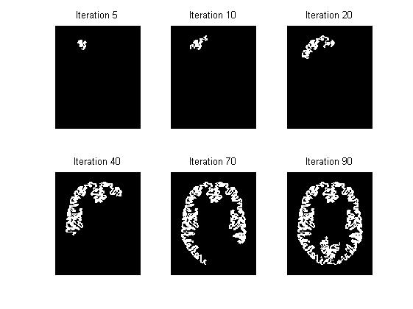
Region Growing Example
Source: Math Works Simple single-seeded region growing
https://www.mathworks.com/matlabcentral/mlc-downloads/downloads/submissions/35269/versions/2/screenshot.jpg

Slide 7
Region Growing Segmentation
There are both seeded and unseeded region growing algorithms
Both rely on the assumption that pixels/voxels in neighboring regions have similar attributes
The algorithms rely a great deal on the user’s knowledge to choose the optimal seed.
Region will grow after seed chosen by acquiring other neighboring pixels/voxels
Region will continue to do so until there are no longer anymore eligible neighbors which is determined by user specifications

Slide 8
Region Growing Segmentation Cont.
User specifications fall into the categories of minimum area threshold as well as similarity threshold value
Minimum area threshold being a chosen value that a partition’s size must exceed
Similarity threshold value is the accepted difference in value between neighboring pixels/voxels that determines whether they are part of the same region
Another downfall of seed selection is that there is a possibility of creating too many partitions in the image but this again can be mitigated by user experience and knowledge

Slide 9
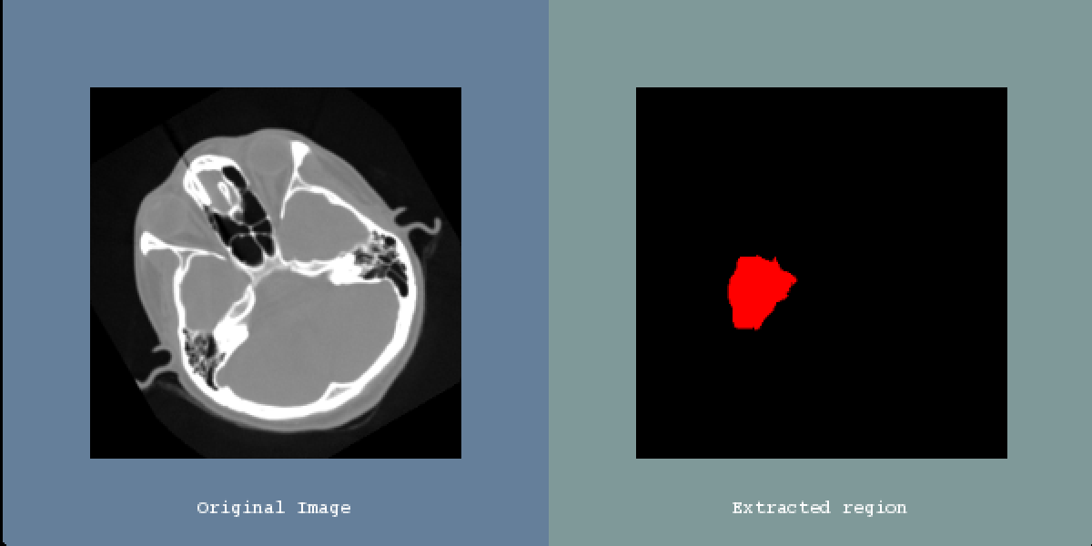
Region Growing Segmentation Result

Slide 10
ITK, VTK Components Used
#include <vtkSmartPointer.h> #include <vtkRendererCollection.h> #include <vtkPointPicker.h> #include <vtkSphereSource.h> #include <vtkPolyDataMapper.h> #include <vtkRenderer.h> #include <vtkRenderWindow.h> #include <vtkRenderWindowInteractor.h> #include <vtkActor.h> #include <vtkImageViewer2.h> #include <vtkPNGReader.h> #include <vtkPNGReader.h>

Slide 11
#include <vtkInteractorStyleTrackballCamera.h> #include <vtkObjectFactory.h> #include <vtkSliderWidget.h> #include <vtkSliderRepresentation3D.h> #include <vtkSliderWidget.h> #include "itkImage.h" #include "itkImageFileReader.h" #include "itkConfidenceConnectedImageFilter.h" #include "itkFlipImageFilter.h" #include "itkImageToVTKImageFilter.h" #include "itkScalarToRGBColormapImageFilter.h" #include "itkBilateralImageFilter.h" #include "itkImageDuplicator.h" #include "itksys/SystemTools.hxx" #include <sstream> #include "QuickView.h"

Slide 12
Advantages and Disadvantages of Region Growing Segmentation
Advantages
Region growing can accurately separate regions that have the same defined properties
Region growing can provide original images with clear edges that’ll lead to to good segmentation results
We are able to set the criteria for seed point and area
we can choose multiple criteria at once
Disadvantages
Takes more processing power
sensitive to noise
possibility of too many partitions

Slide 13
Challenges
VTK & ITK installation
Different platforms
Visual Studio versions
Installation time
Inexperience with software
Communication Difficulties
Scheduling Conflicts
Work schedule limited
Project Difficulties
Struggled getting people on the same page

Slide 14
THANKS FOR LISTENING

