Slide 1
Comparison-Scatter Plot vs Bubble Plot

Slide 2
Explanation
In Bubble chart and Scatter plot created with different measures using sample-superstore.xls
There is no correlation between them

Slide 3
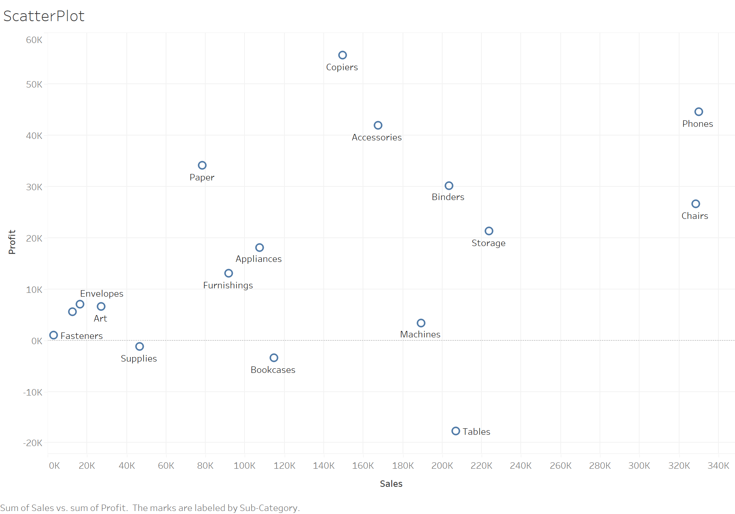

Slide 4
