Slide 1
ASSIGNMENT ARRAY SHIFT
TEAM MEMBERS:
Shewtha Joshi
Nikitha Patil
Deepa Shabadi
Chandana HM
TRAINER:
Shilpa Vaidya

Slide 2
description
The project is of array_ shift in this project we need to print the 1 and it has to be displayed. And then we need to shift the positions using the keyboard key values .Then when the 1 value comes to the last position that doesn’t has to shift and the keys we are mentioning are 2, 4, 6, 8 . This positions has to display at the output and the condition is that the array is of 2 dimension we need to convert that it into one dimensional array. And this has to work in any of the array size .

Slide 3
PSEUDOCODE:
The program is of array_shift
Class program
{
Enter the key values And using the condition we need to print the 1 And then shift the positions using the key values The keys we need to use are 2, 4 , 6 , 8.
If( key == 6 )
Console.WriteLine( “ can’t shift right “);
else
Move position
Else if ( key == 2 )
Console.WriteLine(“ can’t shift down “);
Else
Move position Else if ( key == 8 )
Console.WriteLine ( “ can’t shift up “);
Now it comes to the else part if these conditions are wrong then

Slide 4
Else
{
Console.WriteLine(“ can’t shit down “);
}
Then the conditions are not satisfied then comes out of the loop and print the invalid key
Else
{
Console.WriteLine (“ Invalid key “);
And then display it And there’s a condition we are using is the array is of 2-D we need to convert it into 1-D array Enter the value =0;
For( int i=0; i< sqrt.length; i++)
And then in the main function We will be printing the array We need to print the size array
For(int i = 0 ; i < arr.length ; i++)
Console.WriteLine ( “ array is = “);
End of the program

Slide 5
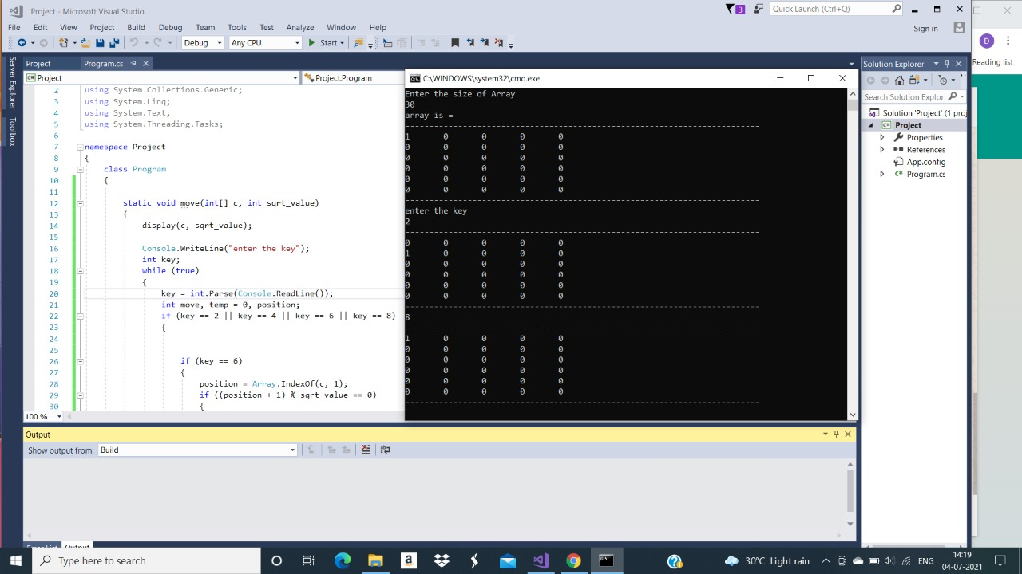
SCREENSHOTS:
Taking array length as 30 and enter the key 2 to shift down and key 8 to shift up

Slide 6
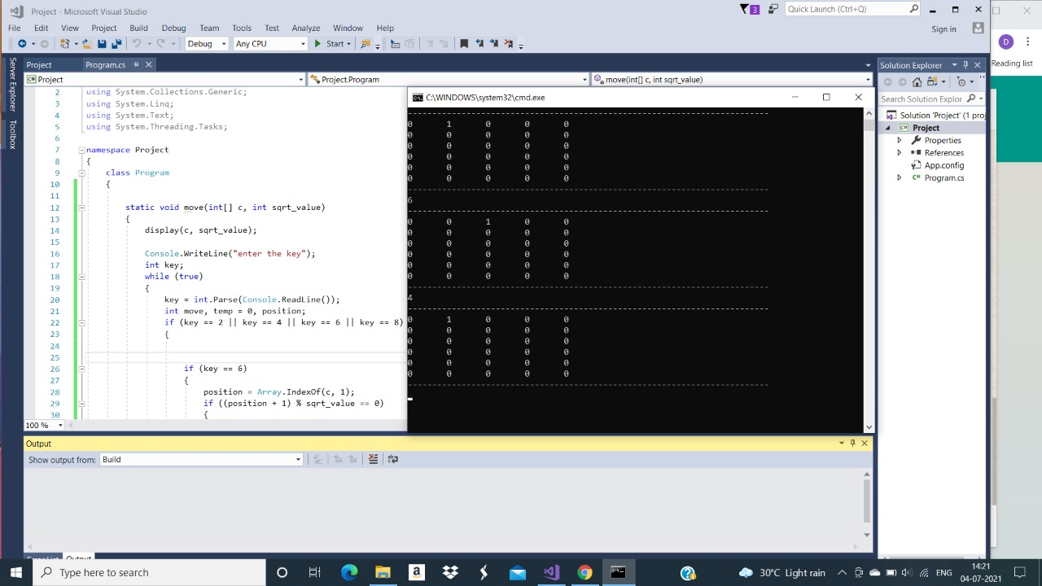
Enter the key 6 to shift right and key 4 to shift left

Slide 7

When the value 1 reaches to the top boundary, we cant shift the value to the up and that will remain in the same position

Slide 8

When the value 1 reaches to the down boundary, we cant shift the value to the down and that will remain in the same position

Slide 9

When the value 1 reaches to the right boundary, we cant shift the value to the right and that will remain in the same position

Slide 10

When the value 1 reaches to the left boundary, we cant shift the value to the left and that will remain in the same position

Slide 11
THANK YOU

