Slide 1


Classification of Galaxies
based on their Shape
Presented BY:
1544_Shweta Waskar
1556_Snehal Waskar
Prashant Karhale Akshay Tilekar (External Guide)
Center Coordinator

Slide 2
Overview
Introduction
Classification Of Galaxies
Convolution Neural Network
Conclusion
Future Scope
Institute for Advanced Computing and Software Development, Akurdi

Slide 3
Introduction to Galaxies
A group of billions of stars and their planets, gas, and dust that extends over many thousands of light-years and forms a unit within the universe
There are billions of galaxies discovered till date
In 1924, Edwin Hubble divided galaxies into different “classes” based on their appearance.
Institute for Advanced Computing and Software Development, Akurdi

Slide 4
Classification of Galaxies
Hubble classified galaxies based on their shape. The classification is as follows-
Spiral
Elliptical
Irregular
As our data contains images of group of galaxies, we have made another class to identify group of galaxies as “Cluster”
Institute for Advanced Computing and Software Development, Akurdi

Slide 5
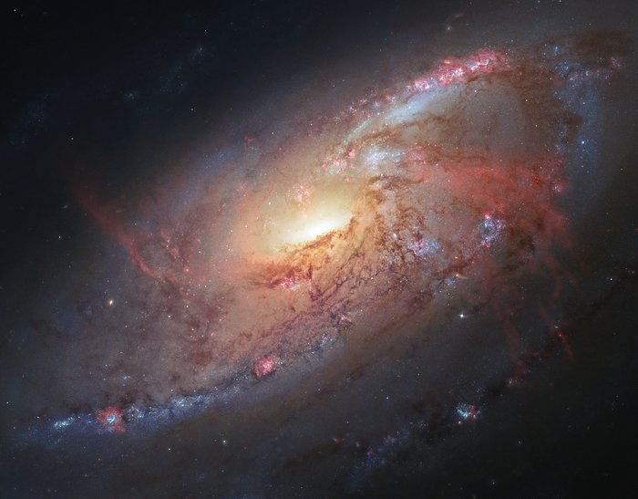
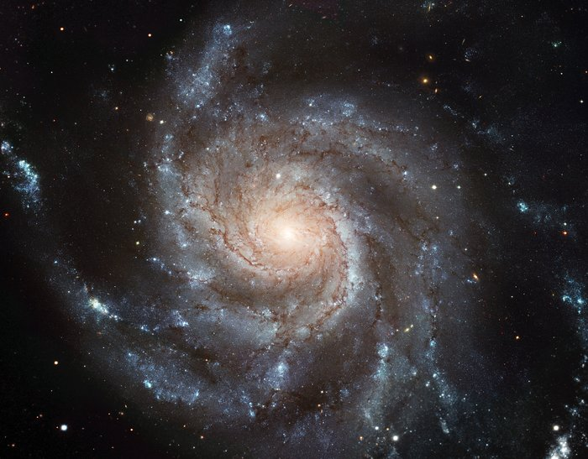
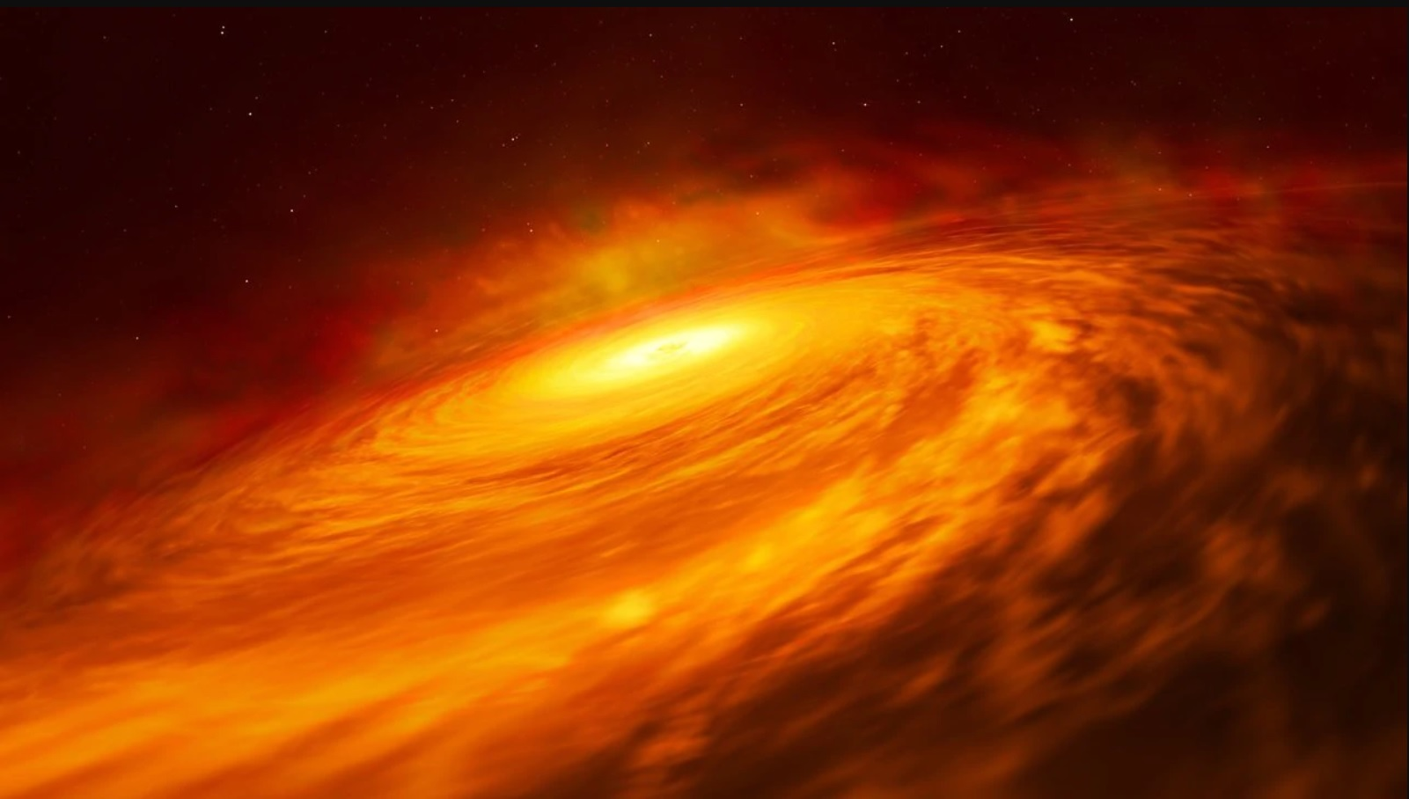
Spiral Galaxies
Fig. Spiral Galaxies
Spiral galaxies consist of a flat, rotating disk containing stars, gas and dust, and a central concentration of stars known as the bulge
Institute for Advanced Computing and Software Development, Akurdi

Slide 6
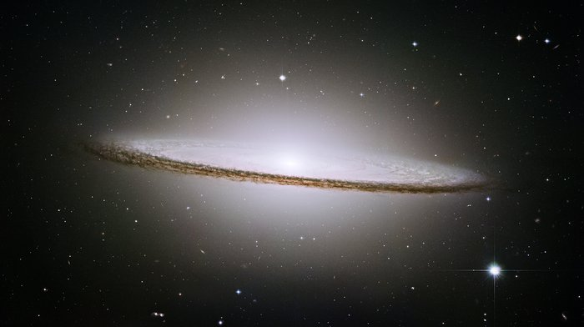
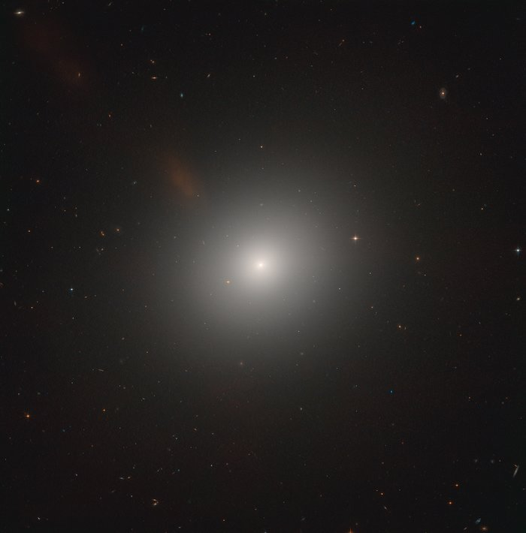
Elliptical Galaxies
Fig. Elliptical Galaxies
An elliptical galaxy is a type of galaxy with an approximately ellipsoidal shape and a smooth, nearly featureless image
Elliptical galaxies have a broader range in size than other types of galaxies
Institute for Advanced Computing and Software Development, Akurdi

Slide 7
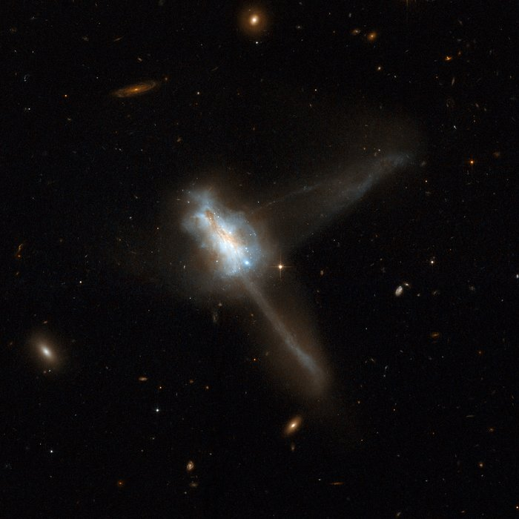
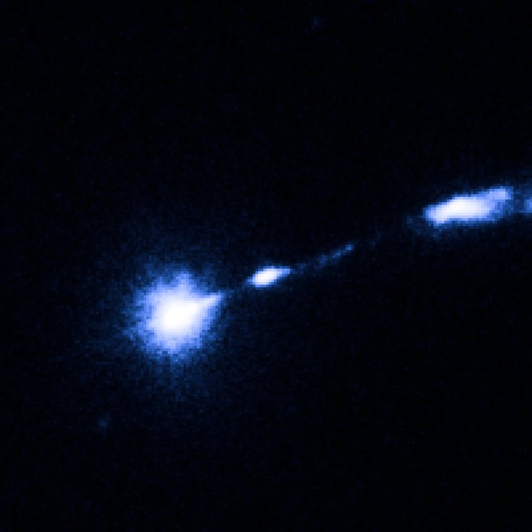
Irregular Galaxies
Fig. Irregular Galaxies
No morphological symmetry
Lots of young, blue stars and interstellar material
Smaller than most spirals and elliptical galaxies
Institute for Advanced Computing and Software Development, Akurdi

Slide 8
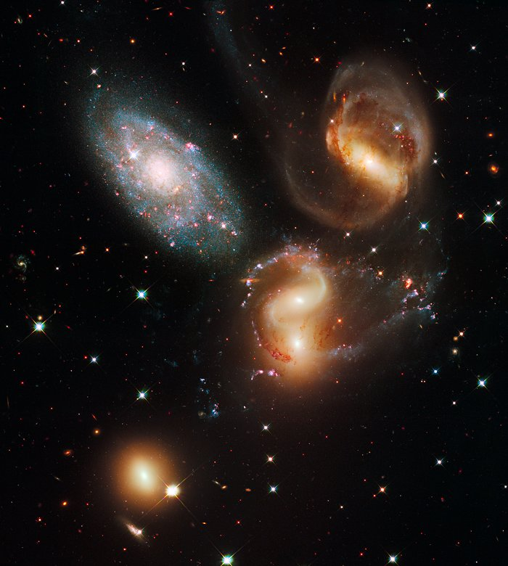
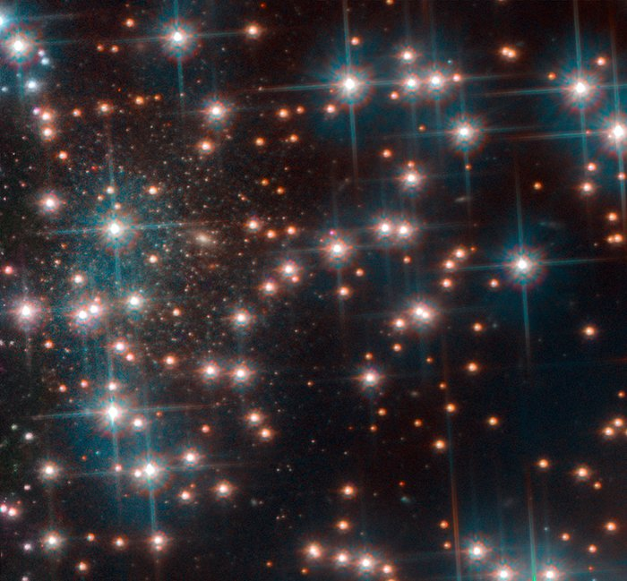
Cluster of Galaxies
Fig. Cluster of Galaxies
They're large collections of thousands of galaxies held together by mutual gravitational attraction
A typical galaxy cluster contains 50 to 1000 galaxies, and has a total mass between 100 trillion and 1 quadrillion solar masses, stretching across a distance of 30 million light-years
Institute for Advanced Computing and Software Development, Akurdi

Slide 9
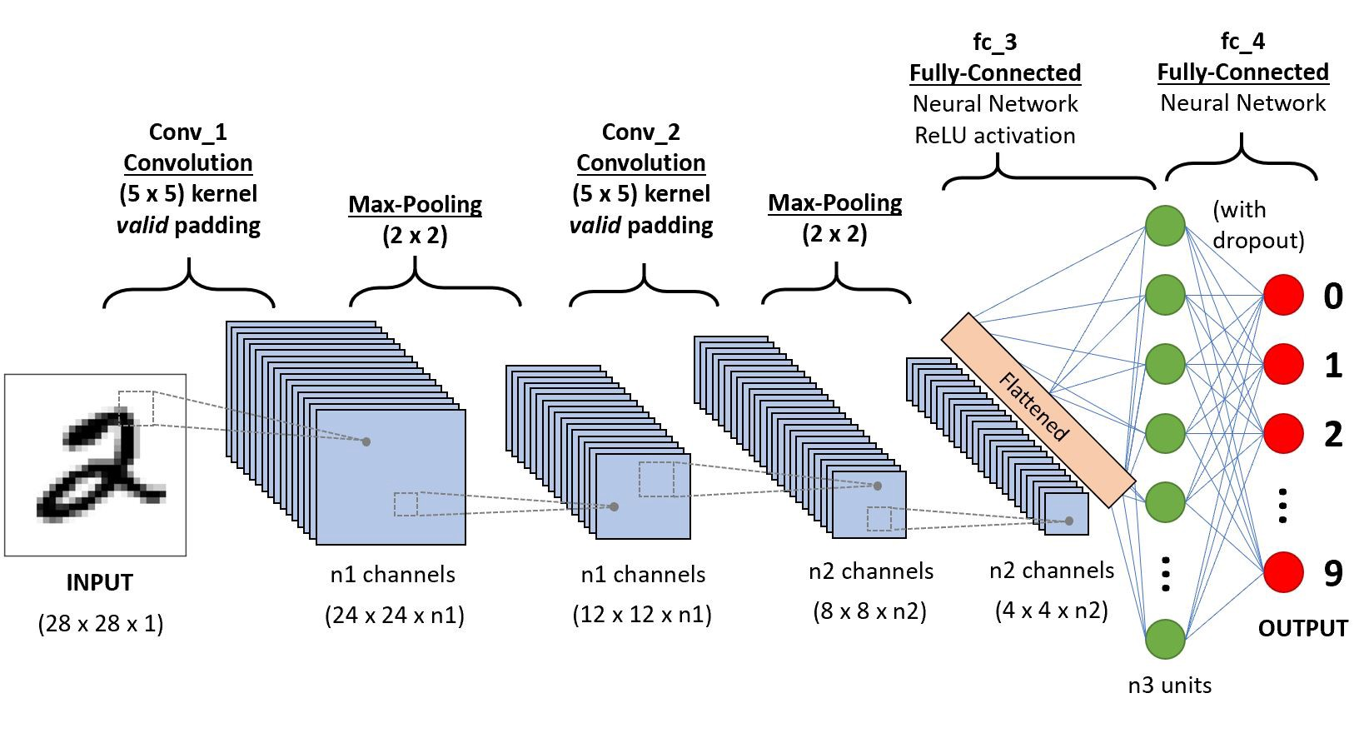
Convolution Neural Network
In deep learning, a convolutional neural network is a class of deep neural networks, most commonly applied to analyzing visual imagery. They are also known as shift invariant or space invariant artificial neural networks, based on their shared-weights architecture and translation invariance characteristics.
Institute for Advanced Computing and Software Development, Akurdi

Slide 10
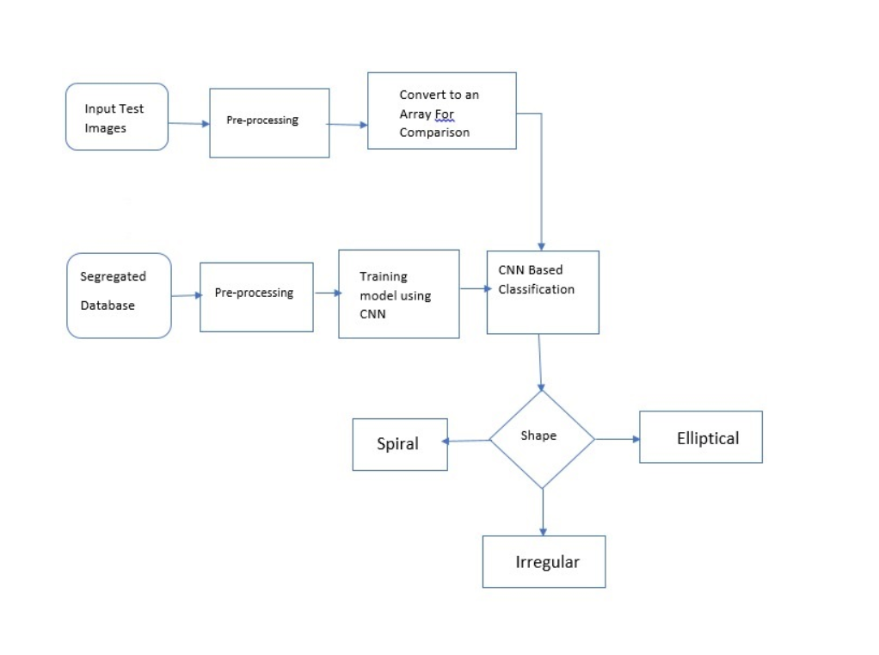
Proposed Methodology
Institute for Advanced Computing and Software Development, Akurdi

Slide 11
Dataset
Name | Number of classes | Class name
MilkyWay | 01 | spiral
M87 | 01 | Elliptical
Rose Galaxy | 01 | Irregular
Institute for Advanced Computing and Software Development, Akurdi

Slide 12
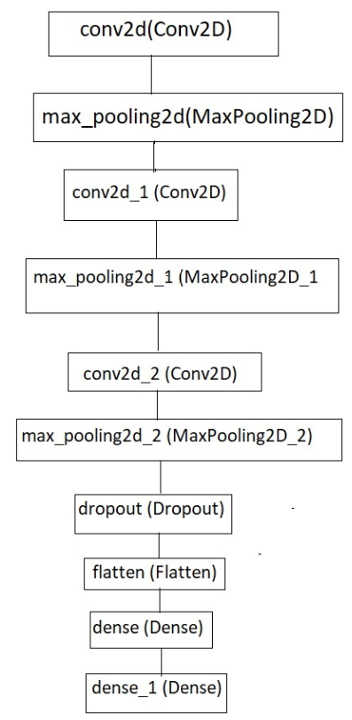
Main Steps to build a CNN
Convolution Operation
ReLU Layer (Rectified Linear Unit)
Pooling Layer (Max Pooling)
Flattening
Fully Connected Layer
Institute for Advanced Computing and Software Development, Akurdi

Slide 13
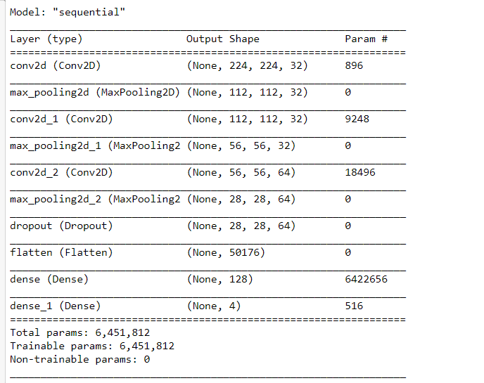
Model Summary
Institute for Advanced Computing and Software Development, Akurdi

Slide 14
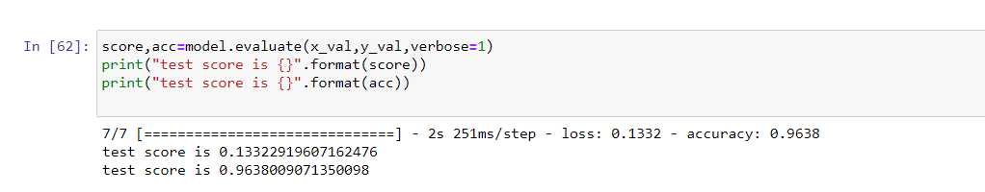
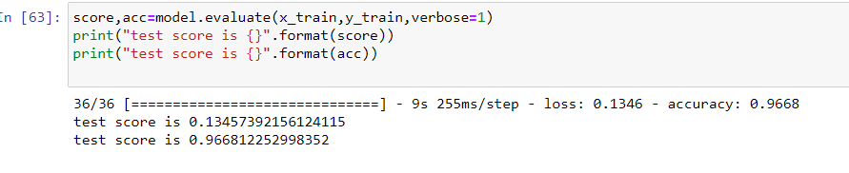
Accuracy
Test Accuracy
Train Accuracy
Institute for Advanced Computing and Software Development, Akurdi

Slide 15
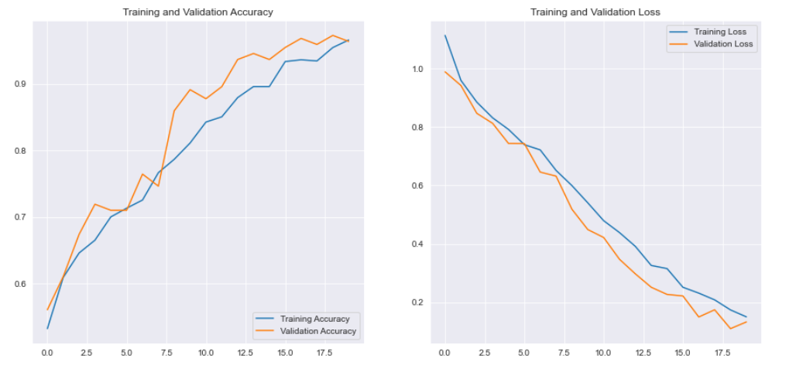
Graph for Accuracy and Loss
Institute for Advanced Computing and Software Development, Akurdi

Slide 16
Conclusion
We have successfully classified the galaxies based on their shape having training and testing accuracy of 96.68% and 96.38% respectively.
This system has utilized deep learning capabilities to achieve automatic classification of galaxy based on their shape.
It is concluded from accuracy that CNN is highly suitable for automatic detection and classification of galaxies.
Institute for Advanced Computing and Software Development, Akurdi

Slide 17
Future Scope
To detect the shape of very faint objects.
To increase the accuracy
Develop independent machine learning algorithm
Institute for Advanced Computing and Software Development, Akurdi

Slide 18
Thank You
Institute for Advanced Computing and Software Development, Akurdi

