Slide 1
Feature Reduction in Time Series - Literature Review
Autonomous Multisensor Systems Group
Institute for Intelligent Cooperating Systems
Faculty of Computer Science
Otto von Guericke University, Magdeburg
Team Members: Debapriya Roy, Shweta Bambal, Jayanthee Siva Perumal
05.06.2025

Slide 2
Contents
Introduction
Feature Reduction Architectures
Linear
LLE
PCA
Non-linear
Variational Autoencoders
Deep Learning Classification (LSTM + ResNet)
Hybrid Autoencoder (LSTM + CNN)
Transformer-based Autoencoder
Project Timeline
Future Work
References

Slide 3
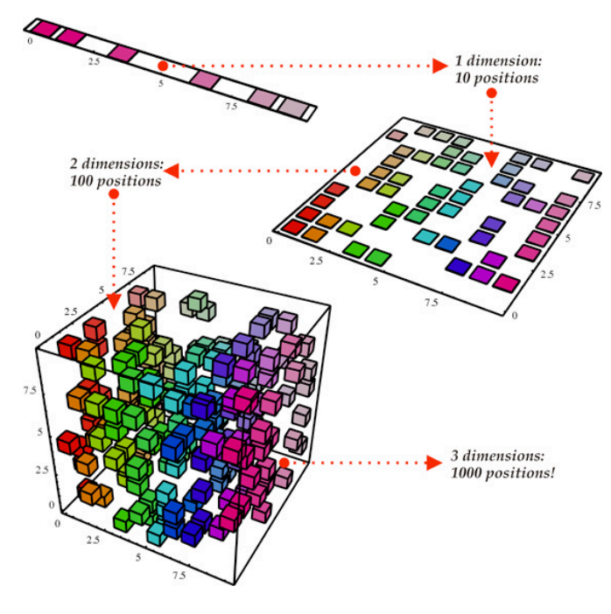
Introduction
Feature Reduction/Dimensionality Reduction : process of reducing the number of input variables (features) in a dataset.
A crucial step in the data preprocessing for machine learning.
Primary goal - simplify the dataset while retaining its essential characteristics.
Ex: Weather Dataset (Temp, Humidity, Dew point, Rainfall, Wind Speed, Weather Type)
Humidity and Dew point are highly correlated.
Remove Dew point feature.
Predict Weather Type as Sunny, Rainy or Foggy based on other features.
Figure 1 : Feature Reduction
https://deepai.org/machine-learning-glossary-and-terms/feature-reduction

Slide 4
Variational Autoencoder (VAE)
Goal: To develop a deep learning-based compression method (VAE) for reducing the dimensionality of long ECG time series while maintaining the signal’s critical characteristics for classification and reconstruction.
Datasets used: PTB-XL ECG
A large-scale public dataset of 12-lead ECG recordings.
Each ECG signal has 10 seconds of data sampled at 500 Hz, resulting in 60,000 data points per recording.
Labels include multiple cardiovascular diagnoses.
Results:
AE achieved up to 90% compression with low reconstruction error.
Outperformed PCA and Wavelet in retaining signal quality.
https://arxiv.org/pdf/2204.11060
Notes:
Research Paper - DIMENSION REDUCTION FOR TIME SERIES WITH VARIATIONAL AUTOENCODERS
Link: https://arxiv.org/pdf/2204.11060
Technique: Variational Autoencoder (VAE) Used for: Compressing ECG signals (similar to multichannel CNC sensor data)
Steps:
Segment time series into windows.
Normalize input signals.
Encode into μ and σ via convolutional layers.
Sample latent vector z (reparameterization trick).
Decode z to reconstruct the signal.
Optimize loss: reconstruction + KL divergence.
We can apply the same compression idea to reduce our 52 control signals into a compact, meaningful latent representation for predicting energy consumption (CURRENT|1–6)

Slide 5
Variational Autoencoder (VAE)
Relevance to CNC Dataset:
Compresses 52 control signals (like TORQUE, ENC_POS) into low-dimensional vectors.
Helps in predicting current, anomaly detection, or data storage.
Advantages:
Captures nonlinear patterns across sensor signals.
Learns robust, compact features automatically.
Disadvantages:
Needs large data and long training times.
Latent features are not easily interpretable.

Slide 6
Deep Learning Classification (LSTM, ResNet)
Goal: To design an interoperable and automated system that classifies, labels, and maps raw control and sensor signals in CNC machine environments using a combination of deep learning and rule-based techniques.
Dataset Used: Industrial CNC Machine Data (CMX & DMC machines)
Multivariate sensor data from real brownfield CNC machines.
Includes signals such as LOAD, ENC_POS, TORQUE, CTRL_DIFF, CMD_SPEED, etc.
Covers different materials (Aluminum, Steel) and components.
Results:
Achieved accurate signal classification across CNC axes using LSTM and ResNet.
Improved signal interpretability and usability through hybrid ML + rule-based mapping.
https://www.sciencedirect.com/science/article/pii/S2213846323000676
Notes:
Research Paper - INTEROPERABLE SYSTEM FOR AUTOMATED EXTRACTION & IDENTIFICATION OF MACHINE CONTROL DATA IN BROWNFIELD PRODUCTION
Link: https://www.sciencedirect.com/science/article/pii/S2213846323000676
Technique: Signal Cleaning + Deep Learning Classification (LSTM, ResNet)
Steps:
Preprocess & clean noisy/missing signals.
Normalize all signals.
Use DL models to classify signals (e.g., torque vs. position).
Drop or merge irrelevant/duplicate signals.
Apply domain rules to map signals to machine axes.

Slide 7
Deep Learning Classification (LSTM, ResNet)
Relevance to CNC Dataset: This paper uses the exact same CNC dataset and machine types we are using and helps identify which features to retain or drop — a form of practical feature reduction.
Advantages:
Works directly on our exact machine setup.
Improves interpretability by linking signals to machine components.
Supports hybrid ML + rule-based approach.
Disadvantages:
Needs domain knowledge to fine-tune mappings.
May not generalize easily to new machines.
ML model training depends on quality of labeled signals.
Notes:
This is the origin of our dataset.
Guides which signals to keep and how to reduce input space logically.

Slide 8
Principal Component Analysis (PCA)
Goal: PCA remains highly effective for dimensionality reduction — particularly in improving the performance, speed, and stability of deep learning models when dealing with long multivariate sequences.
Dataset used: PCA was tested on time-series data from sources like electricity usage, weather, and traffic — all real-world signals that change over time and involve lots of variables, just like CNC machine data.
Results:
PCA was tested with deep learning models like RNNs, CNNs, and Transformers.
It reduced training time by 20–60%, lowered memory use, and kept or improved model accuracy.
Even with fewer time steps or features, key trends and peaks in the signal were preserved.
Relevance to CNC Data:
Reduces 52+ sensor features into a smaller, manageable set
Reduces correlated signals (e.g., torque, load, speed) into fewer uncorrelated components
Captures dominant patterns in machine behavior with minimal information loss
Improves efficiency of models used for predicting spindle current, tool wear, or process stability
arXiv:2412.19423

Slide 9
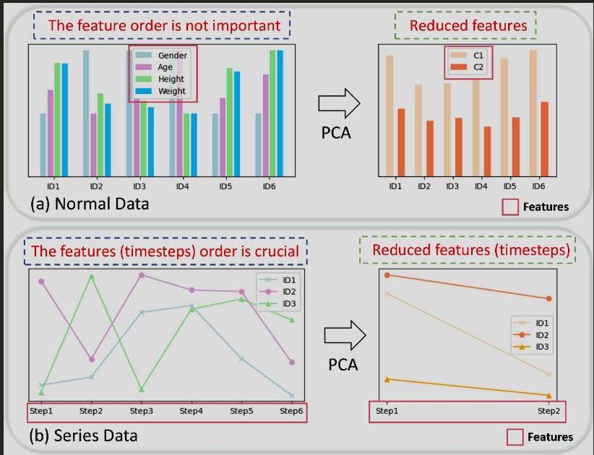
Principal Component Analysis (PCA)
Advantages:
Fast and easy to use
Removes noise and redundant features
Speeds up and stabilizes models
Disadvantages:
Only works well when signals have linear relationships
The new features it creates are hard to understand directly
It may miss complex patterns between sensors (like torque and speed combined)

Slide 10
Kernel PCA (KPCA)
Goal: Enhance traditional PCA by introducing kernel functions that allow it to capture nonlinear structures in data
Dataset Used:
Synthetic dataset:
Swiss Roll and concentric circles — artificially created shapes that represent data lying on a nonlinear manifold.
These examples helped demonstrate that KPCA could "unfold" curved data structures that regular PCA cannot handle.
Real-world dataset:
The MNIST digit dataset — images of handwritten numbers where the pixel patterns form complex, nonlinear relationships.
KPCA was able to better separate different digit classes compared to PCA by capturing nonlinear variations in the images.
Relevance to CNC:
Our CNC sensor data (like torque, speed, vibration) can have overlapping patterns across different machine states.
Like digit shapes, these sensor patterns are complex and nonlinear.
KPCA helps separate those hidden states better than PCA — ideal for tasks like fault detection or mode classification.
https://www.researchgate.net/publication/220500224_Nonlinear_Component_Analysis_as_a_Kernel_Eigenvalue_Problem

Slide 11
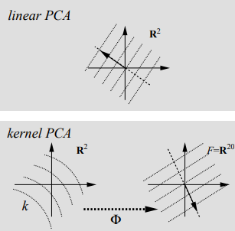
Kernel PCA (KPCA)
Results:
KPCA successfully unfolded nonlinear structures in synthetic datasets (e.g., Swiss roll, concentric circles) that PCA could not.
On the MNIST digit dataset, KPCA achieved better separation of digit classes, showing its strength in capturing complex, nonlinear variations in real-world data.
Advantages:
Captures nonlinear relationships between features
Reveals hidden structure in complex data
Improves feature separation for difficult datasets
Disadvantages:
Slower than PCA, especially with large datasets
Needs careful kernel and parameter selection
Harder to apply to new data without saving the full kernel

Slide 12
LLE (Locally Linear Embedding)
Goal: To introduce a new method for nonlinear dimensionality reduction that preserves the local relationships between neighboring data points when mapping high-dimensional data to a lower-dimensional space.
Dataset Used:
Synthetic 3D data (like the Swiss roll and S-curve)
High-dimensional face image datasets (each image = one data point in a high-dimensional space)
Datasets were chosen to test how well LLE preserves manifold structure when unfolding data.
Results :
LLE successfully "unfolded" curved datasets (like Swiss rolls) into flat, meaningful 2D representations.
On face datasets, it grouped images smoothly based on pose (e.g., left to right rotation).
It outperformed PCA by preserving the structure of local neighborhoods, which PCA often distorted.
Relevance to CNC :
CNC sensor signals often show subtle local variations over time (e.g., slight changes in load or vibration).
LLE preserves these fine-grained patterns, making it ideal for detecting small behavioral shifts or early signs of failure.
Useful for unsupervised clustering, machine state identification, or transition detection in sensor logs.
https://www.science.org/doi/10.1126/science.290.5500.2323

Slide 13
LLE (Locally Linear Embedding)
Advantages:
Captures local structure in the data
Good at unfolding nonlinear manifolds
No tuning of global cost function
Disadvantages:
Sensitive to noise and the choice of number of neighbors
Not ideal for real-time use (slow and hard to generalize to new data)

Slide 14
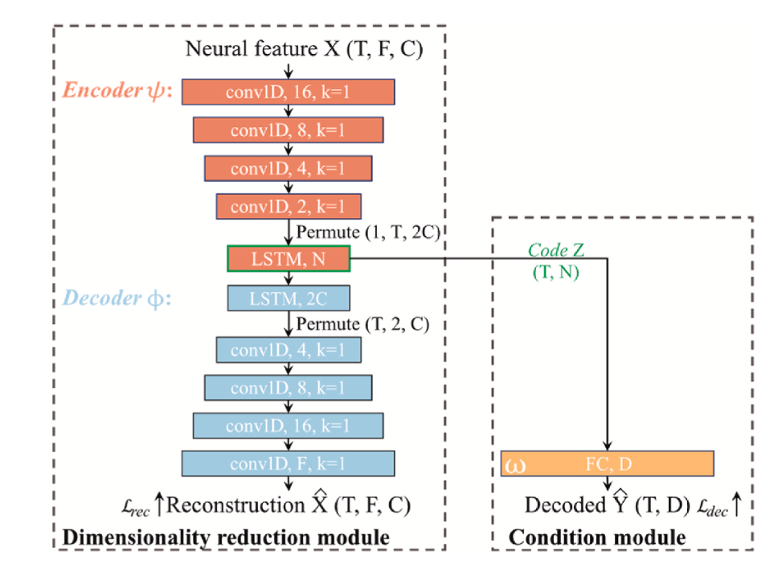
Hybrid Autoencoder (LSTM + CNN)
Goal : Hybrid framework combines the ability of feature extraction of CNN and the temporal dynamic of LSTM to yield high-performance latent representations of original neural signals.
Dataset :
Center-out Task: LFP data from macaques performing joystick-controlled movements.
Food Tracking Task: Public ECoG dataset where monkeys track 3D food movements.
Matrix with dimensions [128 channels × N timepoints]
N = duration of a session.
Fig 1: ReduceNet Framework [5]

Slide 15
Hybrid Autoencoder (LSTM + CNN)
Results / Conclusion:
ReduceNet outperformed KPCA, PLS, PSID, and LFADS in decoding performance across both datasets.
Achieved high decoding accuracy with fewer components.
Provided interpretable representations by associating frequency components with behavior.
Key Advantages :
A semi-supervised learning approach with a decoding target as a constraint..
Demonstrated scalability, interpretability, and generalizability.
Disadvantages :
Training time (~55 minutes per session) is high compared to traditional methods.

Slide 16
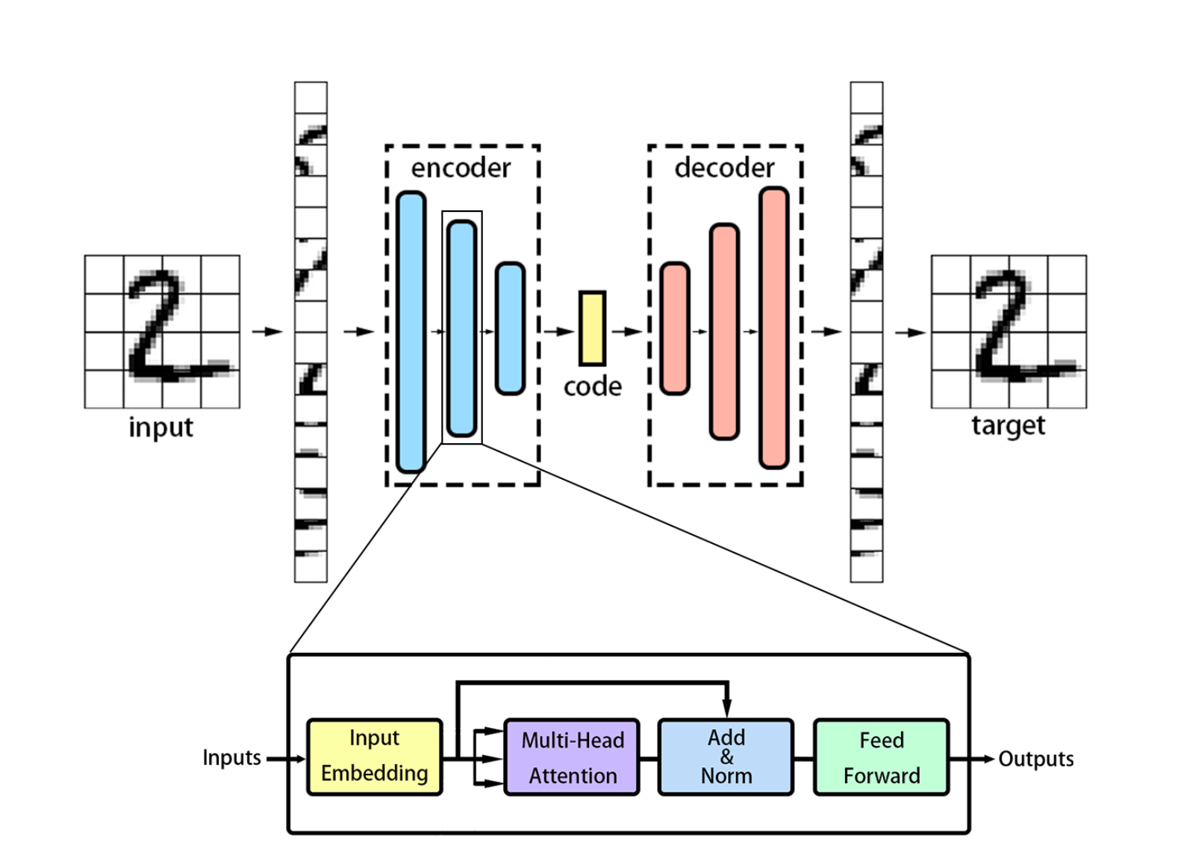
Transformer-based Autoencoder
Goal : Reduce data dimensionality while retaining essential information for better data visualization, image reconstruction, and face recognition
Datasets :
MNIST Dataset (Handwritten Digits)
Total Samples : 70,000
Image Size : 28 × 28 pixels
ImageNet Dataset (Large-Scale Visual Recognition)
Total Samples : 14 Million
Image Size : 256 × 256 pixels
Fig 2: Transformer-DR Architecture[4]

Slide 17
Transformer-based Autoencoder
Results/Conclusion:
Transformer-DR offered better class separability in 2D space.
Transformer-DR retained more image details than AE.
Transformer-DR and its variant Transformer-DRr reduced feature dimensions from 37632 → 12544.
Proved that high recognition can be maintained even with reduced features.
Disadvantages :
Computationally Expensive
Slower Training Time
Requires Careful Tuning

Slide 18
Project Timeline
Project Phase | Apr-25 |  | May-25 |  |  |  | Jun-25 |  |  |  | Jul-25 |  |  |  | Aug-25
 | W3 | W4 | W1 | W2 | W3 | W4 | W1 | W2 | W3 | W4 | W1 | W2 | W3 | W4 | W1 | W2 | W3 | W4
Literature review
Research Paper Gathering
Summarizing LR
First Report Draft
Deciding Implementation Method
Implementation
Evaluation of Performance
Second Draft
Final Report Writing
Final Draft
Review and Submission

Slide 19
Way Forward…
Start Implementation and Experimentation with the following methods :
PCA
Kernel PCA
VAE
Transformer-based Autoencoder
Partial Implementation and Results till 1st July to show Intermediate Results
Record key difference between the above mentioned methods.

Slide 20
References
M. Ashraf et al., "A Survey on Dimensionality Reduction Techniques for Time-Series Data," in IEEE Access, vol. 11, pp. 42909-42923, 2023, doi: 10.1109/ACCESS.2023.3269693. https://ieeexplore.ieee.org/document/10107391
Wan, X., Li, H., Zhang, L. et al. “Dimensionality reduction for multivariate time-series data mining”. J Supercomput 78, 9862–9878 (2022). https://doi.org/10.1007/s11227-021-04303-4
W. Todo, B. Laurent, J.-M. Loubes, and M. Selmani, “Dimension Reduction for Time Series with Variational AutoEncoders”, arXiv:2204.11060, Apr. 2022. https://doi.org/10.48550/arXiv.2204.11060
Ruisheng Ran, Tianyu Gao, Bin Fang, “Transformer-based dimensionality reduction”, 15 Oct 2022. https://arxiv.org/abs/2210.08288
Xingchen Ran, Weidong Chen, Blaise Yvert, Shaomin Zhang, “A hybrid autoencoder framework of dimensionality reduction for brain-computer interface decoding”, Computers in Biology and Medicine, Volume 148, 2022,105871, ISSN 0010-4825, https://doi.org/10.1016/j.compbiomed.2022.105871.
https://deepai.org/machine-learning-glossary-and-terms/feature-reduction
https://medium.com/aimonks/a-comparative-analysis-of-dimensionality-reduction-techniques-in-machine-learning-3389c5103348
https://medium.com/data-science/dimensionality-reduction-for-data-visualization-pca-vs-tsne-vs-umap-be4aa7b1cb29
https://www.geeksforgeeks.org/dimensionality-reduction/

Slide 21
Feature Reduction in Time Series
Thank You For Your Attention!

