Slide 1
Future Scope of Crowd Density Monitoring System
Submitted By:
Shweta(747925)

Slide 2
Introduction
This is about the what additional features can be added to existing crowd density monitoring system.
Crowd density monitoring system is a system which displays the estimated number of people in a specific location

Slide 3
Contents to be discussed
Additional features
Availability of Space
Availability of systems(example in library)
Booking of Systems
Possible Way of achieving these features
Block Diagram
Conclusion
References

Slide 4
Availability of Space
During the analyzation of pictures taken by cameras to estimate the people count:
It can also be analyzed that how much space is available or we can say that how many people can be accumulated more.

Slide 5
Possible Way
For this ,there should be database that has the information that how many maximum number of people can be present at a specific place.
So, by comparing the estimated people count with that database ,the number of people that can be accumulated more can be estimated .
This data can be provided through app or web portal

Slide 6
Available Systems
In case of libraries or other places, the information about the number of systems that are not in use can also be provided through app.
So the people can take decision effectively whether to visit the place or not.

Slide 7
Possible Way
For achieving this, there should already be information available regarding the total number of available systems at a place.
So after estimating the number of systems in use with the help of images , this data can be made available to people through app or web portals that how many are still available.

Slide 8
Booking of Systems
An additional feature can be added that a person can book a system .There can be a time limit set for this like 5 to 10 minutes. If the person does not reach in prescribed time , the booking will be cancelled.

Slide 9
Possible way
At the reception desk of libraries or other places, this information can be presented that a system has been booked well as the name of the person who has booked.

Slide 10
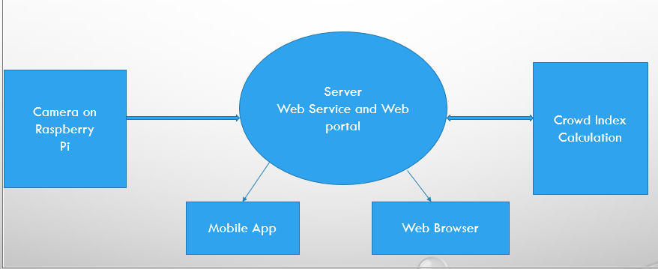
Block Diagram
Database for additional information
Configured for booking

Slide 11
Conclusion
So ,By addition of more features ,the System can be made more useful .As a result of these features, the customers can take decisions more effectively which save their time and money.

Slide 12
References
“Crowd Density Monitoring System”, IPI Singapore,2018, https://www.ipi-singapore.org/technol.ogy-offers/crowd-density-monitoring-system

