Slide 1

WALCHAND COLLEGE OF ENGINEERING,SANGLI.
Department of Computer Science and Engineering
Presentation on
Mini-project DIP
PRESENTED BY : 1. Shweta B. Chavan(2018BTECS00204)
2. Sukanya S. Gaikwad (2018BTECS00216)
GUIDED BY : Mr. K . P. Kamble

Slide 2
Problem Statement
Given the image, count number of straight lines in the image. Locate the breaks in the line (if any). Fill up the gaps if applicable. Implement suitable algorithm

Slide 3
Algorithm
To count straight lines.
Take source image.
Take one variable to keep track of no. of lines, count=0.
Convert the image to grayscale
Apply edge detection on image.
Create a 2D array or accumulator to hold values of two parameters r and theta(line is represented as r = xcosθ + ysinθ) using Hough line transform method.
Loop till r and theta values are in the range of the 2d array
Increment count.
Return count.

Slide 4
Continued..
To locate breaks in lines.
Use a filter which creates a black pixel when any of its eight neighbors is black.
Use a thinning filter which removes the extra outline but leaves the filled gaps alone.

Slide 5
Continued..
To fill up gap
Calculate the distance map of the inverse image.
Threshold it to obtain a large outline of the current object.
Then skeletonize to get the central line.
Dilate the skeleton and add it to the original.

Slide 6
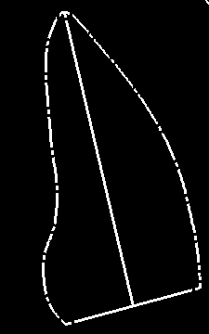
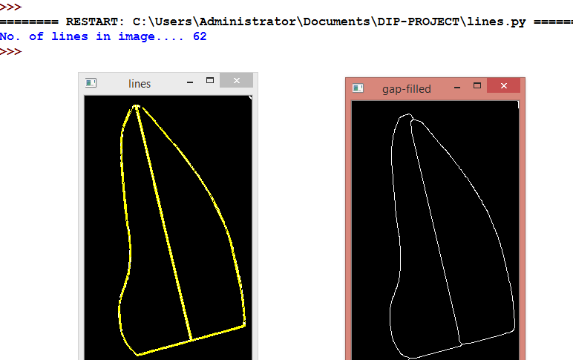
Execution
Original image
Output➔

Slide 7

Image after filling gap..

Slide 8
References
R. C. Gonzalez, R. E. Woods, Digital Image Processing, 3rd Edition. 2002, PHI
https://en.wikipedia.org/wiki/Line_detection
https://answers.opencv.org/question/53548/gap-filling-contours-lines/
https://www.geeksforgeeks.org/line-detection-python-opencv-houghline-method/
Digital image processing-Third edition

Slide 9
Thank You

