Slide 1
Quote Of the Day
BY,
Shweta Herlekar
12th June, 2018

Slide 2
Agenda
Requirements
Proposed Technical Solutions
Comparison
Q & A

Slide 3
Requirements
App should allow user to login with Google credentials
The system should push the quote to the app.
App should show the notification for the quote.
App should provide the setting to change the time slot for notifications.
App should provide user interface for quotes.
App should allow to view the quote individually with download and share option.
App should provide log out option

Slide 4
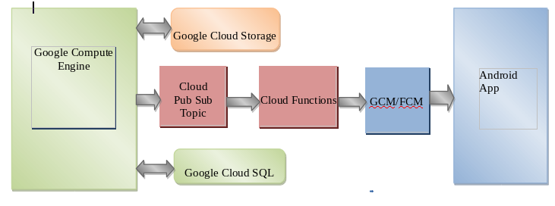
Technical Solution 1

Slide 5
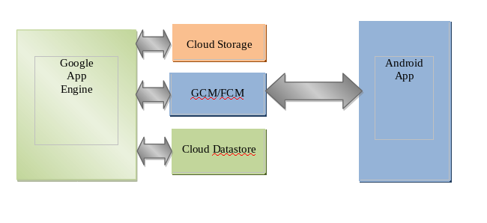
Technical Solution 2

Slide 6
Comparison
 | Solution 1 | Solution 2
Cost(730 hours) | $100-120 per month (GCE VM : $0.76 per hour, GCM plan : $25 per month,) | $30-50 per month (GAE : $0.05 per hour, cloud storage : 0.026 per month, data store : 0.18 per GB )
Performance | Good performance even for 10,000 users | Good performance for 200-300 users
Development efforts | 12 weeks | 6 weeks

Slide 7
Comparison(continued)
 | Approach 1 | Approach 2
Pros | 1. High performance and scalable VM’s 2. Cloud functions provides event-driven processing 3. Fast reporting, targeting and optimization in advertising and media feature of pub sub. 4. This approach can be extended to subscription based model. | 1. App engine provides fully managed application platform. 2. App engine allows familiar language tools. 3. Datastore: Fully managed NoSQL object based database.

Slide 8
Comparison(continued)
 | Approach 1 | Approach 2
Cons | 1. Compute engine VM's changes IP once stopped. 2. Maintenance is mandatory. Cost concern. | 1. App engine provides limited processing capabilities.

Slide 9
Question &
Answers

Slide 10
Thank You!!

