Slide 1
Quote of the day
By,
Shweta Herlekar
June 26, 2018

Slide 2
Agenda
Design approach
Tools/libraries
Configurations
Screens
Application Demo
Publishing app on play store

Slide 3
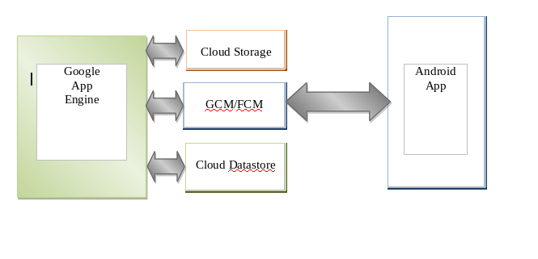
Design

Slide 4
Tools/Libraries
Android Studio
GitHub
Google services library for Google sign-in
Firebase messaging library
Configurations
Google cloud app engine
Google cloud datastore
Google cloud storage
Linking GCP project with FCM console

Slide 5
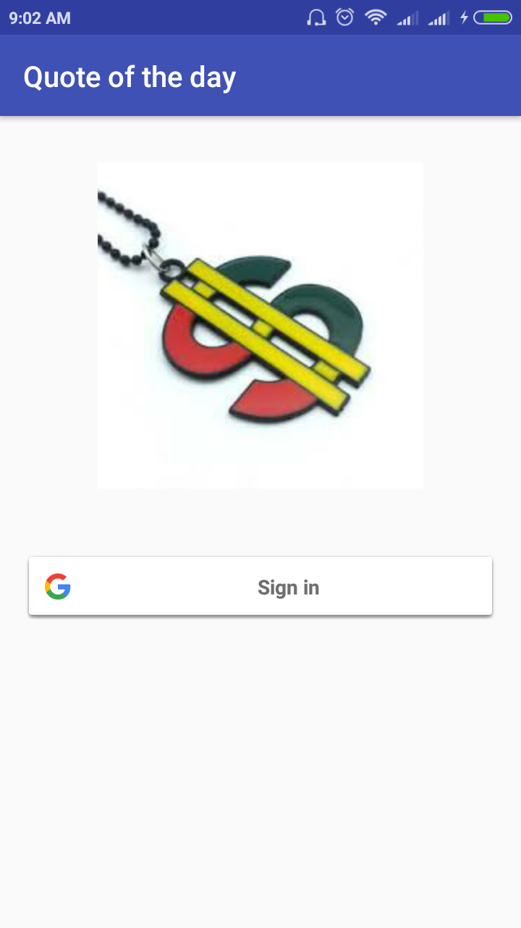
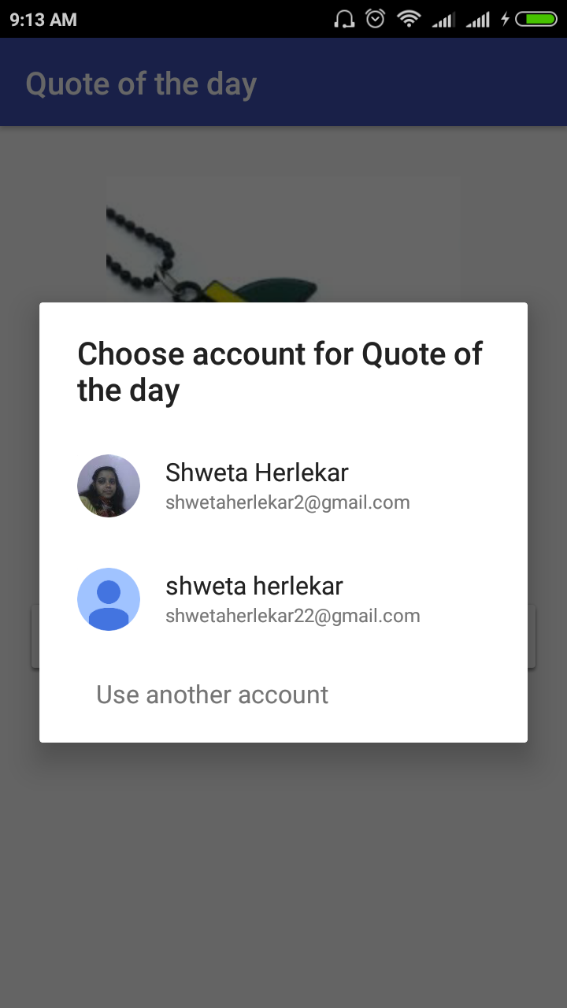
Screens
Login screen
Google Login accounts

Slide 6
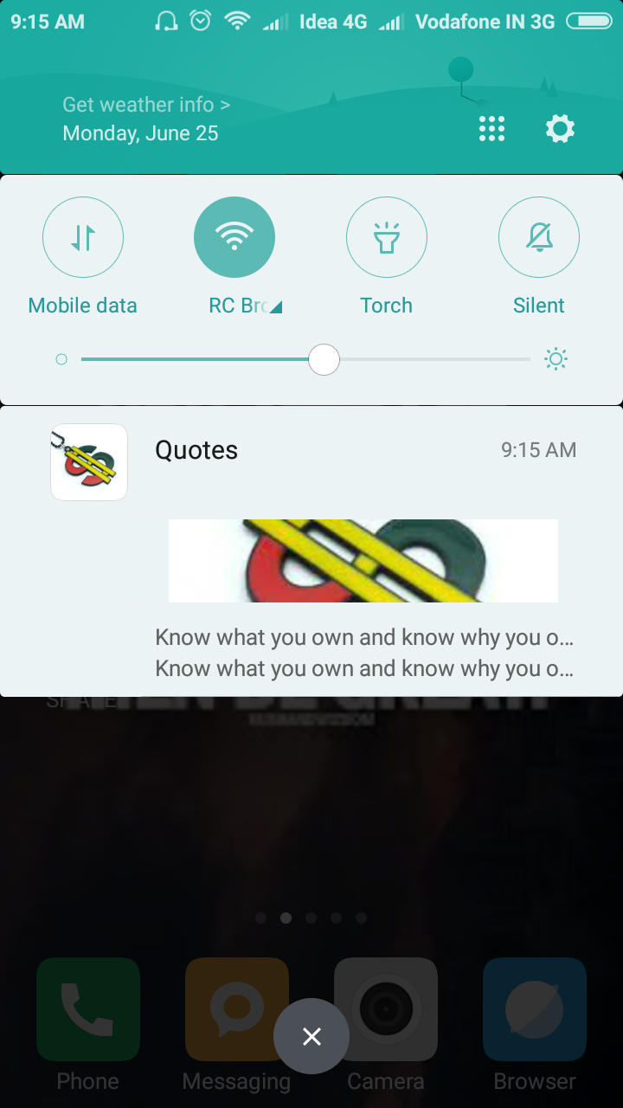
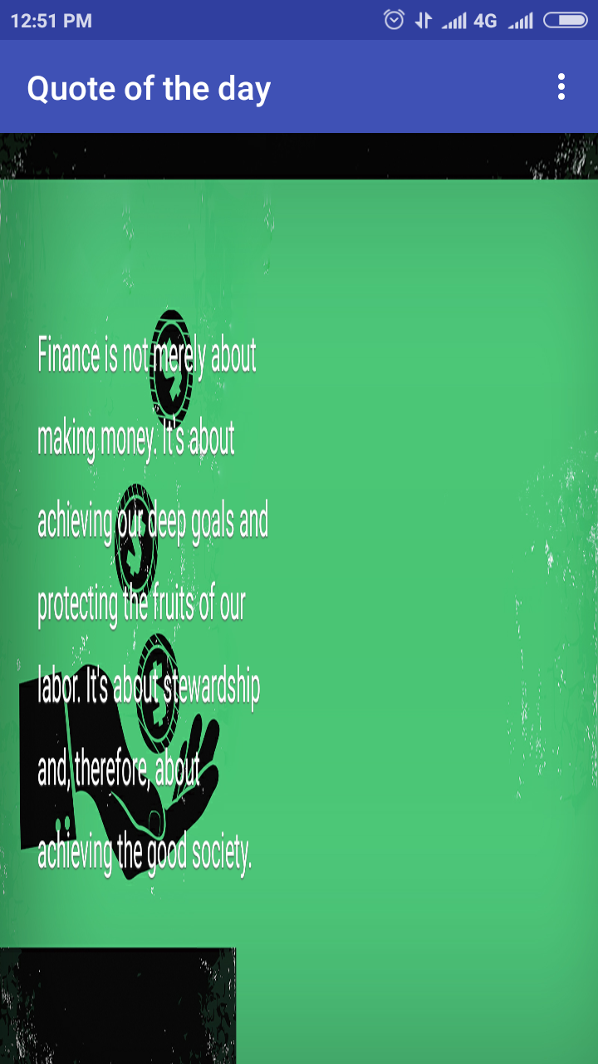
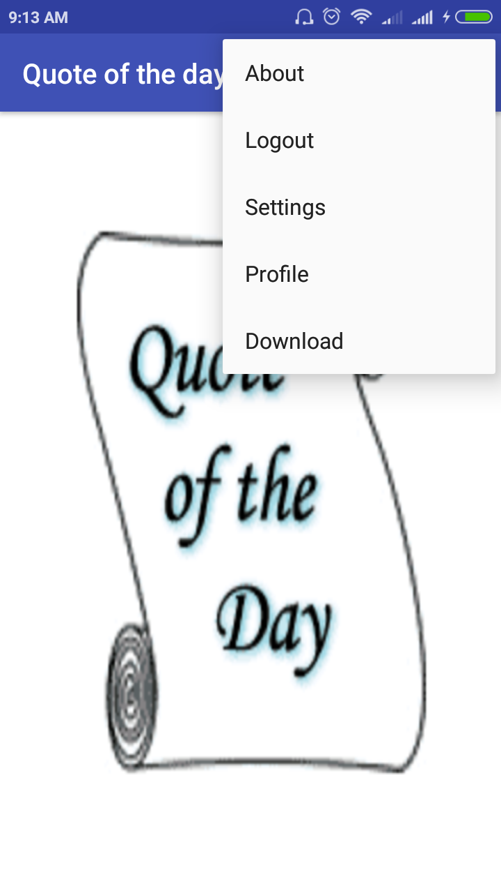
Screen(continued)
FCM notification expandable pop up
Quote image
Menus

Slide 7
Publishing app on Google Play store
Develop an app
Generate a signed apk
Login to Google Play console
Create the merchant account
Pay $25 registration fees
Fill in the mandatory fields in app listing
Upload apk

Slide 8
Thank You!!

