Slide 1
Assignment Reminder
Name: Shweta Agrawal
Email: shweta.agrawal15@gmail.com
License: The MIT license(MIT)

Slide 2
Description
Assignment Reminder is an android application that allows the students to save their assignments and remind them about it.
It also allows students view their saved assignments and delete the assignments.
The records entered and saved by the users will be stored in the database.
It then allows to set the alarm on the set time.

Slide 3
Motivation
Existing situation where students have multiple courses and lots of submissions at the same time which sometimes makes them to forget to do their work before the deadlines.
Database is my interest. For this project I have used Sqllite Database which is directly embedded into the program. It does not require client server database.

Slide 4

This is the main screen. When you press enter button it takes to the next screen.

Slide 5
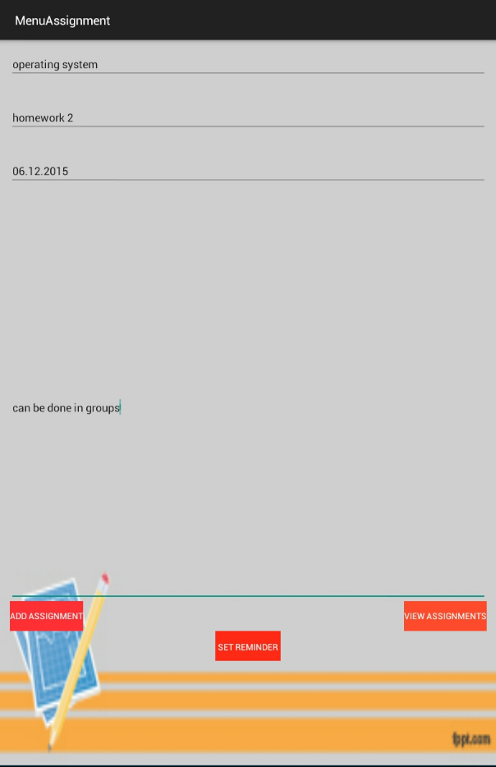
This is the next screen where we can add assignments.

Slide 6
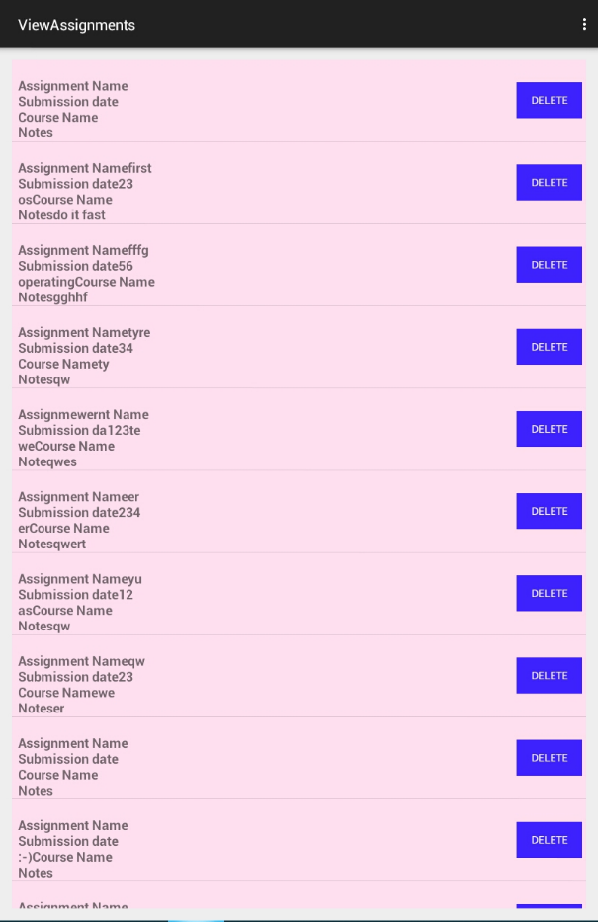
After pressing the view assignments it views all the stored assignments and also allows to delete the selected assignment.

Slide 7

The set reminder button allows to set the reminder using the toggle on/off button.

Slide 8
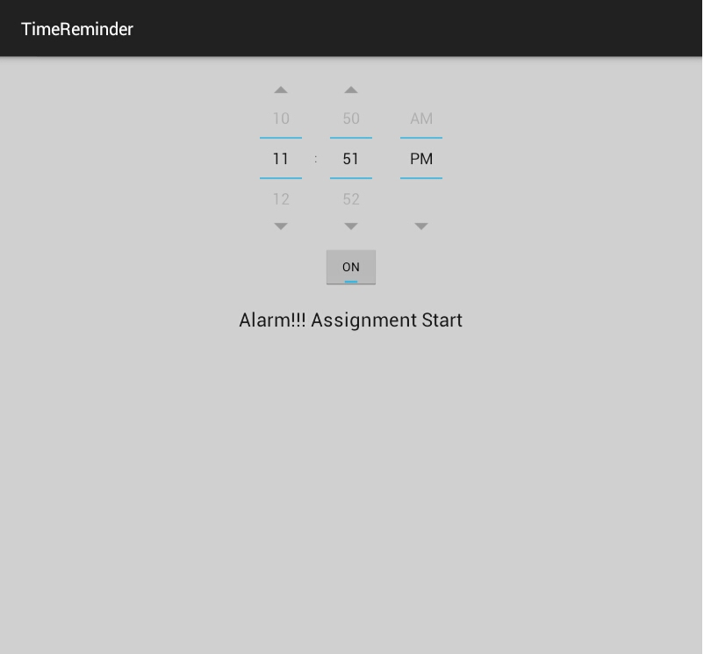
When we start the alarm the alarm starts ringing with the following message and even sends a notification message.

Slide 9
Git Hub link
https://github.com/shwetaagrawal15/AssignmentReminder

Slide 10
Future Work
Modify Assignments
Set alarm using specific date and time
Add email account feature
Add group assignments feature
Alert sound on specific intervals.

Slide 11
Thank You!

