Slide 1
Omnify Intern Assignment
Pivot Tables And Corresponding Charts

Slide 2
Analysis Of Google Ads Data
Total Cost
$2760
Total Payments
$12000
Profit
$9120

Slide 3
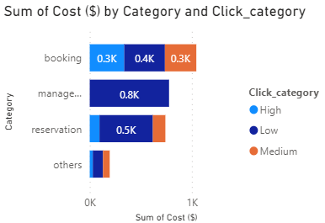
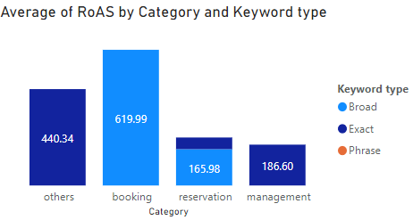
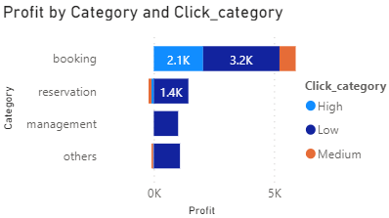
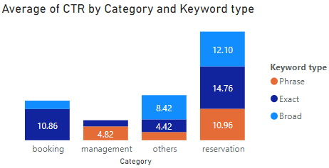
Category | Sum of Cost ($) | Click category
management | 776.85 | Low
reservation | 522.5 | Low
booking | 398.39 | Low
booking | 337.69 | High
booking | 307.82 | Medium
reservation | 122.71 | Medium
others | 99.76 | Low
reservation | 95.65 | High
others | 65.66 | Medium
others | 30.2 | High
Category | Average of RoAS | Keyword type
booking | 619.99 | Broad
others | 440.34 | Exact
management | 186.6 | Exact
reservation | 165.98 | Broad
reservation | 53.27 | Exact
booking | 0 | Exact
booking | 0 | Phrase
management | 0 | Phrase
others | 0 | Broad
others | 0 | Phrase
reservation | 0 | Phrase
Category | Click Category | Profit
booking | Low | 3177.61
booking | High | 2050.31
reservation | Low | 1437.5
others | Low | 1088.24
management | Low | 1011.15
booking | Medium | 672.18
others | High | -30.2
others | Medium | -65.66
reservation | High | -95.65
reservation | Medium | -122.71
Category | Average of CTR | Keyword type
booking | 0 | Phrase
management | 4.82 | Phrase
others | 2.85 | Phrase
reservation | 10.96 | Phrase
booking | 10.86 | Exact
management | 2.16 | Exact
others | 4.42 | Exact
reservation | 14.76 | Exact
booking | 2.94 | Broad
others | 8.42 | Broad
reservation | 12.1 | Broad

Slide 4
Analysis Of Listing Sites Data
Total Cost
$25250

Slide 5
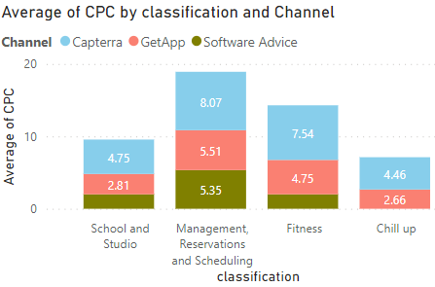
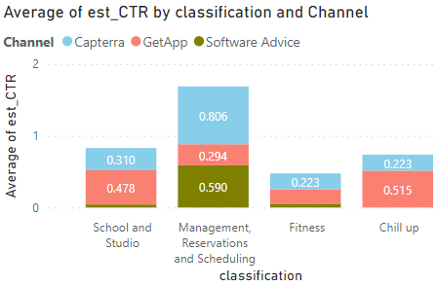
classification | Average of CPC | Channel
School and Studio | 4.75 | Capterra
School and Studio | 2.81 | GetApp
School and Studio | 2 | Software Advice
Management, Reservations and Scheduling | 8.07 | Capterra
Management, Reservations and Scheduling | 5.51 | GetApp
Management, Reservations and Scheduling | 5.35 | Software Advice
Fitness | 7.54 | Capterra
Fitness | 4.75 | GetApp
Fitness | 2 | Software Advice
Chill up | 4.46 | Capterra
Chill up | 2.66 | GetApp
classification | Average of est_CTR | Channel
School and Studio | 0.31 | Capterra
School and Studio | 0.478 | GetApp
School and Studio | 0.043 | Software Advice
Management, Reservations and Scheduling | 0.806 | Capterra
Management, Reservations and Scheduling | 0.294 | GetApp
Management, Reservations and Scheduling | 0.59 | Software Advice
Fitness | 0.223 | Capterra
Fitness | 0.199 | GetApp
Fitness | 0.054 | Software Advice
Chill up | 0.223 | Capterra
Chill up | 0.515 | GetApp

Slide 6
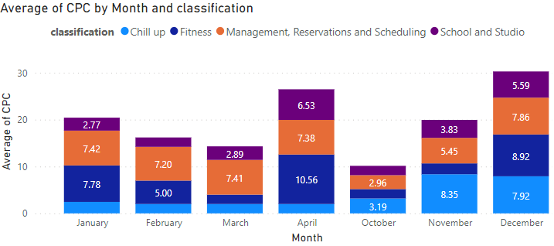
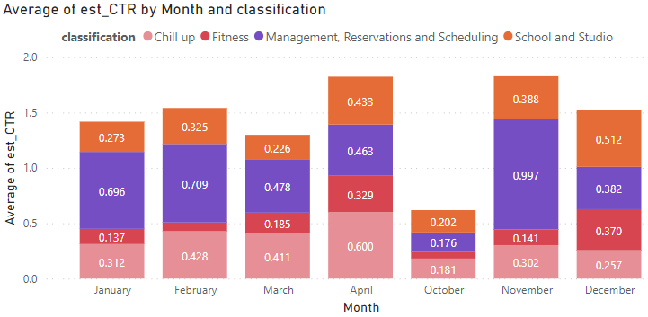
Month | Average of CPC | classification
January | 2.45 | Chill up
January | 7.78 | Fitness
January | 7.42 | Management, Reservations and Scheduling
January | 2.77 | School and Studio
February | 2 | Chill up
February | 5 | Fitness
February | 7.2 | Management, Reservations and Scheduling
February | 2 | School and Studio
March | 2 | Chill up
March | 2 | Fitness
March | 7.41 | Management, Reservations and Scheduling
March | 2.89 | School and Studio
April | 2 | Chill up
April | 10.56 | Fitness
April | 7.38 | Management, Reservations and Scheduling
April | 6.53 | School and Studio
October | 3.19 | Chill up
October | 2 | Fitness
October | 2.96 | Management, Reservations and Scheduling
October | 2 | School and Studio
November | 8.35 | Chill up
November | 2.32 | Fitness
November | 5.45 | Management, Reservations and Scheduling
November | 3.83 | School and Studio
December | 7.92 | Chill up
December | 8.92 | Fitness
December | 7.86 | Management, Reservations and Scheduling
December | 5.59 | School and Studio
Month | Average of est_CTR | classification
January | 0.312 | Chill up
January | 0.137 | Fitness
January | 0.696 | Management, Reservations and Scheduling
January | 0.273 | School and Studio
February | 0.428 | Chill up
February | 0.079 | Fitness
February | 0.709 | Management, Reservations and Scheduling
February | 0.325 | School and Studio
March | 0.411 | Chill up
March | 0.185 | Fitness
March | 0.478 | Management, Reservations and Scheduling
March | 0.226 | School and Studio
April | 0.6 | Chill up
April | 0.329 | Fitness
April | 0.463 | Management, Reservations and Scheduling
April | 0.433 | School and Studio
October | 0.181 | Chill up
October | 0.059 | Fitness
October | 0.176 | Management, Reservations and Scheduling
October | 0.202 | School and Studio
November | 0.302 | Chill up
November | 0.141 | Fitness
November | 0.997 | Management, Reservations and Scheduling
November | 0.388 | School and Studio
December | 0.257 | Chill up
December | 0.37 | Fitness
December | 0.382 | Management, Reservations and Scheduling
December | 0.512 | School and Studio

