Slide 1

CEB Departure View Spotlight
Prepared for
Departure View - Consuming Account - SA
All Time Period
What is the Spotlight?
Employees are leaving your organization and you need answers...
Why are employees leaving
my organization?
Which aspects of my EVP
are least competitive?
How can I reduce dissatisfaction and r
regretted attrition?
How satisfied are departing employees
relative to our talent competitors?
The Spotlight from CEB Departure View sheds light on your organization’s departing employees and provides valuable insight on how to solve key departure challenges.

Slide 2
Spotlight
Departure View - Consuming Account - SA
Prepared for
Your Departure View report includes data from:
1) Organization Segment:
Entire Population
(n = 24)
2) Benchmark:
Global Benchmark
(n = 65081)
Interested in
learning more?
All Departure View results collected through the survey are available in an online dashboard that allows you to:
Compare results
across additional time
periods.
Adjust benchmarks to
evaluate industry and
geographic
competitiveness.
Generate custom
reports for key
stakeholders at your
organization.
All Time Period
cebglobal.com 2

Slide 3
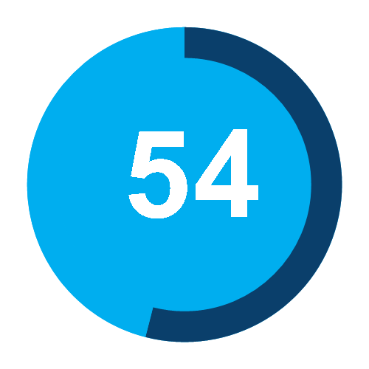

Spotlight
Departure View - Consuming Account - SA
Prepared for
How satisfied are departing employees relative to our talent competitors?
Interested in
learning more?
All Departure View results collected through the survey are available in an online dashboard that allows you to:
Compare results
across additional time
periods.
Adjust benchmarks to
evaluate industry and
geographic
competitiveness.
Generate custom
reports for key
stakeholders at your
organization.
Organization Score Out
of 100
% Change from Prior Period ª
Competitive
Placement
60th
Percentile
90th
Percentile
Departure Index
42
N/A
N/A
N/A
N/A
Index trending
perceptions of
departing employees.
N/A
Neutral
Employee Satisfaction
Level of satisfaction among departing employees.
46%
Below Average
84
93
5
Neutral
Net Promoter Score
Likelihood of departing employees to recommend your organization.
33%
Below Average
41
59
Neutral
EVP Alignment
Alignment of EVP priorities with departing employees’ perceptions.
N/A
N/A
N/A
N/A
N/A
3
Disadvantage
ª Prior Period:
2017 September 01 - 2017 November 01
All Time Period
Benchmark Comparison
Above the 40th percentile
Above the 90th percentile
Above the 60th percentile
Below the 40th percentile
cebglobal.com 2
© 2015 CEB. All rights reserved. CLC2878615PRO

Slide 4
Spotlight
Departure View - Consuming Account - SA
Prepared for
Why are employees leaving my organization?
Interested in
learning more?
All Departure View results collected through the survey are available in an online dashboard that allows you to:
Compare results
across additional time
periods.
Adjust benchmarks to
evaluate industry and
geographic
competitiveness.
Generate custom
reports for key
stakeholders at your
organization.
Most Common
Compensation Change
What is your department ?
What is your gender?
Primary Reasons
for Departure
Description
% Change from Prior Period ª
Top EVP
Alignment Issue
Segments to Watch
Dissatisfied with work experience.
N/A
N/A
N/A
N/A
N/A
N/A
Pushed Away ^{b}
Satisfied with
work experience, but received
better job offer.
N/A
N/A
N/A
N/A
N/A
N/A
Pulled Away
Changed careers, industries or
went back to school.
N/A
N/A
N/A
N/A
N/A
N/A
Career Change
Left for personal or family reasons.
N/A
N/A
N/A
N/A
N/A
N/A
Personal Reasons
Left involuntarily
or retired.
N/A
N/A
N/A
N/A
N/A
N/A
Involuntary
All Time Period
ª Prior Period:
2017 September 01 - 2017 November 01
^{b} If the Change from Prior Period for Pushed Away employees decreases, it reflects an improvement in the results.
cebglobal.com 3

Slide 5








Spotlight
Departure View - Consuming Account - SA
Prepared for
Which aspects of my EVP are least competitive?
Dive Deeper
Departure View offers deep dive question modules to help you further diagnose issues with key EVP attributes.
Additional questions available for:
Career Pathing
Corporate Social
Responsibility
Development
Opportunities
Diversity
Environmental
Responsibility
Location
Manager Quality
Work-life Balance
EVP Development Priorities ª
Change from Prior Period ^{b}
Competitive Placement
What is your department ?
Segments to Watch
What is your gender?
Product or Service Quality
IT
Female
1
Average
Neutral
"Great Employer" Recognition
3
IT
Female
2
Below Average
Disadvantage
Risk Taking
1
IT
Male
3
Below Average
Camaraderie
Manager
Female
4
Below Average
Empowerment
2
IT
Female
5
Below Average
Neutral
Organization Size
Manager
Female
6
Below Average
Disadvantage
Vacation
1
IT
Female
Talk to your Departure View contact or Account
Manager for more information.
7
Below Average
Neutral
Health Benefits
1
IT
Female
8
Below Average
Neutral
ª Priority and competitive placement is based on EVP competitiveness.
^{b} Prior Period:
2017 September 01 - 2017 November 01
All Time Period
Benchmark Comparison
Above the 90th percentile
Above the 60th percentile
Above the 40th percentile
Below the 40th percentile
cebglobal.com 4
© 2015 CEB. All rights reserved. CLC2878615PRO

