Slide 1
COVID-19 Detection using chest radiography
Team Members:
1. Shweta Gaikwad
2. Pallavi Karde
3. Vaibhav Maindad
4. Kaustubh Pawar
Guided by:
Prof. Sumit Harale

Slide 2
Agenda
1.Aim
2.Motivation
3.Objectives
4.Literature Survey
5.Proposed System
6.H/W and S/W to be used and Overall Cost requirements
7.Planning and Scheduling of Project(Gantt Chart)
8.Cost Estimation
9.UML, Data Flow Diagram and Cumulative Flow diagram
10.Risk Involved
11.Social Aspect
12.References

Slide 3
Aim
Covid-19 detection using chest X-Ray using convolutional neural network

Slide 4
Motivations
The outbreak of COVID-19 or coronavirus was first reported in 2019.
It has widely and rapidly spread around the world. The detection of COVID-19 cases is one of the important factors to stop the epidemic, because the infected individuals must be quarantined.
In pandemic year 2020 COVID-19 was not able to detect through RT-PCR test, there was some false negative and false positive reports so doctors had to check CT scan report to detect the infection.
One reliable way to detect COVID-19 cases is using chest x-ray images, where signals of the infection are located in lung areas.
We propose a solution to automatically classify COVID-19 cases in chest x-ray images.

Slide 5
Objectives
Determine the infection using nonhuman contact method using chest radiographs.
To be used in clinical diagnostics for imaging and low cost.
The non-contact method with acceptable accuracy is a potential alternative for rapid COVID-19 testing that can be adapted by the medical fraternity considering the criticality of the time along with the magnitudes of the outbreak.
To be used as second opinion for doctors.
To help doctors to detect patterns in medical images.
Computer-aided diagnosis (CAD) systems employed with deep learning techniques help professionals to make clinical decisions.

Slide 6
Literature Survey
Sr.No. | Title of Paper | Year | Author | Key Points | Gap identified
1. | Automatic detection of COVID-19 from chest radiographs using deep learning | Elsevier 2021 | M.K. Pandit, S.A. Banday , R. Naaz, M.A. Chishti | The proposed model is a non-contact process of determining whether a subject is infected or not and is achieved by using chest radiographs. They used CNN,VGG-16, and transfer learning. | 5%-10% chance for false positive and false negative detection
2. | COVID-19 detection and heatmap generation in chest x-ray images | SPIE.DIGITAL LIBRARY2021 | Worapan Kusakunniran, Sarattha Karnjanapreechakorn, Thanongchai Siriapisith, Punyanuch Borwarnginn, Krittanat Sutassananon, Trongtum Tongdee, Pairash Saiviroonporn | The proposed solution is evaluated based on COVID-19 and normal cases. It is also tested on unseen classes to validate a regularization of the constructed model. They used RESNET for training. | Cannot be used for large size image
3. | SOM-LWL method for identification of COVID-19 on chest X-rays | PLOSONE 2021 | Ahmed Hamza Osman , Hani Moetque Aljahdali, Sultan Menwer Altarrazi, Ali Ahmed | new COVID-19 identification technique based on the locality-weighted learning and self-organization map (LWL-SOM) strategy for detecting and capturing COVID-19 cases. | Database not available in large scale

Slide 7
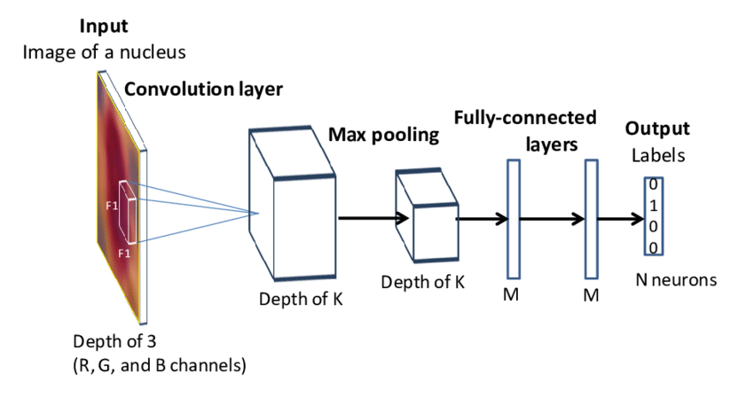
Proposed System
The system used to create this project is CNN (Convolutional Neural Network).

Slide 8
H/W and S/W to be used
Minimum Hardware Requirements :
Processor (CPU) : Intel i3 generation
RAM : 512 MB
Hard Drive : 250 GB or more
Minimum Software Requirements for Development :
Operating System (OS) : Windows 7
Programming Language : Python 3.7
Cloud based Jupyter Notebook environment to run code : Google colab

Slide 9
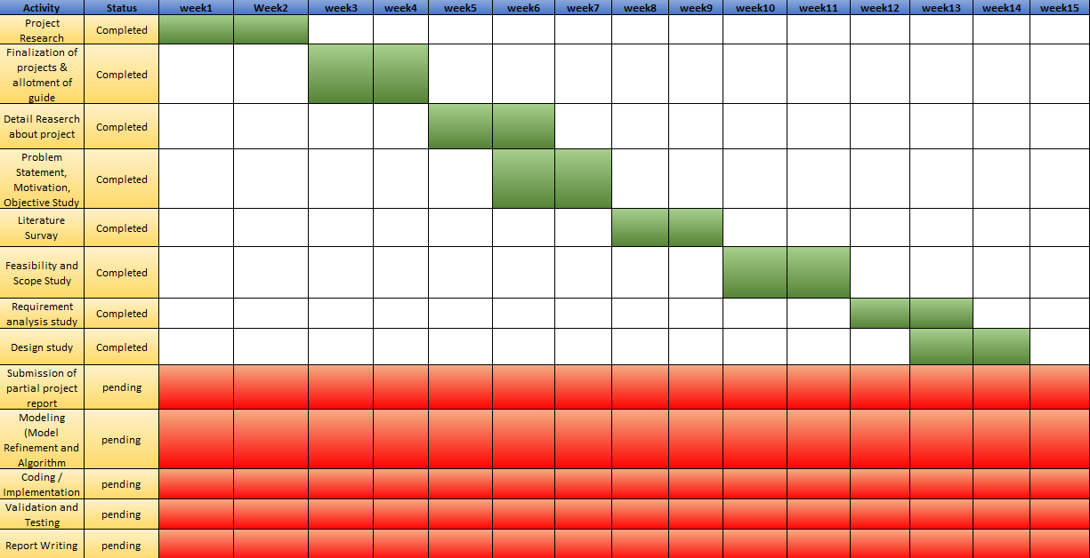
Planning and Scheduling of Project

Slide 10
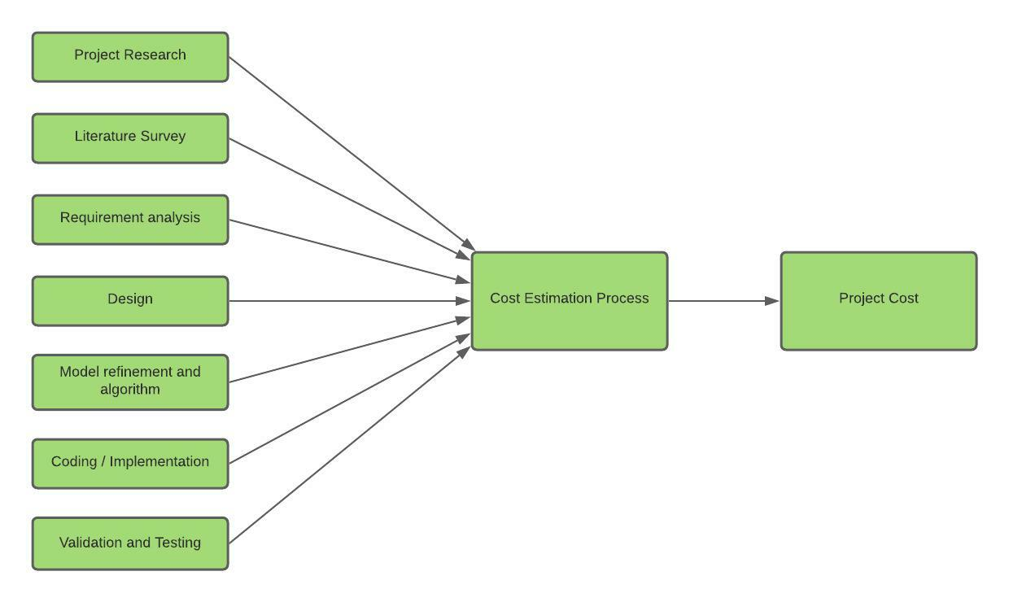
Cost Estimation

Slide 11
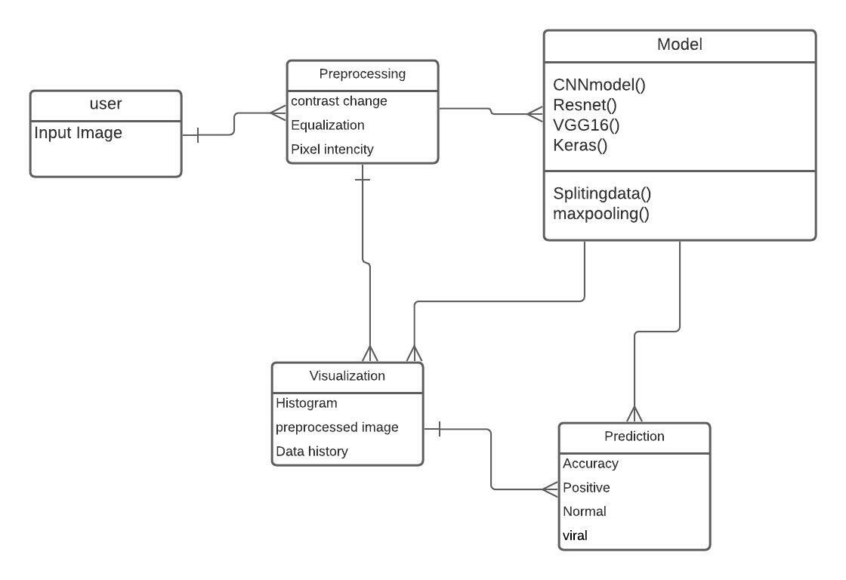
UML and DFD of project
Class diagram

Slide 12
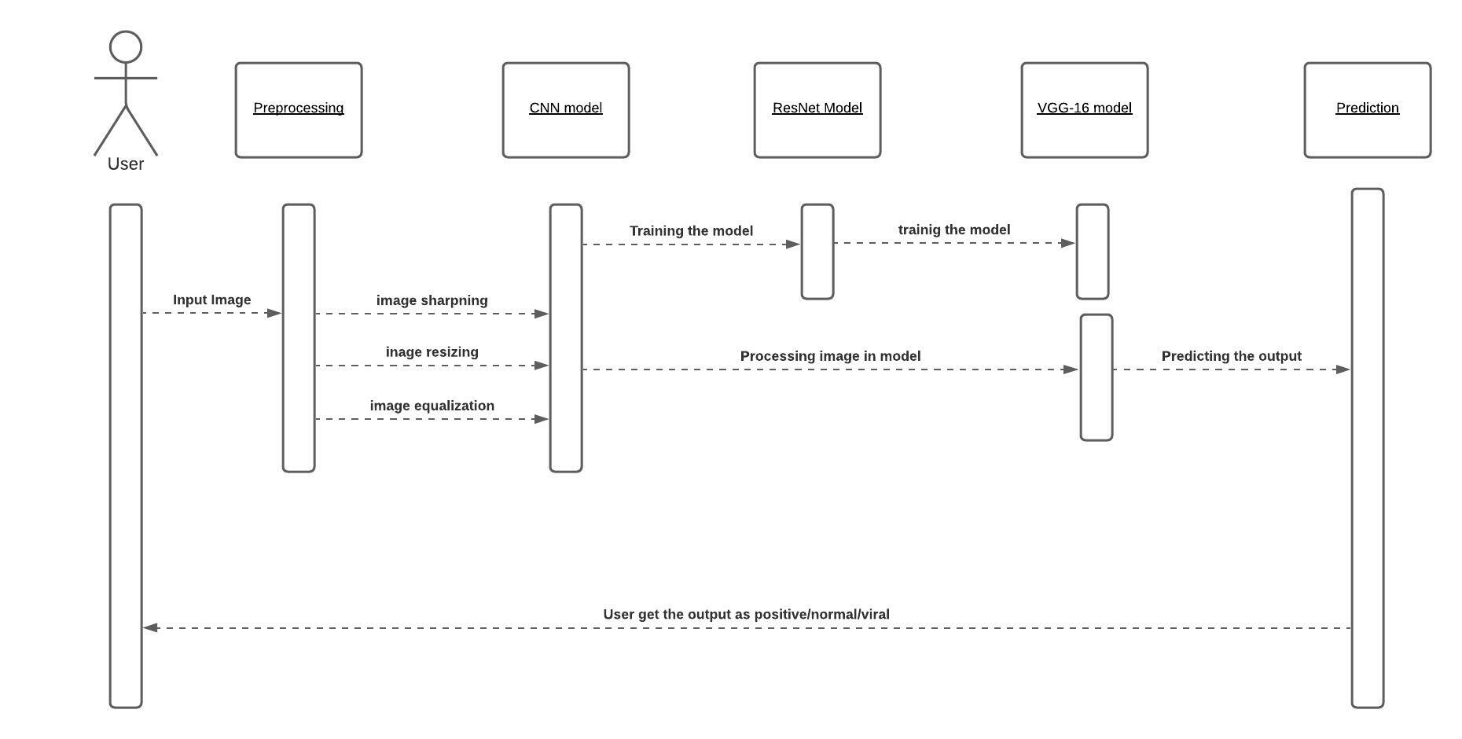
Sequence Diagram

Slide 13
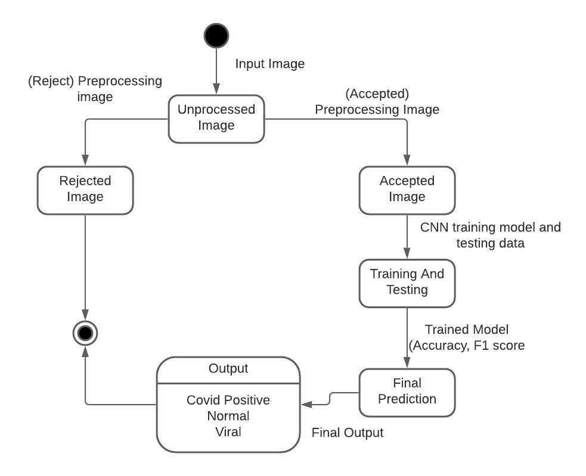
UML and DFD of project
State transition Diagram

Slide 14
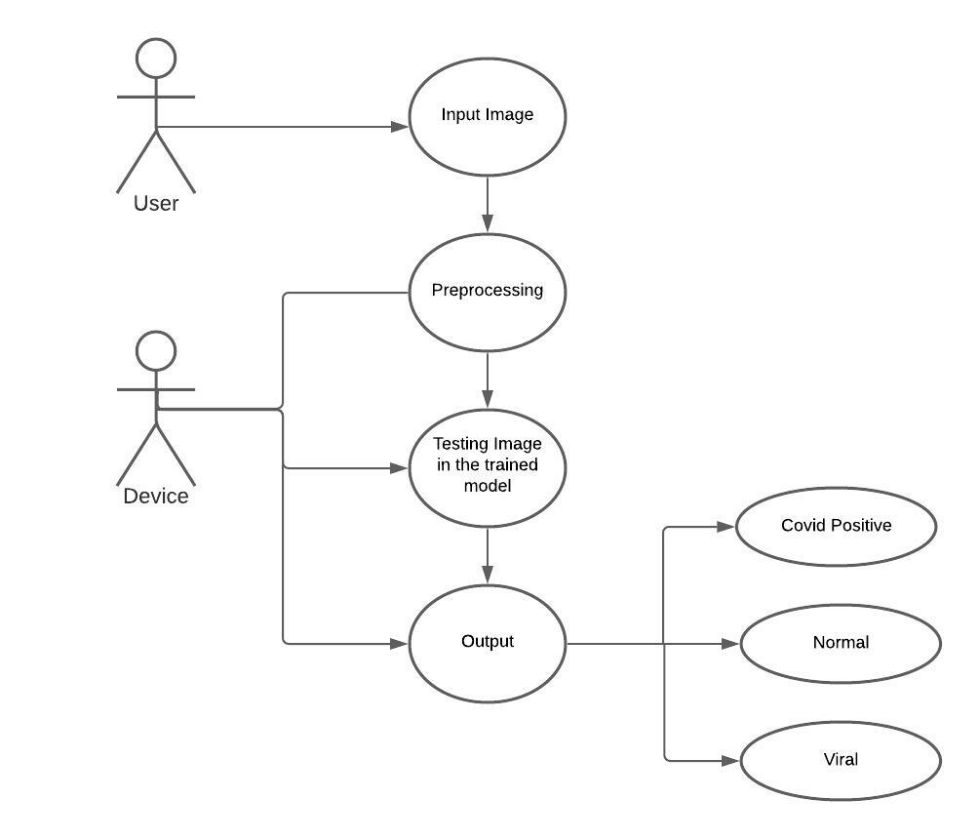
UML and DFD of project
Use Case Diagram

Slide 15
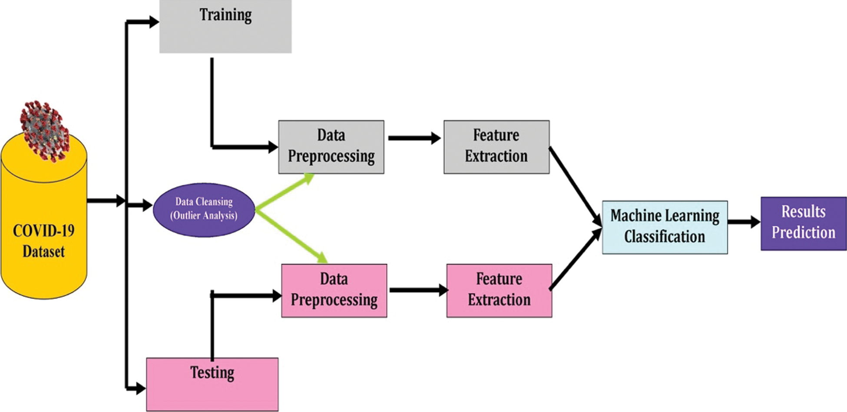
Data Flow Diagram

Slide 16
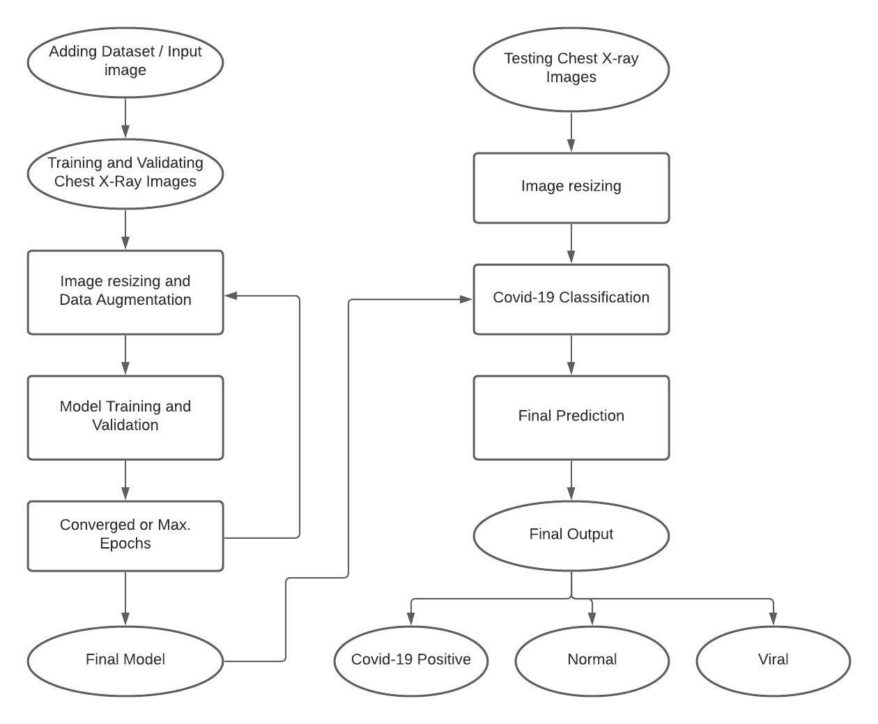
Flow Chart

Slide 17
Risk Involved
Technical and business risks: False positive and False negative results.
False positive can cause giving a wrong treatment to the patients. Resulting in other health complications(e.g., black fungus)
False negative can be fatal for the patient due to delayed or lack of treatment.
To solve this, we could add some new training models into the algorithms.
We could add different factors to get accurate results. (e.g., F1 score)
To confirm the error in the program we can recommend RT-PCR test for patient.

Slide 18
Social Aspect
Covid-19 has spread across different lengths and breadths of the globe, taking a death toll to in Lakhs. The number is well expected to rise even more significantly.
In the absence of a thoroughly tested and approved vaccine, the onus primarily lies on obliging to standard operating procedures and timely detection and isolation of the infected persons.
The detection of SARS n-CoV2 has been one of the core concerns during the fight against this pandemic. To keep up with the scale of the outbreak, testing needs to be scaled at par with it.
With the conventional PCR testing, most of the countries have struggled to minimize the gap between the scale of outbreak and scale of testing.

Slide 19
Social Aspect
The proposed model is a non-contact process of determining whether a subject is infected or not and is achieved by using chest radiographs; one of the most widely used imaging technique for clinical diagnosis due to fast imaging and low cost.
It can be used as second opinion for doctors and also to help doctors to detect patterns in medical images.
Computer-aided diagnosis (CAD) systems employed with deep learning techniques help professionals to make clinical decisions.

Slide 20
Social Aspect
We used the deep learning model to detect COVID19 using chest radiographs automatically.
The study shows the robust and effective method of non-contact testing on COVID patients, which can help in early and cost-effective detection and screening of COVID cases.
Grad CAM images of chest radiographs are presented, which shows the regions of interest for confirmed COVID-19 positive cases, bacterial pneumonia, and healthy cases.
We believe that this study could be used as an initial screening, which can help healthcare professionals to treat the COVID patients by timely detecting better and screening the presence of disease.
It provides not only a cost-effective but also an automatic noncontact testing method, which helps in reducing the risk of COVID contraction by medical practitioners

Slide 21
Scope
The proposed system will be able to help doctors and hospitals to detect covid cases in less time.
People have to give less money for the covid testing.
In the future, we could build a mobile app for the people to test their x-rays at home for the covid detection
We could install the system in every hospital-like x-ray machine or CT scan machine for fast result generation.

Slide 22
References
[1] M.K. Pandit, S.A. Banday, R. Naaz, M.A. Chishti, Automatic detection of COVID-19 from chest radiographs using deep learning, Radiography, Volume 27, Issue 2, 2021, Pages 483-489, ISSN 1078-8174, https://doi.org/10.1016/j.radi.2020.10.018.
[2] Journal Article Kusakunniran, Worapan Karnjanapreechakorn, Sarattha Siriapisith, Thanongchai Borwarnginn, Punyanuch Sutassananon, Krittanat Tongdee, Trongtum Saiviroonporn, Pairash COVID-19 detection and heatmap generation in chest x-ray images 8 Journal of Medical Imaging S1 014001 2021 https://doi.org/10.1117/1.JMI.8.S1.014001 DOI 10.1117/1.JMI.8.S1.014001 SPIE
[3] SOM-LWL method for identification of COVID-19 on chest X-rays Osman AH, Aljahdali HM, Altarrazi SM, Ahmed A (2021) SOM-LWL method for identification of COVID-19 on chest X-rays. PLOS ONE 16(2): e0247176. https://doi.org/10.1371/journal.pone.0247176
[4] COVID-19 pneumonia on chest X-rays: Performance of a deep learning-based computer-aided detection system Hwang EJ, Kim KB, Kim JY, Lim JK, Nam JG, et al. (2021) COVID-19 pneumonia on chest X-rays: Performance of a deep learning-based computer-aided detection system. PLOS ONE 16(6): e0252440. https://doi.org/10.1371/journal.pone.0252440

