Slide 1
COVID-19 Detection using chest radiography
Team Members:
1. Shweta Gaikwad
2. Pallavi Karde
3. Vaibhav Maindad
4. Kaustubh Pawar
Guided by:
Prof. Sumit Harale

Slide 2
Agenda
1.Aim
2.Motivation
3.Objectives
4.Literature Survey
5.Proposed System
6.H/W and S/W to be used and Overall Cost requirements
7.Planning and Scheduling of Project(Gantt Chart)
8.Cost Estimation
9.UML, Data Flow Diagram and Cumulative Flow diagram
10.Risk Involved
11.Social Aspect
12.References

Slide 3
Aim
Covid-19 detection using chest X-Ray using convolutional neural network

Slide 4
Motivations
The outbreak of COVID-19 or coronavirus was first reported in 2019.
It has widely and rapidly spread around the world. The detection of COVID-19 cases is one of the important factors to stop the epidemic, because the infected individuals must be quarantined.
In pandemic year 2020 COVID-19 was not able to detect through RT-PCR test, there was some false negative and false positive reports so doctors had to check CT scan report to detect the infection.
One reliable way to detect COVID-19 cases is using chest x-ray images, where signals of the infection are located in lung areas.
We propose a solution to automatically classify COVID-19 cases in chest x-ray images.

Slide 5
Objectives
Determine the infection using nonhuman contact method using chest radiographs.
To be used in clinical diagnostics for imaging and low cost.
The non-contact method with acceptable accuracy is a potential alternative for rapid COVID-19 testing that can be adapted by the medical fraternity considering the criticality of the time along with the magnitudes of the outbreak.
To be used as second opinion for doctors.
To help doctors to detect patterns in medical images.
Computer-aided diagnosis (CAD) systems employed with deep learning techniques help professionals to make clinical decisions.

Slide 6
H/W and S/W to be used
Minimum Hardware Requirements :
Processor (CPU) : Intel i3 generation
RAM : 512 MB
Hard Drive : 250 GB or more
Minimum Software Requirements for Development :
Operating System (OS) : Windows 7
Other:
Programming Language : Python 3.7
Cloud based Jupyter Notebook environment to run code : Google colab

Slide 7
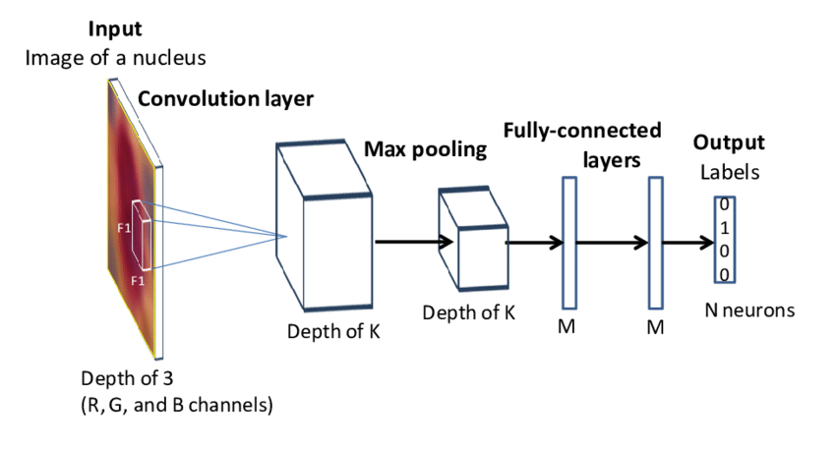
Proposed System
The system used to create this project is CNN (Convolutional Neural Network), VGG-16, ResNet.

Slide 8
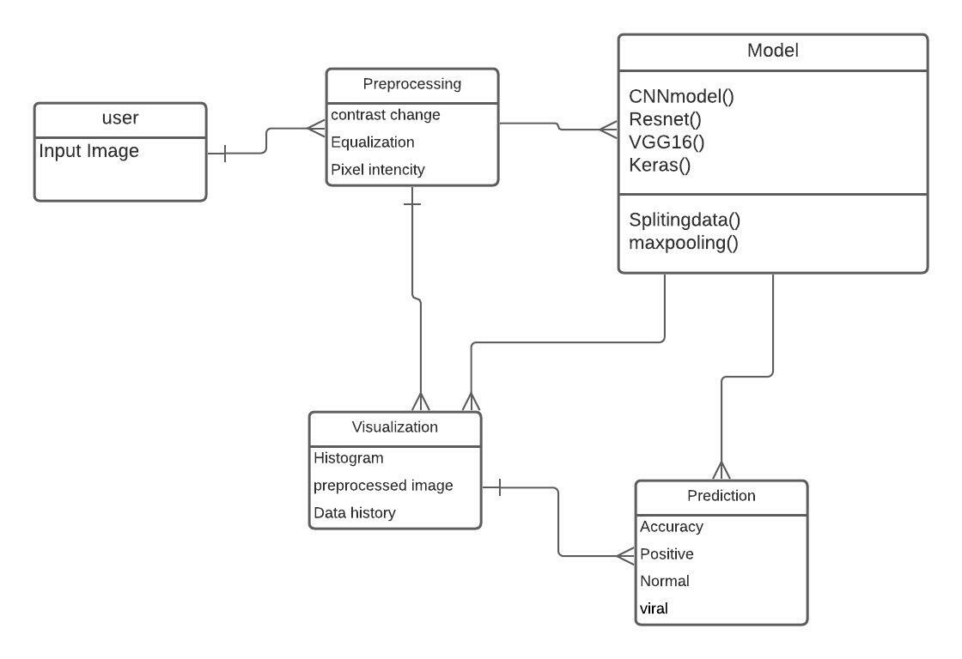
Responsibilities of classes and objects identified in the project

Slide 9
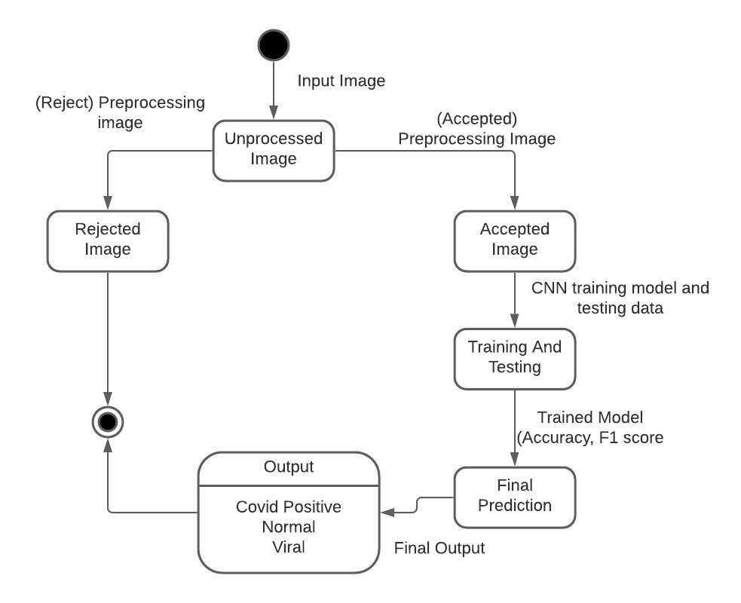
State Transition Diagram

Slide 10
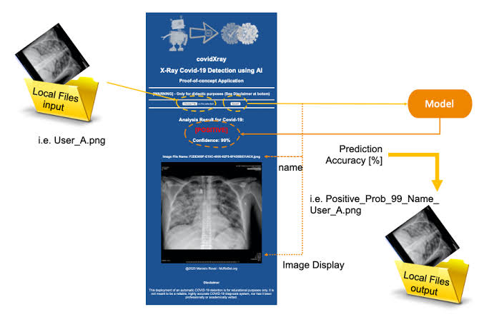
Interface and functional dependencies between modules

Slide 11
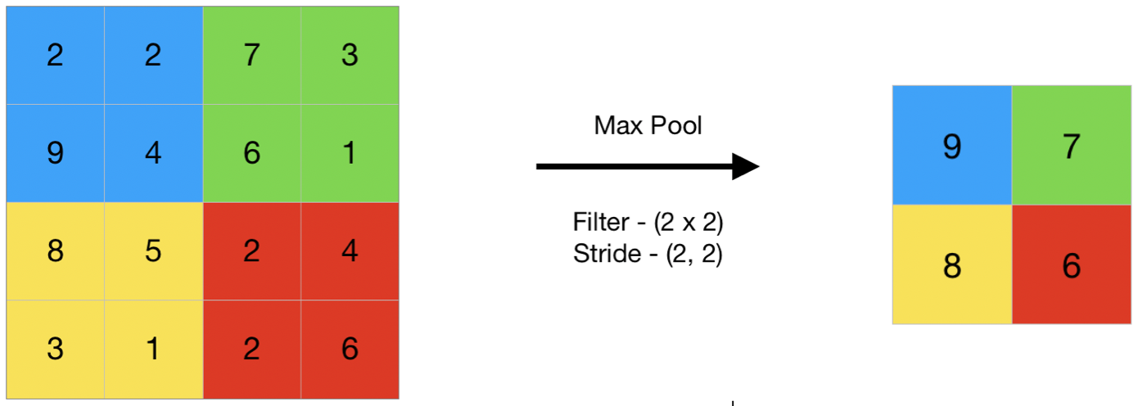
Mathematical Model

Slide 12
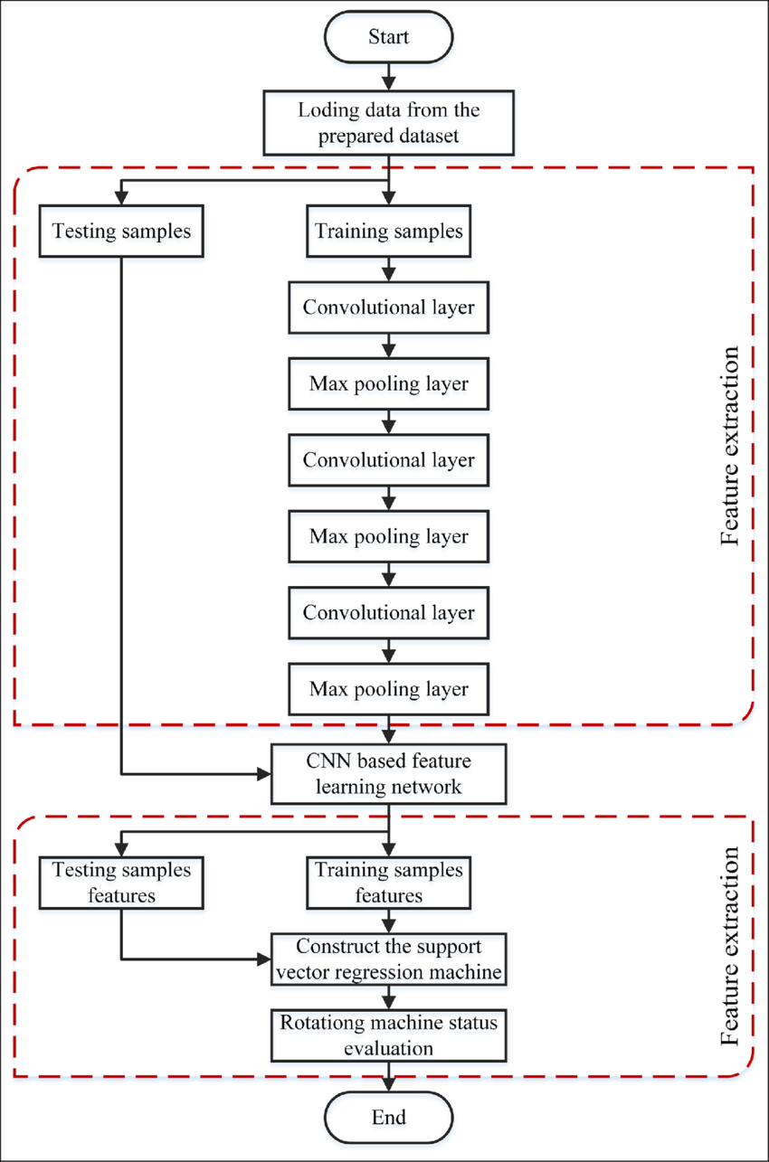
CNN Algorithm

Slide 13
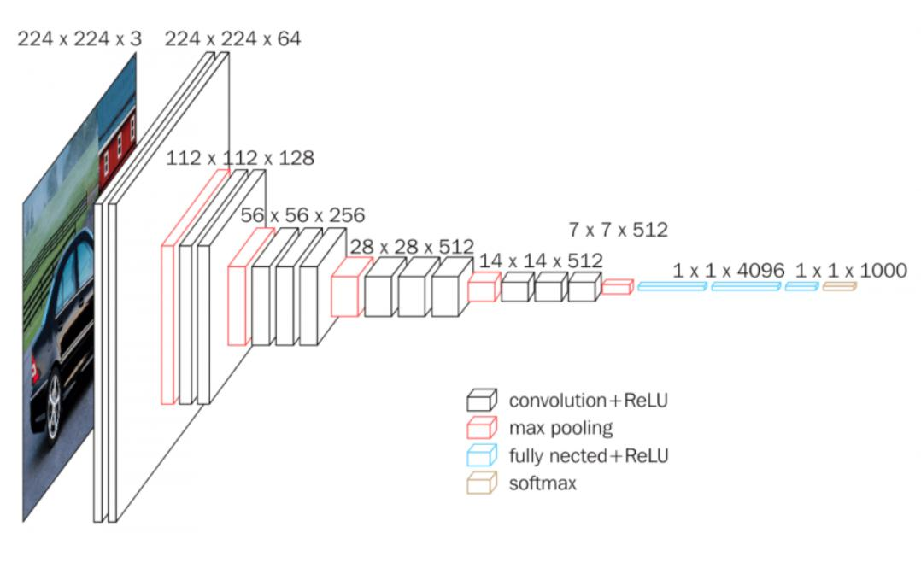
VGG 16 Algorithm

Slide 14
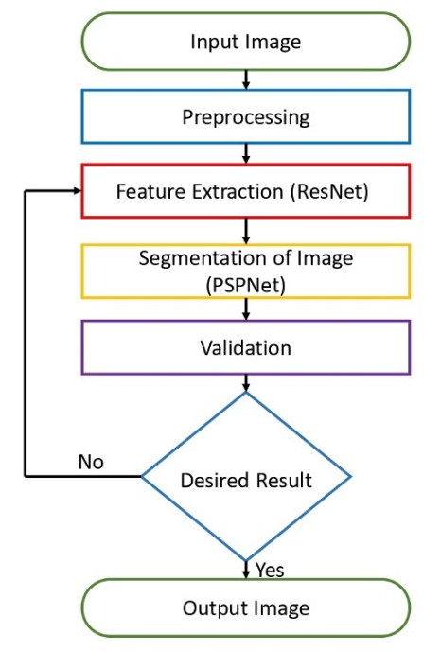
Resnet Algorithm

Slide 15
Conclusion
We used the deep learning model to detect COVID19 using chest radiographs automatically.
• The study shows the robust and effective method of non-contact testing on COVID patients, which can help in early and cost-effective detection and screening of COVID cases.
• Grad CAM images of chest radiographs are presented, which shows the regions of interest for confirmed COVID-19 positive cases, bacterial pneumonia, and healthy cases.
• We believe that this study could be used as an initial screening, which can help healthcare professionals to treat the COVID patients by timely detecting better and screening the presence of disease.
• It provides not only a cost-effective but also an automatic noncontact testing method, which helps in reducing the risk of COVID contraction by medical practitioners

Slide 16
References
[1] M.K. Pandit, S.A. Banday, R. Naaz, M.A. Chishti, Automatic detection of COVID-19 from chest radiographs using deep learning, Radiography, Volume 27, Issue 2, 2021, Pages 483-489, ISSN 1078-8174, https://doi.org/10.1016/j.radi.2020.10.018.
[2] Journal Article Kusakunniran, Worapan Karnjanapreechakorn, Sarattha Siriapisith, Thanongchai Borwarnginn, Punyanuch Sutassananon, Krittanat Tongdee, Trongtum Saiviroonporn, Pairash COVID-19 detection and heatmap generation in chest x-ray images 8 Journal of Medical Imaging S1 014001 2021 https://doi.org/10.1117/1.JMI.8.S1.014001 DOI 10.1117/1.JMI.8.S1.014001 SPIE
[3] SOM-LWL method for identification of COVID-19 on chest X-rays Osman AH, Aljahdali HM, Altarrazi SM, Ahmed A (2021) SOM-LWL method for identification of COVID-19 on chest X-rays. PLOS ONE 16(2): e0247176. https://doi.org/10.1371/journal.pone.0247176
[4] COVID-19 pneumonia on chest X-rays: Performance of a deep learning-based computer-aided detection system Hwang EJ, Kim KB, Kim JY, Lim JK, Nam JG, et al. (2021) COVID-19 pneumonia on chest X-rays: Performance of a deep learning-based computer-aided detection system. PLOS ONE 16(6): e0252440. https://doi.org/10.1371/journal.pone.0252440

