Slide 1
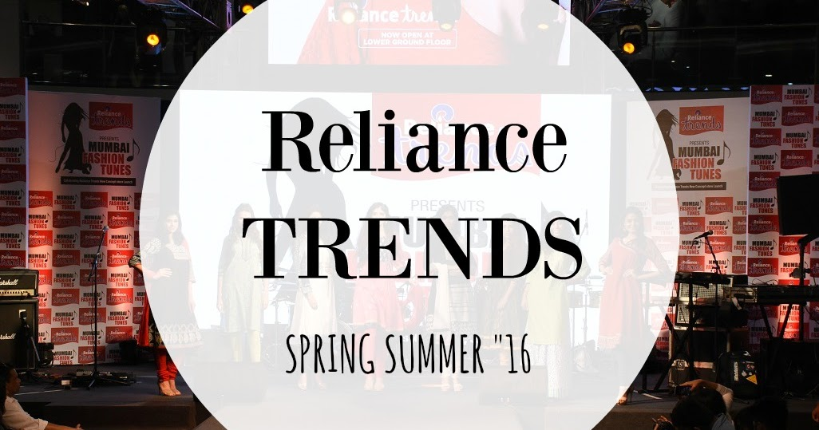

FASHION TREND ANALYSIS

Slide 2
Objective of the Analysis
Find which product categories & brands attract most customers
Evaluate how discounts impact buying behavior
Understand preferences by gender and product category
Examine effects of price segments (Budget / Mid / Premium / Luxury)
Derive insights for optimizing pricing & discount strategy

Slide 3
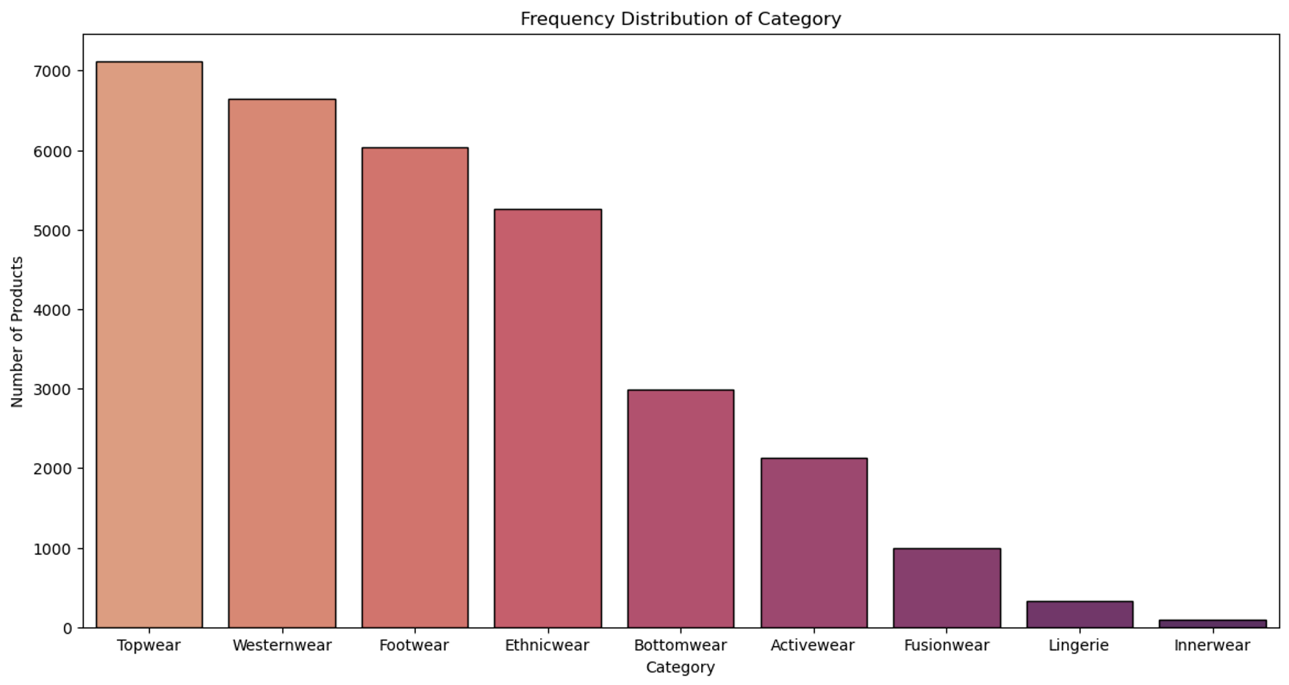
Frequency Distribution of Product Category
Key Insights :
Topwear, Westernwear and Footwear have significantly higher customer engagement.
Innerwear, Lingerie and Fashionwear have the least products.

Slide 4
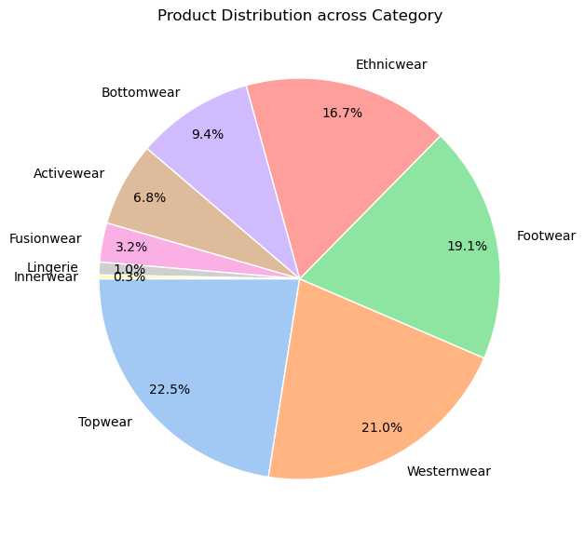
Product Distribution across Category
Key Insights :
Topwear has the highest percentage of products with 22.5% followed by Westernwear 21%, Footwear 19.1% and Ethnicwear 16.7%.
The lowest percentage is of Innerwear 0.3% followed by Lingerie 1%, Fusionwear 3.2%, Activewear 6.8% and Bottomwear 9.4%

Slide 5
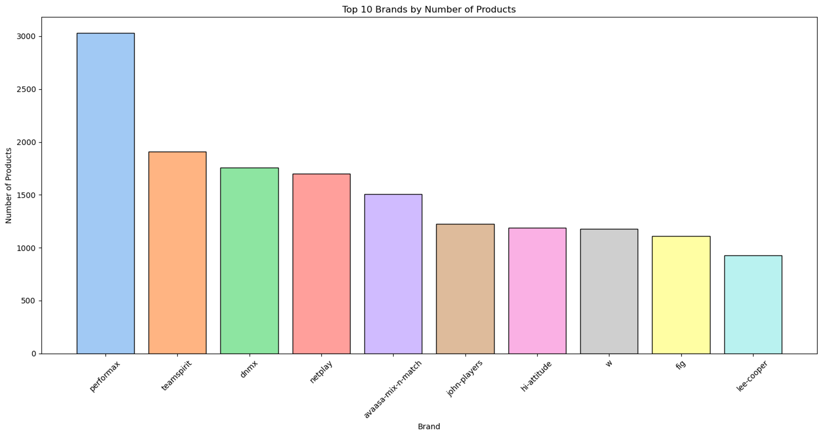
Top 10 Brands by Number of Products
Key Insights :
The Top 10 Brands in these Product Categories are Performax, Teamspirit, DNMX, Netplay, Avaasa Mix-n-match, John-Players, Hi-Attitude, W, Fig and Lee-cooper.
Performax alone has over 3000 products.

Slide 6
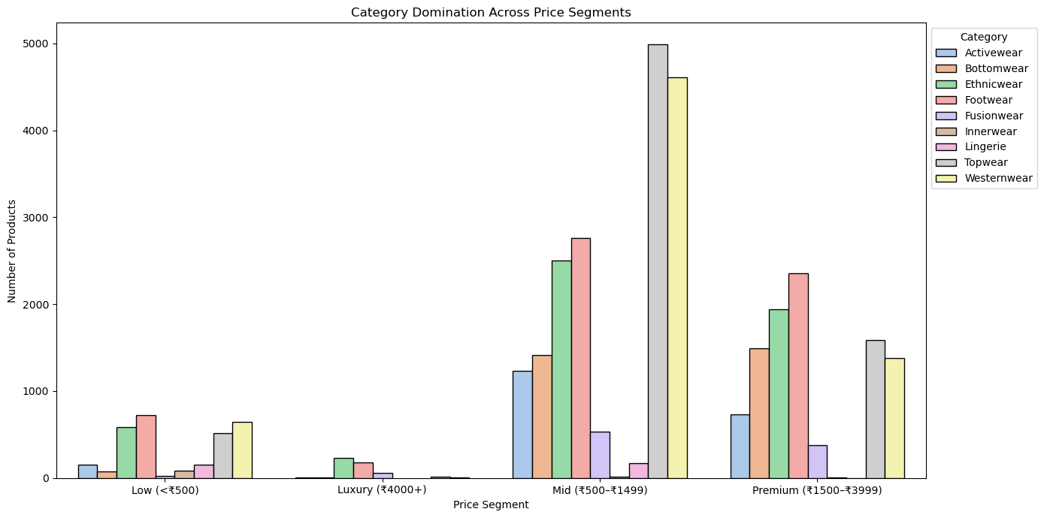
Category domination across Price Segments
Key Insights :
1. Mid-Range Dominates the Market
The Mid price segment (₹500–₹1499) has the highest product volume overall. Especially strong in Topwear and Westernwear — both exceeding 4500–5000 products. Also, high numbers in Bottomwear, Footwear, and Ethnicwear.
2. Premium Segment Also Has Strong Presence
Premium (₹1500–₹3999) holds a significant portion. Again, Topwear and Westernwear lead here. Footwear and Ethnicwear are also relatively strong.
3. Low Segment (≤ ₹500) Is Small but Present
Less variety compared to mid and premium. Footwear and Westernwear have the most products in this range. Innerwear and Ethnicwear have moderate presence.
4. Luxury Segment (₹4000+) Has Minimal Products
Very limited across all categories. Ethnicwear, Footwear, and Bottomwear are slightly represented. Almost no representation for Activewear, Fusionwear, or Innerwear.

Slide 7
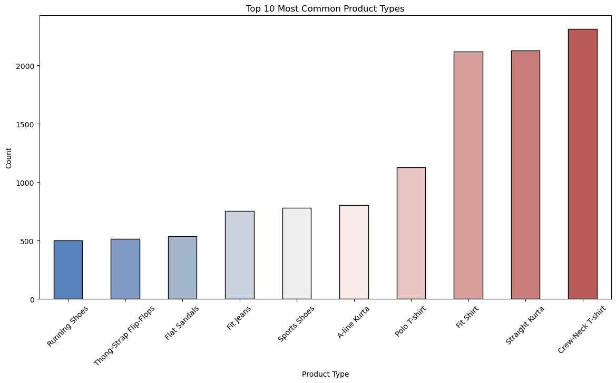
Top 10 Common Product Types
Key Insights :
The Top 10 most common Product types are Crew-Neck T-shirt, Straight Kurta, Fit shirt, Polo T-Shirt, A-Line Kurta, Sports Shoes, Fit Jeans, Flat Sandals, Thong-strap Flip-Flops and Running Shoes.
Crew-Neck T-Shirt, Straight Kurta and Fit Shirt have over 2000 units.

Slide 8
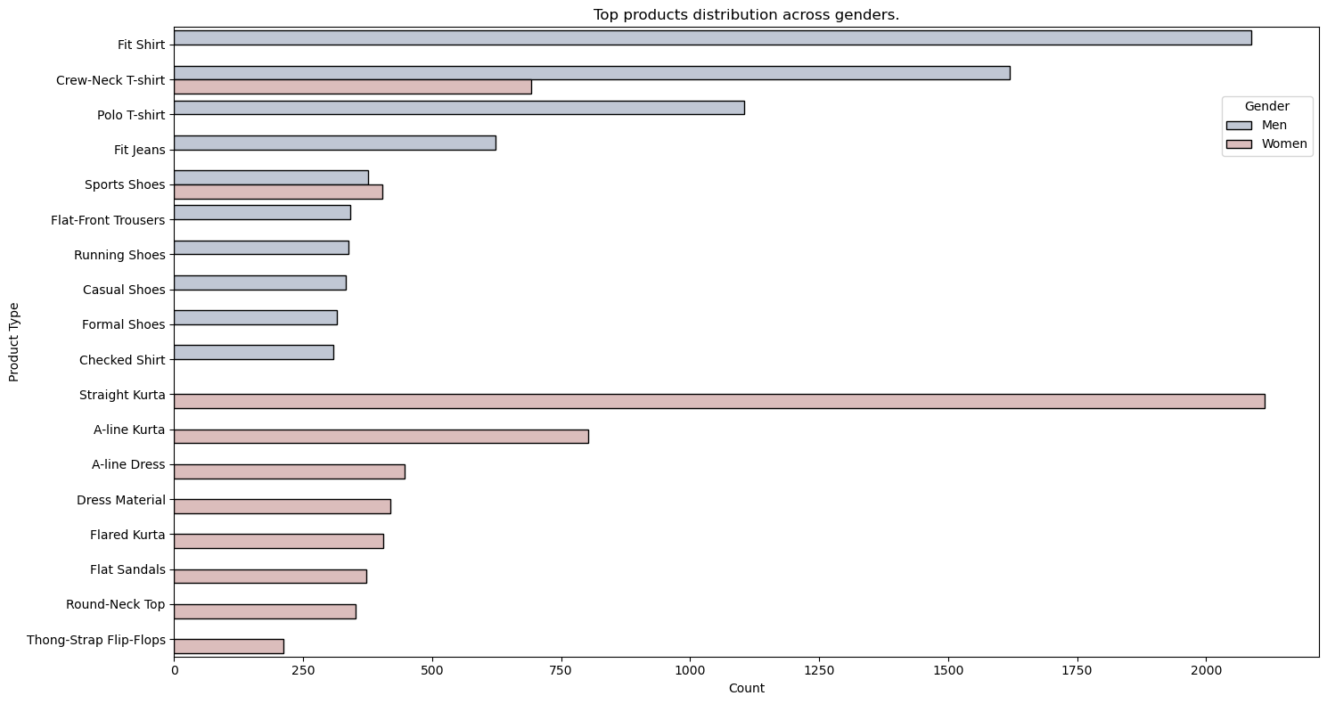
Product distribution across Genders
Key Insights :
1. Men's Top Product Preferences
Fit Shirt is the most popular men's product — over 2000+ units. Followed by Crew-Neck T-shirt, Polo T-shirt, Fit Jeans. Strong presence in footwear too-Sports Shoes, Running Shoes, Formal Shoes, Casual Shoes
2. Women's Top Product Preferences
Straight Kurta is the clear leader — exceeds 2000 units, similar to men’s Fit Shirt. Followed by A-line Kurta, A-line Dress, Flared Kurta Dress Material, Flat Sandals, Round-Neck Top. Product types are more diverse than men's, focused heavily on ethnic & casual categories.

Slide 9
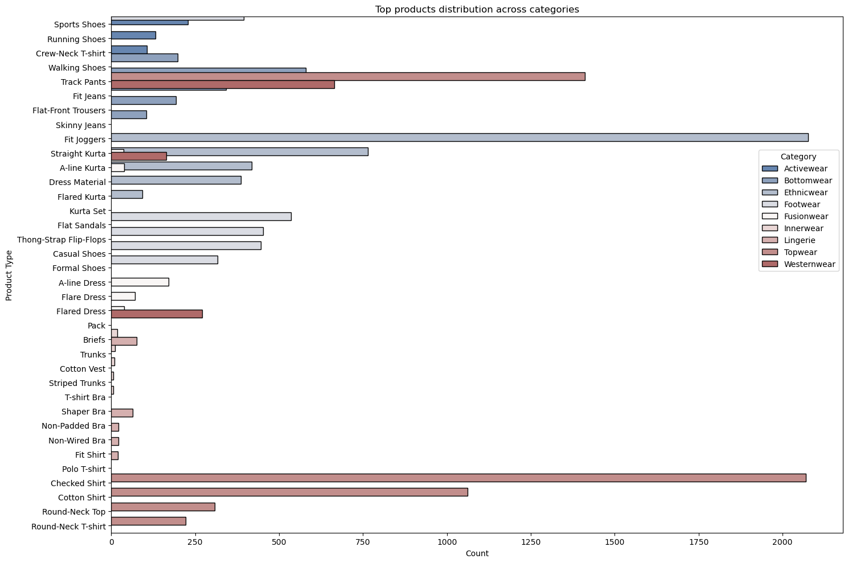
Top products across categories

Slide 10
Top products across categories
Key Insights :
1. Westernwear (Brown bars — heavily dominant)
Most dominant category in terms of product volume.
Leading products: Checked Shirt and Cotton Shirt both exceed ~2000 products each. Round-Neck Top and Round-Neck T-shirt also have large counts. Indicates Westernwear tops are high-demand staples.
2. Topwear
Includes a wide range: Polo T-shirt, Fit Shirt, Cotton Shirt
Strong overlap with Westernwear, but slightly more formal/casual split. Polo T-shirt alone has over 750 products.
3. Bottomwear
Popular products: Track Pants (very high count, similar to Westernwear tops) Flat-Front Trousers, Fit Jeans, Skinny Jeans, Joggers. Suggests strong interest in athleisure and fitted bottoms.
4. Footwear
Includes: Walking Shoes, Running Shoes, Casual Shoes, Formal Shoes Moderate product distribution; no product exceeds ~500. Balanced offering across sports and casual types.
5. Ethnicwear
Dominated by: Straight Kurta, A-line Kurta, Flared Kurta, Kurta Set, Dress Material Ethnicwear category shows moderate but diverse presence. Indicates significant female buyer interest in ethnic wear.
6. Activewear
Low total counts, but includes: Running Shoes, Track Pants, Sports Shoes Track Pants likely shared across categories.
7. Innerwear & Lingerie
Lingerie: Includes bras (T-Shirt Bra, Non-Wired, etc.), Flared Dress (likely sleepwear or homewear).
Innerwear: Briefs, Trunks, Cotton Vests — all under ~300. These categories are small but niche-focused.
8. Fusionwear (Low presence)
Barely represented in this dataset, could suggest underdeveloped category or data imbalance.

Slide 11
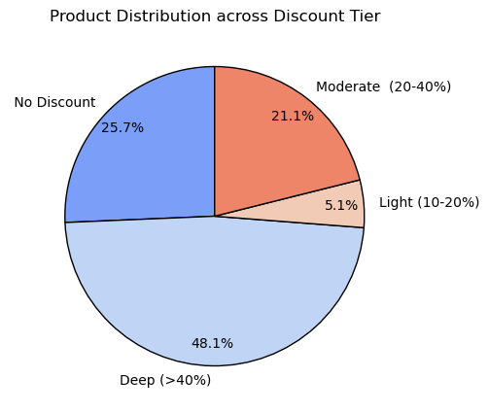
Product distribution across Discount tier
Key Insights :
Maximum products are in the Deep Discount Tier with 48%
Second is No Discount Tier with 25.7% and third is Moderate Discount Tier with 21%
The least products are in the Light Tier with 5%

Slide 12
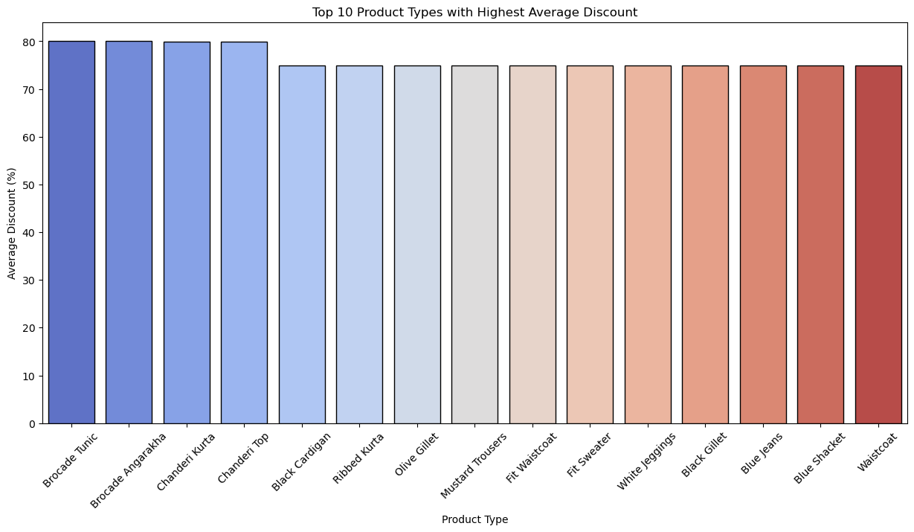
Top 10 Products with Highest Average Discount
Key Insights :
The categories with highest discount are Brocade Tunic, Brocade Angarakha and Chanderi Kurta. All at 80% average discount.
Rest all of the Products are at 70% average discount

Slide 13
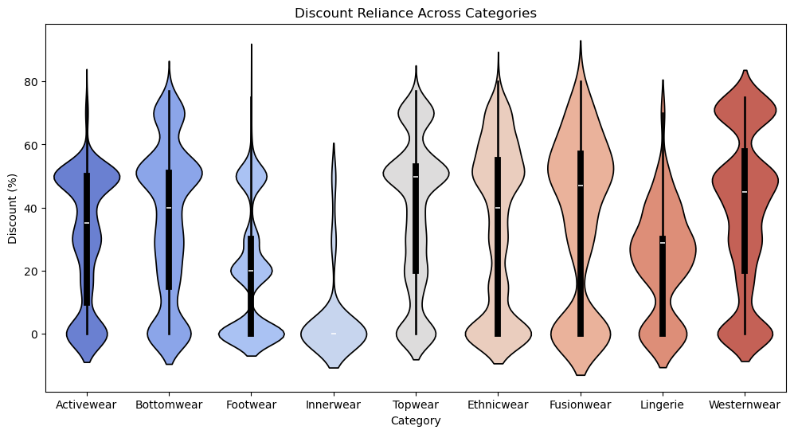
Discount Reliance across Categories
Key Insights :
1. High Discount Dependence
Westernwear & Fusionwear show 50–70% discounts frequently. Heavy reliance on markdowns to boost sales.
2. Moderate Discounting
Activewear, Bottomwear, Topwear, Ethnicwear show discounts usually 30–50%. Balanced reliance on promotions.
3. Low Discount Reliance
Footwear & Innerwear show mostly below 20–30% discounts. Demand remains stable without heavy discounting.
4. Mixed Category
Lingerie: Moderate discounts (~20–40%), with some higher spikes. Indicates selective promotions.
Strategic Implications:
Risk of margin erosion in categories dependent on high discounts (Westernwear, Fusionwear).
Profit resilience in essential categories (Footwear, Innerwear).
Need for optimized discount strategies to balance demand and profitability.

Slide 14
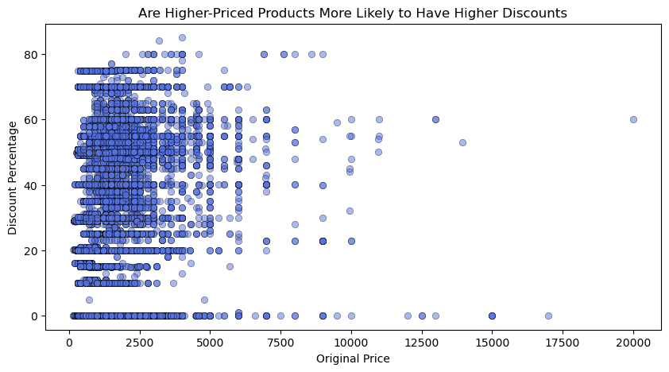
Discount Probability
Key Insights :
1. Discounts Are Widespread
Products across all price ranges receive discounts, but intensity varies. Heavy clustering between ₹500–₹5000 with discounts 20–60%.
2. Higher-Priced Products Show Significant Discounts Too
Premium items (₹10,000+) also receive 40–60% discounts, though fewer in number. Indicates brands push higher-priced inventory with aggressive markdowns.
3. No Strong Linear Relationship
Higher prices do not always mean higher discounts. Discounts are scattered across price bands, suggesting varied brand strategies.
4. Entry-Level Pricing Relies on Discounts
Majority of products under ₹5000 are heavily discounted (20–60%). Suggests discounting is critical for driving sales in mass-market segments.
Strategic Implications:
Luxury/Premium products: Discounting used selectively to move stock.
Mid-range products: Heavy reliance on discounts for competitiveness. Opportunity to explore non-price differentiation to reduce over-discounting.

Slide 15
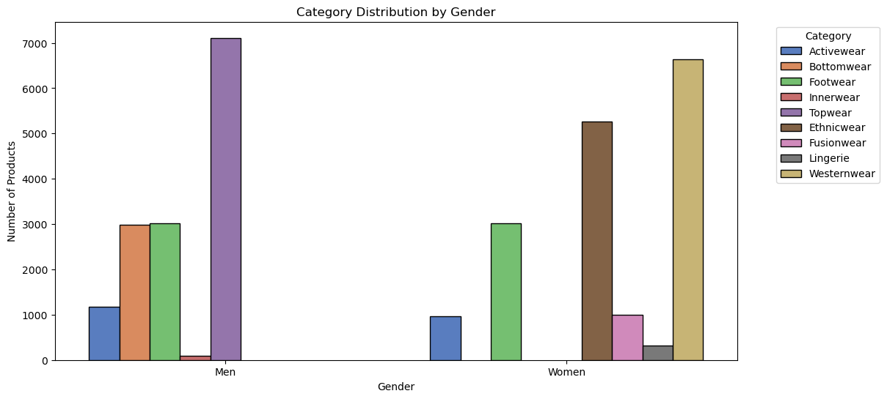
Category Distribution by Gender
Key Insights :
1. Men’s Categories
Topwear dominates with over 7000 products → largest category for men. Bottomwear & Footwear both have strong presence (~3000 products each).Other categories (Activewear, Innerwear) exist but at much lower volumes.
2. Women’s Categories
Westernwear (6600+) and Ethnicwear (5200+) dominate women’s fashion. Footwear equally strong (~3000 products), matching men’s.
Fusionwear (1000+) and Lingerie (400+) add diversity in women’s portfolio. Activewear and Innerwear present but comparatively smaller.
3. Cross-Gender Overlaps
Footwear & Activewear are common strong categories across genders.
Strategic Implications:
Menswear assortment is concentrated, suggesting scope to expand into diverse segments.
Womenswear assortment is broader, indicating higher product variety and fashion-driven demand.

Slide 16
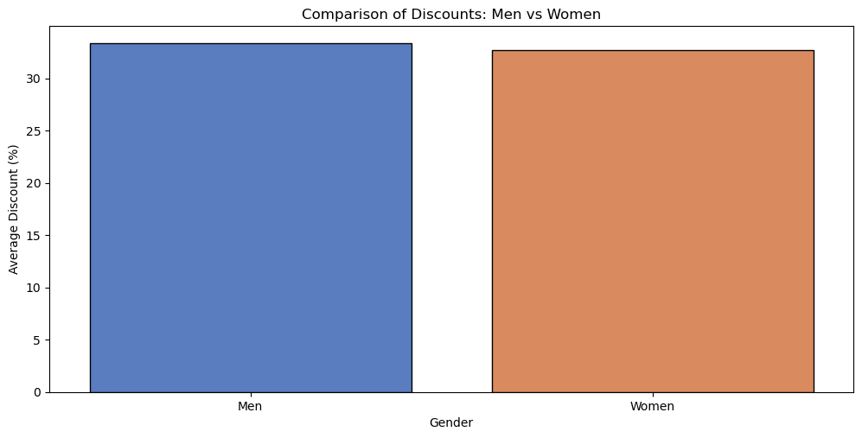
Comparison of Discount by Gender
Key Insights :
Nearly Equal Discounts
Men’s products receive an average discount of ~33%.
Women’s products receive a slightly lower average discount of ~32%.
Strategic Implication:
Pricing teams maintain gender-neutral discounting policies, focusing more on category & price band than gender.
Future opportunities could involve differentiated discounting for categories with higher gender-driven demand (e.g., Westernwear for women, Topwear for men).

Slide 17
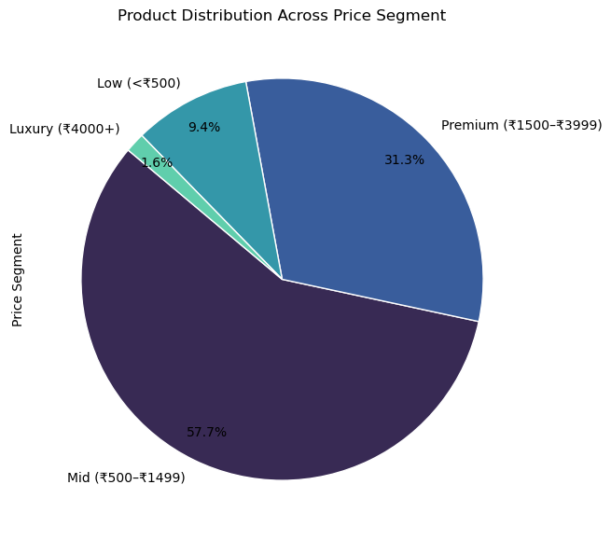
Product Distribution Across Price Segment
Key Insights :
1. Mid-Range Dominance
57.7% of products fall in the ₹500–₹1499 (Mid segment).
Indicates strong focus on affordable fashion catering to mass-market consumers.
2. Premium Segment Presence
31.3% of products priced between ₹1500–₹3999 (Premium segment). Suggests significant offering for aspirational buyers looking for higher perceived value.
3. Low Segment Contribution
Only 9.4% of products priced below ₹500.
Indicates that the brand/platform is not primarily targeting budget shoppers.
4. Luxury Segment is Niche
Just 1.6% of products fall in ₹4000+ Luxury segment.
Luxury positioning is minimal, suggesting limited focus on high-end fashion.
Strategic Implications:
Product portfolio is skewed towards mid-premium affordability. Opportunity to expand in low-price segment to capture price-sensitive shoppers.
Luxury remains underrepresented → could be a deliberate positioning choice or growth area.

Slide 18
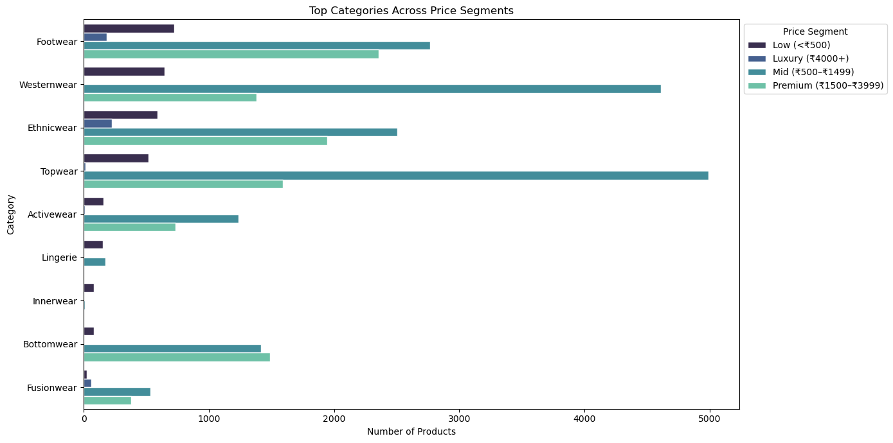
Top Categories Across Price Segment
Key Insights :
1. Mid-Segment Dominance Across Categories
Most categories (Topwear, Westernwear, Ethnicwear, Activewear, Bottomwear, Footwear) are heavily concentrated in the ₹500–₹1499 Mid segment.
2. Topwear & Westernwear Lead in Volume
Topwear (~5000 products) and Westernwear (~4200 products) dominate the assortment. Strong variety offered to capture everyday fashion needs.
3. Premium Presence in Select Categories
Premium pricing (₹1500–₹3999) is significant in Footwear, Ethnicwear, and Bottomwear. Suggests these categories attract aspirational buyers willing to spend more.
4. Limited Luxury Offering
Luxury products (₹4000+) exist mainly in Ethnicwear & Footwear, but volumes are very low. Reflects a niche positioning rather than mainstream strategy.
Strategic Implications:
Portfolio strategy is broad-based but affordability-focused.
Opportunity to expand premium in activewear & fusionwear where demand is emerging.

Slide 19
CONCLUSION
Optimize discount strategy: Offer strategic discounts on categories where sensitivity is high, without eroding brand value in premium segments.
Stock more of the categories / brands that attract highest customer interest.
Tailor inventory & marketing by gender preferences.
Price segmentation: Maintain budget/mid for volume, but promote premium with value messaging.
Use discount + brand + category data to plan promotions (which category/brand combos respond well).

