Slide 1
Growing Genomic Networks from the Desktop to the Cloud with R and Bioconductor
Shweta Gopaulakrishnan, BJ Stubbs, Peter Castaldi, John Platig, Vincent Carey
Channing Division of Network Medicine, Brigham and Women’s Hospital

Slide 2
Introduction

Slide 3
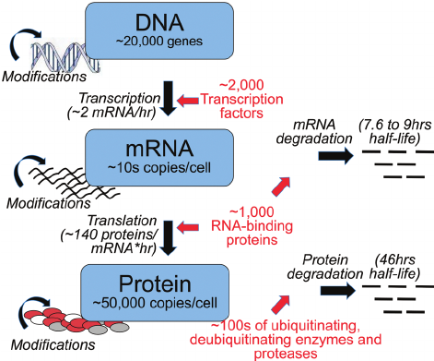
Genomic personalized medicine is the future, but achieving it requires detailed interpretation of human DNA sequence variation.
This interpretation requires uniting information from a variety of experiments in a meaningful and efficient way.
Notes:
Genomic personalized medicine is the future, but achieving it requires detailed interpretation of human DNA sequence variation.
You’re one of a kind. It’s not just your eyes, smile, and personality. Your health, risk for disease, and the ways you respond to medicines are also unique. Medicines that work well for some people may not help you at all. They might even cause problems. Wouldn’t it be nice if treatments and preventive care could be designed just for you?
The careful matching of your biology to your medical care is known as personalized medicine.
The story of personalized medicine begins with the unique set of genes you inherited from your parents. Genes are stretches of DNA that serve as a sort of instruction manual telling your body how to make the proteins and perform the other tasks that your body needs. These genetic instructions are written in varying patterns of only 4 different chemical “letters,” or bases.
The same genes often differ slightly between people. Bases may be switched, missing, or added here and there. Most of these variations have no effect on your health. But some can create unusual proteins that might boost your risk for certain diseases. Some variants can affect how well a medicine works in your body. Or they might cause a medicine to have different side effects in you than in someone else.
This is why although genomic personalized medicine is the future, we also know that it requires a detailed interpretation of human DNA sequence variation.
The figure here depicts the central dogma theory, that we all are aware of - flow of genetic information from DNA to proteins. we can see the vast multitude of events occurring at the cellular level, and hence interpretation of the DNA variations requires uniting information from a variety of experiments in a meaningful and efficient way.
story for genomic personalized medicine.
Effects of the DNA sequence variants are context-dependent, and overall interpretation involves networks of annotations assembled from many thousands of genome-scale experiments that evaluate:
DNA can be personalized to 20 million SNPs. mRNA patterns vary between tissues and overtime. Gene regulation is controlled by mole
- Protein-DNA binding,
- DNA accessibility, and
- Effects of variants on expression of nearby or remote genes

Slide 4
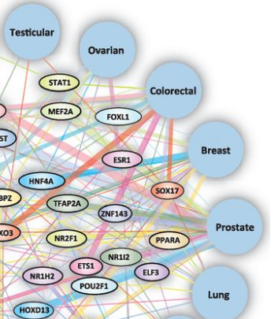
Biological networks are useful to understand human DNA sequence variation obtained from thousands of genome-scale experiments
Matthew T.Maurano, et al. Systematic Localization of Common Disease-Associated Variation in Regulatory DNA. Science. 2012; 337(6099):1190-1195.
Edge thickness represents the number of associations between TF and disease in DHSs in relevant tissues. Network is significantly enriched for overlap with disease-relevant GWAS SNPs, and include many well-studied regulators.⁽¹⁾
Notes:
take one part from colorectal to lung and cut that out.
change title font
Transcription Factors are proteins that bind to a DNA sequence in the promoter regions and facilitate certain chemical reactions.
The observation that GWAS variants associated with multiple distinct diseases within the same broader disease class (e.g., inflammation, cancer) repeatedly localize within the recognition sites of interacting transcription factors suggested that cohorts of such transcription factors might form shared regulatory architectures
how is the kind of network built ? then put the genomic ranges figure ....

Slide 5
CHALLENGE ?
A major challenge in constructing these networks is the massive volumes of annotation and experiment data in different formats.
Datasets :
Expression quantitative trait loci (eQTL) from Genotype-Tissue Expression (GTEx) project (39 Gib per tissue)
Transcription Factor data (606 Gib)
Annotation - FootPrint (115 MB), DNAse hypersensitivity data from ENCODE (8.1 GiB)
We describe a preliminary attack on synthesizing available annotation to build a network, to understand mechanisms of lung disease.
Notes:
Expression quantitative trait loci (eQTLs) are regions of the genome containing DNA sequence variants that influence the expression level of one or more genes. They are identified by studying a population of genetically different individuals . There are four main types of tissue: muscle, epithelial, connective and nervous. And so many subtypes…gtex 53 tissues ?
2. Transcription Factors are proteins that bind to a DNA sequence in the promoter regions and facilitate certain chemical reactions. The mapping between transcription factor names and their unique ids is provided in a separate file (see datasets below).
3. In genetics, DNase I hypersensitive sites (DHSs) are regions of chromatin that are sensitive to cleavage by the DNase I enzyme. In these specific regions of the genome, chromatin has lost its condensed structure, exposing the DNA and making it accessible.
a systematic approach to identify TF-occupied DNA from DNase I-seq data. Algorithms vary, but all rely on the detection of atypical cleavage patterns. Typically, TF-occupied DNA is protected from DNase I cleavage leaving a paucity of cleavages compared to flanking regions.
4. Footprinta short region of DNA within a DNase I hypersensitive site with a cleavage pattern consistent with protein occupancy. This pattern is classically-defined as a paucity of cleavage because protein-bound DNA is typically protected from DNase I cleavage.
Each market basket is uniquely identified by the following triple:
Species, whose mammary gland is being studied
Experiment, in which the discovery was made
Gene name for the gene in whose promoter regions the transcription factors are found.
The match between the (GeneName, Experiment, Species) triples and unique numeric market basket Ids is given a separate file (see datasets below).
Transcription Factors are proteins that bind to a DNA sequence in the promoter regions and facilitate certain chemical reactions. The mapping between transcription factor names and their unique ids is provided in a separate file (see datasets below).
Each market basket in this dataset is the list of transcription factors found to bind to the promoter region of a specific gene, of a specific species discovered in a specific experiment.
The dataset is used for frequent itemset mining tasks.
3.
Add annotation and experiment.
mention Gtex for eQTL. mention ENCODE.

Slide 6
Methods
Implementation & TESTING
Network Building

Slide 7
Software | R Package
MongoDB : A free and open-source cross-platform document-oriented database program Classified as a NoSQL database program, MongoDB uses JSON-like documents with schemas | mongolite : Fast and Simple 'MongoDB' Client for R
Apache Drill : Schema-free SQL Query Engine for Hadoop, NoSQL and Cloud Storage Drill supports a variety of NoSQL databases and file systems, including HBase, MongoDB, Amazon S3, local files, etc. | DrillR : Provides a R driver for Apache Drill which could connect to the Apache Drill Get result (in data frame) from the SQL query and check the current configuration status.
Google BigQuery : BigQuery is Google's fully managed, petabyte scale, low cost analytics data warehouse. An enterprise data warehouse that enables super-fast SQL queries using the processing power of Google's infrastructure | bigrquery : The bigrquery packages provides an R interface to Google BigQuery. It makes it easy to retrieve metadata about your projects, datasets, tables and jobs, and provides a convenient wrapper for working with bigquery from R

Slide 8
MongoDB / Apache Drill As Database Backend

Slide 9
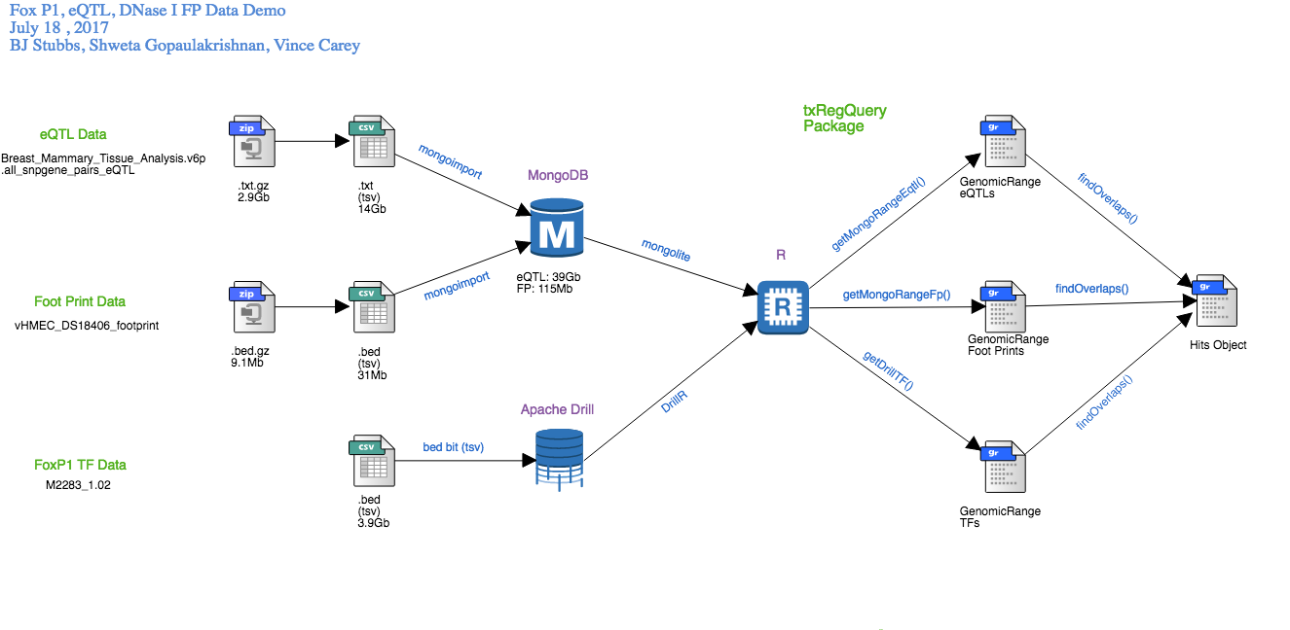
MongoDB works well for coordinate based searches, scales horizontally and supports flexible schemas
Drill is a distributed query engine for large scale datasets, scales to several thousand nodes and it can be used on flat files
Notes:
get a animation like buble to mention - mongo easier to distribute compared to mysql. easy for coordinate based searched using mongo. it scales horizontally, flexible schemas.
for drill - mongo like abilities for flatfiles ... can query anything
What is a .bed file ?
Since its founding in 2001 by a small group of investigators at DFCI, BWH, JHU and UC Berkeley, the Bioconductor project (www.bioconductor.org) has grown to involve over 500 developers on 4 continents, who share code over a common infrastructure based on the R statistical computing environment to enable efficient analysis of the newest genome-scale assays.

Slide 10
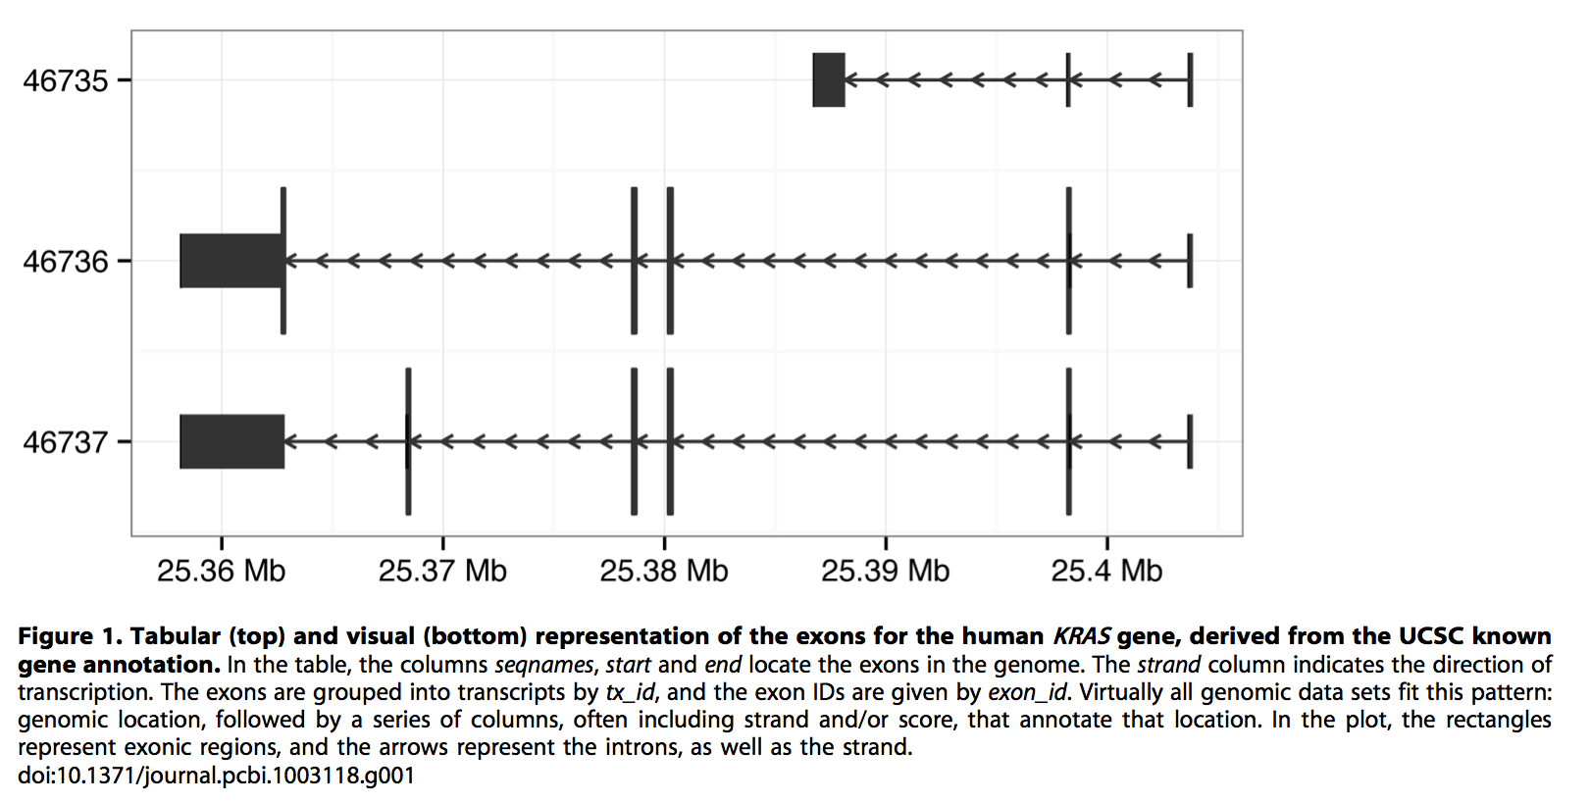
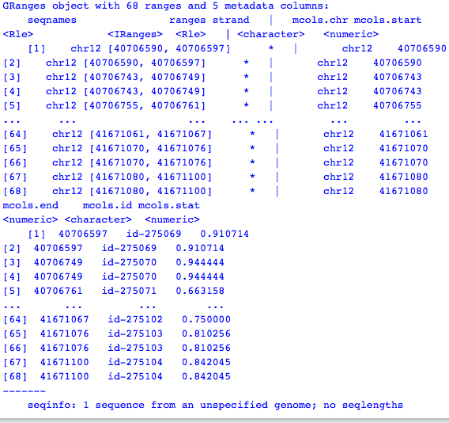
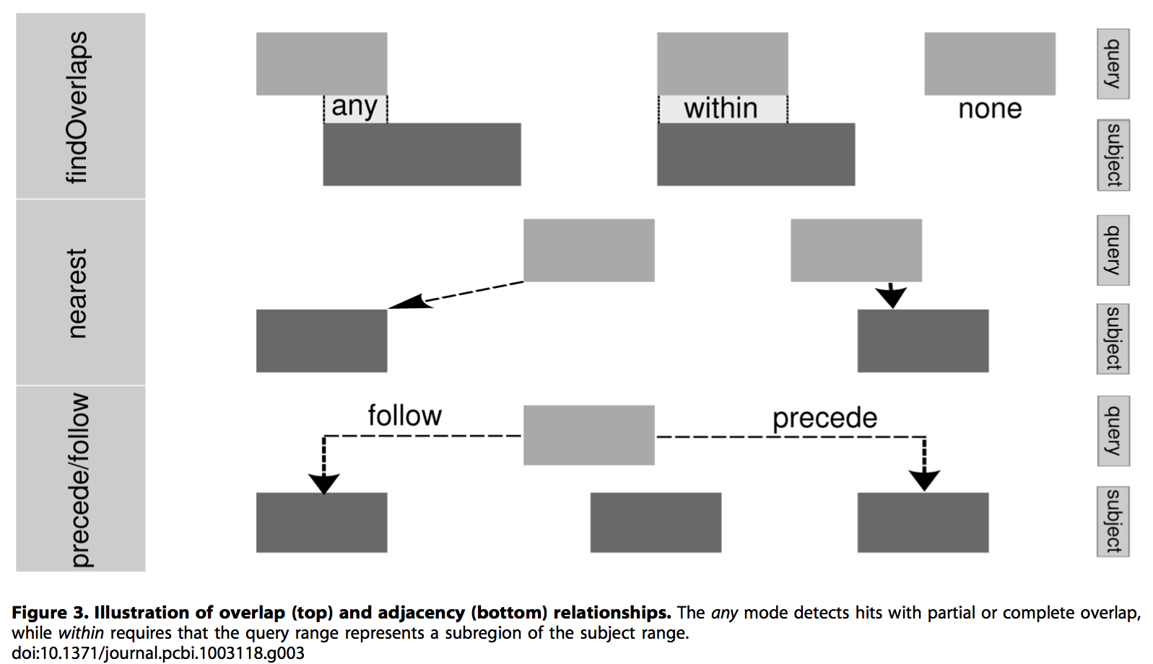
Human KRAS gene, derived from the UCSC known gene annotation.
GenomicRanges
⁽²⁾
findOverlaps()
Notes:
The genome is typically represented as a linear sequence, splitover multiple chromosomes, and data are linked to the genome by occupying a range of positions on the sequence. Consider the representation of human Kras gene here., for chromosome 12, we have different tracks for different annotations and boxes are exons and the arros are introns with the direction of transcription… x axiss how the location on the genome… all this can be represented efficiently using one object called the Granges as shown here – just go through this object once…. Virtually all genomic data sets fit this pattern – genomic location, followed by a series of columns, often including strand and/or score, that annotate that location.⁽² Now we have Granges for each type of our dataset and this makes it easier to findOverlaps (overlapping regions) between two or more datasets using the findOverlap() function …. That could be used as a base for developing nodes and eges to generate a graph and look at all the information in one glance.
Tabular(top), visual(bottom) representation of the exons for the human KRAS gene, derived from the UCSC known gene annotation.
seqnames, start, end locate the exons in the genome, strand indicates direction of transcription.
Virtually all genomic data sets fit this pattern – genomic location, followed by a series of columns, often including strand and/or score, that annotate that location.⁽²⁾

Slide 11
Google BigQuery As Remote Database Backend

Slide 12
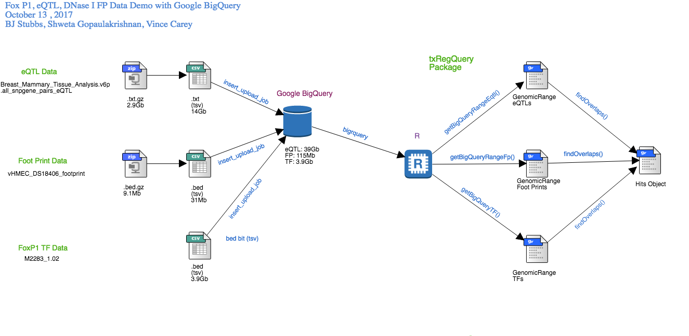
An enterprise data warehouse that enables super-fast SQL queries
G
Notes:
As data size grows, BigQuery adds more servers to the mix - keeping performance almost constant.
In other words, as your data grows you should expect costs to increase linearly, with performance staying almost constant. No indexes needed. And this is one of the big reasons why people choose BigQuery for their analytical workloads.
Google bigquery costs :
Storage$0.02 per GB, per month $0.01 per GB, per month for long term storageStreaming Inserts$0.01 per 200 MBLoading, Copying, or Exporting Data Metadata OperationsFree

Slide 13
Throughput of BigQuery & MongoDB as backend
Query eQTL MongoDB
Expr : my_collection$find(myquery)
my_collection : Breast_Mammary_Tissue_Analysis.v6p.all_snpgene_pairs_eQTL
Unit : seconds
Min(s) | Lq(s) | Mean(s) | Median(s) | Uq(s) | Max(s) | Neval(s)
3.7 | 4.12 | 4.27 | 4.3 | 4.4 | 5 | 5
Query eQTL BigQuery
Expr : (eqtl_tbl %>% filter(chr == mychr) %>% filter(snp_pos >= mystart) %>% filter(snp_pos <= myend) %>% as.data.frame())
File : Breast_Mammary_Tissue_Analysis.v6p.all_snpgene_pairs_eQTL
Unit : seconds
Min(s) | Lq(s) | Mean(s) | Median(s) | Uq(s) | Max(s) | Neval(s)
79 | 79 | 80.1 | 80 | 81 | 82.3 | 5
Detailed Results . . .

Slide 14
Network Building/Future
TxRegQuery is an R package that utilizes mongolite, GenomicRanges, and bigrquery to provide users with specialized tools for information access, retrieval from both MongoDB/Drill and BigQuery backends.
TxRegQuery makes it possible to extract data in the form of GRanges object, using functions like getMongoRangeEqtl(), getBigQueryRangeFp(), with the required arguments.
These objects can be filtered and intersected to create node-edge lists used in the formulation of regulatory networks.

Slide 15
TxRegQuery
getMongoRangeEqtl()
getMongoRangeFp()
findOverlaps()
eQTL GRanges
Footprint GRanges
Hits Object
Notes:
insert a slide for

Slide 16
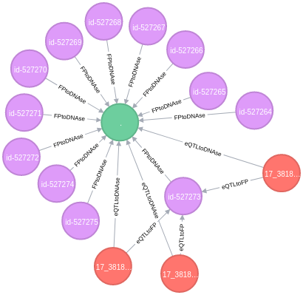
RARA-AS1
MSL1
GSDMA
Notes:
myoff=100*1000 mystartGo=38077296-myoff myendGo=38083884+myoff mychrGo=17
dnase hypersenstive region, we identified 12 eqtl regions,
ef=findOverlaps(myEQTL,myFP, type="any") ed=findOverlaps(myEQTL,myDNAse, type="any") et=findOverlaps(myEQTL,myTF, type="any")
mention gene names that they affect
Male Specific Lethal 1
Gasdermin A : Some strong eQTLs are also asthma susceptibility loci. For example, rs3859192 on chr17q21 is robustly associated with the mRNA levels of GSDMA (P = 3.55×10⁻¹⁵¹). ... The eQTLs and gene networks identified in this study are powerful tools for elucidating the causal mechanisms underlying pulmonary disease.
RARA Antisense RNA 1

Slide 17
These platforms were studied to get a broader understanding of local versus cloud computing storage needs, monetary costs, and performance characteristics.
TxRegQuery makes it possible to extract data in the form of GRanges objects, which can be filtered and intersected to create node-edge lists used in the formulation of and inference on regulatory networks.

Slide 18
REFERENCES
Matthew T.Maurano, et al. Systematic Localization of Common Disease-Associated Variation in Regulatory DNA. Science. 2012; 337(6099):1190-1195.
Lawrence M, Huber W, Page`s H, Aboyoun P, Carlson M, et al. (2013) Software for Computing and Annotating Genomic Ranges. PLoS Comput Biol 9(8): e1003118. doi:10.1371/journal.pcbi.1003118.

Slide 19


ACKNOWLEDGEMENTS
We would like to extend our thanks to :
NHLBI grants R01 HL118455, R01 HL086601, R01 HL124233 ,
NCI U01 CA214846-01 for supporting our work

Slide 20
Thank You!
QUESTIONS ?

