Slide 1
Evolution to an AI-Driven Intelligent Change Platform
Advancing innovation through smart automated solutions
Notes:
AI-generated content may be incorrect. ---

Slide 2
Change Platform Transformation Roadmap
Notes:
Transformation Journey Overview: From Manual to Intelligent, Current State: Manual, iCreate-Driven, and Duplicative, Phase 1 (L460 – 2026): Dashboarding, Initial Automation, and Impact Analysis, Phase 2 (L461 Expansion): Reusable Workflows and Event-Based Triggers, Phase 3: Legacy Vehicles, Service BOM, and Lifecycle Integration, Future State: AI-Driven Intelligent Change Platform

Slide 3

Transformation Journey Overview: From Manual to Intelligent
Current Challenges
Manual efforts and platform duplication cause inefficiencies, longer cycle times, and higher error risks.
Phase One: Transparency and Control
Introduce dashboards, automation, and impact analysis to enhance visibility and reduce manual tasks.
Phase Two: Standardized Workflows
Implement reusable workflows and event triggers for scalable, repeatable, and responsive change management.
Future State: AI-Driven Platform
AI enables automatic impact analysis, smart change execution, and predictive insights to optimize transformation.
Notes:
The transformation journey outlined in this roadmap represents a structured evolution from fragmented, manual change management practices to a unified, AI-driven intelligent change platform. At the highest level, the journey moves through clearly defined maturity stages, each designed to address specific pain points while building the foundation for the next phase. Today’s environment is characterized by heavy manual effort, dependence on iCreate, and duplicated activities across platforms such as 3DX and iCreate. This results in inefficiencies, increased cycle times, and higher risk of errors or inconsistencies in change execution. The roadmap addresses these challenges incrementally rather than through a disruptive, one-time overhaul. The first major shift focuses on introducing transparency and control through dashboarding, initial automation, and structured impact analysis. This phase emphasizes visibility—helping stakeholders understand what is changing, where, and with what potential impact—while also reducing basic manual work. The second phase expands these capabilities by introducing reusable workflows and event-based triggers. At this stage, change processes become more standardized, repeatable, and responsive, allowing the organization to scale change management efficiently across programs and platforms. Human intervention is still present, but it is increasingly guided by system-driven logic rather than ad hoc decision-making. The third phase extends modernization efforts to legacy vehicles by integrating Service BOMs and lifecycle data. This ensures that older platforms and products are not left behind and that change intelligence spans the full product portfolio. Finally, the future state represents a fundamental shift in how changes are created, analyzed, and executed. AI capabilities enable automatic impact analysis, smart change creation, and predictive insights that anticipate downstream effects before issues occur. Full decommissioning of iCreate becomes possible because its core functions are absorbed and enhanced within the intelligent platform. Overall, this journey balances risk, value delivery, and long-term vision, ensuring sustainable transformation rather than short-term optimization.

Slide 4

Current State: Manual, iCreate-Driven, and Duplicative
Manual and Fragmented Processes
Current change management relies heavily on manual actions and fragmented data across multiple tools, reducing efficiency and visibility.
Duplicative Efforts and Inconsistency
Engineers and coordinators duplicate evaluations in separate tools, causing wasted effort, inconsistent outcomes, and longer turnaround times.
Lack of Standardized Workflows
Variation in process execution across teams increases operational risk and introduces errors during manual handoffs.
Limited Innovation and Reactive Reporting
Dependence on existing systems limits innovation and results in retrospective reporting, causing delays and rework across functions.
Notes:
The current state of the change management ecosystem is heavily manual and largely driven by iCreate, with significant duplication of effort across iCreate and 3DX. Change creation, analysis, and execution often rely on individual expertise rather than system intelligence, making outcomes inconsistent and difficult to scale. Engineers and change coordinators frequently perform the same evaluations multiple times in different tools, leading to wasted effort and longer turnaround times. Because data and logic are fragmented across platforms, there is limited end-to-end visibility into the true impact of a change, especially when it spans multiple systems, products, or lifecycle stages. Another critical challenge in the current state is the lack of standardized workflows. While processes may be documented, actual execution varies widely across teams and programs. This variability increases operational risk, particularly when experienced resources are unavailable or when changes must be executed under tight timelines. Manual handoffs between systems also introduce opportunities for errors, such as missed dependencies, outdated data, or incorrect configurations. As product complexity increases, these risks compound, making the current model increasingly unsustainable. From a strategic perspective, continued dependence on iCreate limits innovation. Enhancements tend to focus on keeping the system operational rather than enabling new capabilities such as predictive analysis or intelligent automation. Reporting is often retrospective, meaning issues are identified after they have already caused delays or rework. This reactive posture affects not only engineering efficiency but also downstream functions such as manufacturing, service, and supply chain. In summary, the current state delivers basic functionality but at a high operational cost. It provides a clear baseline that justifies the need for a phased, technology-driven transformation toward a more intelligent, integrated, and future-ready change platform.

Slide 5

Phase 1 (L460 – 2026): Dashboarding, Initial Automation, and Impact Analysis
Dashboarding for Visibility
Dashboards provide consolidated, near-real-time views of change activities and key performance metrics.
Initial Automation Tasks
Automation targets repetitive, low-complexity tasks to reduce errors and free expert resources.
Structured Impact Analysis
Impact analysis assesses affected components to guide change management with consistent data models.
Change Management and Adoption
Early benefits build user confidence and momentum for deeper transformation in future phases.
Notes:
Phase 1 represents the foundational step in the transformation journey and is planned around the L460 timeline in 2026. The primary objective of this phase is to establish visibility, consistency, and early automation without introducing excessive disruption to existing operations. Dashboarding plays a central role by providing stakeholders with a consolidated view of change activities, statuses, and key metrics. Instead of relying on manual tracking or fragmented reports, teams gain near-real-time insights into change volume, bottlenecks, and cycle times. Initial automation in this phase targets high-effort, low-complexity tasks that consume significant manual time today. Examples include automated data synchronization between systems, standardized change templates, and rule-based validations that prevent incomplete or incorrect change submissions. While these automations may appear incremental, they collectively reduce human error and free up expert resources to focus on higher-value analysis and decision-making. A critical capability introduced in Phase 1 is structured impact analysis. Rather than relying solely on individual judgment, the system begins to assess which parts, documents, configurations, or downstream processes may be affected by a proposed change. Although this analysis may not yet be fully intelligent or predictive, it establishes a consistent framework and data model that later AI capabilities can build upon. Importantly, Phase 1 is as much about change management and adoption as it is about technology. By delivering quick, visible benefits, it builds confidence among users and creates momentum for deeper transformation in subsequent phases.

Slide 6
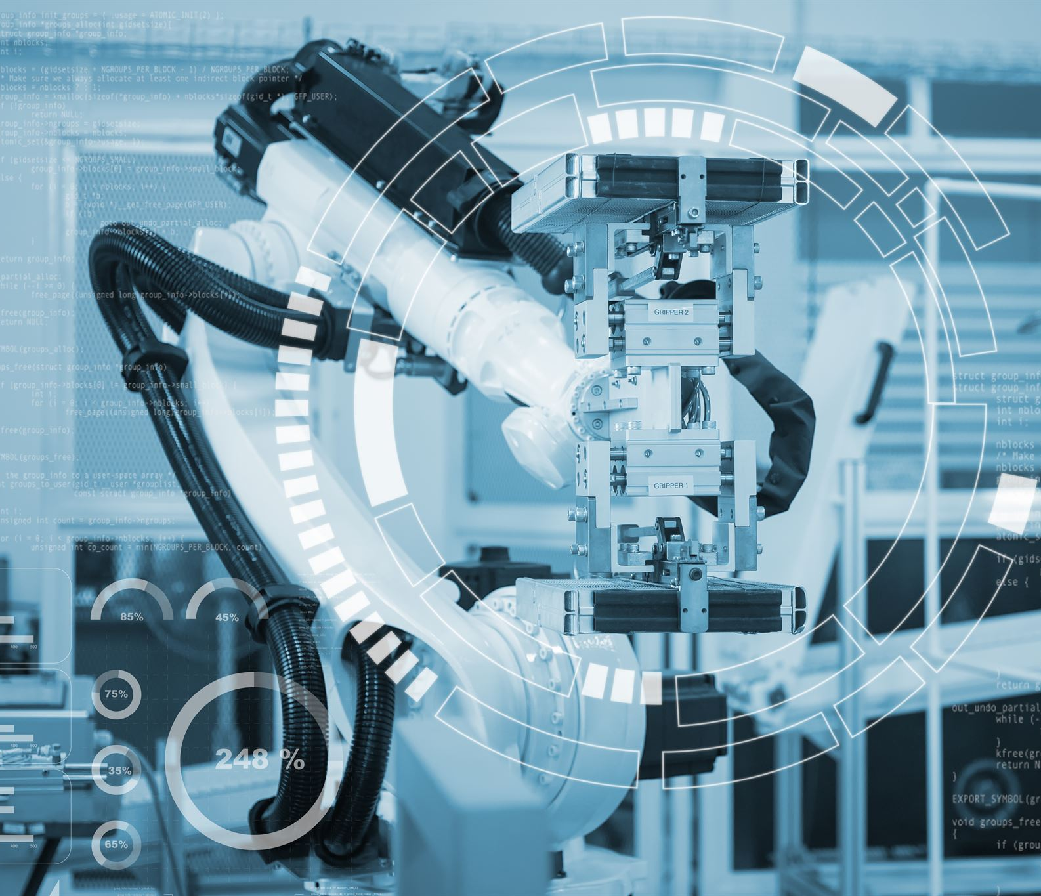
Phase 3: Legacy Vehicles, Service BOM, and Lifecycle Integration
Legacy Vehicle Integration
Phase 3 integrates legacy vehicles and historical data into modern change platforms to unify governance and intelligence.
Service BOM Integration
Integrating Service BOM provides comprehensive views of product configuration, servicing, and customer impacts.
Lifecycle Integration
Lifecycle integration connects product changes across development, production, service, and end-of-life stages.
Business and Technical Value
This phase reduces operational silos and enhances AI capabilities by expanding data depth and visibility enterprise-wide.
Notes:
Phase 3 addresses one of the most complex but essential aspects of the transformation: integrating legacy vehicles and historical data into the modern change platform. Many organizations struggle with a split landscape where new products benefit from advanced tools, while older platforms continue to rely on outdated processes. This phase ensures that legacy vehicles are brought into the same governance and intelligence framework through Service BOM and lifecycle integration. Service BOM integration enables a comprehensive view of how products are configured, serviced, and supported in the field. By linking change management directly to Service BOMs, the organization can assess not only design impact but also service, maintenance, and customer implications. Lifecycle integration further connects changes to different product stages, from development and production to service and end-of-life. This holistic perspective reduces the risk of unintended consequences and supports more informed decision-making. Technically, Phase 3 often involves complex data harmonization and integration efforts. However, the business value is substantial. Legacy products gain the same level of visibility, control, and analytical rigor as newer ones, reducing operational silos. This phase also strengthens the data foundation required for AI-driven capabilities by expanding the breadth and historical depth of change-related data. Ultimately, Phase 3 ensures that the intelligent change platform is truly enterprise-wide rather than limited to select programs or future products.

Slide 7

Future State: AI-Driven Intelligent Change Platform
AI-Powered Insight Generation
The platform actively assists users by generating insights, recommendations, and predictions beyond predefined rules.
Auto Impact Analysis
Utilizes historical data and patterns to identify downstream effects and anticipate risks early in the change lifecycle.
Smart Change Creation
AI-driven suggestions guide users on affected items, workflows, approvals, and timing to optimize change management.
Unified Data-Driven Platform
Decommissioning legacy systems to achieve a scalable, intelligent platform that supports strategic decisions and growth.
Notes:
The future state represents a paradigm shift from automated processes to an AI-driven intelligent change platform. In this state, the system does not merely execute predefined rules but actively assists users by generating insights, recommendations, and predictions. Auto impact analysis becomes a core capability, leveraging historical data, relationships, and patterns to identify downstream effects with a high degree of confidence. This allows teams to anticipate risks and trade-offs early in the change lifecycle rather than reacting after issues emerge. Smart change creation further transforms user interaction with the platform. Instead of manually defining every aspect of a change, users are guided by AI-driven suggestions for affected items, workflows, approvals, and timing. Predictive insights enable scenario analysis, such as forecasting potential delays, cost implications, or quality risks associated with different change options. These capabilities elevate change management from an operational function to a strategic decision-support capability. A critical outcome of this future state is the full decommissioning of iCreate. Its functionalities are not only replaced but significantly enhanced within the intelligent platform, reducing system complexity and maintenance overhead. More importantly, the organization achieves a unified, data-driven approach to change that scales with product complexity and business growth. The intelligent change platform becomes a competitive advantage, enabling faster innovation, higher quality, and more resilient operations across the entire product lifecycle.

