Slide 1

iCreate Transformation Roadmap: Toward Intelligent Change Management
Strategic steps for effective organizational transformation
Notes:
AI-generated content may be incorrect. ---

Slide 2
Context and Need for Transformation
Notes:
iCreate Transformation Vision and Objectives, Current Landscape and Operational Challenges

Slide 3

iCreate Transformation Vision and Objectives
Legacy System Challenges
Legacy manual systems create duplicated effort and risk inconsistency outside the native 3DX workflow.
Phased Transformation Approach
The roadmap introduces a phased, low-risk evolution aligned with vehicle milestones starting with L460.
Integrated Intelligent Ecosystem
Vision for an event-driven, scalable change management system integrated tightly with 3DX.
Automation and Data-Driven Decisions
Incremental automation builds confidence while enabling real-time visibility and AI-assisted intelligence.
Notes:
The iCreate Transformation Roadmap is driven by a clear business need to reduce dependency on a legacy, manually intensive system while ensuring continuity for ongoing vehicle programs. iCreate has historically played a critical role in change management by providing BOM intelligence, instance awareness, and structured data capture. However, it operates outside the native 3DX workflow, leading to duplicated effort, reduced adoption, and increased risk of inconsistency. The objective of this transformation is not to abruptly replace iCreate, but to introduce a phased, low-risk evolution that aligns with upcoming vehicle milestones, starting with L460. The vision is to move toward an intelligent, event-driven change management ecosystem that is tightly integrated with 3DX, scalable across vehicle lines, and capable of supporting both current and future enterprise requirements. This roadmap prioritizes continuity for Model Year 30 deliveries, ensures service-level obligations are met for legacy vehicles, and introduces automation incrementally to build confidence and adoption. By positioning iCreate as a capability set rather than a single tool, the transformation focuses on preserving what works today—such as BOM awareness and structured approvals—while eliminating manual duplication and external dependencies. Over time, this approach enables data-driven decision-making, real-time visibility, and a foundation for AI-assisted change intelligence, ultimately supporting a controlled and sustainable retirement of iCreate.

Slide 4

Current Landscape and Operational Challenges
Fragmented Workflows and Duplication
Engineers duplicate data between 3DX and iCreate, causing longer cycle times and increased data mismatch risks.
Embedded Knowledge Challenges
Critical iCreate logic is embedded user knowledge, making its removal difficult without disrupting workflows.
Limited Automation Adoption
Existing automation tools have low adoption due to usability issues and application-specific constraints.
Lack of Unified Reporting
No enterprise-wide dashboard provides real-time insights into change status, bottlenecks, or program impacts.
Notes:
The current change management landscape is characterized by fragmented workflows and heavy reliance on manual intervention. Engineers primarily work within 3DX for part modifications, EBOM updates, and engineering changes, but must then replicate much of this information in iCreate to complete the formal change process. This duplication increases cycle time and introduces opportunities for data mismatch. Additionally, iCreate’s logic around part instances, suffixes, and version availability is embedded knowledge that users rely on, making immediate removal impractical. Existing automation such as macros or native utilities has seen limited adoption due to usability constraints and the need to work within specific applications. From a reporting perspective, while dashboards exist in isolation—such as Celonis or internal change dashboards—there is no unified, enterprise-approved view that provides real-time insight into change status, bottlenecks, or program-level impact. Furthermore, the absence of event-based triggers means that changes are reactive rather than proactive, relying on users to manually initiate downstream actions. These challenges collectively highlight why iCreate continues to persist, but also why a structured transformation is essential to support upcoming vehicle programs without increasing operational risk.

Slide 5
Strategic Vision and Phased Approach
Notes:
Target-State Vision for Intelligent Change Management, Phased Transformation Strategy

Slide 6
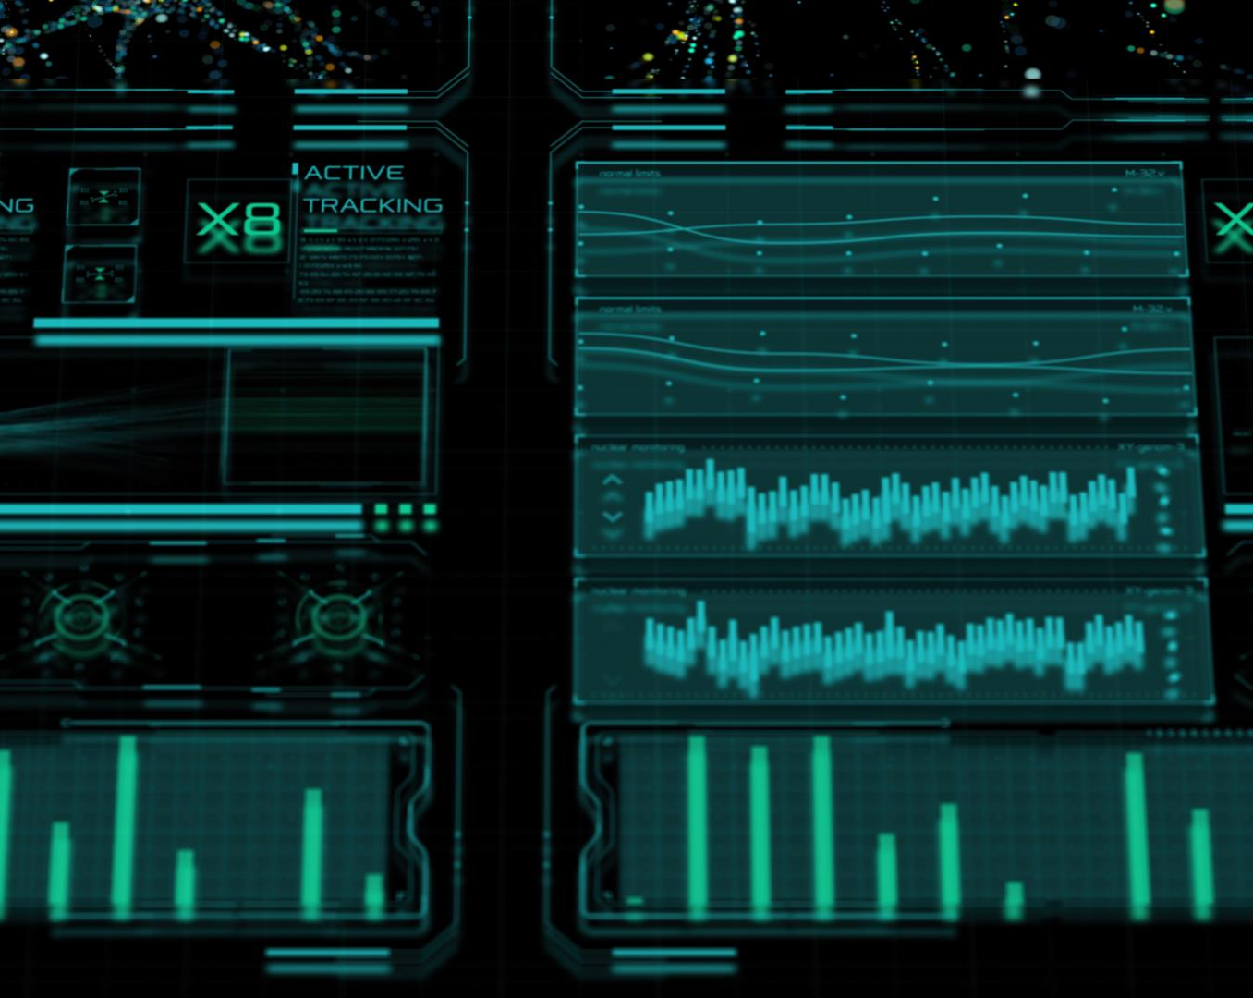
Target-State Vision for Intelligent Change Management
Integrated Intelligent Platform
A seamless platform integrates change management within the 3DX ecosystem while ensuring governance compliance.
Event-Driven Automation
Automated event-driven workflows connect change initiation, impact analysis, approvals, and reporting without manual handoffs.
Proactive Impact Identification
The system detects changes in parts and EBOM updates, highlighting impacted vehicle lines and downstream artifacts proactively.
Flexible AI-Enabled Transition
Gradual embedding of AI-assisted recommendations supports safe transition and flexible configuration across programs.
Notes:
The target-state vision for change management is an integrated, intelligent platform that operates seamlessly within the 3DX ecosystem while meeting enterprise governance standards. In this future state, change initiation, impact analysis, approval workflows, and reporting are connected through event-driven automation rather than manual handoffs. When a part revision changes or an EBOM structure is updated, the system proactively identifies impacted instances, vehicle lines, and downstream artifacts. Users are guided through structured workflows that reduce cognitive load and reliance on tribal knowledge. Enterprise dashboards provide a single source of truth, consolidating data from 3DX, Snowflake, and EDP4E to deliver program-level visibility and actionable insights. Importantly, this vision acknowledges that different vehicle programs have different maturity levels and constraints. Therefore, flexibility and configurability are key design principles. By embedding intelligence gradually—starting with rules-based automation and progressing toward AI-assisted recommendations—the organization can transition safely while maintaining delivery commitments. This vision sets the foundation for retiring iCreate not as a forced change, but as a natural outcome of superior, integrated capabilities.

Slide 7

Phased Transformation Strategy
Incremental Capability Introduction
Capabilities are introduced incrementally, aligning with vehicle program timelines and organizational readiness for smoother adoption.
Phase-Specific Focus Areas
Each phase targets specific vehicle programs and legacy systems to ensure controlled implementation and scalability.
Value Delivery and Feedback
Each phase delivers tangible value such as reduced manual effort and improved visibility, with clear checkpoints for stakeholder feedback.
Alignment with Business Milestones
The strategy aligns technical delivery with business goals to minimize disruption and support change management adoption.
Notes:
A phased transformation strategy is essential to balance innovation with operational stability. Rather than attempting a big-bang replacement of iCreate, the roadmap introduces capabilities incrementally, aligned with vehicle program timelines and organizational readiness. Phase 1 focuses on L460, a single-plant vehicle, allowing controlled implementation and rapid learning. Phase 2 expands these capabilities to L461 and similar programs, emphasizing reuse and scalability. Phase 3 addresses legacy and non–U-BOM vehicles, incorporating service BOM and long-term support considerations. Finally, Phase 4 delivers enterprise-wide intelligent change management, enabling full iCreate decommissioning. Each phase delivers tangible value on its own, such as reduced manual effort or improved visibility, while also building toward the long-term vision. This approach minimizes disruption, supports change management adoption, and provides clear checkpoints for stakeholder feedback. By aligning technical delivery with business milestones, the phased strategy ensures that transformation supports, rather than threatens, program delivery.

Slide 8
Program-Based Rollout Roadmap
Notes:
Phase 1 – L460 Rollout (Current Year), Phase 2 – Expansion to L461 and Similar Programs, Phase 3 – Legacy and Service Vehicle Support

Slide 9
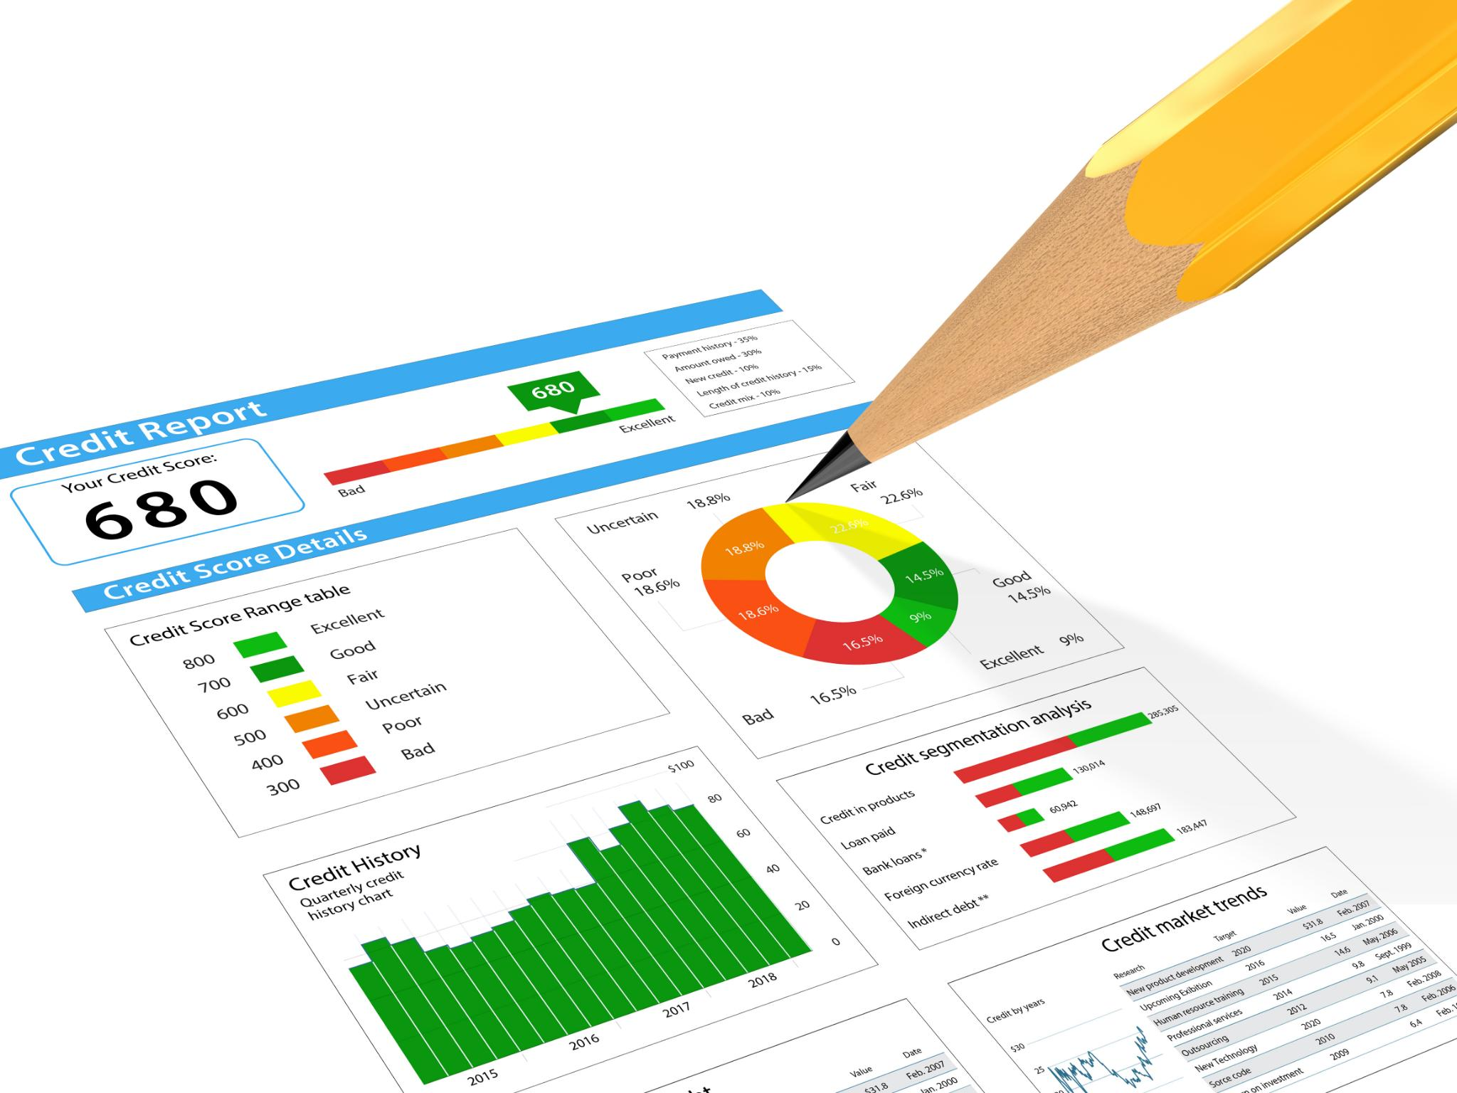
Phase 1 – L460 Rollout (Current Year)
iCreate-Independent Change Flow
Phase 1 aims to enable change processes independent of iCreate, reducing complexity for the L460 single-plant vehicle program.
Smart Change Creation
Introducing smart change creation tools to enhance structured change management and improve visibility during the rollout.
Enhanced Dashboarding
Dashboards provide quick wins by improving transparency and delivering immediate value to stakeholders without disrupting workflows.
Impact Analysis Capability
Initial capability for impact analysis supports informed decision-making and design refinements for future phases.
Notes:
Phase 1 centers on enabling an iCreate-independent change flow for the L460 program within the current year, aligned to Model Year 30 milestones. As a single-plant vehicle, L460 provides an ideal environment to validate new approaches with reduced complexity. Key deliverables include a smart change creation concept, enhanced dashboarding, and an initial impact analysis capability. The goal is not full automation, but sufficient capability to demonstrate that core iCreate functions—such as structured change creation and visibility—can be supported through integrated tools. Dashboards act as a quick win, offering immediate value to stakeholders by improving transparency without disrupting existing processes. Lessons learned from L460 will inform design refinements and adoption strategies for subsequent phases. Success in this phase establishes confidence that future releases can be supported without increasing reliance on iCreate.

Slide 10

Phase 2 – Expansion to L461 and Similar Programs
Scaling and Standardization
Phase 2 expands capabilities from L460 to L461 and similar programs focusing on reuse and standardization.
Data Platform Integration
Integration with Snowflake and EDP4E enhances consolidated reporting and cross-program insights.
Automation of Approvals
Improved automation reduces manual coordination through automated approvals and notifications.
Broader Organizational Adoption
Demonstrating minimal customization reinforces solution viability for wider adoption across programs.
Notes:
Phase 2 focuses on scaling proven capabilities from L460 to L461 and other similar vehicle programs. At this stage, emphasis shifts from validation to reuse and standardization. Change templates, impact analysis logic, and dashboards are extended to support multiple programs while maintaining configurability for program-specific rules. Integration with enterprise data platforms such as Snowflake and EDP4E becomes more prominent, enabling consolidated reporting and cross-program insights. This phase also introduces improved automation around approvals and notifications, reducing manual coordination. By demonstrating that the solution can operate across programs with minimal customization, Phase 2 reinforces the viability of the transformation and prepares the organization for broader adoption.

Slide 11

Phase 3 – Legacy and Service Vehicle Support
Legacy Vehicle Challenges
Legacy and non-U-BOM vehicles require continuous service despite production ending, posing unique support challenges.
Service BOM and Parts Tracking
Robust management of service BOMs and parts replacement tracking ensures seamless support and lifecycle data management.
Transformation Strategy Impact
Extending change management to service scenarios reduces manual workarounds and decreases reliance on legacy tools like iCreate.
Notes:
Phase 3 addresses the unique challenges associated with legacy and non–U-BOM vehicles, where production may have ended but service obligations continue under defined contracts. These programs require robust handling of service BOMs, parts replacement tracking, and long lifecycle data management. The transformation strategy incorporates these needs by extending change management capabilities to cover service-specific scenarios, ensuring continuity without reintroducing manual workarounds. This phase is critical to reducing long-term dependency on iCreate, as legacy support is often cited as a reason for retaining the tool. By demonstrating that service and legacy requirements can be met within the new ecosystem, Phase 3 closes a major gap in the transformation roadmap.

Slide 12
Solution Architecture and Capabilities
Notes:
Smart Change Builder and Event-Based Automation, Impact Analysis, Dashboarding, and AI Readiness

Slide 13

Smart Change Builder and Event-Based Automation
Simplified Change Creation
Smart Change Builder standardizes change creation with drag-and-drop EBOM and automated document attachment.
Event-Based Automation
Automated triggers handle downstream processes like part revisions without manual intervention, ensuring smooth workflows.
Improved Data Quality and Efficiency
Structured workflows improve data quality, accelerate cycle times, and increase adoption within integrated environments.
Notes:
The Smart Change Builder is a core capability designed to simplify and standardize change creation while reducing manual effort. Implemented as a web-based interface or 3DX widget, it enables users to drag and drop EBOM structures, automatically attach supporting documents, and initiate approvals. Event-based automation underpins this capability, ensuring that key actions—such as part revisions or EBOM updates—trigger downstream processes without user intervention. Together, these features replicate and enhance essential iCreate functionality within an integrated environment. By guiding users through structured workflows and leveraging system events, the Smart Change Builder improves data quality, accelerates cycle time, and increases adoption. Over time, these rule-based automations provide a foundation for more advanced intelligence.

Slide 14

Impact Analysis, Dashboarding, and AI Readiness
Comprehensive Impact Analysis
Impact analysis tool maps part usage across EBOMs and vehicle lines to assess change scope before execution.
Real-time Dashboard Insights
Dashboards consolidate change status, cycle times, and bottlenecks to provide stakeholders real-time visibility.
AI-Ready Data Integration
Integration with Snowflake and EDP4E ensures scalable, compliant data infrastructure ready for AI enhancements.
Progressive AI Adoption
Machine learning models predict change risk, suggest impacted areas, and recommend optimal actions based on trusted data.
Notes:
Impact analysis and enterprise dashboarding are critical enablers of informed decision-making. The proposed impact analysis tool identifies where a part is used across EBOMs, vehicle lines, and instances, allowing engineers to understand the full scope of a change before execution. Dashboards consolidate this information with change status, cycle times, and bottlenecks, providing real-time visibility to stakeholders. Integration with Snowflake and EDP4E ensures enterprise compliance and scalability. Importantly, these capabilities are designed with AI readiness in mind. As data quality and coverage improve, machine learning models can be introduced to suggest impacted areas, predict change risk, and recommend optimal actions. This progressive enhancement ensures that AI adoption is grounded in reliable data and trusted workflows.

Slide 15
Value, Timeline, and Conclusion
Notes:
Business and Technical Benefits, Roadmap Timeline and Strategic Conclusion

Slide 16
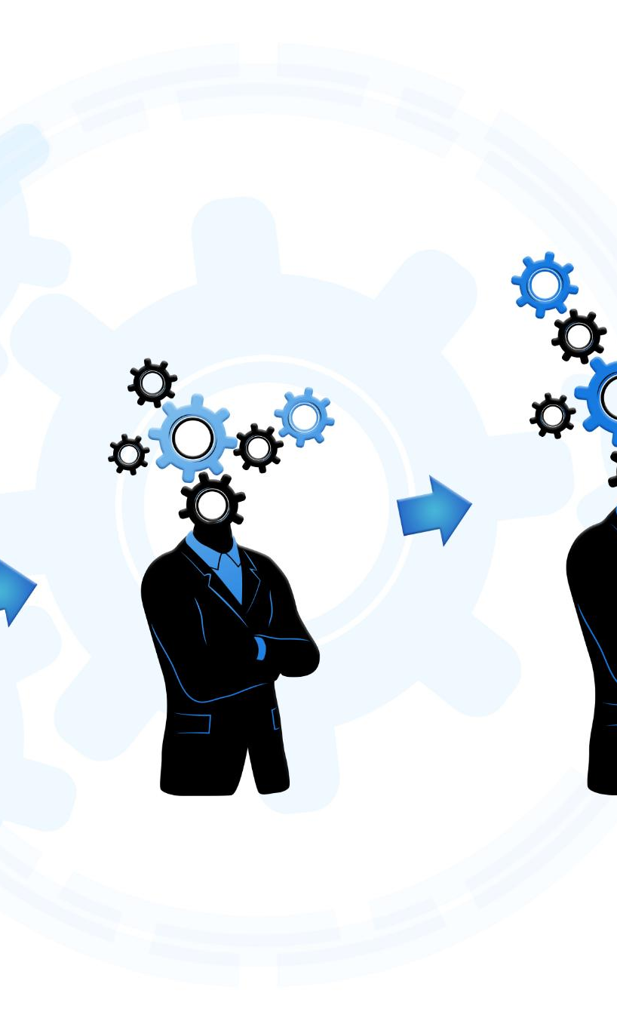
Business and Technical Benefits
Business Efficiency Gains
Reduced manual effort and faster change cycles lead to significant cost savings and improved delivery confidence.
Enhanced Decision-Making
Improved visibility supports better decision-making and proactive risk management for business success.
Technical Integration Benefits
Event-driven workflows improve data consistency and reduce system fragmentation across technical environments.
Scalability and Maintenance
Standardized templates and reusable components lower maintenance overhead and support system scalability.
Notes:
The transformation delivers clear business and technical benefits at each stage. From a business perspective, reduced manual effort and faster change cycles translate directly into cost savings and improved delivery confidence. Enhanced visibility supports better decision-making and proactive risk management. Technically, the shift toward integrated, event-driven workflows improves data consistency and reduces system fragmentation. Standardized templates and reusable components lower maintenance overhead and support scalability. By aligning benefits with each phase, the roadmap ensures that value is realized early and sustained over time, reinforcing stakeholder support.

Slide 17

Roadmap Timeline and Strategic Conclusion
Initial Focus on L460
Current year priorities include delivering POC capabilities, dashboards, and beginning automation for L460.
Expansion to L461 and Integration
Next year focuses on expanding coverage to L461 and enhancing enterprise integration and workflow automation.
AI-Assisted Intelligence and iCreate Decommissioning
Future goals include AI-assisted intelligence and complete decommissioning of iCreate as capabilities mature.
Strategic Conclusion
Building a scalable foundation starting with L460 enables a confident transition to an intelligent change management ecosystem.
Notes:
The roadmap timeline reflects a pragmatic balance between urgency and stability. In the current year, focus remains on L460, delivering POC-level capabilities, dashboards, and initial automation. The following year expands coverage to L461 and additional programs, strengthening enterprise integration and workflow automation. Beyond that, AI-assisted intelligence and full iCreate decommissioning become achievable outcomes rather than aspirational goals. In conclusion, iCreate will continue to play a role in the short term, but its dependency will reduce steadily as integrated capabilities mature. By starting with L460 and building a scalable foundation, the organization can transition confidently toward an intelligent change management ecosystem that supports both present needs and future innovation.

