Slide 1
IMAGE CAPTION BOT

Slide 2

Motivation
What do you see in the picture ?
Human :
A guy eating a pizza.
A young guy in a black shirt is sitting in a restaurant.
Have you ever thought of generating a caption of images thought computer machines which could be very useful in various real world problems such as-
Aid to blind people
Self driving cars
Google image search
Describing CCTV cameras

Slide 3
Introduction
Caption model relies on 2 main components.
CNN (Convolution Neural Network) – To recognize object of the image(features)
RNN (Recurrent Neural Network) – To process the sequential data (generating sequence of words)
Merging these 2 components will give the model which can predict the caption of any given image. End-to-end system is trained to maximize the likelihood of target description for given image.
State of the art – Microsoft Caption Bot, NVIDIA device for blind. Dataset – Flicker8k Motivation from Machine Translation: encoder RNN and decoder RNN. Encoder RNN is replaced by CNN.

Slide 4
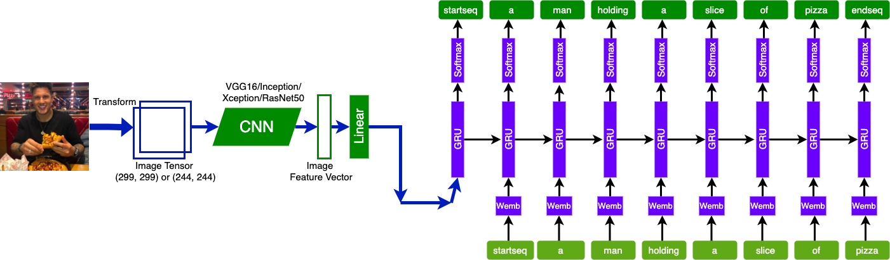
Model
Models used for feature extraction(CNN) - Xception/InceptionV3/VGG16/ResNet50
Captioning model(RNN) – LSTM/GRU
Sentence generation approach – Greedy Search, Beam Search(k3)

Slide 5
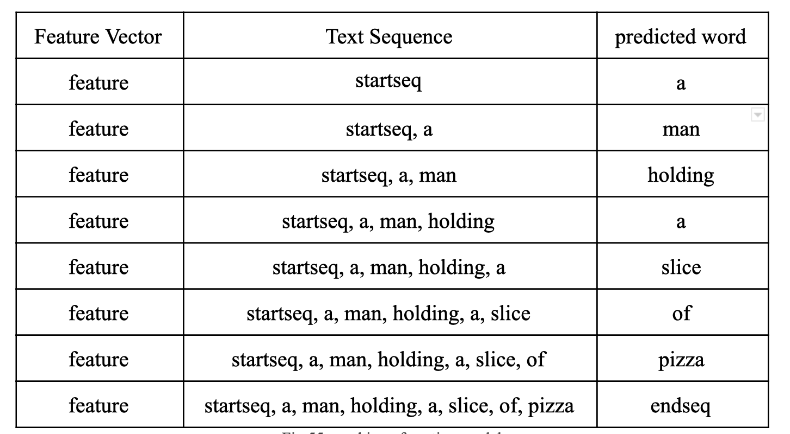
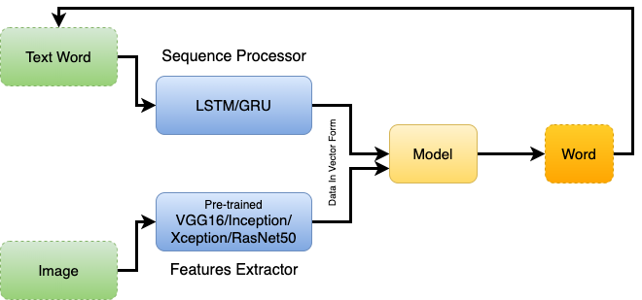
Sequence Generation

Slide 6
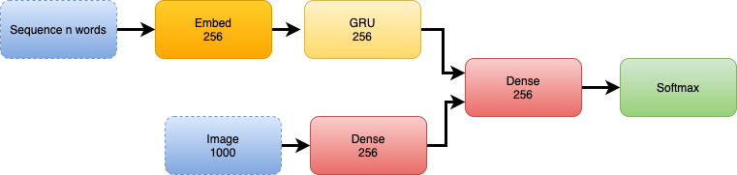
Training details
Training Images - 6000,
Validation Images - 1000
Training captions - 30000
Validation Captions - 5000
Length of largest caption of training - 40
Training vocabulary Size - 7378
Batch size - 64
Steps per epoch for training - 94
Steps per epoch for validation - 16
Epoch - Different for all the models

Slide 7
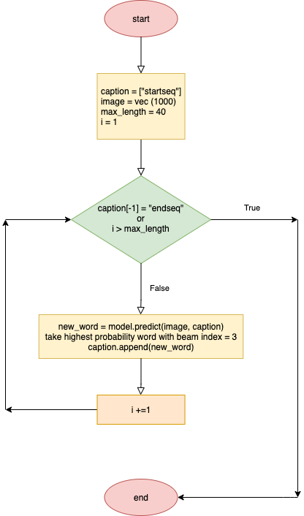
Model testing
Same set of operations as training
Features Extraction using CNN
Passing those features and “Startseq” to the predict function of model.
Use beam search or greedy search to select the most probable next word
This process will be repeated until reaches the max caption length or find “endseq”

Slide 8
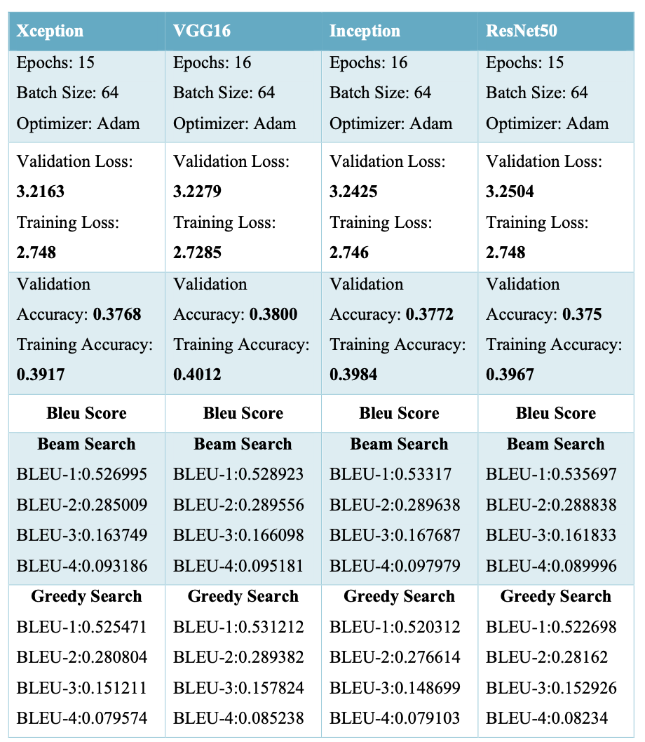
Evaluation –
Model is save based on the Validation loss.
For checking the sentence accuracy Bleu score is generated on the test dataset.
The graphs of loss and accuracy I would to show on the UI with more details.

Slide 9
