Slide 1
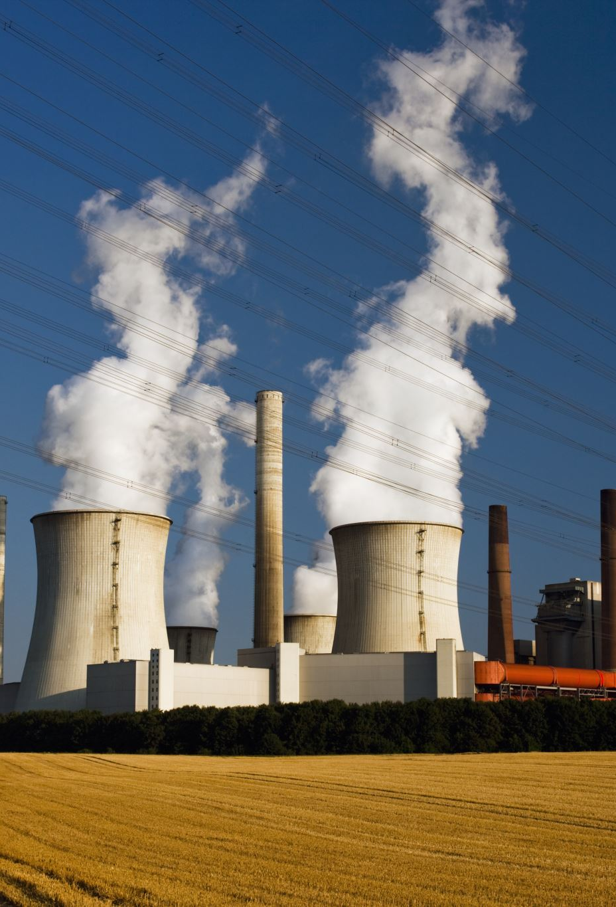
Generating Electricity: Renewables & Non-Renewables
Shweta Jain
Mohsen Farrokhrouz
Oliver King

Slide 2

Project Goals
To analyse electricity-generation trends:
Compare and contrast different approaches to electricity generation around the world.
Use forecasts to determine the global electricity outlook:
Specifically, the growth of renewable electricity production.

Slide 3

Analysis
Analyse electricity-generation trends:
Power BI and Tableau-based interactive dashboard for 48 countries.
Forecast the Australia/global electricity outlook:
Using machine-learning to model and forecast:
Growth of Renewable-based electricity-generation globally.
Renewables and Non-Renewables electricity-generation in Australia

Slide 4
Analysis (Part 2 / 2)
Forecast the global electricity outlook:
Using machine-learning to model and forecast:
Growth of Renewable-based electricity-generation globally.
Renewables and Non-Renewables electricity-generation in Australia
Solar-based electricity-generation in Australia.

Slide 5

Approach
Cleanse data (Extract, Transform, Load)
Export data into database (PostgreSQL)
Retrieve data from database (SQLAlchemy)
Develop interactive dashboard (Power BI & Tableau)
Develop machine-learning model to predict and forecast electricity outlook (ARMA, ARIMA, SARIMA, LSTM)
1
Source data
2
3
4
5
6

Slide 6

1. Source Data
Title | Format | Source | Data Frequency
Electricity Generation (by Generation-type and Country) | CSV | International Energy Agency (IEA) | Monthly
Population (by Country) | CSV | World Bank | Annual
GDP (by Country) | CSV | World Bank | Annual
Continent/Region/Country/Country Code | CSV | GitHub user: “lukes” (via Kaggle) | Single

Slide 7

2. Cleanse Data (Extract, Transform, Load)
Undertook process to clean, normalize and standardize data in preparation for modelling:
Read in multiple CSV files from various open sources
Removed countries with insufficient/null data points from MES_0123.csv, GDP.csv continents2.csv and population.csv
Standardised all datasets with 3-digit country codes (ISO 3166-1)
Transformed GDP and Population data (from annual to monthly)
Python functions used:
Used melt function to convert to one date per row for each country.
Used reindex to rearrange the columns
Used rename function to rename columns
Used drop function to drop columns
Used lambda function to calculate the difference between current column value with previous values
Used merge function to merge the datasets

Slide 8
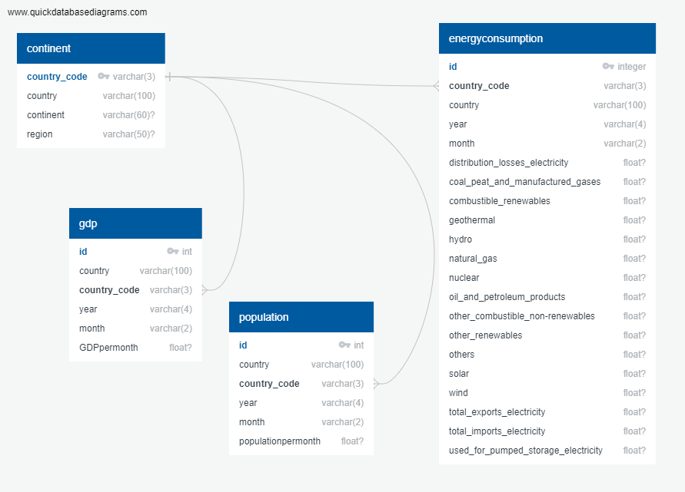
3. Export data into database (PostgreSQL)
Create tables
Import CSV data
Join on standardised 3-digit "Country Code"
4. Retrieve data from database
(SQLAlchemy)
Create engine
Connect to local host (.gitignore password)
Read in data for modelling

Slide 9

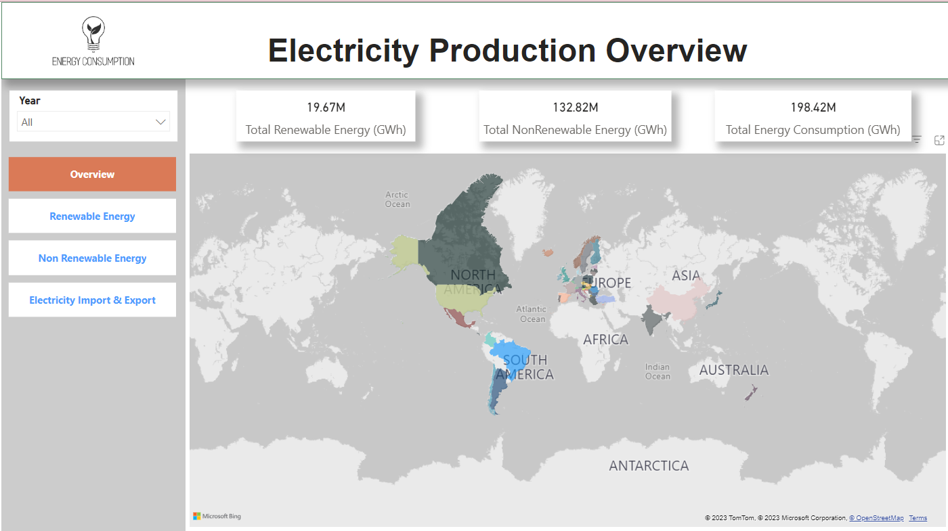
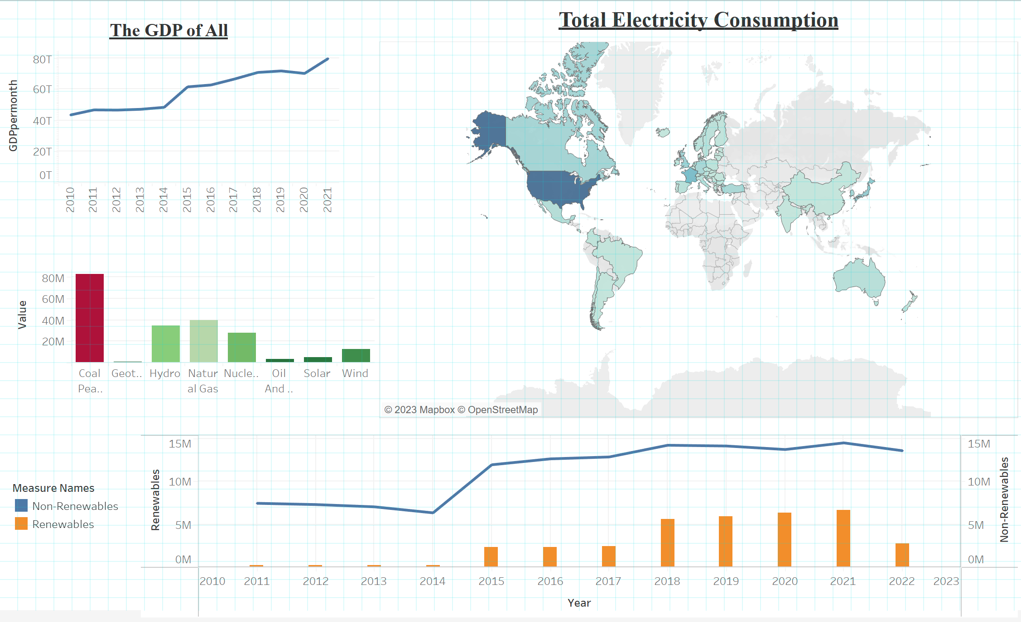
5. Visualization
PowerBI
Tableau

Slide 10
5. Develop Interactive Dashboard (Tableau)
Purpose of dashboard (what does it tell user).
Why each element has been included.
Technical Features.
Skills and processes used.
Use of the map layers, filters, new measures, combined charts.
Multiple data sources used and creating the relationship between each.

Slide 11
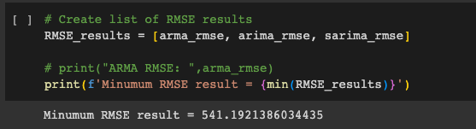
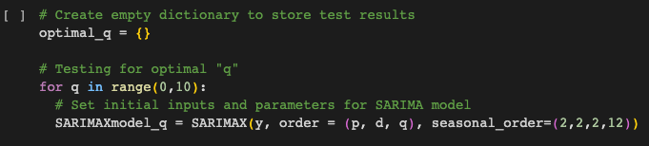
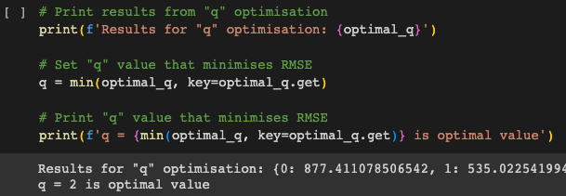
6. Develop Machine-Learning Model
OVERVIEW:
Developed a time-series model:
Time is the independent variable (x-axis)
Opted for “ARMIA family” of time-series model;
3 types: ARMA, ARIMA, SARIMA models
Determine best of these - lowest error (RMSE)
Use “For Loop” to iterate through model inputs:
This determines input combination that minimises RMSE
Resulting “optimised” model should produce lower error measure.
… let’s see the results

Slide 12
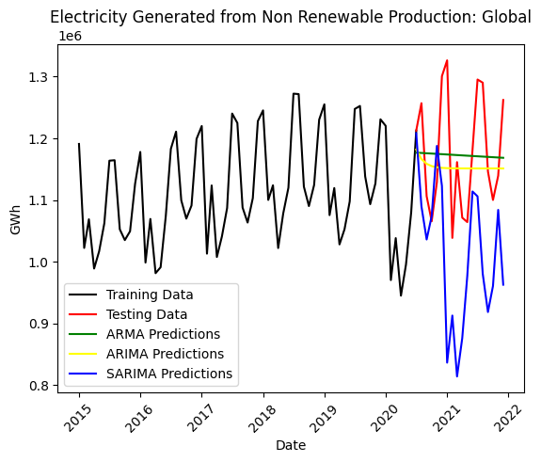
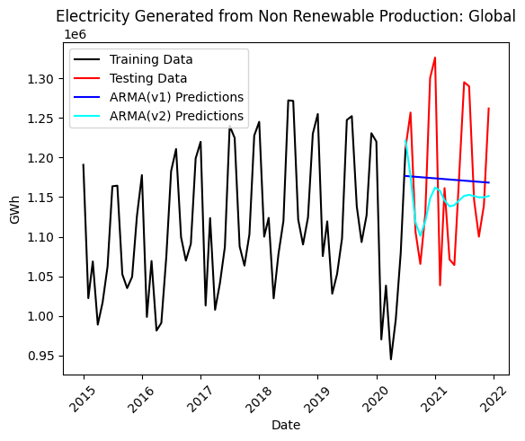
Machine-Learning Model: # 1
Electricity Generated from Non-Renewable Production: Global
Select Model-type:
Tested each model type:
2. Optimise:
Run ’for loop’ on range of p, d, q inputs:
Model Type | RMSE
ARMA | 91,579
ARIMA | 93,053
SARIMA | 209,550
Model Type | RMSE
ARMA (v1) | 91,579
ARMA (v2) optimised | 87,669

Slide 13
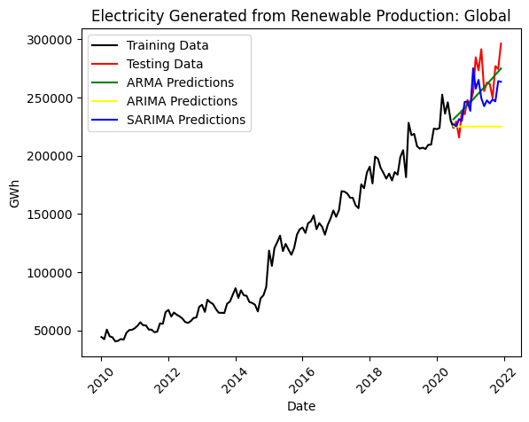
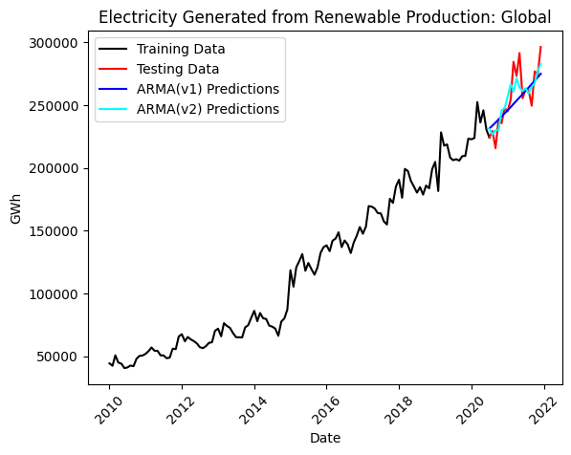
Machine-Learning Model: # 2
Electricity Generated from Renewable Production: Global
Select Model-type:
Tested each model type:
2. Optimise:
Run ’for loop’ on range of p, d, q inputs:
Model Type | RMSE
ARMA | 15,229
ARIMA | 38,725
SARIMA | 18,686
Model Type | RMSE
ARMA (v1) | 15,229
ARMA (v2) optimised | 11,995

Slide 14
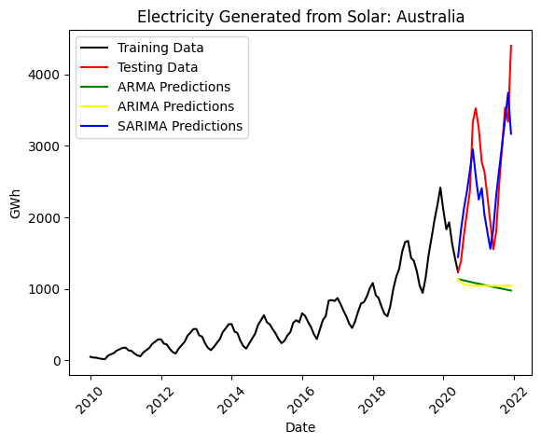
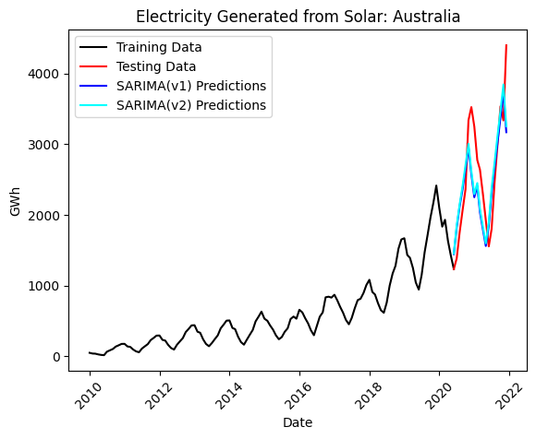
Machine-Learning Model: # 3
Electricity Generated from Solar Production: Australia
Select Model-type:
Tested each model type:
2. Optimise:
Run ’for loop’ on range of p, d, q inputs:
Model Type | RMSE
ARMA | 1,738
ARIMA | 1,733
SARIMA | 541
Model Type | RMSE
SARIMA (v1) | 541
SARIMA (v2) optimised | 531

Slide 15
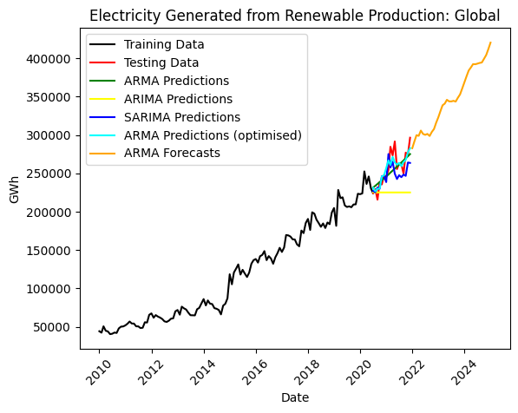
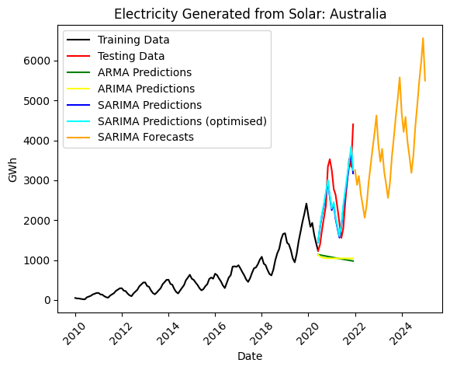
Machine-Learning Model: ARMA, ARIMA and SARIMA

Slide 16
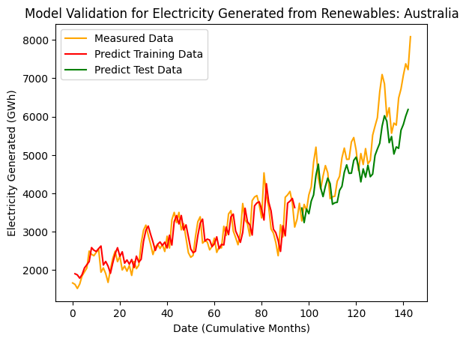
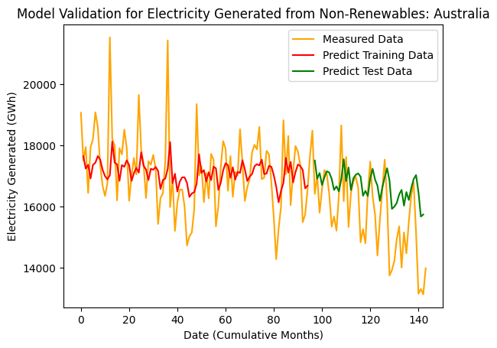
Machine-Learning Model: LSTM

