Slide 1
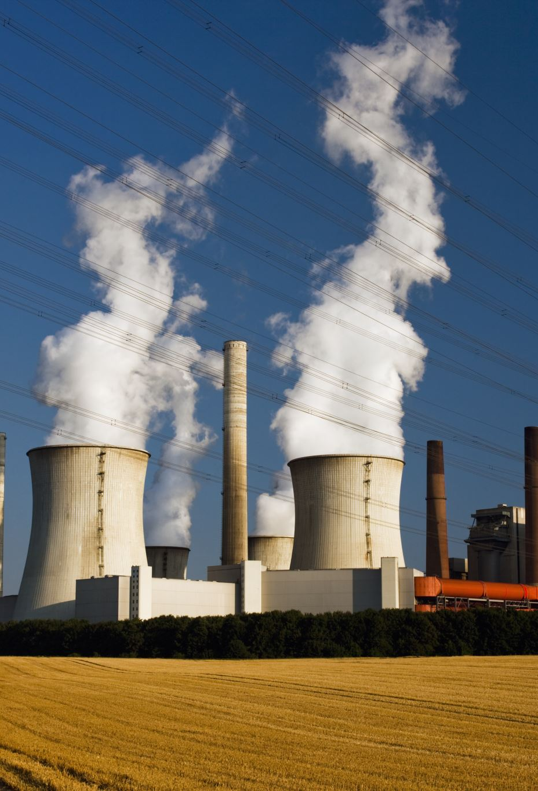
Electricity Production: Trends & Forecasts Renewables & Non-Renewables
Shweta Jain
Mohsen Farrokhrouz

Slide 2

Project Goals
To analyse electricity-generation trends:
Compare and contrast different approaches to electricity generation around the world.
Use forecasts to determine the global electricity outlook:
Growth of global renewable electricity production in next 3 years
Growth of renewable and non-renewable electricity for Australia in next 3 years

Slide 3

Analysis
Analyse electricity-generation trends:
Power BI and Tableau-based interactive dashboard for 48 countries.
Forecast the Australia/global electricity outlook:
Using machine-learning to model and forecast:
Growth of Renewable-based electricity-generation globally.
Renewables and Non-Renewables electricity-generation in Australia

Slide 4

Approach
Cleanse data (Extract, Transform, Load)
Export data into database (PostgreSQL)
Retrieve data from database (SQLAlchemy)
Develop interactive dashboard (Power BI & Tableau)
Develop machine-learning model to predict and forecast electricity outlook (ARMA, ARIMA, SARIMA, LSTM)
1
Source data
2
3
4
5
6

Slide 5

2. Cleanse Data (Extract, Transform, Load)
Undertook process to clean, normalize and standardize data in preparation for modelling:
Read in multiple CSV files from various open sources
Removed countries with insufficient/null data points from MES_0123.csv, GDP.csv continents2.csv and population.csv
Standardised all datasets with 3-digit country codes (ISO 3166-1)
Transformed GDP and Population data (from annual to monthly)
Python functions used:
Used melt function to convert to one date per row for each country.
Used reindex to rearrange the columns
Used rename function to rename columns
Used drop function to drop columns
Used lambda function to calculate the difference between current column value with previous values
Used merge function to merge the datasets

Slide 6
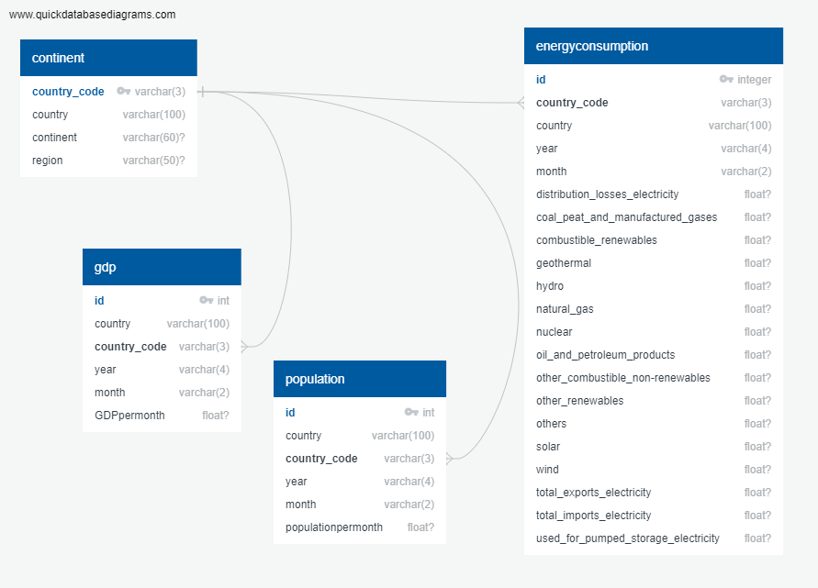
3. Export data into database (PostgreSQL)
Create tables
Import CSV data
Join on standardised 3-digit "Country Code"
4. Retrieve data from database
(SQLAlchemy)
Create engine
Connect to local host (.gitignore password)
Read in data for modelling

Slide 7

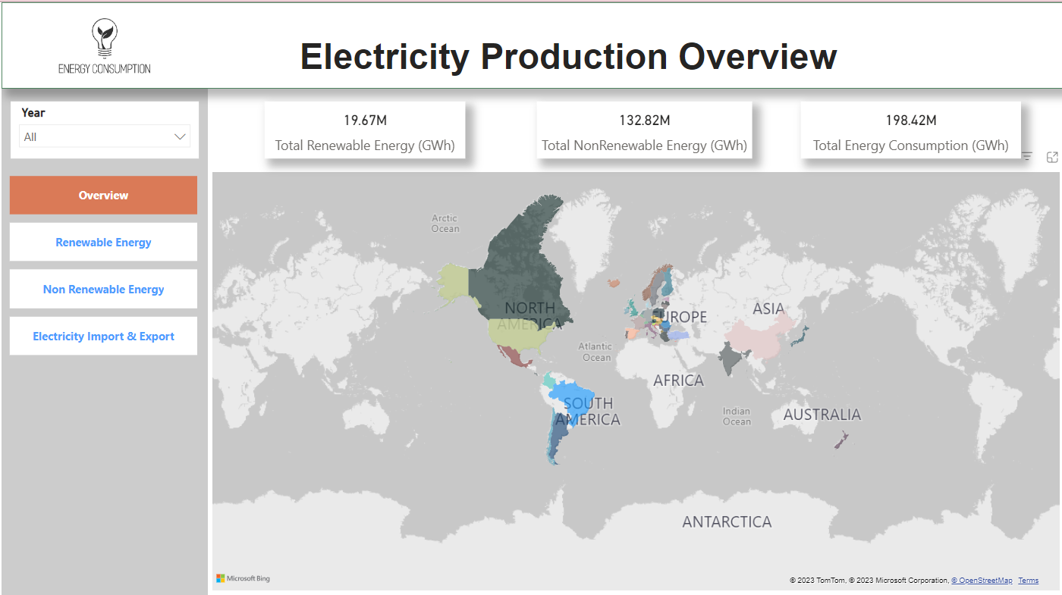
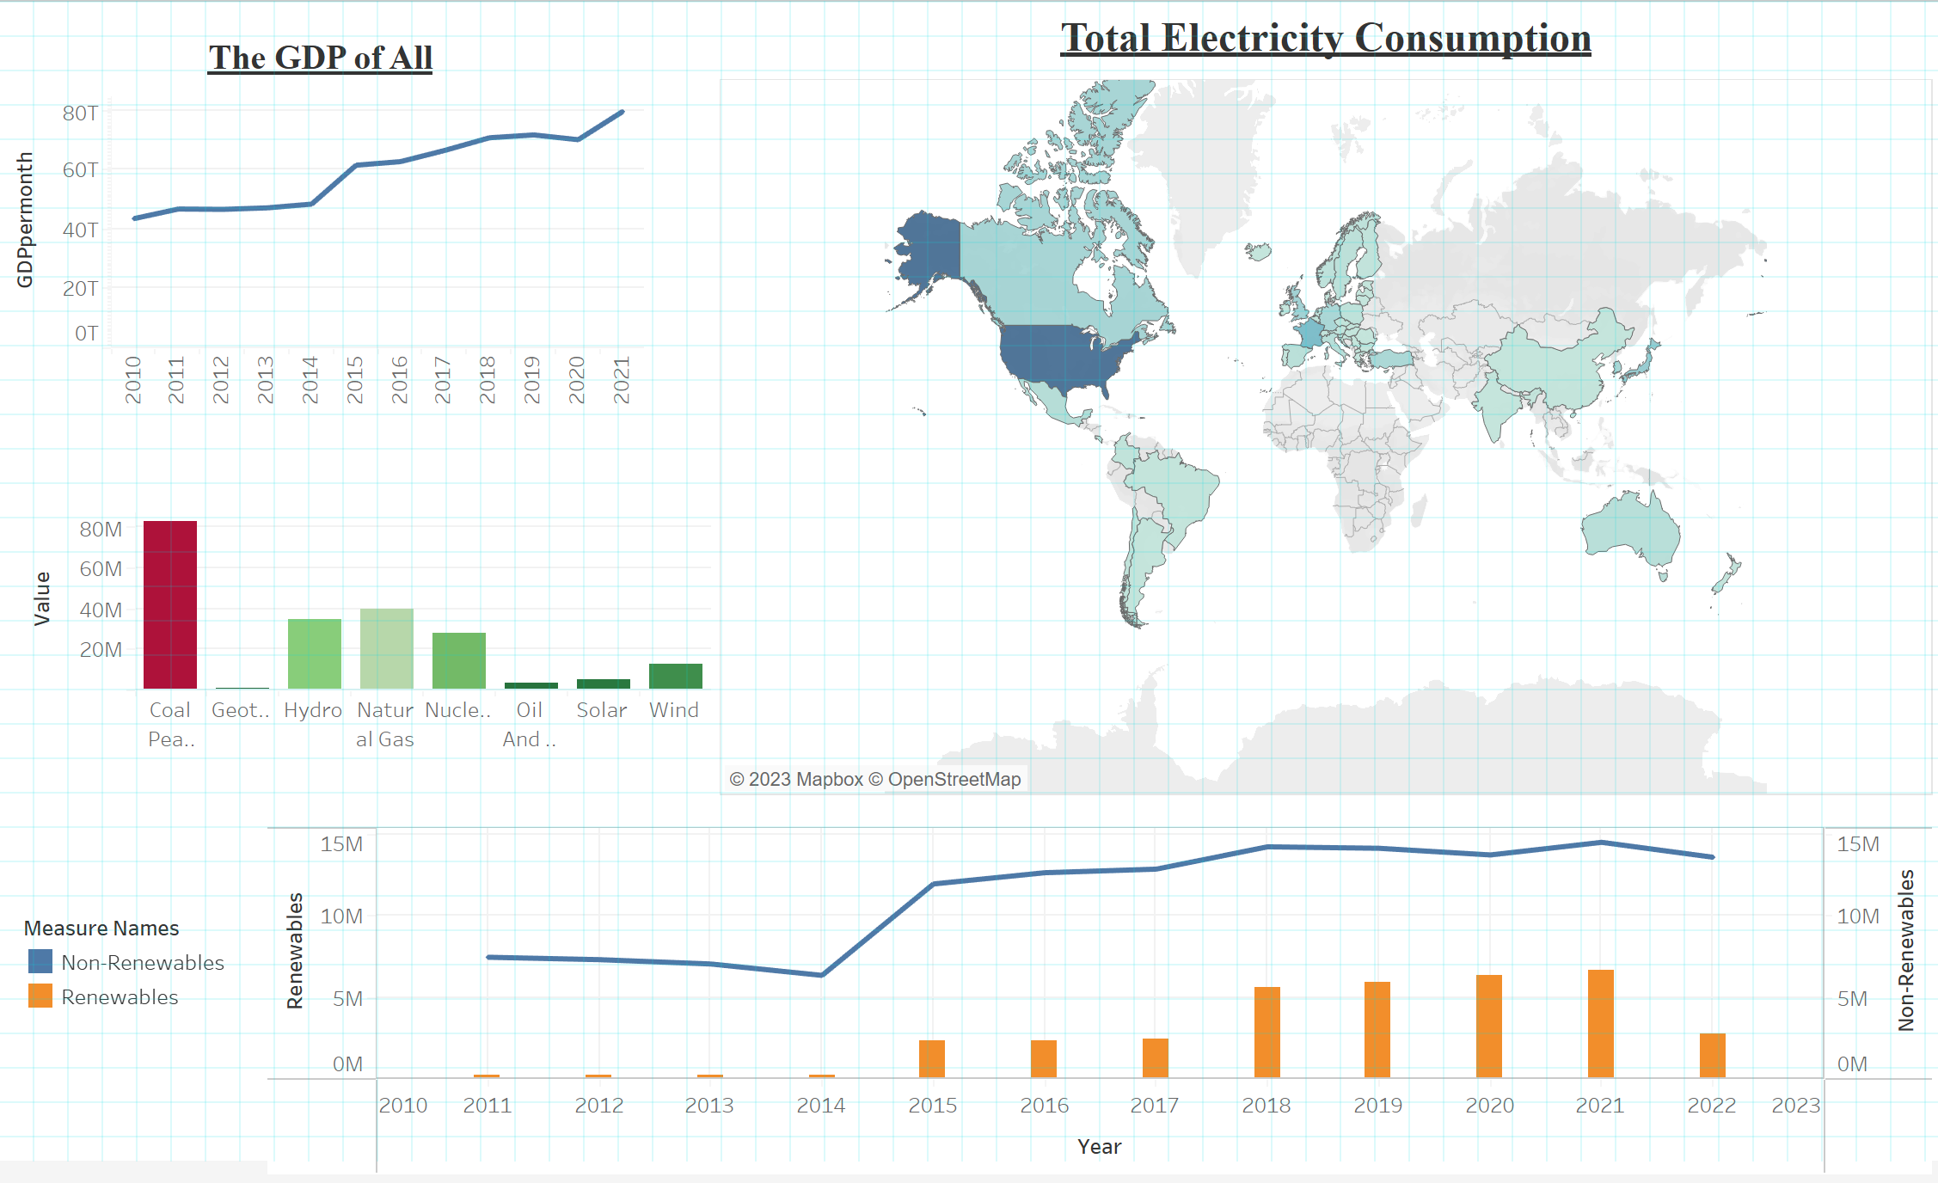
5. Visualization
PowerBI
Tableau

Slide 8
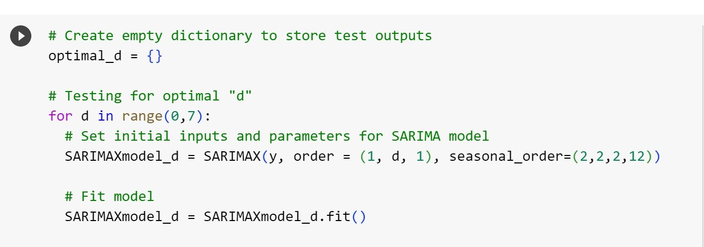
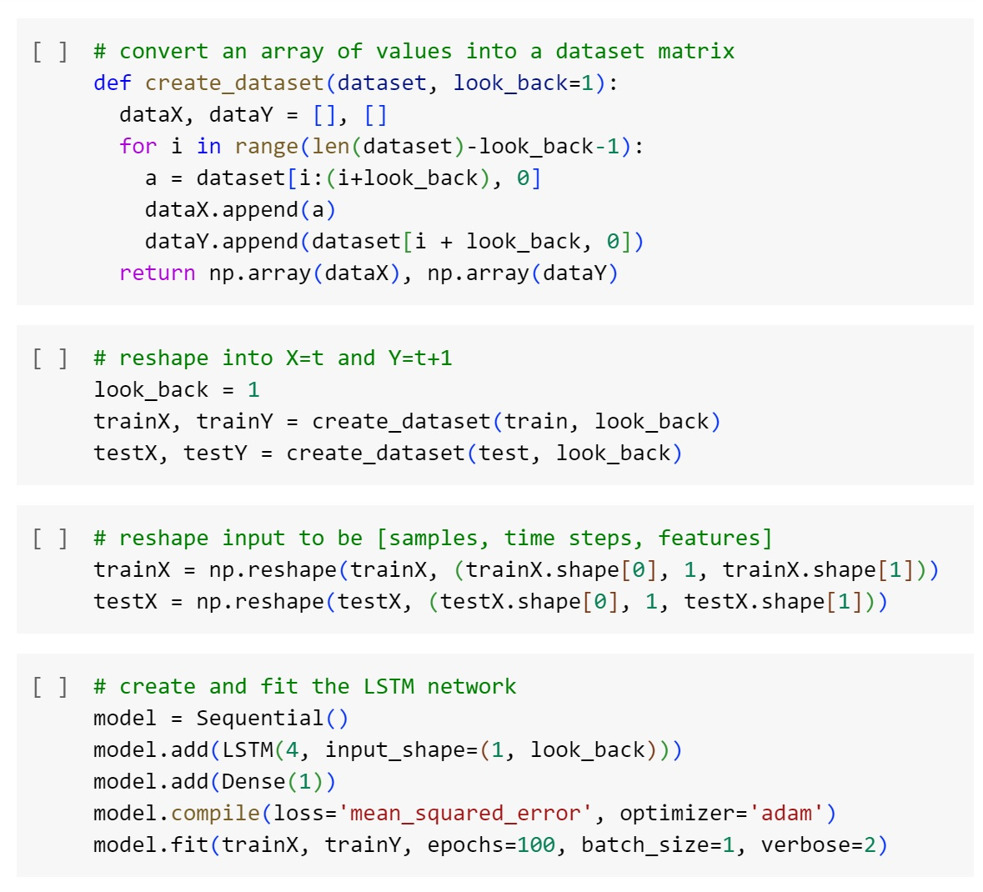
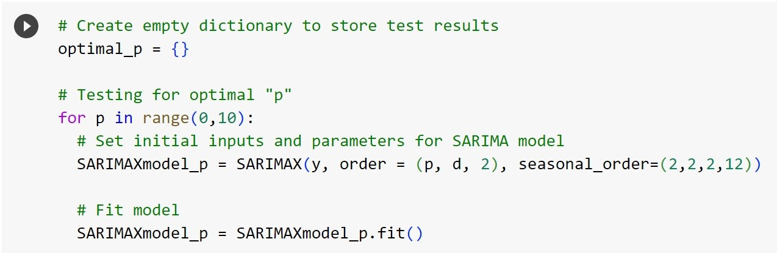
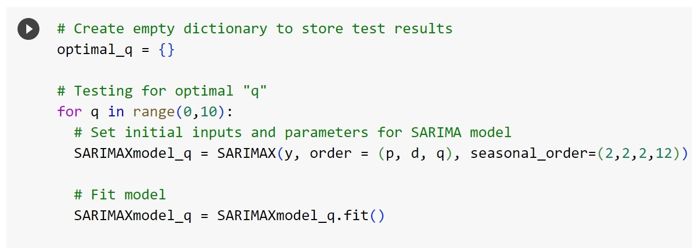
6. Develop Machine-Learning Model

Slide 9
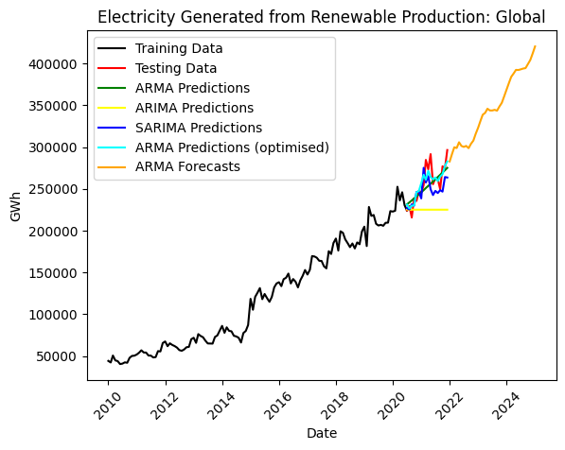
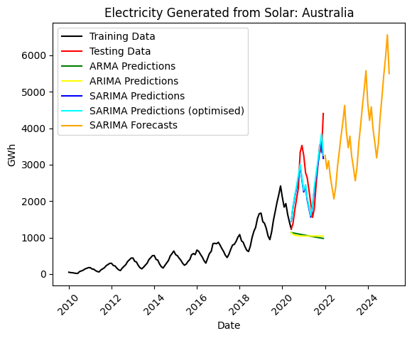
Machine-Learning Model: ARMA, ARIMA and SARIMA

Slide 10
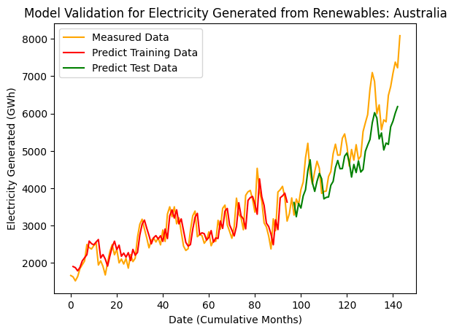
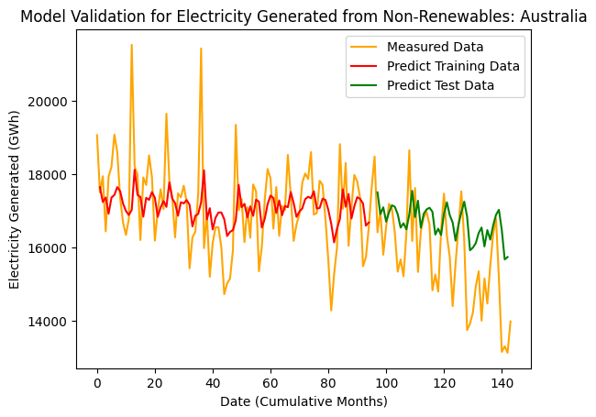
Machine-Learning Model: LSTM

Slide 11
Learnings and Improvements
Trend of renewables vs. non-renewables in Australia
The high share of non-renewables in electricity production
Utilization of automated ETL

