Slide 1
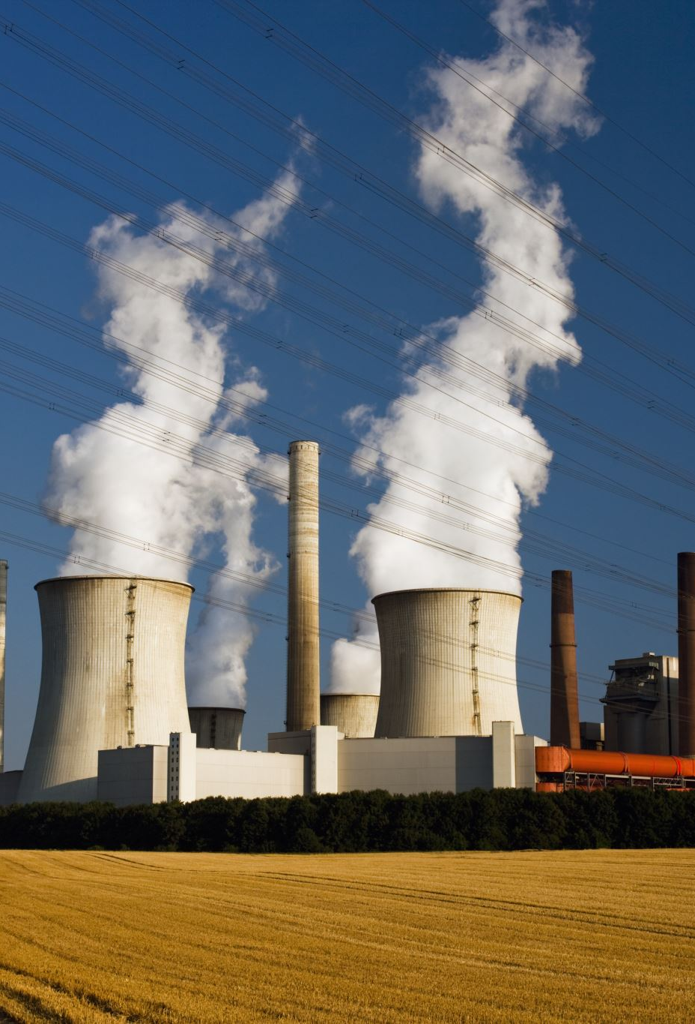
Generating Electricity: Renewables & Non-Renewables
Shweta Jain
Mohsen Farrokhrouz
Oliver King

Slide 2

Project Goals
To analyse electricity-generation trends:
Compare and contrast different approaches to electricity generation around the world.
Use forecasts to determine the global electricity outlook:
Specifically, the role of renewables and non-renewables.

Slide 3

Analysis (Part 1 / 2)
Analyse electricity-generation trends:
Tableau-based interactive dashboard.
Allows users to investigate historic trends of 48 countries.

Slide 4
Analysis (Part 2 / 2)
Forecast the global electricity outlook:
Using machine-learning to model and forecast:
Solar-based electricity-generation in Australia.
Renewable and Non-renewable-based electricity-generation globally.

Slide 5

Approach
Cleanse data (Extract, Transform, Load)
Export data into database (PostgreSQL)
Retrieve data from database (SQLAlchemy)
Develop interactive dashboard (Tableau)
Develop machine-learning model to predict and forecast electricity outlook (ARIMA)
1
Source data
2
3
4
5
6

Slide 6

1. Source Data
Title | Format | Source | Data Frequency
Electricity Generation (by Generation-type and Country) | CSV | International Energy Agency (IEA) | Monthly
Population (by Country) | CSV | World Bank | Annual
GDP (by Country) | CSV | World Bank | Annual
Continent/Region/Country/Country Code | CSV | GitHub user: “lukes” | Single

Slide 7

2. Cleanse Data (Extract, Transform, Load)
Undertook process to clean, normalize and standardize data in preparation for modelling:
Read in multiple CSV files
Removed countries with insufficient data points
Standardised all datasets with 3-digit country codes (ISO 3166-1)
Transformed GDP and Population data (annual > monthly)

Slide 8
3. Export data into database (PostgreSQL)
Create tables
Import CSV data
Join on standardised 3-digit "Country Code"
4. Retrieve data from database (SQLAlchemy)
Create engine
Connect to local host (.gitignore password)
Read in data for modelling

