Slide 1

Streaming Service Platform Database
Group 9
Ankita Dhekane
Maheshwari Bhandare
Shwetalee Gadekar
Trupti Lone

Slide 2
Contents
01
Business/Organization Description
02
Conceptual ERD
03
Relation Schema
04
ERD with 3NF
05
Data Analysis

Slide 3
Streaming Platform Overview
On-Demand entertainment
Subscription-Based Model
Content & User Management
Scalability & Security
Users can watch movies, TV shows, and exclusive content anytime, anywhere
Platforms offer different plans with varying features and pricing.
Efficient handling of user accounts, subscriptions, payments, and content metadata.
The database must support a growing user base while ensuring data integrity and security

Slide 4
Benefits of Developing a Database
Efficient Subscriber Management
Manages users, profiles, subscriptions, devices, and payments
Comprehensive Content Cataloging
Stores metadata, tracks licensing, and links actors/directors
Streaming Analytics
Logs watch history, ad views, and user engagement trends.
User Engagement
Supports watchlists, reviews, ratings for content discovery
Customer Support
Handles support tickets and tracks issue resolution

Slide 5

Conceptual Design
User, Profiles, Subscription Plans, Content, Episodes, Watch History, Reviews, Advertisements, Customer Support
Identifying Core Entities
User (user_id, name, email, plan_id), Content (content_id, title, genre, duration), Payments (payment_id, user_id, amount)
Defining Key Attributes
One-to-Many - A User can have multiple Profiles and Payments.
Many-to-Many - Users watch multiple Content items, and content is viewed by multiple Users
Establishing Relationships

Slide 6
Entity Clusters
Subscriber Management
Content Cataloging
Streaming Analytics
Customer Support & Monetization
Watch History
Watchlist
Reviews
Advertisements
Ad Views
Customer Support
User
Profiles
Subscription Plans
Payments
Content
Episodes
Actors/Director

Slide 7
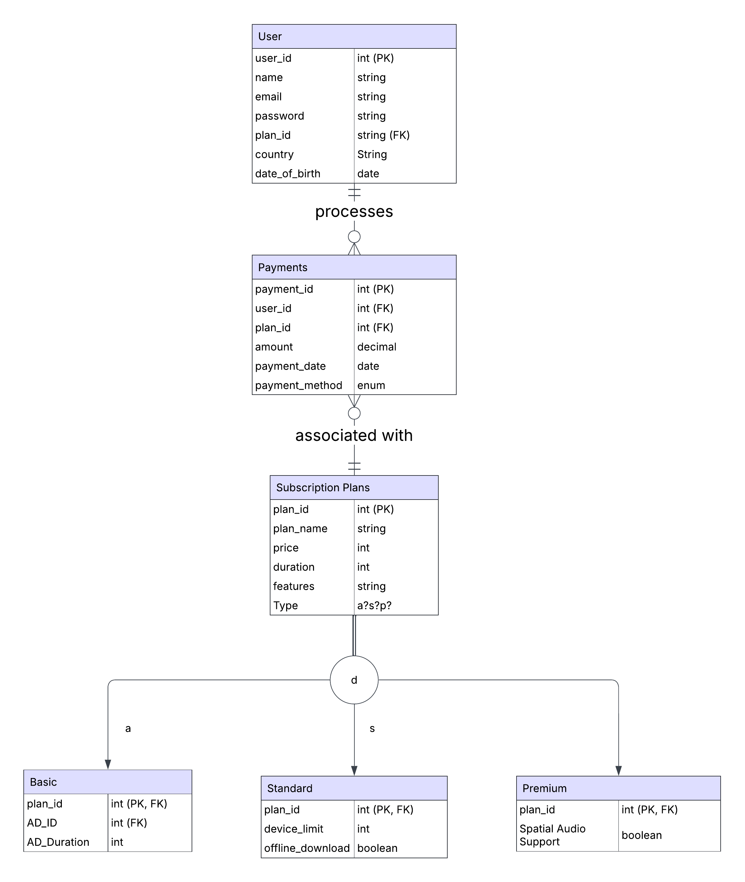
Subscriber Management
Entities : User, Subscription Plans, and Payments are the core entities, with Subscription Plans having subtypes (Basic, Standard, Premium).
Payments : One-to-many relationship between Users and Subscription Plans, requiring a separate Payments entity to track transactions.
Payments Attributes : Stores amount, payment date, and payment method, allowing independent tracking of subscription payments, renewals, and failures.

Slide 8
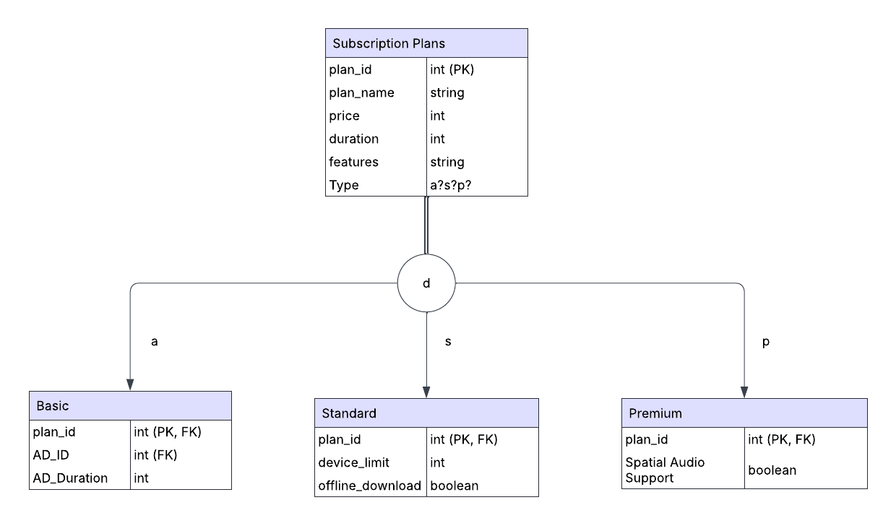
Supertype & Subtype for Subscription plans
Concepts Used in Our Model
Supertype: Subscription Plans (generic entity for different plan types).
Subtypes: Basic, Standard, and Premium (each with unique attributes).
Total Specialization Rule (Double Line)
Every instance of the supertype must belong to at least one subtype.
A Subscription Plan must be either Basic, Standard, or Premium.
Disjoint Rule (Only One Subtype):
An instance of the supertype can belong to only one subtype.
A plan cannot be both Basic and Standard at the same time.

Slide 9
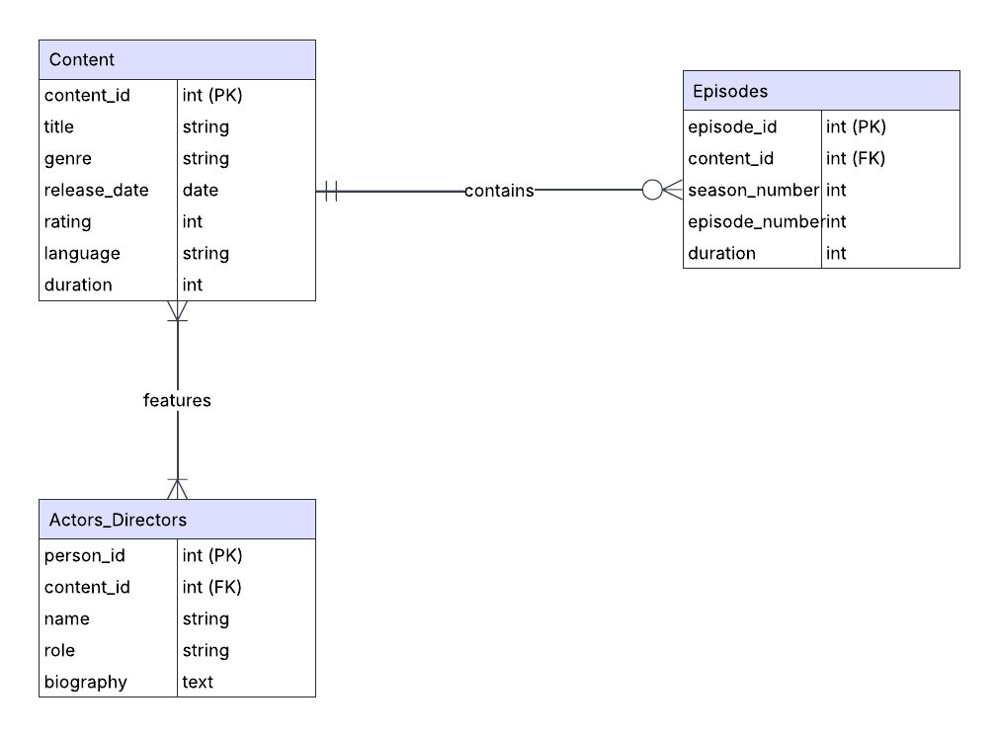
Content Cataloging
Entities : Content, Episodes, and Actors_Directors are the core entities, where Content represents movies/TV shows, Episodes store episode details, and Actors_Directors track associated people.
Relationships :
One-to-many relationship between Content and Episodes, as a TV show can have multiple episodes.
Many-to-many relationship between Content and Actors_Directors, allowing multiple actors/directors per content and vice versa.

Slide 10
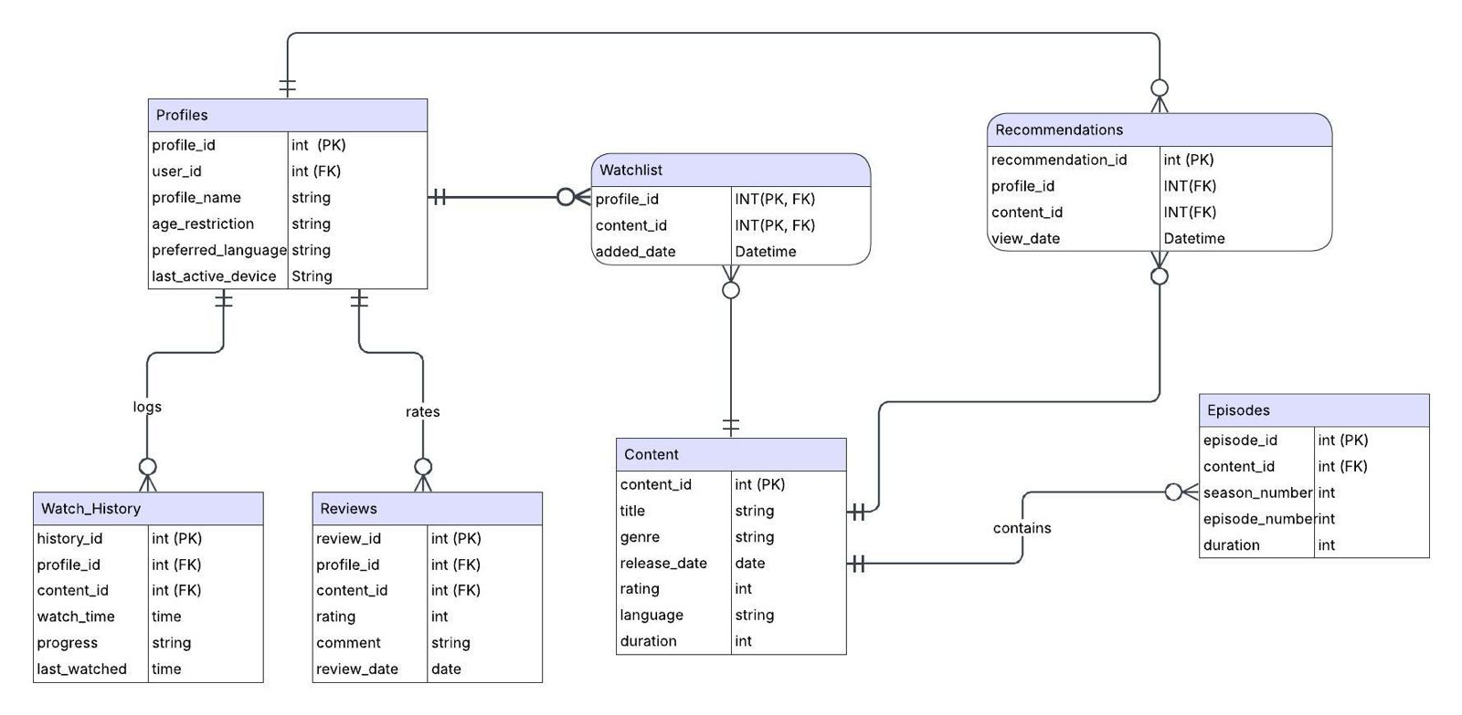
Streaming Analytics
Entities – Profiles, Content, Watch_History, Reviews, Watchlist, and Recommendations manage user interactions and content metadata.
Watchlist as an Associative Entity – Connects Profiles and Content in a many-to-many relationship, tracking saved content with added_date.
Recommendations as an Associative Entity – Links Profiles and Content, storing view_date for personalized suggestions.

Slide 11
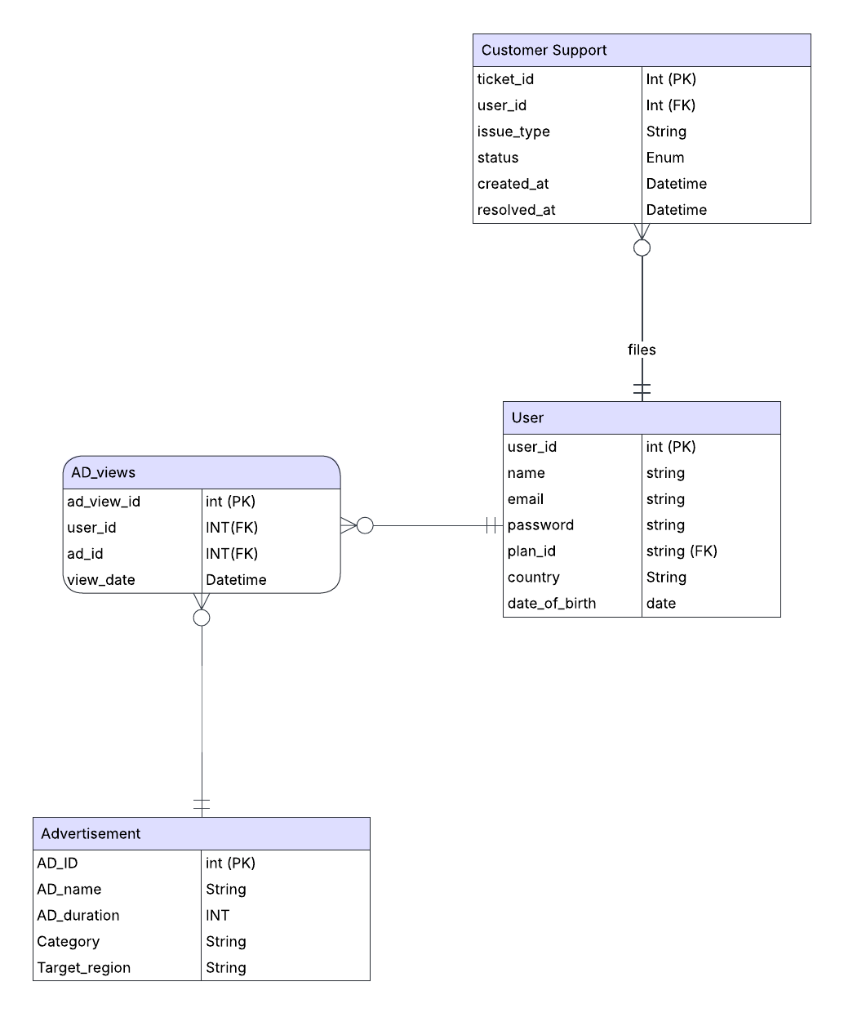
Customer Support & Monetization
Entities – The system includes User, Customer Support, Advertisement, and AD_views, managing user interactions, issue resolution, and ad tracking
AD_views as an Associative Entity – Links Users and Advertisements in a many-to-many relationship, tracking ad views with view_date
Customer Support Relationship – Connects Users and Support Tickets, allowing issue tracking with attributes like issue_type, status, and resolution time.

Slide 12
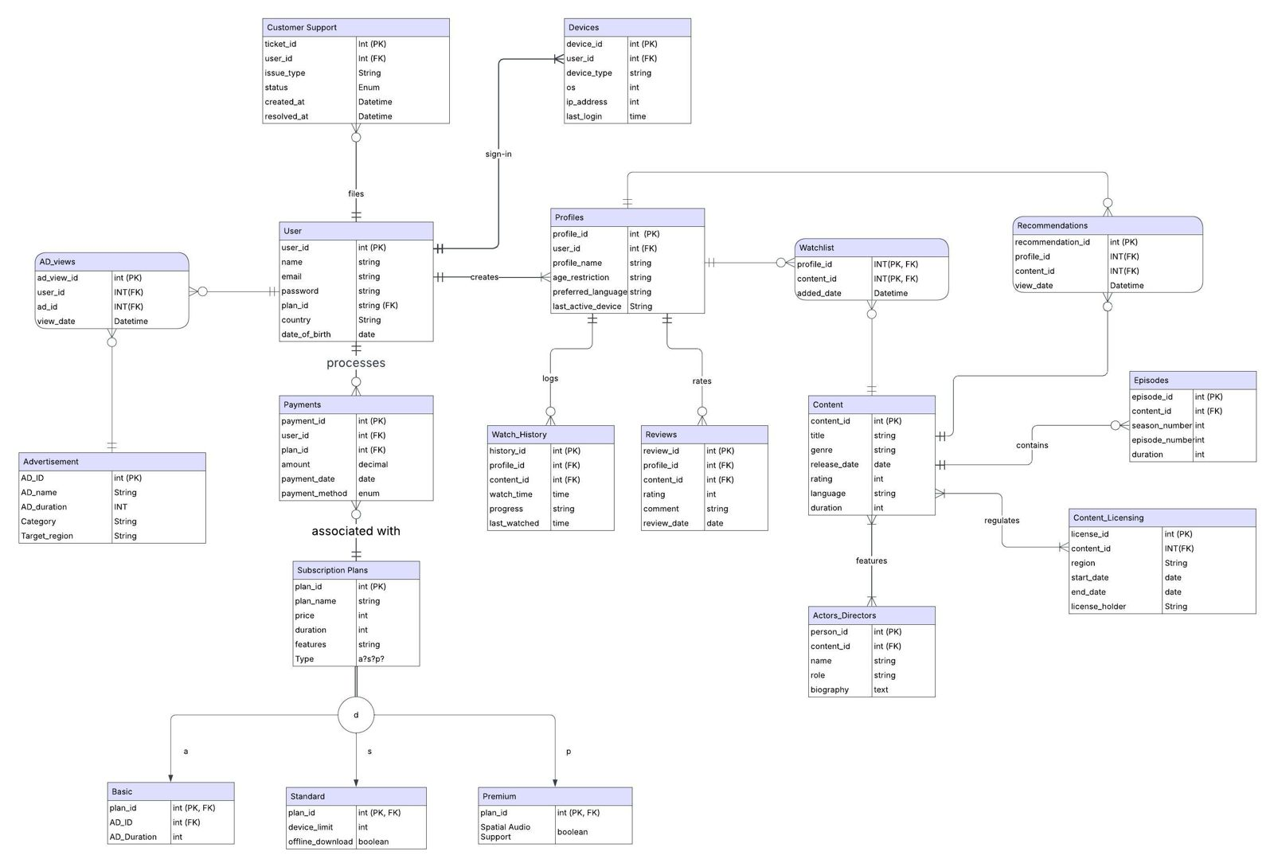
Entity Relationship Diagram

Slide 13
Transformation into Relational Model
Regular Entities
Weak Entities
Binary Relationships
Associative Entities
Supertype/Subtype Relationships

Slide 14
Mapping Regular Entities
User (Primary Key: user_id)
Profiles (Primary Key: profile_id)
Devices (Primary Key: device_id)
Payments (Primary Key: payment_id)
Subscription Plans (Primary Key: plan_id)
Basic (Primary Key: plan_id)
Standard (Primary Key: plan_id)
Premium (Primary Key: plan_id)
Customer Support (Primary Key: ticket_id)
Advertisement (Primary Key: AD_ID)
Content (Primary Key: content_id)
Actors_Directors (Primary Key: person_id)
Content_Licensing (Primary Key: license_id)
Episodes (Primary Key: episode_id)
Reviews (Primary Key: review_id)
Regular Entities

Slide 15
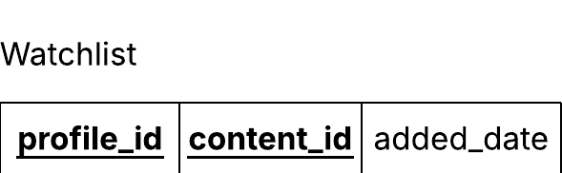
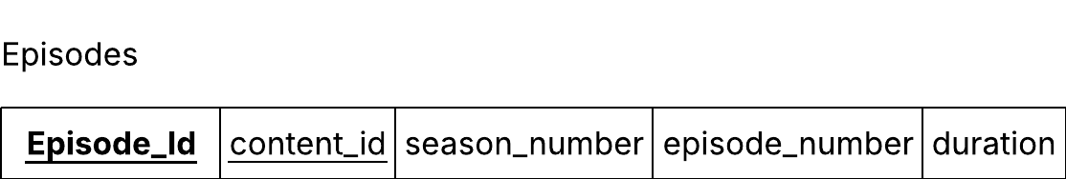
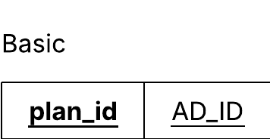
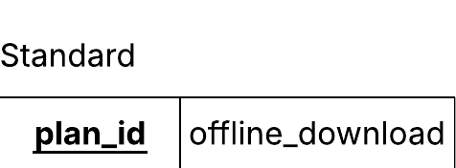
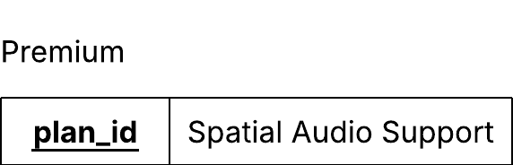
Mapping Weak Entities
Weak Entities

Slide 16
Mapping Binary Relationships
User - Profiles (creates): One user can create multiple profiles
User - Devices (sign-in): A user can sign in from multiple devices
User - Customer Support (files): A user can file multiple support tickets
Profiles - Watch_History (logs): A profile can have multiple watch history entries
Profiles - Reviews (rates): A profile can write multiple reviews
Content - Episodes (contains): A series can have multiple episodes
Content - Content_Licensing (regulates): A content item can have multiple licenses
Content - Actors_Directors (features): A content item can have multiple actors/directors
Binary Relationships

Slide 17
Mapping Associative Entities
Watchlist → Connects Profiles ↔ Content (Profiles add content to watchlist).
AD_Views → Connects Users ↔ Advertisement (Users view ads).
Recommendations → Connects Profiles ↔ Content (Personalized content suggestions).
Actors_Directors → Connects People ↔ Content (Actors/Directors in content)
Associative Entities

Slide 18
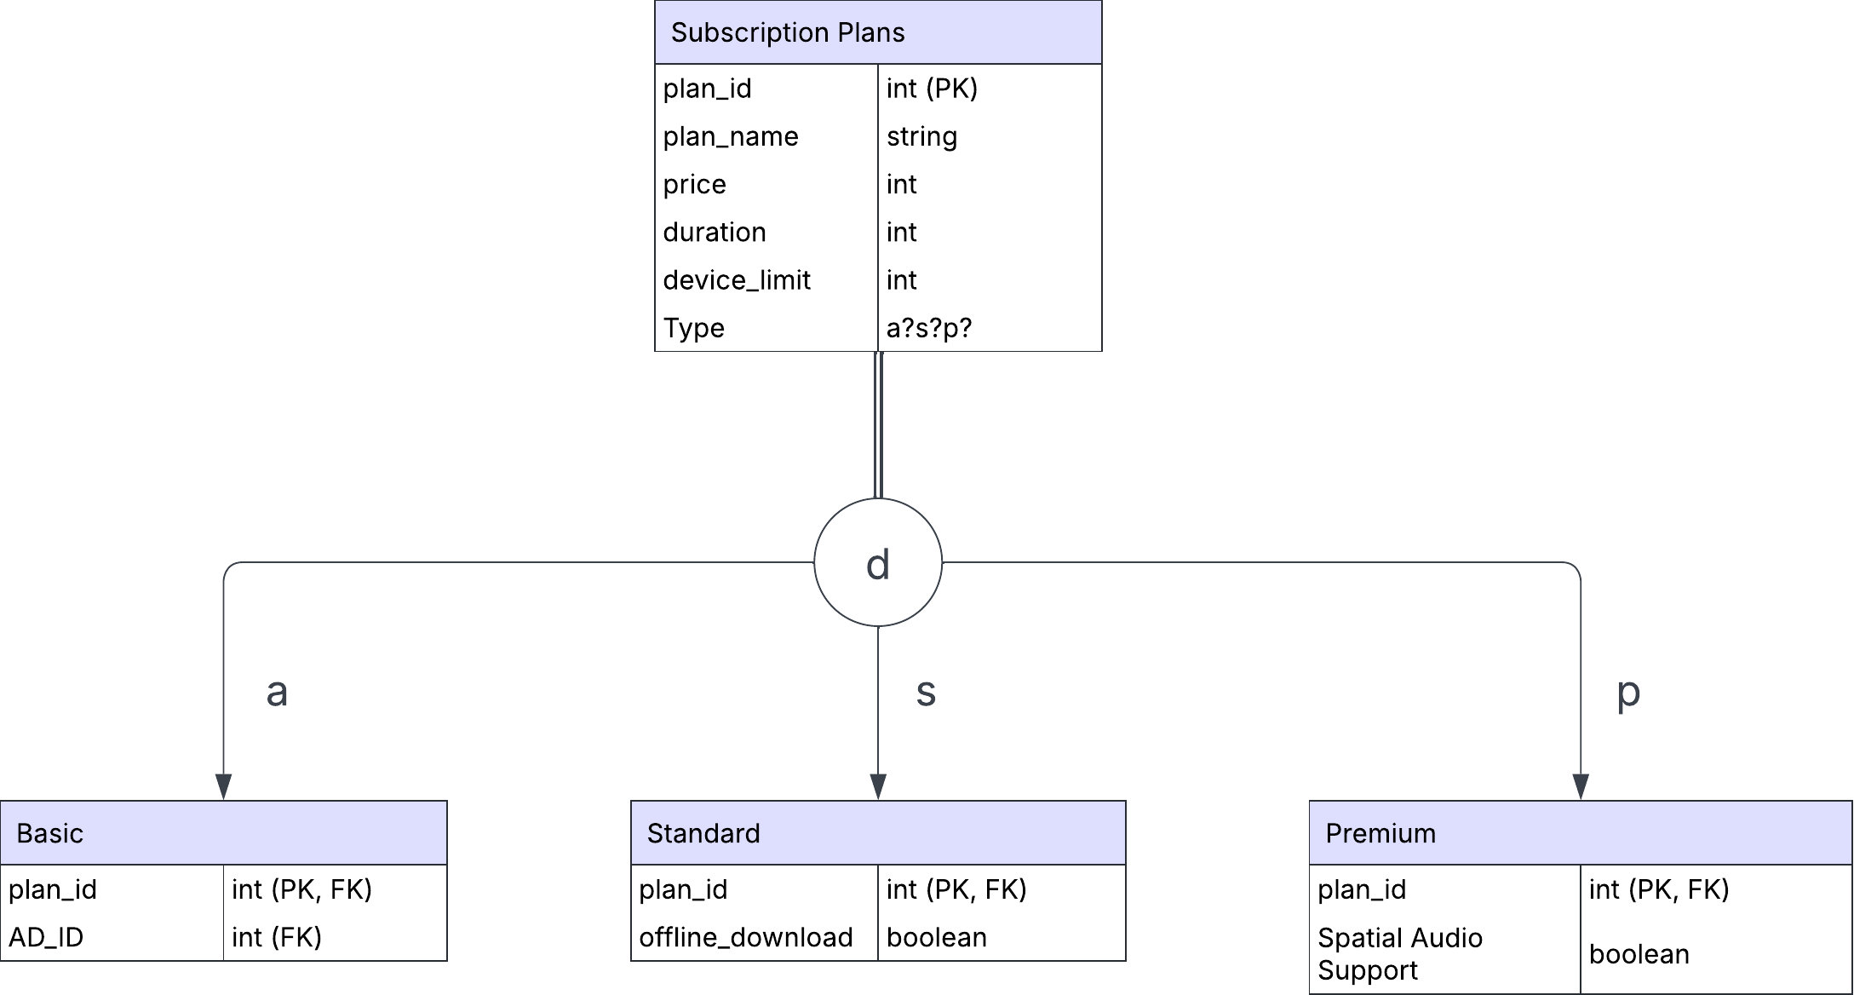
Mapping Supertype/Subtype Relationships
Supertype/Subtype Relationships

Slide 19
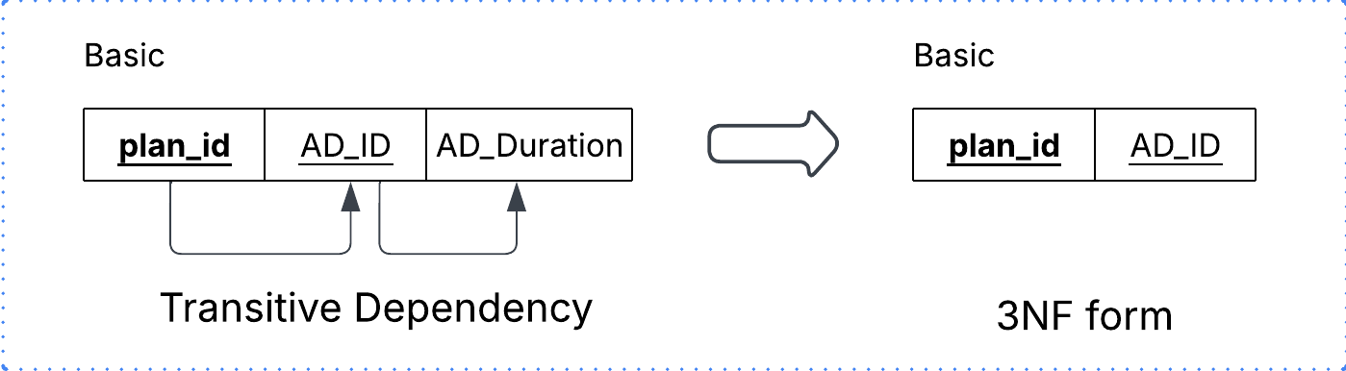
Removing Transitive Dependencies
The attribute AD_Duration in Basic is already part of the Advertisement entity
Since AD_Duration is functionally dependent on AD_ID, and AD_ID is a foreign key in Basic, this creates a transitive dependency
To ensure 3NF, we should not store AD_Duration in the Basic entity because it already belongs in the Advertisement table. Remove AD_Duration from Basic. Join with Advertisement when needed, using AD_ID

Slide 20
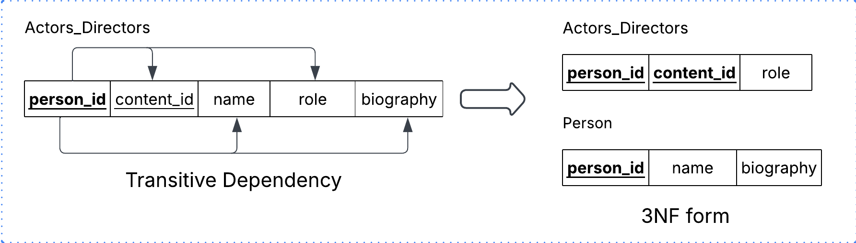
Removing Transitive Dependencies
The original Actors_Directors table has person_id as the primary key and includes content_id, name, role, and biography
name and biography depend only on person_id, not content_id, creating a transitive dependency and violating 3NF
To ensure 3NF, Splitting into two tables:
Actors_Directors (person_id, content_id, role) → Links people to content
Person (person_id, name, biography) → Stores personal details separately

Slide 21
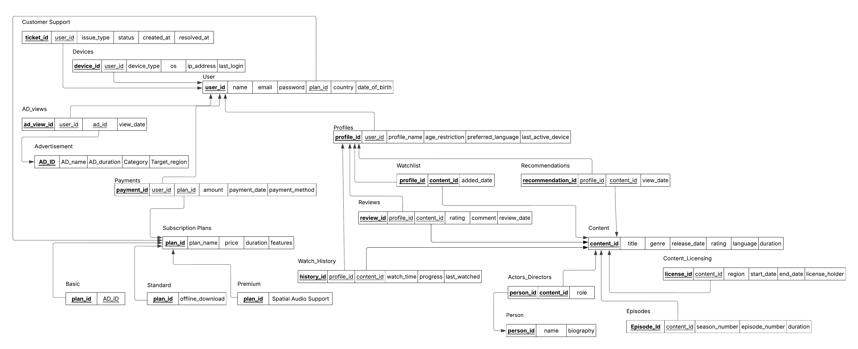
Relational Schema

Slide 22
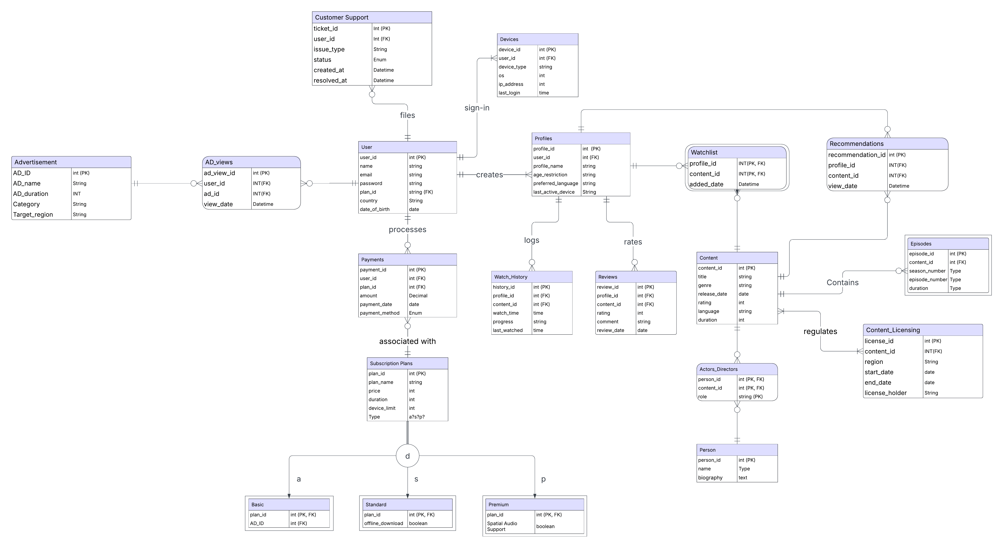
Final ER Model

Slide 23
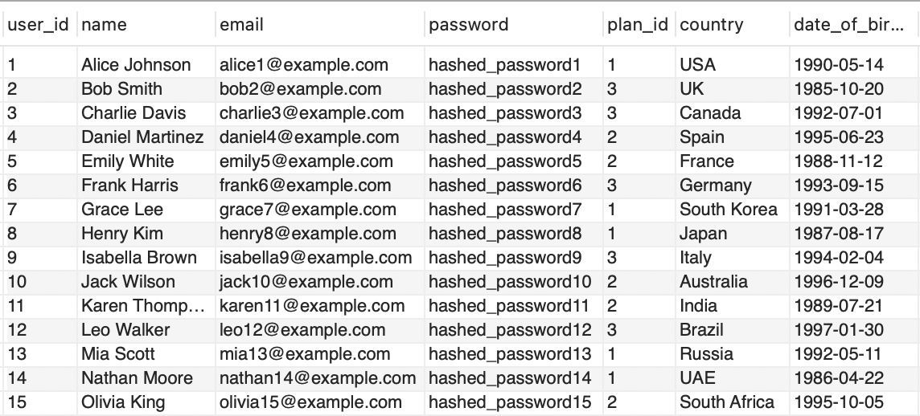
Data – User Table
Table Name - User
user_id – Unique user identifier
name – User’s full name
email – Unique email address
password – Encrypted login password
plan_id – Subscription plan reference
country – User’s country of residence
date_of_birth – User’s birth date

Slide 24
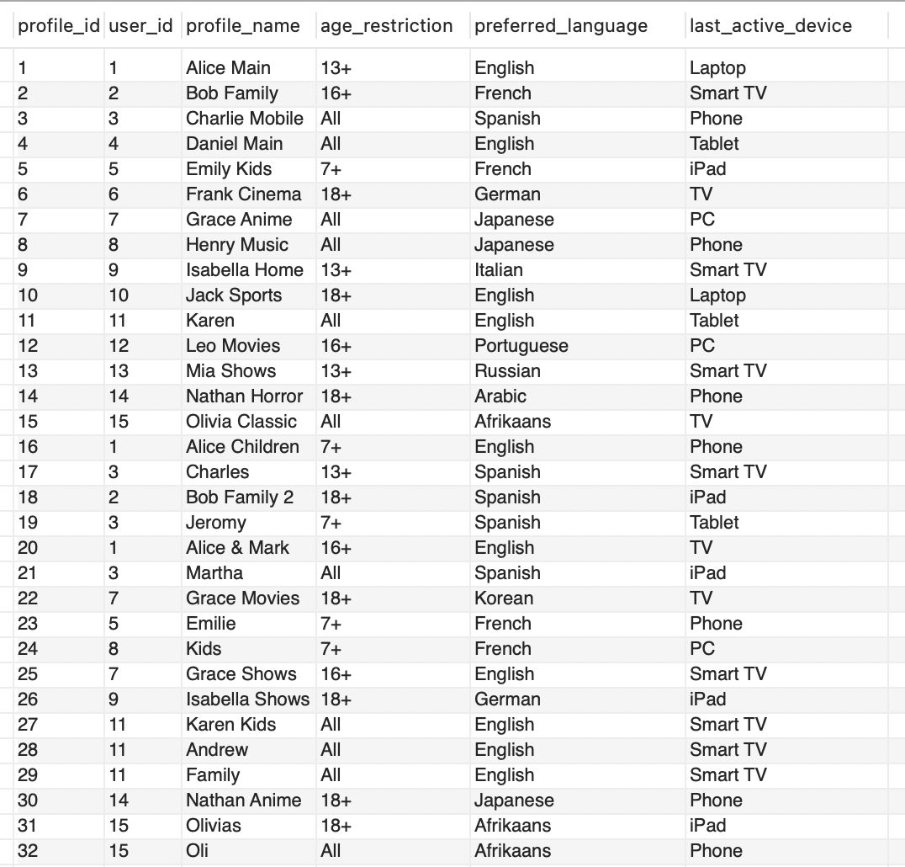
Data – Profile Table
profile_id – Unique profile identifier
user_id – Linked user’s ID
profile_name – Profile’s display name
age_restriction – Content access limitation
preferred_language – Chosen language preference
last_active_device – Recently used device

Slide 25
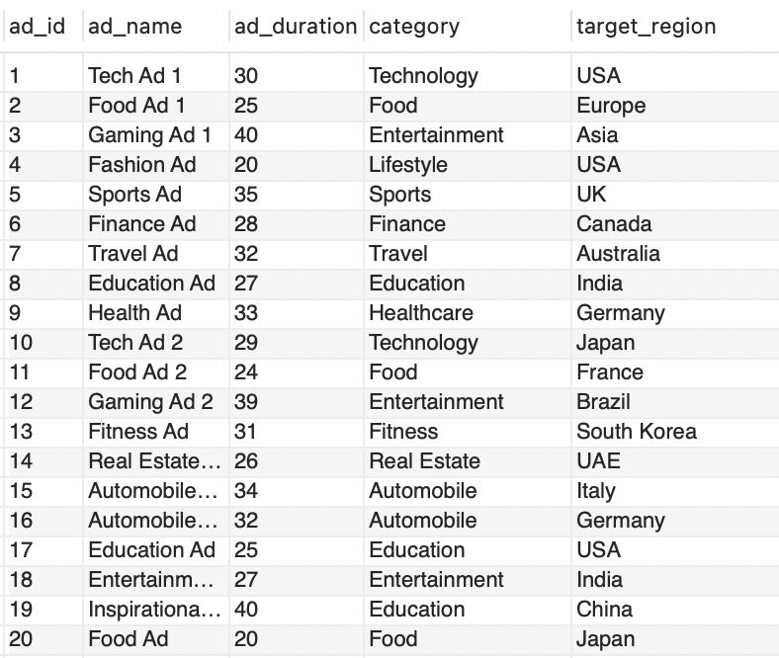
Data – Advertisement Table
Table Name - Advertisement
ad_id – Unique advertisement identifier
ad_name – Name of the advertisement
ad_duration – Duration in seconds
category – Advertisement category/type
target_region – Targeted geographical region

Slide 26
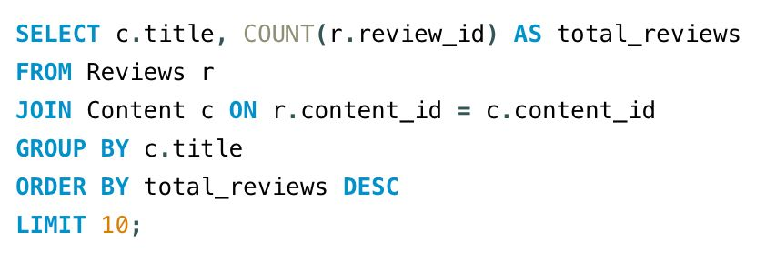
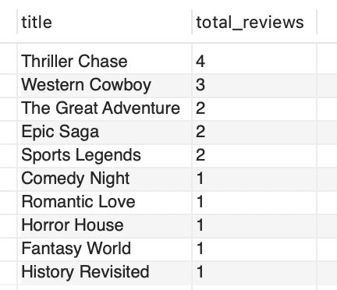
Example Query # 1

Slide 27
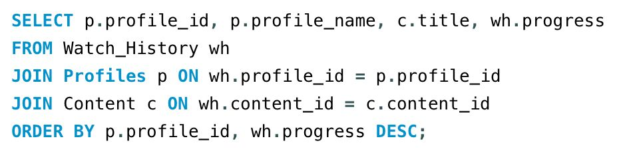
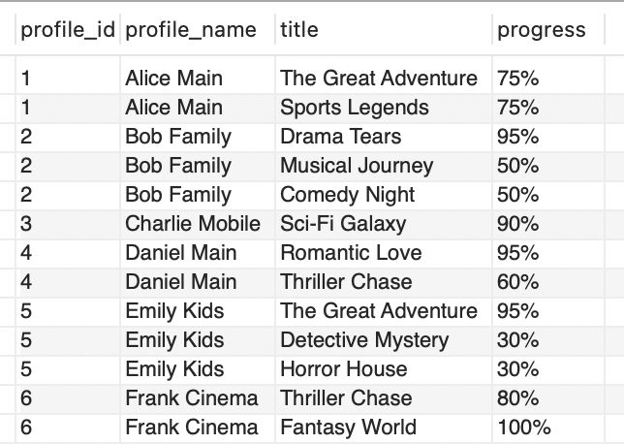
Example Query # 2

Slide 28
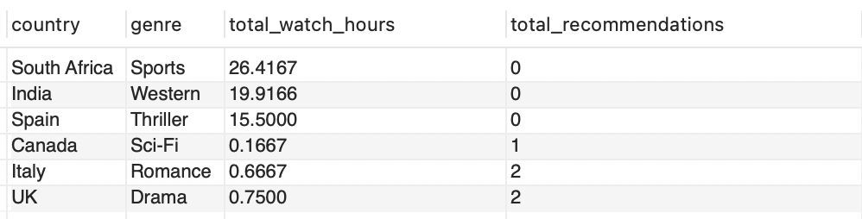
Data Analysis #1
The recommendation system appears misaligned with user preferences, as the most-watched genres receive no recommendations, while lesser-watched genres are being suggested

Slide 29
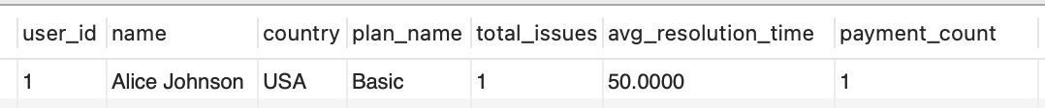
Data Analysis #2
A Basic plan user, faces long issue resolution times (50 hours) and low payment activity, indicating a potential churn risk due to poor support experience

Slide 30
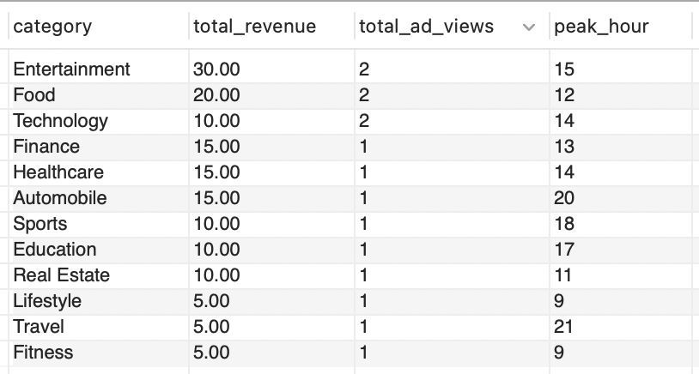
Data Analysis #3
Ad revenue and engagement peak at specific hours, with Entertainment leading in revenue and Food and Technology performing well around lunchtime.

Slide 31
Thank You! Q&A?

