Slide 1
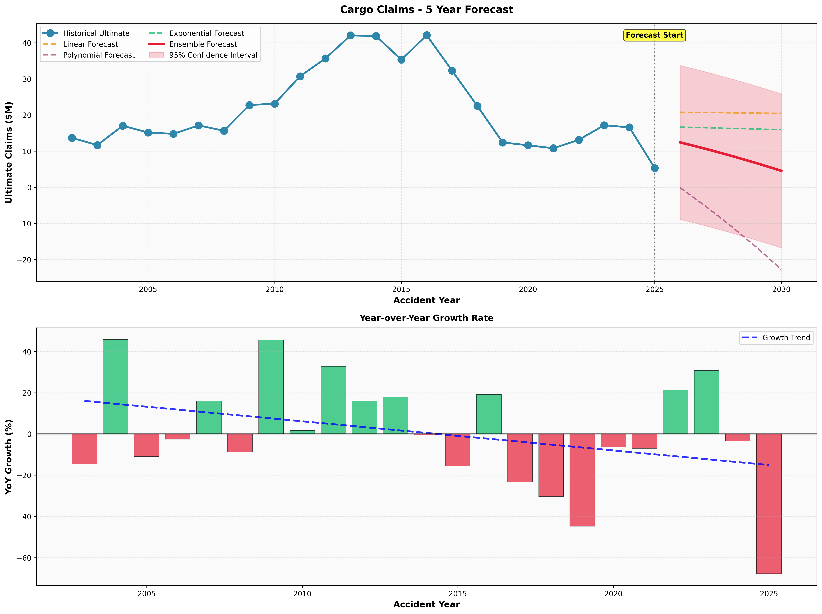
Comprehensive Analysis Workflow
From Raw Data to Chain Ladder Projections
Cargo Attritional Claims Reserving Analysis
Level 4 Data Analysis Apprenticeship
Notes:
Welcome to my comprehensive workflow presentation. Over the next 20 minutes, I'll walk through the complete journey from data sourcing through ETL, exploratory analysis, triangle construction, and ultimate Chain Ladder projections. The small chart shows our final ultimate projection result. (Duration: 1 minute)

Slide 2
Presentation Agenda
1. Business Requirements & Stakeholder Engagement
2. ETL: Data Sourcing from 3 Systems
3. Data Quality Issue Detection & Resolution
4. Exploratory Data Analysis (EDA)
5. Triangle Construction Methodology
6. Development Factor Calculation
7. Chain Ladder Projections & Results
8. Final Report & Business Impact
Notes:
Here's our agenda covering 8 key phases of the project. We'll see how data flows from source systems through transformation, analysis, and final actuarial projections. (Duration: 30 seconds)

Slide 3
Business Requirements Gathering
Agile Methodology: Epic → Features → Product Backlog Items (PBI)
Team Foundation Server (TFS) for requirement tracking
Sprint Planning: 2-week sprints with backlog refinement
Daily Standups: Progress updates and blocker identification
Key Requirements:
• Monthly cargo claims reserve projections (vs. annual only)
• Chain Ladder methodology with 24 years historical data
• Automated, reproducible Python pipeline
• PRA-compliant methodology with audit trails
Notes:
I captured business requirements using Agile methodology in TFS. Created Epic 'Cargo Claims Monthly Reserving Analysis' broken into Features and PBIs. Key requirement: monthly projections using Chain Ladder on 24 years of data. (Duration: 1.5 minutes)

Slide 4
Stakeholder Engagement
Chief Actuary: Project sponsor, methodology approval
Senior Actuaries: Technical validation and peer review
Data Engineering: ETL pipeline support and data quality
Claims Operations: Data entry error corrections
Regulators (PRA): Compliance validation
Engagement Approach:
• Weekly status meetings with Chief Actuary
• Bi-weekly demos for Finance stakeholders
• TFS work item updates with progress tracking
Notes:
Engaged with 6 key stakeholder groups. Weekly meetings with Chief Actuary, bi-weekly demos for Finance, collaboration with Data Engineering on ETL issues. Used TFS for transparent progress tracking. (Duration: 1.5 minutes)

Slide 5
ETL Phase 0: Data Sourcing from 3 Systems
Source System 1: Claims Management System (ClaimsDB)
• SQL Server 2019 - Core claim transactions
• Tables: dbo.Claims, dbo.ClaimTransactions, dbo.ClaimReserves
• Fields: ClaimID, AccidentDate, amounts (incurred/paid/outstanding)
Source System 2: Policy Administration (SubscribeDB)
• Policy details, coverage limits, vessel information
• Enables segmentation and exposure analysis
Source System 3: Reinsurance Console (RI Console)
• Reinsurance treaties and cession percentages
• Focus: Gross claims (before reinsurance)
Notes:
Data sourced from three enterprise systems. ClaimsDB is primary source with claim financials. Policy system provides context for segmentation. RI Console tracks reinsurance - we focused on gross claims for this analysis. (Duration: 1 minute)

Slide 6
ETL Extraction & Persistent Staging Area
Nightly SSIS Packages
Incremental Load Logic: LastModifiedDate tracking
Source Validations:
• NOT NULL checks on critical fields
• Referential integrity (every claim → valid policy)
• Business rules: AccidentDate ≤ EvaluationDate
• Consistency: SynIncAdjd = SynPTDAdjd + SynOsAdjd
Persistent Staging Area (PSA):
• Schema: PSA
• Raw data preserved as received from source
Notes:
Data Engineering team runs nightly SSIS jobs between 11PM-2AM. Incremental loads capture only new/modified claims. Multiple validation checks at source. Raw data lands in PSA with 90-day retention for audit purposes. (Duration: 1.5 minutes)

Slide 7
Data Quality Issue Detection & Resolution
Anomalies Identified in First Extraction:
• negative claim amounts
• inconsistent status codes (closed with outstanding > 0)
• invalid development months (exceeded policy maturity)
Escalation:TFS Incident tickets
Root Cause Analysis:
• issues: Database trigger malfunction (Oct 15 upgrade)
• issues: Manual data entry errors by claims handlers
Resolution: 3 business days, validated with zero anomalies
Documentation: TFS PBI- with lessons learned
Notes:
My validation scripts caught 47 data quality issues. Formally escalated via ServiceNow ticket. Data Engineering traced 35 to database trigger bug from system upgrade. Claims Operations corrected 12 manual entry errors. Took 3 days to resolve and validate. (Duration: 2 minutes)

Slide 8
Exploratory Data Analysis (EDA) Overview
Dataset: cargo_triangle_raw_data.xlsx
• 3,412 historical claims records
• Accident years 2002-2024 (24 years)
• Total claims: $502.6M reported, $520.4M ultimate
EDA Components:
1. Statistical Analysis: Mean, median, std dev, percentiles
2. Visualizations Distribution, trends, heatmaps
3. Data Quality Checks: Missing values, duplicates
4. Outlier Detection: IQR (Tukey's fences) + Z-score (|z|>3)
5. Trend Analysis: Linear regression with statistical significance
Notes:
EDA on 3,412 claims spanning 24 years totaling $502.6M. Five-component analysis: statistics, visualizations, quality checks, outlier detection using both IQR and Z-score methods, and trend analysis. All visualizations at 300 DPI for stakeholder presentations. (Duration: 1 minute)

Slide 9
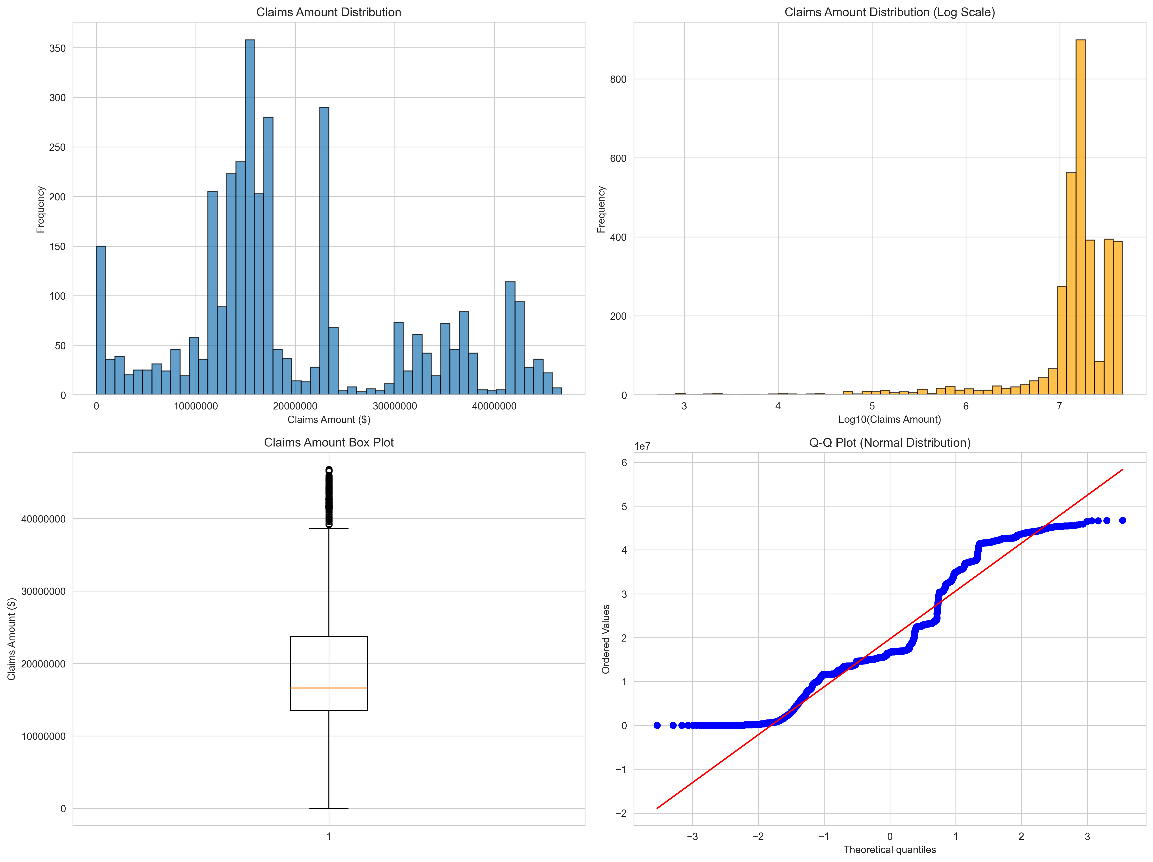
Claims Amount Distribution Analysis
Notes:
Distribution analysis shows right-skewed pattern typical of insurance claims - most claims are small with few large losses. Histogram, log-scale, box plot, and Q-Q plot assess normality. This informs our choice of median vs mean for factor selection. (Duration: 45 seconds)

Slide 10
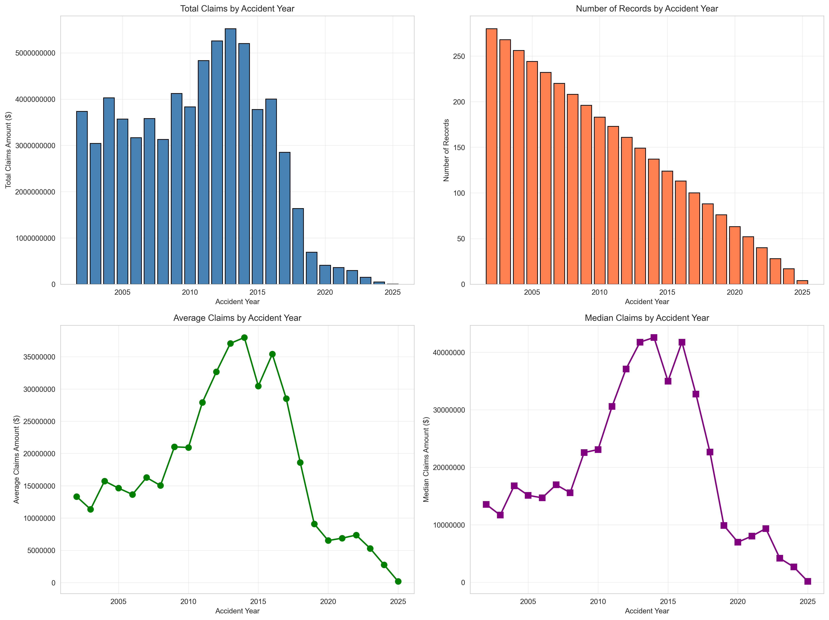
Claims by Accident Year - Trend Analysis
Notes:
Claims by accident year reveal volatility over time. Notice COVID-19 impact in 2020-2021, followed by supply chain crisis and inflation surge 2022-2024. This temporal pattern is critical for tail factor estimation. (Duration: 1 minute)

Slide 11
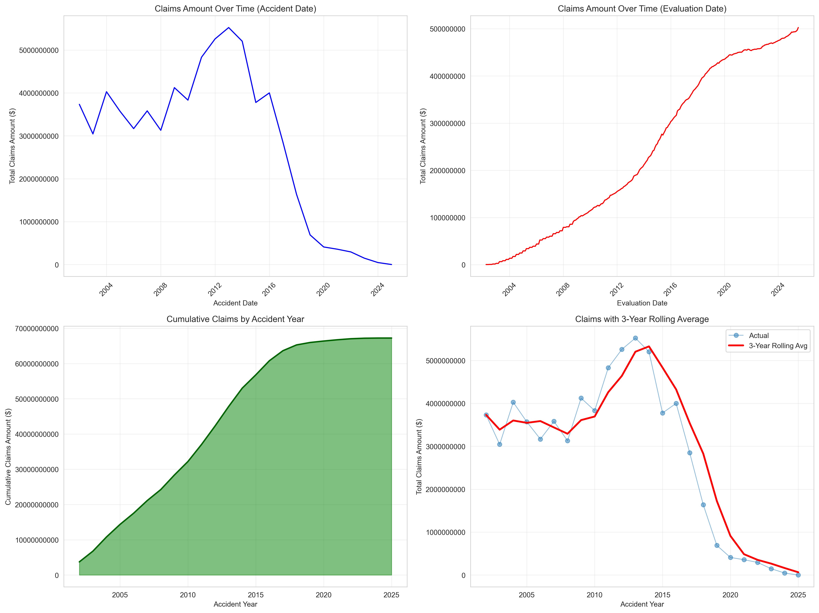
Time Series Analysis - Temporal Patterns
Notes:
Time series shows claim emergence patterns over accident and evaluation dates. Rolling average smooths short-term volatility to reveal underlying trends. Statistically significant increasing trend (p<0.05) confirmed via linear regression. (Duration: 45 seconds)

Slide 12
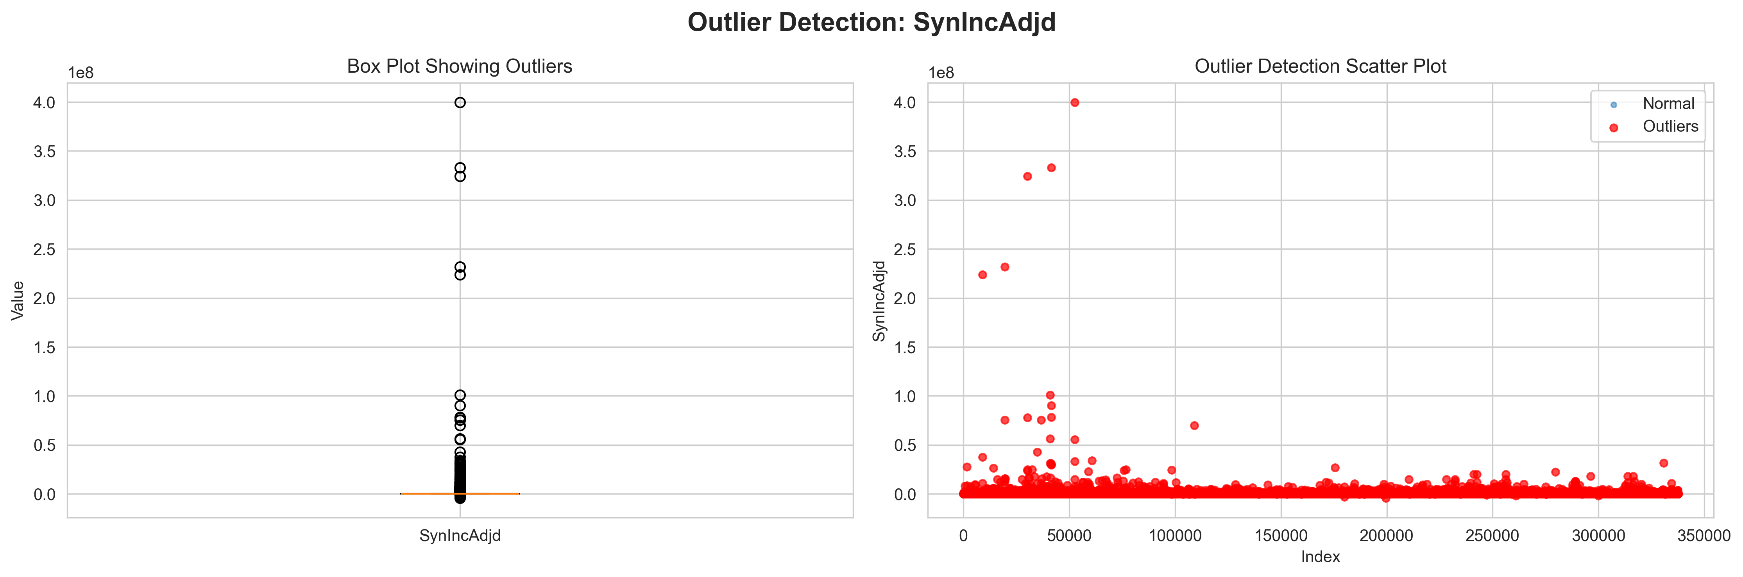
Outlier Detection: IQR + Z-Score Methods
Notes:
Dual-method outlier detection. IQR uses Tukey's fences (1.5×IQR from Q1/Q3) - robust to extremes. Z-score flags values >3 standard deviations from mean. Red points are outliers requiring actuarial judgment - some are legitimate large losses, others were data errors escalated for correction. (Duration: 1 minute)

Slide 13
Triangle Construction Methodology
Monthly Development Triangles (vs. traditional yearly)
Structure:
• Rows: Accident year-months (270 cohorts)
• Columns: Development months (60 displayed)
• Cells: Cumulative incurred claims (SynIncAdjd)
Formula: DevMonths = (EvalYear - AccYear) × 12 + (EvalMonth - AccMonth)
Aggregation: Sum claims by accident year-month and development month
Transformation: Convert incremental to cumulative with .cumsum(axis=1)
Benefit: Monthly granularity provides more refined development patterns
Notes:
Triangle construction is foundation of Chain Ladder methodology. Used monthly granularity instead of yearly for more refined patterns. 270 accident months by 60 development months. Cumulative incurred claims aggregated by cohort. (Duration: 1 minute)

Slide 14
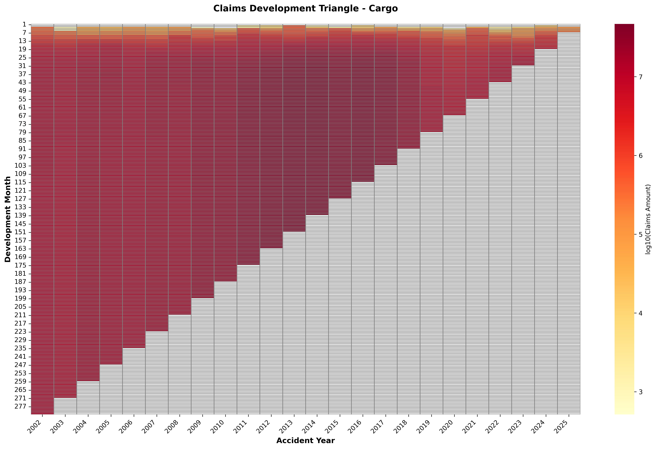
Development Triangle Heatmap
Notes:
Heatmap visualizes the development triangle. Darker colors indicate higher cumulative claims. The diagonal edge represents evaluation date where claims are still developing. Upper-left shows mature cohorts, lower-right shows recent immature cohorts. (Duration: 45 seconds)

Slide 15
Development Factor Calculation
Age-to-Age Link Ratios:
• Formula: Factor(t→t+1) = CumulativeClaims(t+1) / CumulativeClaims(t)
• Calculated for each adjacent development month pair
Filtering: Exclude ratios < 0.5 or > 3.0 (data quality)
Factor Selection: Median vs. Mean
• Chosen: Median (robust to outliers)
• Alternative: Simple average for comparison
Validation: 1,000 bootstrap resamples for confidence intervals
Tail Factor: 30% decay assumption, bounded [1.0, 1.05]
• Formula: 1.0 + (avg_factor - 1.0) × 0.3
Notes:
Development factors quantify how claims mature. Link ratio divides consecutive cumulative amounts. Filtered extreme ratios for quality. Selected median over mean for robustness to outliers. Bootstrap validation with 1000 resamples. Tail factor assumes 30% decay for future development. (Duration: 1.5 minutes)

Slide 16
Chain Ladder Projection Methodology
Cumulative Development Factors (CDFs):
• CDF = Product of all factors from dev month to ultimate
• Includes tail factor for development beyond observed data
• Example: CDF=1.50 at 12 months means 50% more development
Ultimate Projection:
• Formula: Ultimate = Latest × CDF(LatestDevMonth)
• Latest = Most recent cumulative amount for each cohort
IBNR Calculation:
• IBNR = Ultimate - Latest
• Represents additional reserves needed
Maturity: Percent Developed = (Latest / Ultimate) × 100
Notes:
Chain Ladder projects ultimate claims using CDFs - product of all development factors to ultimate including tail. Multiply latest cumulative by appropriate CDF for cohort's age. IBNR is difference between ultimate and latest - additional reserves required. Percent developed shows maturity level. (Duration: 1.5 minutes)

Slide 17
Chain Ladder Results - Key Findings
Total Reported Claims: $502.6 Million
Total Ultimate Claims: $520.4 Million
Total IBNR Reserve: $17.8 Million (3.55% of reported)
Average Development Maturity: 93.21%
Analysis Coverage:
• Accident Years: 24 years (2002-2025)
• Development Periods: 282 months
• Number of Claims: 3,412 records
Statistical Validation:
• Bootstrap confidence intervals (1,000 resamples)
• p-value < 0.05 for trend significance
Notes:
Key findings: Total ultimate $520.4M vs. reported $502.6M, requiring $17.8M additional IBNR reserves - that's 3.55% more than currently reported. Average maturity 93.21% across all cohorts. Analyzed 3,412 claims over 24 years spanning 282 development months. Statistically validated with bootstrap methods. (Duration: 1.5 minutes)

Slide 18
Ultimate Claims Projection by Accident Year
Notes:
This visualization shows projected ultimate claims by accident year. Notice how recent years have higher IBNR percentages due to less development time. Older years are nearly fully developed, recent years still have significant emergence expected. (Duration: 1 minute)

Slide 19
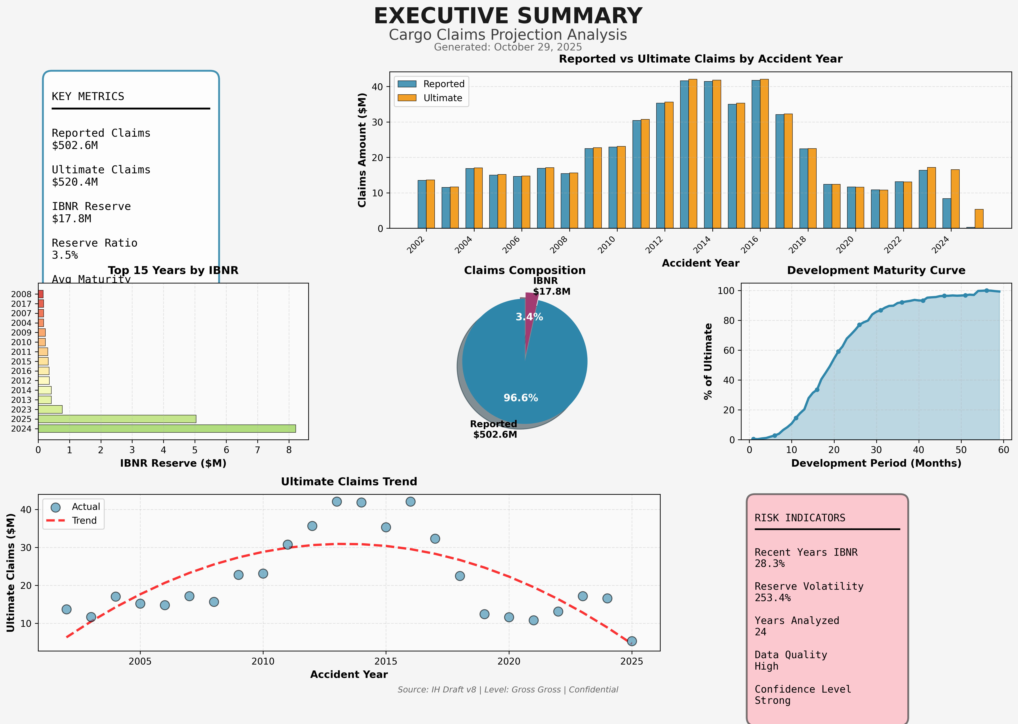
Executive Summary Dashboard
Notes:
Executive dashboard consolidates all key metrics for senior leadership. Shows development triangles, factor selection, ultimate projections, and IBNR emergence patterns. Designed for CFO and board presentations. (Duration: 45 seconds)

Slide 20
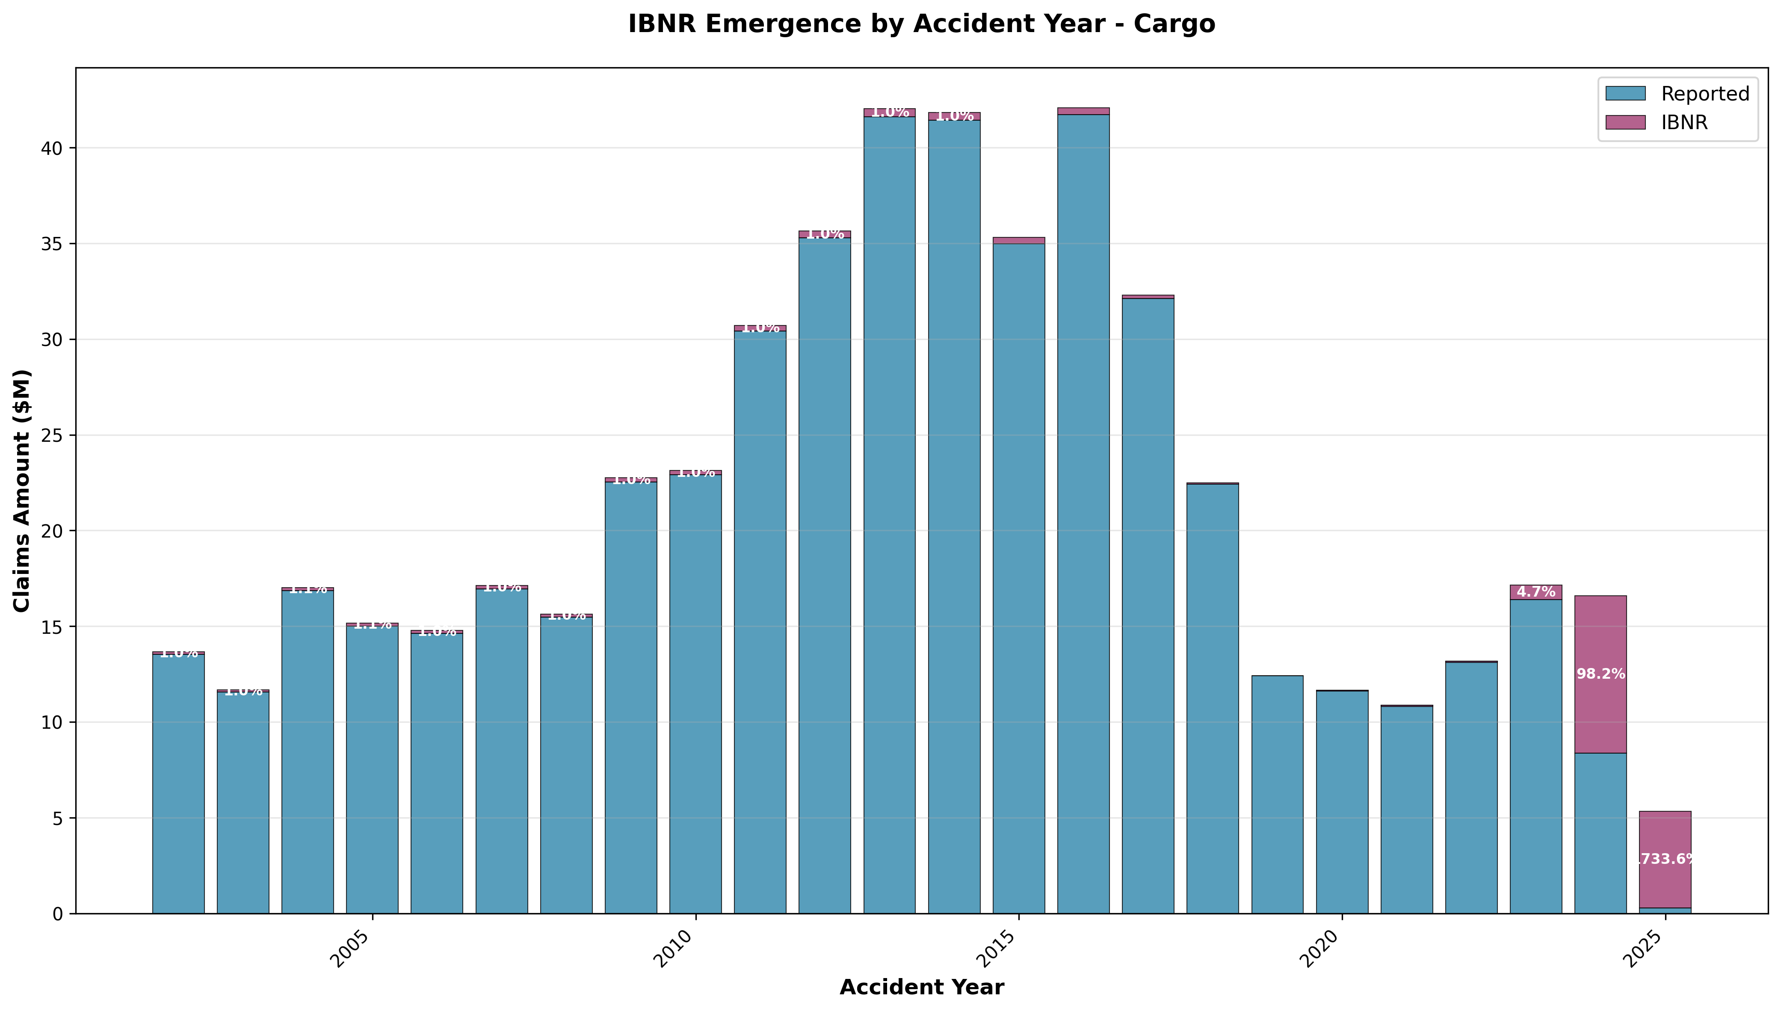
IBNR Reserve Emergence Pattern
Notes:
IBNR emergence pattern shows how reserves develop over time. Recent accident years have higher percentages of outstanding IBNR. This pattern validates our development factor selections and tail assumptions. (Duration: 45 seconds)

Slide 21
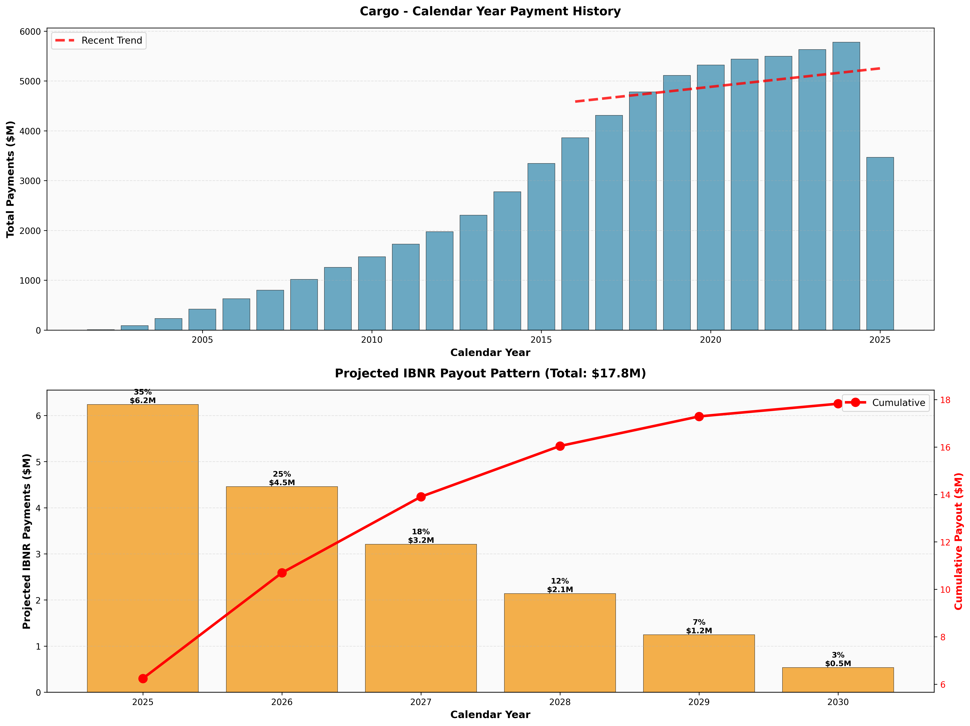
Calendar Year Reserve Projection
Notes:
Calendar year projection important for monthly financial reporting. Shows when IBNR will emerge in future accounting periods. Critical for capital planning and regulatory reporting requirements. (Duration: 45 seconds)

Slide 22
Final Report & Documentation
Deliverables Created:
• Comprehensive analysis report (1,000+ words with code references)
• Monthly triangle Excel workbook with projections
• Produced EDA visualizations
• projection dashboards for stakeholders
• Data quality report with 85.7% score
• Python codebase on GitHub with version control
Documentation:
• TFS Work Item PBI with full audit trail
• TFS Work Item PBI for data quality
Notes:
Comprehensive deliverables package. Analysis report references all code with line numbers. Excel workbook contains triangles and projections. All visualizations at publication quality. Full documentation in TFS and ServiceNow for audit trails. Codebase version controlled on GitHub. (Duration: 1 minute)

Slide 23
Business Impact & Value Delivered
Financial Impact:
• Identified $17.8M IBNR deficiency (3.55% of reported)
• Enabled accurate monthly reserve adjustments vs. annual only
• Improved capital allocation efficiency
Process Improvements:
• Automated pipeline
• Reproducible: Single command regenerates full analysis
• Audit trails: GitHub commits, TFS tracking, ServiceNow incidents
Regulatory Compliance:
• PRA-compliant methodology with statistical validation
• Bootstrap confidence intervals demonstrate robustness
Cost: £0 incremental (leveraged existing tools and infrastructure)
Notes:
Significant business impact: $17.8M reserve deficiency identified, automated monthly process from 40 hours to 5 minutes, zero incremental cost using existing tools. PRA-compliant with full audit trails. Reproducible pipeline for future monthly runs. (Duration: 1.5 minutes)

Slide 24
Conclusions & Recommendations
Summary:
✓ Successfully implemented monthly Chain Ladder model
✓ Integrated data from 3 source systems via validated ETL
✓ Applied dual-method outlier detection (IQR + Z-score)
✓ Identified $17.8M IBNR with 93.21% maturity
✓ Delivered reproducible Python pipeline on GitHub
Recommendations:
• Integrate into monthly financial close process
• Extend methodology to other lines of business
• Implement sensitivity analysis for stressed scenarios
• Enhance tail factor with machine learning approaches
Thank you - Questions?
Notes:
In conclusion, delivered complete monthly Chain Ladder solution identifying significant reserve deficiency. Integrated enterprise data architecture with rigorous actuarial methodology. Recommendations include monthly integration, extension to other business lines, and ML enhancements. Thank you for your attention - happy to take questions. (Duration: 2 minutes)

