Slide 1
Git Simplified

Slide 2
Terminology
Repo
Git directory on every computer is a full-fledged repository with:
Complete history,
Full version tracking abilities, and is
Independent of any network access or a central server.
Branch
Git doesn’t store data as a series of changesets or deltas,
but instead as a series of snapshots.

Slide 3
More Terminology
Working tree
Consist of files that you are currently working on.
Index
Is a staging area where new commits are prepared. It acts as the interface between a working tree and a repository.

Slide 4
Even more Terminology
origin
The default name that Git gives to your main remote repo. Your box has its own repo, and you most likely push out to some remote repo that you and all your coworkers push to. That remote repo is almost always called origin, but it doesn't have to be.
upstream
generally refers to the original repo that you have forked
HEAD - "what is my repo currently pointing at"
The current commit your repo is on. Most of the time HEAD points to the latest commit in your branch, but that doesn't have to be the case.

Slide 5
Topography
Server
Repo A
Repo B
fork
master
Branch_1
master
Branch_1
push
pull
push
pull
push
pull
push
pull
clone
clone
Set remote origin
Local
Repo A
Repo B
master
Branch_1
master
Branch_1
add
commit
merge
add
commit
add
commit
add
commit

Slide 6
Repo Operation
Initialize/reinitialize a git repo, from the folder run:
git init
Push the repo to the server
Add the remote origin
git remote add origin https://github.com/ahmed/sample.git
Push to the remote origin. You specify the branch (current branch is default)
git push -u origin master

Slide 7
Inter-repo Operations
Clone a repo into a newly created directory
git clone <repo URL>
Fork: easier from bitbucket UI
https://confluence.atlassian.com/bitbucket/forking-a-repository-221449527.html
Pull: fetch and merge changes
git pull
Push: push your committed changes up to remote origin
git push
Set Origin
git remote set-url <repo url>

Slide 8
Working with remote
List remotes
git remote
or
git remote –v
Add a remote
git remote add <shortname> <url>
Example:
git remote add ahmedsample https://github.com/ahmed/samplerepo
Switch between remotes
git remote set-url origin <repo-url>
Use the <shortname> to fetch changes from this remote
git fetch ahmedsample
You can access branches in this remote via <shortname>/<branchname>
Example: ahmedsample/master
Pushing to a remote, use git push <remotename> <branchname>
Ex: git push ahmedsample master

Slide 9
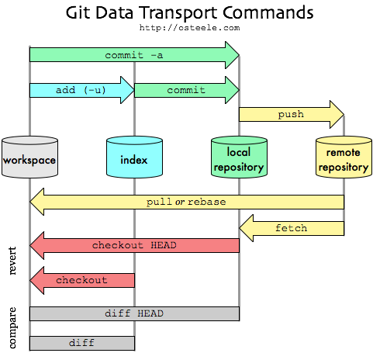
Working tree vs Index vs HEAD

Slide 10
Branch Operations
List current branches
git branch
Which will show :
* current_branch
other_branch_one
other_branch_two
Change current branch
git checkout [name_of_your_branch]

Slide 11
Create a branch
Create a branch on local repo
git checkout -b [name_of_your_new_branch]
Push the branch to origin repo
git push origin [name_of_your_branch]

Slide 12
Delete a branch
Delete a local branch, if totally merged:
git branch -d [branch_name]
To force the deletion of local branch, if not totally merged:
git branch -D [branch_name]
Delete the branch on the server:
git push origin --delete <branch_name> ← Git version 1.7 or newer
Or
git push origin :[branch_name]. ← Older Git versions

Slide 13
Branch ops, cont.
Add a new remote for your branch:
git remote add [name_of_your_remote]
Push changes from your commit into your remote branch:
git push [name_of_your_new_remote] [name_of_your_branch]
Update your local branch with changes from the remote original branch:
git fetch [name_of_your_remote]
Merge changes you fetched into working copy:
git merge
pull = fetch + merge
git pull

Slide 14
Pull vs. fetch

Slide 15
Inside-branch ops
Get status of your files (modified/not tracked, staged/ready to commit)
git status
Stage your changes (add files to index)
git add .
Or
git add <file path>
Commit your staged changes (add to local repo)
git commit -m “comment message”

Slide 16
Inside-branch ops, cont.
Shelve or Stash your changes. This stash your modified and staged changes.
git stash
List your stashes
git stash list
Unshleve/unstash
git stash apply
https://git-scm.com/book/en/v1/Git-Tools-Stashing
https://git-scm.com/docs/git-stash

Slide 17
Inside-branch ops, cont.
Undo working (untracked or not staged) files
git checkout .
Remove untracked files
git clean
https://git-scm.com/docs/git-clean
Undo working and staged changes
git reset
https://git-scm.com/docs/git-reset
Undo committed changes (turning them to working files)
git revert
https://git-scm.com/docs/git-revert

Slide 18
Inter-branch ops
Merge. Incorporates changes from the named commits (since the time their histories diverged from the current branch) into the current branch.
While on the destination branch, run the merge command
git merge [name_of_your_source_branch]
This will bring all the changes since the history diverged.
https://git-scm.com/docs/git-merge

Slide 19
Inter-branch ops
Switch between branches.
git checkout [name_of_branch]
https://git-scm.com/docs/git-checkout

Slide 20
Resources
“Pro Git” Book https://git-scm.com/book/en/v2

