Slide 1
CALAMBRA
OLIVE OIL
Monte Carlo Risk Analysis
Part B · Crystal Ball Simulation
Group 1-4
Ajaiy Prabhu
Shweta Mittal
Ish Patel
Sumeet Shinde
EGRMGMT 580 · Decision Models · Spring 2026
Notes:
This presentation answers a single question: how many gallons should Frank Lockfeld order for 1994? Part A gave us a deterministic base case of negative $104,976, which looks like a clear loss. Part B uses Monte Carlo simulation to show why that single number is misleading and what the full range of outcomes actually looks like. We ran 100,000 trials across 9 uncertain variables with 3 correlation relationships built directly from Frank's own estimates.

Slide 2
PROBLEM SETUP
What are we solving for Frank Lockfeld?
The Business
What We Need to Find
Frank Lockfeld
1
What is the full distribution of outcomes- not just the base case?
Imports premium Calambra olive oil from Greece, sells to specialty retailers in the Bay Area.
2
Which uncertain variables drive the most risk?
1993 Order
800 gallons placed i.e. ~325 cases produced. Whether 1993 sells out is the pivot event for this entire business.
3
How does 1993 sell-out status change everything for 1994?
The Decision
4
What is the optimal 1994 order quantity across scenarios?
How many gallons to order for 1994? Frank must commit before 1993 results are known.
5
How should Frank approach catalog deals and broker negotiations?
Part A Result
Deterministic base case = –$104,976. Alarming, but it's a single point , not the full picture.
6
What is the value of getting better information before deciding?
Notes:
Frank imports premium Calambra olive oil from Greece and sells through specialty retailers in the Bay Area. In 1993 he placed an 800-gallon order, which produces roughly 325 cases after bottling losses. The critical structural feature of this business: whether 1993 sells out completely is not just one input among many, it is the branching event that determines which version of 1994 Frank is even operating in. The deterministic Part A model pegged total value at negative $104,976. That number is not wrong; it is just one point on a distribution that has significant upside scenarios the deterministic model cannot see. The six questions on the right frame exactly what simulation adds: the full distribution, the key drivers, the conditional structure of 1994, the optimal order quantity, the role of catalog deals and broker negotiations, and the value of getting better information before committing.

Slide 3
SIMULATION SETUP
9 Crystal Ball assumptions · 3 correlations · 100,000 trials
Uncertain Variable
Distribution / Range
Correlation Matrix
1993 Base Retail Demand
Custom · 0 – 500 cases
1993 Demand b/w Wholesale Price
+0.5
Neiman Marcus Deal
Binary · 0 or 100 cases (p = 10%)
Higher demand: price holds or rises
Williams-Sonoma Deal
Binary · 0 or 30 cases (p = 40%)
Advertising Boost per Catalog Deal
Custom · 0 – 75 cases
1993 Demand b/w Broker Take
−0.5
1994 Demand (if sold out in 1993)
Custom · 0 – 1,880 cases
Higher demand: broker fee falls
1994 Demand Multiplier (if not sold)
Custom · 0 – 3.9× of 1993 actual sales
Wholesale Price per Case
Custom · $113.82 – $186.18
Wholesale Price b/w Broker Take
0.0
Broker Take (1994+)
Custom · 3.53% – 27.43%
No direct relationship assumed
100,000 trials
Key design: 1994 demand is not one distribution — it's an IF formula conditional on 1993 sell-out.
Forecast: Total Value at End of Year 1994
Notes:
Crystal Ball assumption, all built from Frank's 10th, 50th, and 90th percentile estimates from the case interview. A few things worth explaining on this slide.
On the assumptions table: the first four rows, base retail demand, Neiman Marcus, Williams-Sonoma, and advertising boost, all feed into total 1993 demand. Rows five and six are the most structurally important: 1994 demand is not a single distribution. It is an IF formula. If 1993 sells out, the sold-out branch fires using Frank's 300/1,200/1,600 case estimates. If 1993 does not sell out, the model switches to a multiplier in 1993 actual sales, Frank's estimates were 0.25x, 1x, and 3x. These two branches represent entirely different business realities, and that conditional logic is the most important modeling decision in Part B. Wholesale price and broker take are the remaining two assumptions, both directly affect margin in every scenario.
On the correlation matrix: three relationships directly from Frank. Demand and price at positive 0.5, strong demand years tend to support higher prices. Demand and broker take at negative 0.5, strong demand gives Frank negotiating leverage to push fees down. Price and broker have zero correlation, no direct relationship assumed. These were entered manually in Crystal Ball's Define Correlations matrix, not estimated by us.
The 100,000-trial count is standard for stable distributional results at this model complexity.

Slide 4
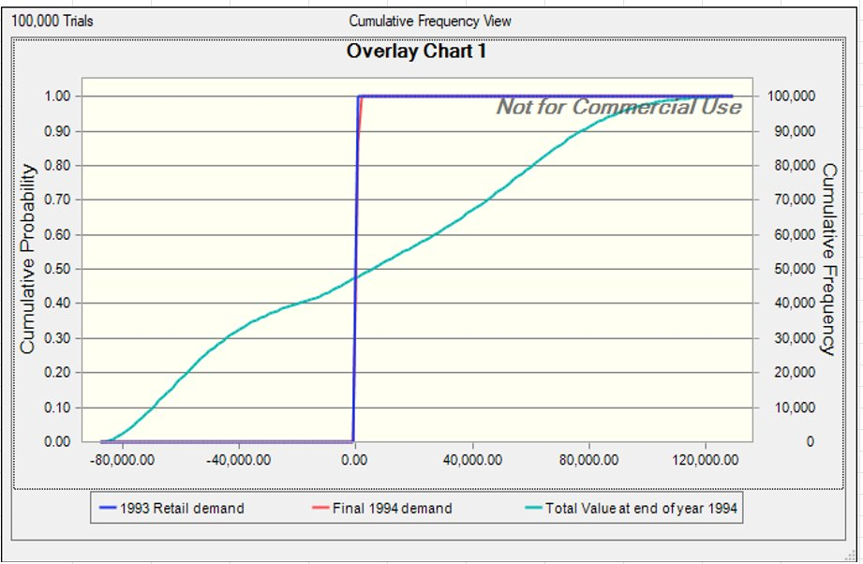
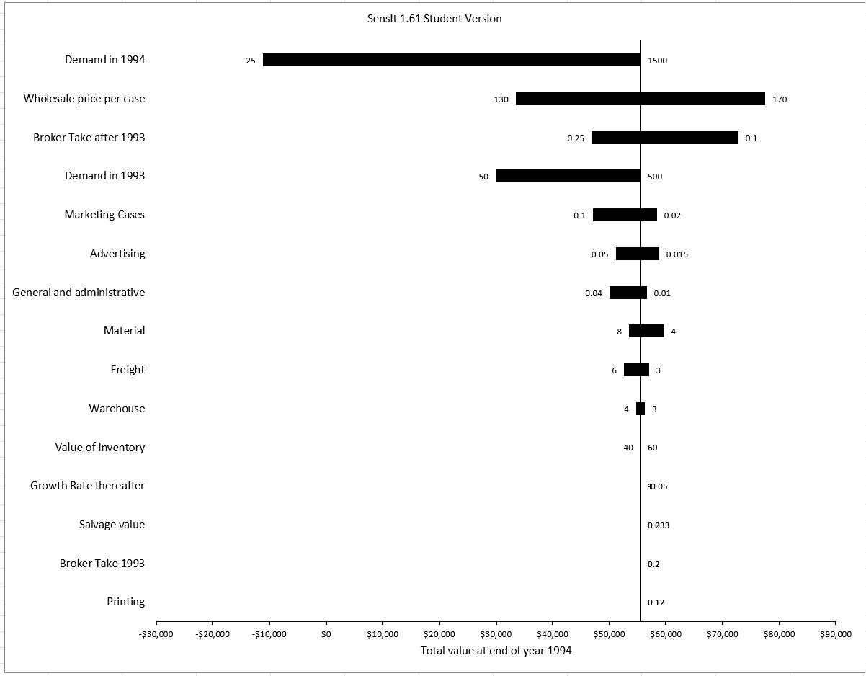
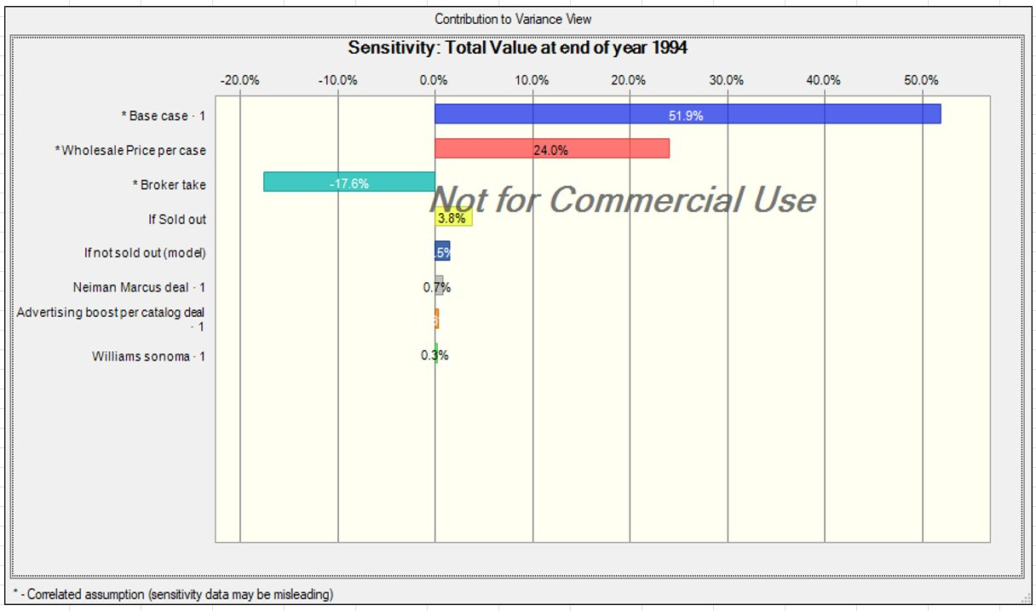
1993 DEMAND: THE SELL-OUT HINGE
The most important variable- drives 51.9% of all outcome variance
Cumulative Frequency 1993 and 1994 and Total Value
Tornado Chart: Total Value after 1994
Sensitivity Analysis
307.6
317.0
149.4
~50%
Mean (cases)
Median
Std Dev
P(Sell-Out)
Strong demand year: price is high AND broker fee is low simultaneously. Correlations compound both the upside and the downside.
Notes:
Cumulative Frequency 1993 and 1994 and Total Value: This is the cumulative distribution function for total 1993 demand across all 100,000 trials. The x-axis is cases; the y-axis is cumulative probability. Read it as: what is the probability that demand falls at or below a given number of cases. The mean is 307.6 cases and the median is 317. The sell-out threshold, how many cases Frank can produce from his 800-gallon 1993 order, is roughly 300 cases. Because the median sits just above that threshold, approximately 50% of trials result in a sell-out. This is not a comfortable margin. Frank is essentially on a coin flip for the event that drives over half of all outcome variance.
The standard deviation of 149 cases reflects the spread of Frank's custom distribution. The range runs from near zero to just under 700 cases, capturing both the scenario where the product gets no traction at all and the scenario where demand significantly exceeds supply.
Tornado Chart: Total Value after 1994: This scatter plot shows simulated pairs of 1993 demand and wholesale price across trials. The positive slope confirms the +0.5 correlation is working correctly in the model, high demand scenarios cluster toward higher prices, low demand scenarios toward lower prices. This is not a tight relationship, the scatter is wide, but the directional effect is real and material given wholesale price contributes 24% of outcome variance.
Sensitivity Analysis: Same structure but negative slope. High demand trials cluster toward lower broker fees; low demand trials cluster toward higher fees. The negative 0.5 correlation means that in a bad demand year, Frank faces a double penalty: lower revenue AND a higher percentage going to the broker. In a strong demand year, he gets a double benefit. This compounding effect is why correlations matter so much here, ignoring them would significantly understate both the upside and the downside tails of the total value distribution.

Slide 5
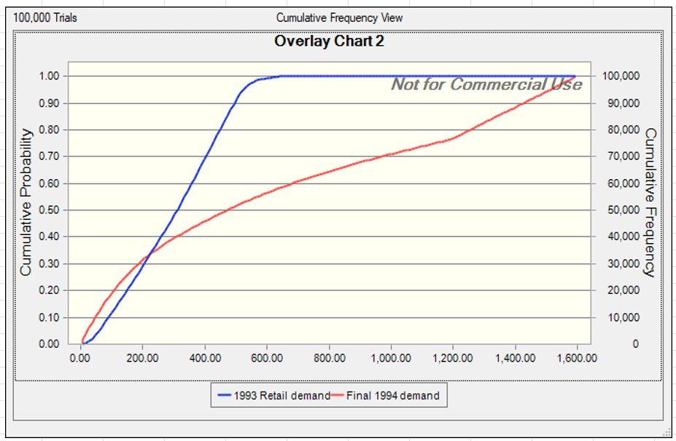
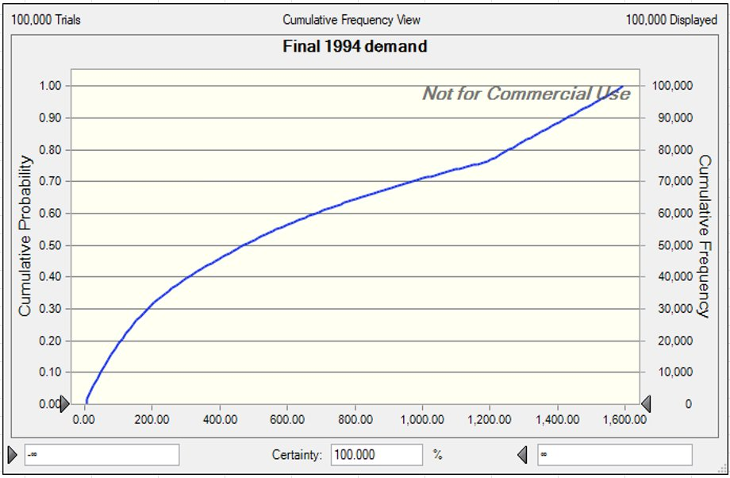
KEY DRIVERS: TORNADO & SENSITIVITY
SensIt one-at-a-time CB contribution to variance across 100K trials
Cumulative Frequency Chart
Final 1994 Demand Cumulative Frequency Chart
Variance Breakdown
51.9%
1993 Demand (Base Case)
24.0%
Wholesale Price
17.6%
Broker Take (neg.)
3.8%
Sell-Out Branch
~2%
Catalog Deals (combined)
1993 demand drives more variance than all other variables combined. It is not just an input — it is the switch between two business futures.
Notes:
Cumulative Frequency Chart: This chart is built by moving each uncertain variable from its low value to its high value one at a time while holding everything else at the base case, then measuring the resulting swing in total value. The variables are ranked by the size of that swing, widest bar at the top, narrowest at the bottom. The key reading: 1993 base retail demand produces by far the widest bar. Moving just that one variable from low to high swings total value by more than any other input. Wholesale price is second, broker take is third and shows a negative relationship, higher broker take means lower value, which is why the bar extends in the negative direction.
Final 1994 Demand Cumulative Frequency Chart: This chart is different in methodology. Instead of moving one variable at a time, Crystal Ball measures how much each variable contributes to the total variance across all 100,000 trials simultaneously, accounting for all the cross-variable interactions and correlations happening at once. The result is consistent with the tornado: 1993 demand at 51.9%, wholesale price at 24%, broker take at 17.6% negative, sell-out branch at 3.8%, catalog deals combined at roughly 2%.
One technical note on this chart: Crystal Ball flags correlated assumptions with a warning that sensitivity data may be misleading. This is because when variables are correlated, attributing variance cleanly to each individual variable is not perfectly precise. That is why we show both charts, the tornado gives a clean one-at-a-time view, the CB chart gives the simulation-integrated view. Both point to the same hierarchy of drivers.\
The takeaway from both charts combined: 1993 demand is not just the most important variable, it is the switch that determines which version of the entire business Frank is running. Everything else is secondary.

Slide 6
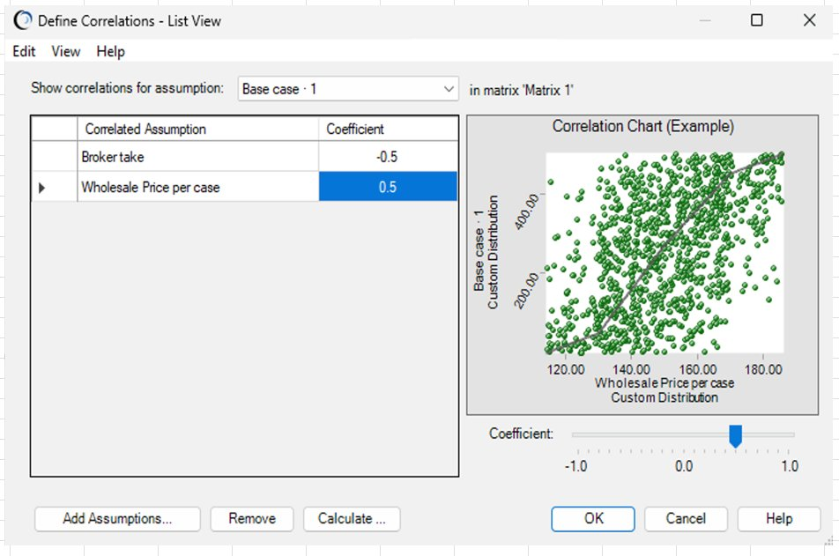
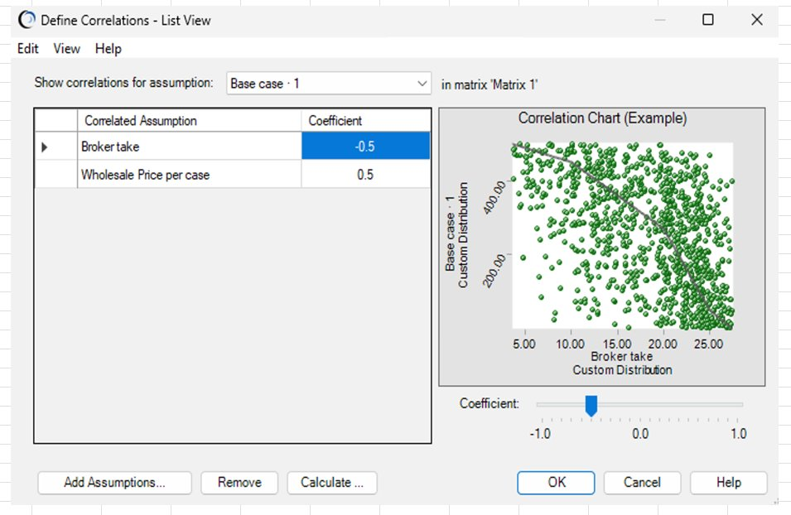
1994 DEMAND: CONDITIONAL ON 1993 SELL-OUT
Base Case vs Wholesale Price
Base Case vs Broker take
307.6
~300
630.5
±522
1993 Mean
Sell-Out Threshold
1994 Mean
1994 Std Dev
Sold out - median 1994 demand = 1,200 cases
Not sold out: 1× 1993 actual (Business likely shut down)
Notes:
Base Case vs Wholesale Price: This distribution is the blended result of the two conditional branches, roughly half the trials following the sold-out path, half following the multiplier path. The mean is 630.5 cases, but the standard deviation is 522 cases, nearly as large as the mean itself. This extreme width is exactly what the sell-out hinge produces. The CDF shape shows a relatively flat section at low demand levels, then a steep rise through the middle range, then a long right tail extending to 1,600 cases. That long tail represents the sold-out scenarios where Frank's 1994 demand is exceptionally high.
Compared to 1993's standard deviation of 149 cases, the 1994 standard deviation of 522 is 3.5 times larger. 1994 is a fundamentally more uncertain year, and that uncertainty is entirely created by the conditional branching structure, not by any individual variable being especially volatile.
Base Case vs Broker take: This overlay chart plots both distributions on the same axes, allowing direct comparison. The 1993 distribution is tighter and concentrated between zero and roughly 700 cases. The 1994 distribution has a much wider spread with a pronounced right tail. The visual gap between them makes the sell-out hinge concrete: if 1993 resolves well, the 1994 distribution shifts dramatically to the right. If not, it collapses back toward the 1993 range.
The two outcome tags at the bottom translate this directly: sell-out in 1993 gives a median 1994 demand of 1,200 cases. No sell-out gives roughly 307 cases, essentially flat from 1993, with business shutdown likely. These are not similar outcomes with different upside. They are two different businesses.

Slide 7
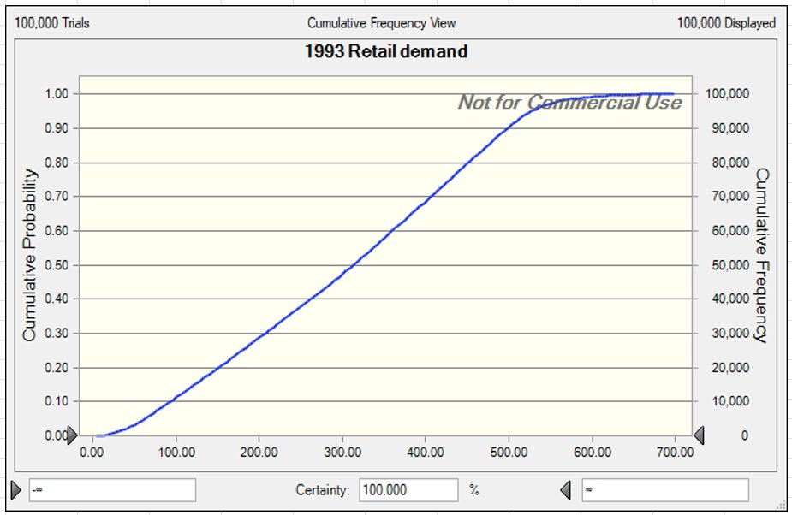
TOTAL VALUE DISTRIBUTION
Full profit risk profile across 100,000 scenarios · 3,000-gallon order assumed
Total Retail Demand 1993 Cumulative Frequency
Simulation Statistics
Deterministic Base
–$104,976
MC Mean
+$4,404
MC Median
+$6,473
Std Dev
$56,221
Minimum
–$88,566
Maximum
+$130,310
P(loss)
~45%
Skewness
0.07 right
MC mean is $109K above the deterministic base case. Sell-out upside is real — single-point models cannot see it.
Note: all statistics reflect the 3,000-gallon order in the model. Our recommendation of 1,250–1,500 gallons improves expected value by eliminating liquidation drag.
Notes:
Total Retail Demand 1993 Cumulative Frequency: This is the key output chart. The x-axis is total dollar value at end of year 1994, the y-axis is cumulative probability. A few reference points to call out: the curve crosses zero at approximately the 45th percentile, meaning roughly 45% of all simulated scenarios result in a negative total value, a loss. The 10th percentile is around negative $88,000. The 90th percentile is around positive $130,000. The median is positive $6,473, meaning more than half of scenarios produce a profit, but the loss scenarios are severe enough to matter significantly.
The deterministic base case of negative $104,976 appears as a single point on the far left of this distribution, a real scenario, but not remotely representative of the expected outcome. The Monte Carlo mean of positive $4,404 is $109,000 higher. That gap is entirely attributable to the sell-out upside scenarios that a single-point deterministic model cannot access.
The slight right skew- skewness of 0.07, means the distribution has a longer right tail than left. Best-case outcomes are further from the median than worst-case outcomes, which is favorable, but the standard deviation of $56,000 on a mean of $4,000 makes this an extremely high-variance bet regardless.
Important caveat on this slide: all statistics shown reflect the 3,000-gallon order quantity used in the model. Our recommended 1,250-1,500-gallon order would produce a different, improved distribution by eliminating the liquidation drag from overstock.

Slide 8
RISK ANALYSIS
Quantifying the downside, upside, and loss probability
IF 1993 SELLS OUT (~50% probability)
IF 1993 DOES NOT SELL OUT (~50% probability)
1994 Demand Range
300–1,600 cases
1994 Demand
0.25× – 3× of 1993 actual
Median 1994 Demand
1,200 cases
Median 1994 Demand
~307 cases (1× actual)
Expected Total Value
+$60K – $130K
Expected Total Value
–$88K – +$20K
P(positive outcome)
~85%
Business Continuity
Shut down advised
Business validated. Stores compete for 1994 allocation. National expansion viable.
Experiment failed. Brokers and retailers lose confidence. No 1995 order.
Overall Risk Profile (3,000-gallon order)
~45%
–$88K
+$130K
$56K
12.8×
+$4.4K
P(loss)
Worst case
Best case
Std deviation
Coeff. of variation
Expected value
CV of 12.8× on a $4K mean: this is a speculative venture. Expected value is positive, but barely, and with substantial loss probability.
Notes:
The two scenario cards at the top translate the simulation into plain business language. In the sell-out scenario, which has roughly 50% probability- 1994 demand ranges from 300 to 1,600 cases with a median of 1,200. Expected total value in that branch runs from positive $60,000 to $130,000, and roughly 85% of those trials are positive. The business is validated, retailers want more product, and national expansion becomes viable.
In the no-sell-out scenario, also roughly 50% probability, 1994 demand follows the multiplier on 1993 actual sales. If 1993 actual sales were modest, 1994 demand under the 1x median multiplier is similarly modest, roughly 307 cases. Expected total value in that branch runs from negative $88,000 to positive $20,000. Business continuity is not viable; Frank would rationally shut down rather than continue.
The six risk metrics at the bottom give the full picture at the 3,000-gallon order: 45% loss probability, worst case negative $88,000, best case positive $130,000, standard deviation $56,000, coefficient of variation 12.8, expected value positive $4,400. The CV of 12.8 is the most important number on this slide. It means the uncertainty, measured by standard deviation, is nearly 13 times larger than the expected gain. By any conventional risk measure, this is a speculative venture. The expected value is positive, but only barely, and it requires accepting substantial probability of a significant loss.

Slide 9
ALTERNATIVES - ORDER QUANTITY COMPARISON
Three strategies evaluated against mean 1994 demand of 630 cases
CONSERVATIVE
RECOMMENDED
AGGRESSIVE
~750 gal to -303 cases
1,250–1,500 gal to 500–600 cases
3,000 gal to 1,211 cases
Cases Produced
~303 cases
500–600 cases
~1,211 cases
vs Mean Demand (630)
Undercovers by 327
Covers ~80th percentile
Overcovers by 581
Liquidation Exposure
Near zero
~30-130 cases
~580 cases
Liquidation Cost
~$0
~$4K–$18K
~$78K margin lost
If 1993 Sells Out
Misses major upside
Captures most upside
Full upside, high cost
If 1993 Fails
Minimal loss
Moderate loss
Significant loss
Expected Value (est.)
~$15K–$25K
~$18K–$30K
+$4.4K (as modeled)
Recommended: 1,250–1,500 gallons- best balance of upside capture and liquidation protection given ~630 case mean demand.
Notes:
This table compares three order quantity strategies against the simulation's mean 1994 demand of 630 cases.
The conservative option of roughly 750 gallons produces about 303 cases, well under the mean demand. Liquidation exposure is near zero, and if 1993 fails the downside is minimal. But if 1993 sells out and 1994 demand reaches 1,200 cases, producing only 303 cases means leaving roughly 900 cases of potential revenue on the table. Expected value estimated in the $15,000-$25,000 range.
The recommended option of 1,250-1,500 gallons produces 500-600 cases, covering approximately the 80th percentile of expected 1994 demand. Liquidation exposure is manageable at 30-130 cases in an average scenario. If 1993 sells out, most of the upside is captured. If 1993 fails, the loss is moderate but not catastrophic. Expected value estimated in the $18,000-$30,000 range, superior to both alternatives on a risk-adjusted basis.
The aggressive option of 3,000 gallons produces 1,211 cases against a mean demand of 630, overproducing by roughly 581 cases in the average scenario. Those 581 cases go to liquidation at salvage value, roughly $15 per case versus $150 at full price. That is $135 of destroyed margin per case, times 581 cases, equaling approximately $78,000 in margin destruction in the mean scenario alone. The simulation's own expected value for this option is only positive $4,400, the worst of the three strategies despite having the highest production capacity, precisely because of that liquidation drag.
The highlighted recommended column shows the dominant strategy: it beats conservative on upside capture and beats aggressive on cost protection.

Slide 10
RECOMMENDATION
Three levers Frank controls. Here is what the simulation says about each.
01 · ORDER QUANTITY
02 · CATALOG DEALS
03 · BROKER TAKE
1,250–1,500
Neiman Marcus
1993 Rate
20%
10% chance - 100 cases
Fixed- non-negotiable.
Highest single deal value. Push hard.
1994 Range
10–25%
Williams-Sonoma
Fully negotiable based on 1993 performance.
GALLONS
40% chance - 30 cases
More likely. Smaller volume.
Best case
10%
≈ 500–600 cases produced
Strong 1993: Frank has leverage. Corr = -0.5.
Covers ~80% of demand
Ad Boost (each deal)
per deal - +10–50 cases
Worst case
25%
3,000 gal → $78K margin lost
to liquidation at $15/case
~20 case avg retail lift per deal.
Weak 1993- broker holds all leverage.
Both deals raise P(sell-out):
The #1 value driver.
Broker take = 17.6% of variance. If 1993 succeeds, renegotiate immediately- target 10%.
+$4.4K
+$130K
-$88K
$56K
MC Expected Value
Best Case
Worst Case
Std Deviation
Notes:
Three levers, walk left to right
Order Quantity: 1,250-1,500 gallons
After bottling losses, 1,250 gallons produces ~500 cases and 1,500 gallons produces ~600 cases. Mean 1994 demand from simulation is 630, so this range sits just under expected demand without overcommitting.
The case against 3,000 gallons is simple: it produces 1,211 cases against a 630-case mean. Roughly 580 cases go to liquidation at $15/case versus $150 full price, that's $78,000 in destroyed margin in the average scenario. The simulation's own expected value for 3,000 gallons is only +$4,400, the worst of the three alternatives, entirely because of that liquidation drag.
Catalog Deals
Neiman Marcus is 10% probability, 100 cases, low odds, highest volume. Williams-Sonoma is 40%, 30 cases, more likely, smaller. Each deal adds roughly 20 cases of advertising lift on top.
More importantly: both deals raise P(sell-out) in 1993, which is the event driving 51.9% of all outcome variance. Every case they add moves Frank closer to the sell-out threshold. Pursue both, prioritize Neiman Marcus.
Broker Take
1993 is fixed at 20%, non-negotiable. 1994 is fully negotiable, range 10–25%. The 0.5 correlation with demand means a strong 1993 gives Frank real leverage. If 1993 succeeds, open that negotiation immediately and target 10%. Broker take is 17.6% of outcome variance, the difference between 10% and 20% is material across every 1994 scenario.
The bottom metrics reflect the 3,000-gallon model. Under our recommended order, expected value improves by eliminating liquidation losses.

Slide 11
CONCLUSIONS
Answering the objective: understand the risks, determine the order quantity
Order 1,250-1,500 gallons in 1994
1
Produces 500-600 cases matching expected demand. 3,000 gallons sends ~580 cases to liquidation- $78K in destroyed margin. Cut the order.
1993 sell-through is the highest-leverage action
2
51.9% of outcome variance is driven by 1993 demand. Securing Neiman Marcus, pushing holiday stocking, and maximizing 1993 sell-through is worth more than any 1994 quantity optimization.
Catalog deals matter beyond their direct sales volume
3
NM (10%, 100 cases) and W-S (40%, 30 cases) each add advertising lift and- critical raise P(sell-out) in 1993, which triggers the entire high-demand 1994 demand branch.
If 1993 succeeds, negotiate broker take to 10% immediately
4
Broker take is 17.6% of outcome variance with -0.5 correlation to demand. Strong 1993 gives real leverage. The difference between 10% and 20% is material across all 1994 scenarios.
This is a high-risk venture: enter with a stop-loss rule
5
CV of 12.8× on a $4K mean. ~45% chance of a loss. Worst case –$88K. EVPI ≈ $19,500, spend it on retailer pre-orders and catalog signals first. If 1993 fails to sell out, shut it down.
EGRMGMT 580 · Decision Models · Group 1-4 · Spring 2026
Notes:
order 1,250-1,500 gallons. The math is clear; 3,000 gallons destroys $78,000 in margin in the average scenario through overstock liquidation.
1993 execution is the single highest-leverage action Frank can take. 51.9% of all outcome variance is determined by how well 1993 sells. No amount of 1994 order optimization comes close to the value of selling out in 1993. Neiman Marcus, holiday retailer stocking, and maximizing 1993 shelf placement matter more than anything else on this list.
Catalog deals are not just revenue line items. They directly shift the probability of a 1993 sell-out. Neiman Marcus at 10% probability for 100 cases and Williams-Sonoma at 40% probability for 30 cases each add an advertising boost on top of the direct case volume. Frank should treat these deals as risk management tools that improve his position on the sell-out hinge.
Broker renegotiation is time-sensitive. The negative 0.5 correlation with demand means the leverage only exists while Frank has a strong 1993 result to point to. If 1993 succeeds, the negotiation window opens immediately. Target 10%, not the 20% base rate. That difference is 17.6% of outcome variance across all 1994 scenarios.
Frank should enter this with a documented stop-loss rule, roughly 45% of scenarios result in a loss, with a worst case of negative $88,000. The coefficient of variation is 12.8. If 1993 does not sell out, the model projects shutdown as the rational choice. Frank needs to decide that threshold in advance, not in the moment.

Slide 12
THANK
YOU
Monte Carlo Risk Analysis
Part B · Crystal Ball Simulation
Group 1-4
Ajaiy Prabhu
Shweta Mittal
Ish Patel
Sumeet Shinde
EGRMGMT 580 · Decision Models · Spring 2026

