Slide 1


Pharmaceutical Consulting Services & Beyond
Your trusted partner for pharmaceutical projects
Turnkey plant engineering • Project management • Global regulatory compliance
Since 2003 | ISO 9001:2015 Certified | Indore • Ahmedabad
Notes:
Opening slide. JD Pharma Consultants — pharmaceutical consulting and turnkey plant engineering since 2003.

Slide 2
Turnkey consultancy for regulated manufacturing
WHO WE ARE
JD Pharma Consultants delivers turnkey consultancy services to the Pharma, Biopharma, Nutraceutical, Food & Beverages, API and Chemical industries.
We design facilities in compliance with USFDA, MHRA, WHO-GMP, EU-GMP, TGA, ANVISA and Schedule M — and stay with you from the planning stage until the plant is validated by the regulatory authority.
2003
30+
Year established
Pharmaceutical facilities consulted & set up
13+
ISO
INDUSTRIES WE SERVE
Pharma
Biopharma
Nutraceutical
Countries with completed projects
9001:2015 certified — Bureau Veritas, UKAS accredited
Food & Beverages
API
Chemicals
Notes:
Key facts: established 2003, 30+ pharmaceutical facilities consulted and set up, projects in 13+ countries, ISO 9001:2015 certified (Bureau Veritas, certificate IND.26.14131/QM/U, UKAS accredited).

Slide 3

Designed to pass global inspections
REGULATORY EXPERTISE
We invest considerable time and resources to keep our consulting team current with new regulatory requirements, advances in technology and machinery, and process optimisation breakthroughs.
USFDA
MHRA
EU-GMP
WHO-GMP
United States
United Kingdom
European Union
World Health Org.
TGA
ANVISA
Schedule M
cGMP
Australia
Brazil
India
Current GMP
Notes:
Regulatory frameworks JD Pharma designs to: USFDA, MHRA, EU-GMP, WHO-GMP, TGA, ANVISA, Schedule M and cGMP.

Slide 4






OUR VISION
WHY JD PHARMA
To be among the top 3 pharmaceutical consultancies in the world
Why clients work with us
Proven track record
Regulatory depth
Two decades of pharma projects delivered since 2003
Facilities designed to WHO, GMP, USFDA, MHRA, TGA, ANVISA & Schedule M
— by creating value and providing innovative solutions that reduce cost and turnaround time, without compromising on environmental requirements, while enriching the local community.
Experienced engineers
Always up to date
Electrical, mechanical & instrumentation engineers, pharmacists and biopharmacists
In constant sync with process technology and regulatory changes
Tailor-made solutions
Turnkey responsibility
No one size fits all — every design suits your project environment
End-to-end ownership from concept to final plant validation
Creating value with smarter solutions — experience matters.
Notes:
Vision and the six reasons clients choose JD Pharma.

Slide 5
One partner from first drawing to validation
TURNKEY APPROACH
01
Project planning & design
The project chain is only as strong as its weakest link.
08
Validation
02
Machine selection
Our capability ensures every link is covered. We work with you from the planning stage until the plant is validated by the required regulatory authority.
TURNKEY
APPROACH
07
Testing & commissioning
03
Tender preparation
Plan
Layouts, capacity, feasibility and design basis
06
Equipment selection
04
Vendor approval
Build
Tenders, vendor approval, procurement and installation
05
Procurement
Qualify
Testing, commissioning, validation and approval
Notes:
The eight-stage turnkey cycle: project planning & design, machine selection, tender preparation, vendor approval, procurement, equipment selection, testing & commissioning, validation.

Slide 6
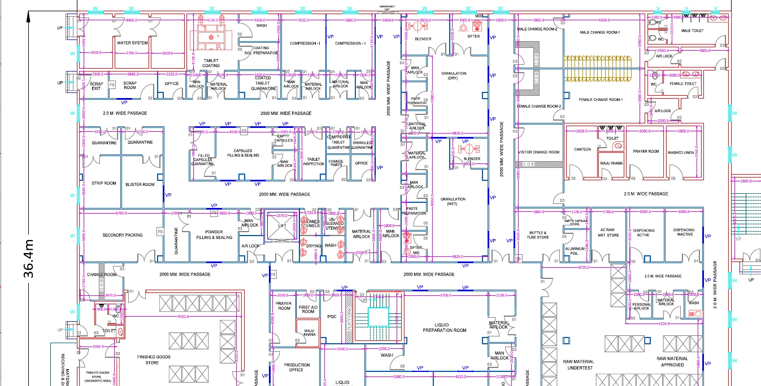


Engineering that starts on the drawing board
TURNKEY SOLUTIONS
GMP-compliant layouts
Plant, machine placement and site master plans built for inspection
Multi-discipline coordination
Civil, HVAC, electrical and utility drawings aligned in one design
Fresh, innovative approach
Long-term or interim compliance solutions — customised for each project
Sample GMP plant layout — zoning, man & material flow and room classification
Notes:
Example of a GMP layout drawing produced by JD Pharma.

Slide 7
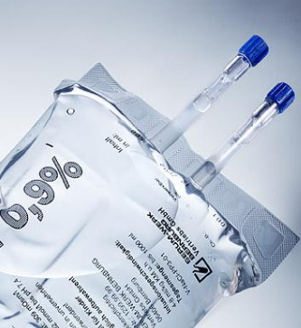


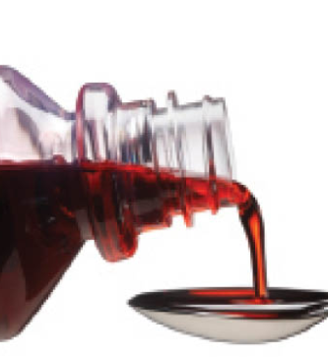
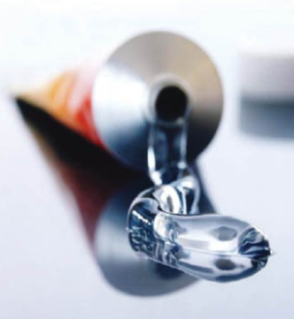
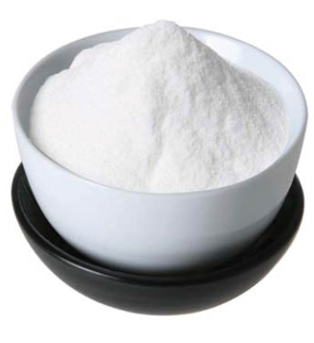
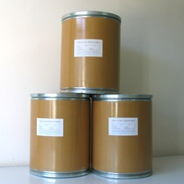
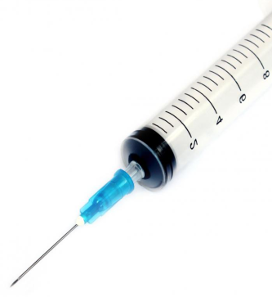
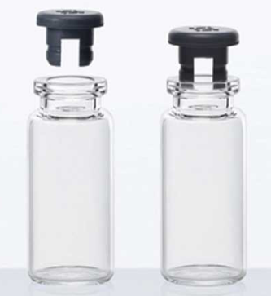
Expertise across every key dosage form
CORE COMPETENCE
30+
pharmaceutical facilities consulted and set up — at both micro and macro level
Large Volume Parenterals
LVP / IV fluids
Small Volume Parenterals
Vials & ampoules
Solid Dosages
Tablets | Capsules
Liquid Orals
Syrups | Suspensions
Ointments
Creams & topicals
Dry Powder
Dry powder injectables
API
Active pharma ingredients
Medical Devices
Device manufacturing
Oncology Products
High-potency facilities
Notes:
Dosage forms and segments: LVP, SVP, solid dosages, liquid orals, ointments, dry powder, API, medical devices, oncology products.

Slide 8





Seven service lines, one accountable partner
WHAT WE DO
Pharmaceutical Engineering
Project Management Consulting
Plant Documentation
Plant Operation Management
Plant layout, civil, HVAC, electrical, utility and cleanroom design
Schedules, tenders, vendors and site coordination to handover
SOPs, site master file, qualification and validation documents
Operational support to run plants efficiently and inspection-ready
12
Turnkey Project Services
Third-Party Audit Services
Global Regulatory Compliance
engineering disciplines delivered in-house — detailed on the next slides
End-to-end delivery from concept to a validated plant
Independent GMP audits and gap assessments
USFDA, WHO-GMP and EU-GMP consulting and facility design
Notes:
Service lines as listed on jdpharmaconsultants.co.in.

Slide 9



Plant & building design
ENGINEERING DISCIPLINES 1/3
Plant Layout Design
Civil Design
Layouts per USFDA, MHRA, TGA, WHO-GMP, cGMP & Schedule M
Man & material flow and machine placement drawings
Site plans with expansion, utility and admin blocks
Architectural & structural drawings of the plant building
BOQ, estimates and floor, wall & ceiling specifications
Cleanroom partition specs, tenders and vendor selection
Electrical Engineering
Utility Design
Complete power distribution and HT yard design
SLDs, earthing, cable & cable-tray layouts
Specs for panels, transformers, DG sets, MCC/PCC, VFDs, UPS
Purified water, WFI, compressed air, vacuum, gas, CIP & SIP
P&IDs for water generation & distribution
BOQ, procurement and approval of vendor drawings
Notes:
Plant layout, civil, electrical and utility design scope from the company profile.

Slide 10



Clean environments & process
ENGINEERING DISCIPLINES 2/3
HVAC
Cleanroom Design
Air-flow diagrams, AHU piping & ducting layouts
AHU grouping, filtration, room classification, pressure zoning
DQ, BOQ, GA drawings, RCP and HVAC tendering
Cleanrooms from ISO Class 1 to Class 9 (FS209E 1–100,000)
Modular walls, walkable ceilings, doors, windows & lighting
Specifications, BOQ, tenders and vendor selection
Capacity Design & Machinery
Plant Safety Engineering
Productivity-based machinery selection
URS for machinery, lab instruments & utilities
Tender documents, quotations and vendor selection
Product, personnel, spill, dust & static-discharge safety plans
Fire / smoke detection and protection design philosophy
Fire water tank, hydrant and sprinkler systems
Notes:
HVAC, cleanroom, machinery selection and plant safety scope.

Slide 11



Compliance, environment & feasibility
ENGINEERING DISCIPLINES 3/3
Environmental Engineering
cGMP Compliance
Effluent identification and complete ETP system design
Scrubbers / incinerators for exhaust air handling
Solid & liquid waste disposal, air and noise pollution control
Alteration & addition plans to make existing plants cGMP-compliant
SOPs, site master file and validation documentation
Readiness for regulatory inspections
Feasibility Study Reports
Turnkey Services
Executive summary and product description
Plant technical details
Market analysis and financial analysis
Complete end-to-end services for pharma projects
From conceptualisation to project handover
Almost all key areas under a single scope
Notes:
Environmental, cGMP, feasibility and turnkey scope.

Slide 12

Trusted from California to Riyadh
SELECTED PROJECTS
01
02
03
Hakeem Pharma
Doctors Company
NutraWest, Inc.
Riyadh, Saudi Arabia
Jeddah, Saudi Arabia
California, USA
Engineering design of a pharmaceutical plant
Oral solid dosage (OSD) manufacturing plant
Nutraceutical manufacturing project
04
05
06
Becton Dickinson
Simfa Labs Pvt. Ltd.
IIIM (CSIR)
Bawal, Haryana, India
Pithampur, India
Pithampur, India
Cleanroom 7 — HVAC, electrical and validation
Pharmaceutical manufacturing unit
Manufacturing unit
Notes:
Projects referenced in client testimonials on jdpharmaconsultants.co.in.

Slide 13
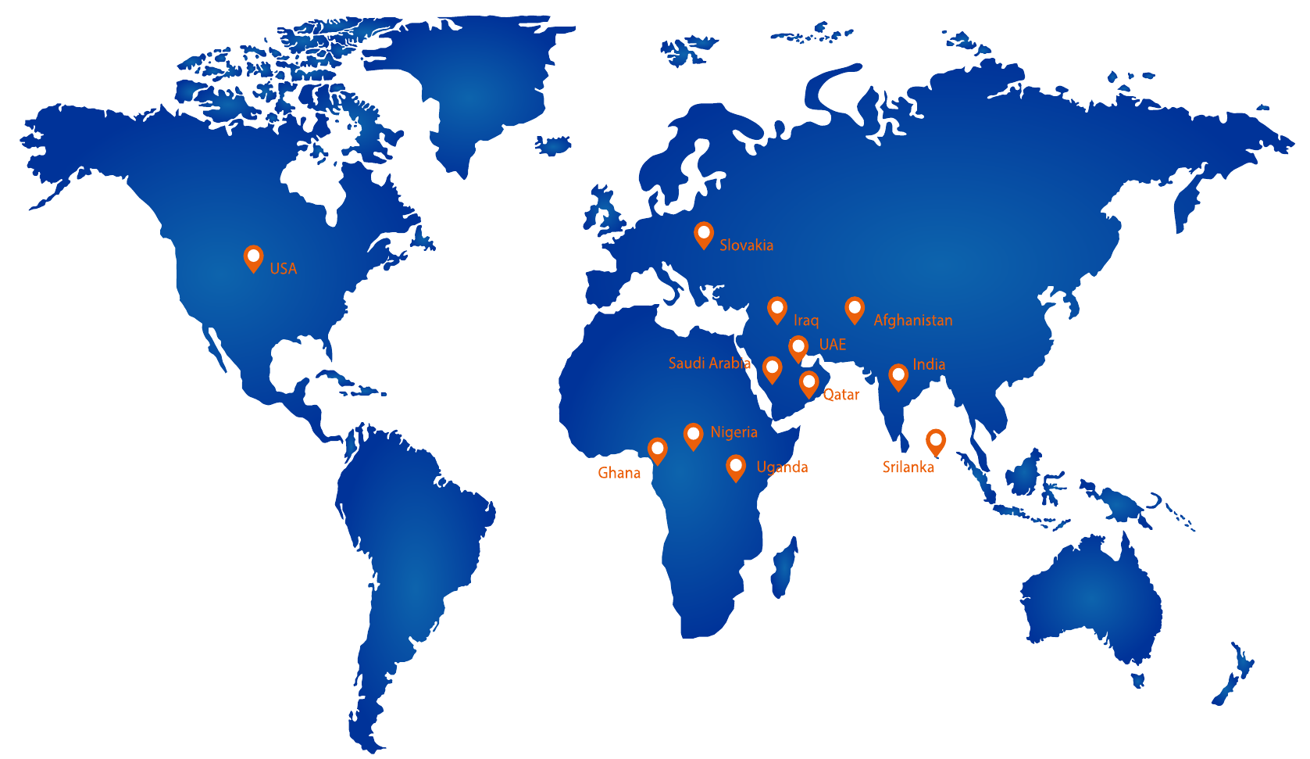
Projects delivered in 13+ countries
GLOBAL PRESENCE
AMERICAS & EUROPE
USA • Slovakia
MIDDLE EAST
Saudi Arabia • UAE • Qatar • Iraq
ASIA
India • Afghanistan
Pakistan • Sri Lanka
AFRICA
Nigeria • Ghana • Uganda
Notes:
Countries with JD Pharma projects or clients, from the company profile map.

Slide 14
40+ clients in India and worldwide
OUR CLIENTS
International 18 clients
India 22 clients
Arab Chemist Co. — Saudi Arabia
Hakeem Pharma — Saudi Arabia
Omar Ban Taha Alsaggaf Factory — Saudi Arabia
Pharmacare Leading Mfg. Co. — Saudi Arabia
Doctors Company — Saudi Arabia
Global Pharma LLC — Dubai
White Star Pharma Solutions — Iraq
Zavita Pharma — Iraq
Life Pearl Pharmaceuticals — Afghanistan
GalaxyPharma — Pakistan
Sands Active (MelwaPharma) — Sri Lanka
Invapharm Inc. — USA
NutraWest, Inc. — USA
Best Green Lab — Slovakia
Dony Triumph & Co. — Nigeria
Hyenang Pharmaceuticals — Nigeria
Kendick Pharmacy — Ghana
Kimsy Meds — Uganda
BectonDickinson India
CSIR – IIIM, Jammu
Kronox Lab Sciences
Advanced Enzymes Technologies
Nitika Pharmaceutical Specialties
Accra Pac India
Bliss Lifesciences
PRICON
Bharat Explosive
Apollo International, New Delhi
Glumex Pharmaceuticals, Mumbai
Govt. Opium & Alkaloids Works, Neemuch
Arihant Chemicals, Ratlam
India Phosphate, Ujjain
Hindustan Phosphate, Pithampur
DJ Laboratories, Pithampur
Namokar Speciality Chemicals, Pithampur
Simfa Labs, Pithampur
Sanctus Drugs & Pharma, Pithampur
Zenith Drugs, Indore
Pricon Surgicals, Jodhpur
Sagar Rubber Products, Mehsana
Notes:
Client list from the company profile; NutraWest and Doctors Company added from website testimonials.

Slide 15





Let's build your next compliant facility
From feasibility to validation — talk to our team today.
HEAD OFFICE — INDORE
BRANCH OFFICE — AHMEDABAD
501 & 503, 5th Floor, Fortune Business Centre, R.N.T. Marg, Indore, M.P. 452001
507, Shilp Aperia, Iscon–Ambli Road, near Landmark Hotel, Ahmedabad, Gujarat 380052
+91 731 4043825 | +91 72230 68942
+91 2717 416683
info@jdpharmaconsultants.co.in
www.jdpharmaconsultants.co.in
Scan to visit
Notes:
Closing slide with office addresses and contact details.

