Slide 1
DASHBOARD CONCEPT · DRAFT v0.1
EUSP Operations
Queue Command Centre
A single Helix view over every EUSP assignment group — built to answer one question each morning: where is work about to breach, and who is not holding any.
8
3
5
assignment groups
regions — AP · AM · EU
technology towers
EUSP Service Operations · draft for review · 23 July 2026
Notes:
Draft one of the EUSP queue dashboard. Sample data only — the layout and column set are what we need Jay to sign off before we build in Helix.

Slide 2
The eight queues, grouped the way we work them
IN SCOPE
Region drives the shift that owns the queue; tower drives who can actually resolve the ticket.
AP
1 queue
AM
4 queues
EU
3 queues
AP-IC-EUSP - EUSP OPERATIONS
AM-IC-EUSP - MDM Support L2 AM
EU-IC-EUSP - L2 Mobility and Systems
EUSP Operations · L1/L2
Intune / MDM · L2
Intune / Mobility · L2
AM-IC-EUSP - MEM Support L3
EU-IC-EUSP - Client Architect
Intune / MEM · L3
Client Engineering · L3/L4
AM-IC-EUSP - W365 Support L3
EU-IC-EUSP - Client PAM Support
Windows 365 · L3
PAM / Privilege · L2/L3
AM-IC-EUSP - SCCM Support L3
SCCM / MECM · L3
AP Operations behaves as an intake queue while the L3 groups are engineering queues — so they cannot share one SLA target or one ageing threshold.
02

Slide 3
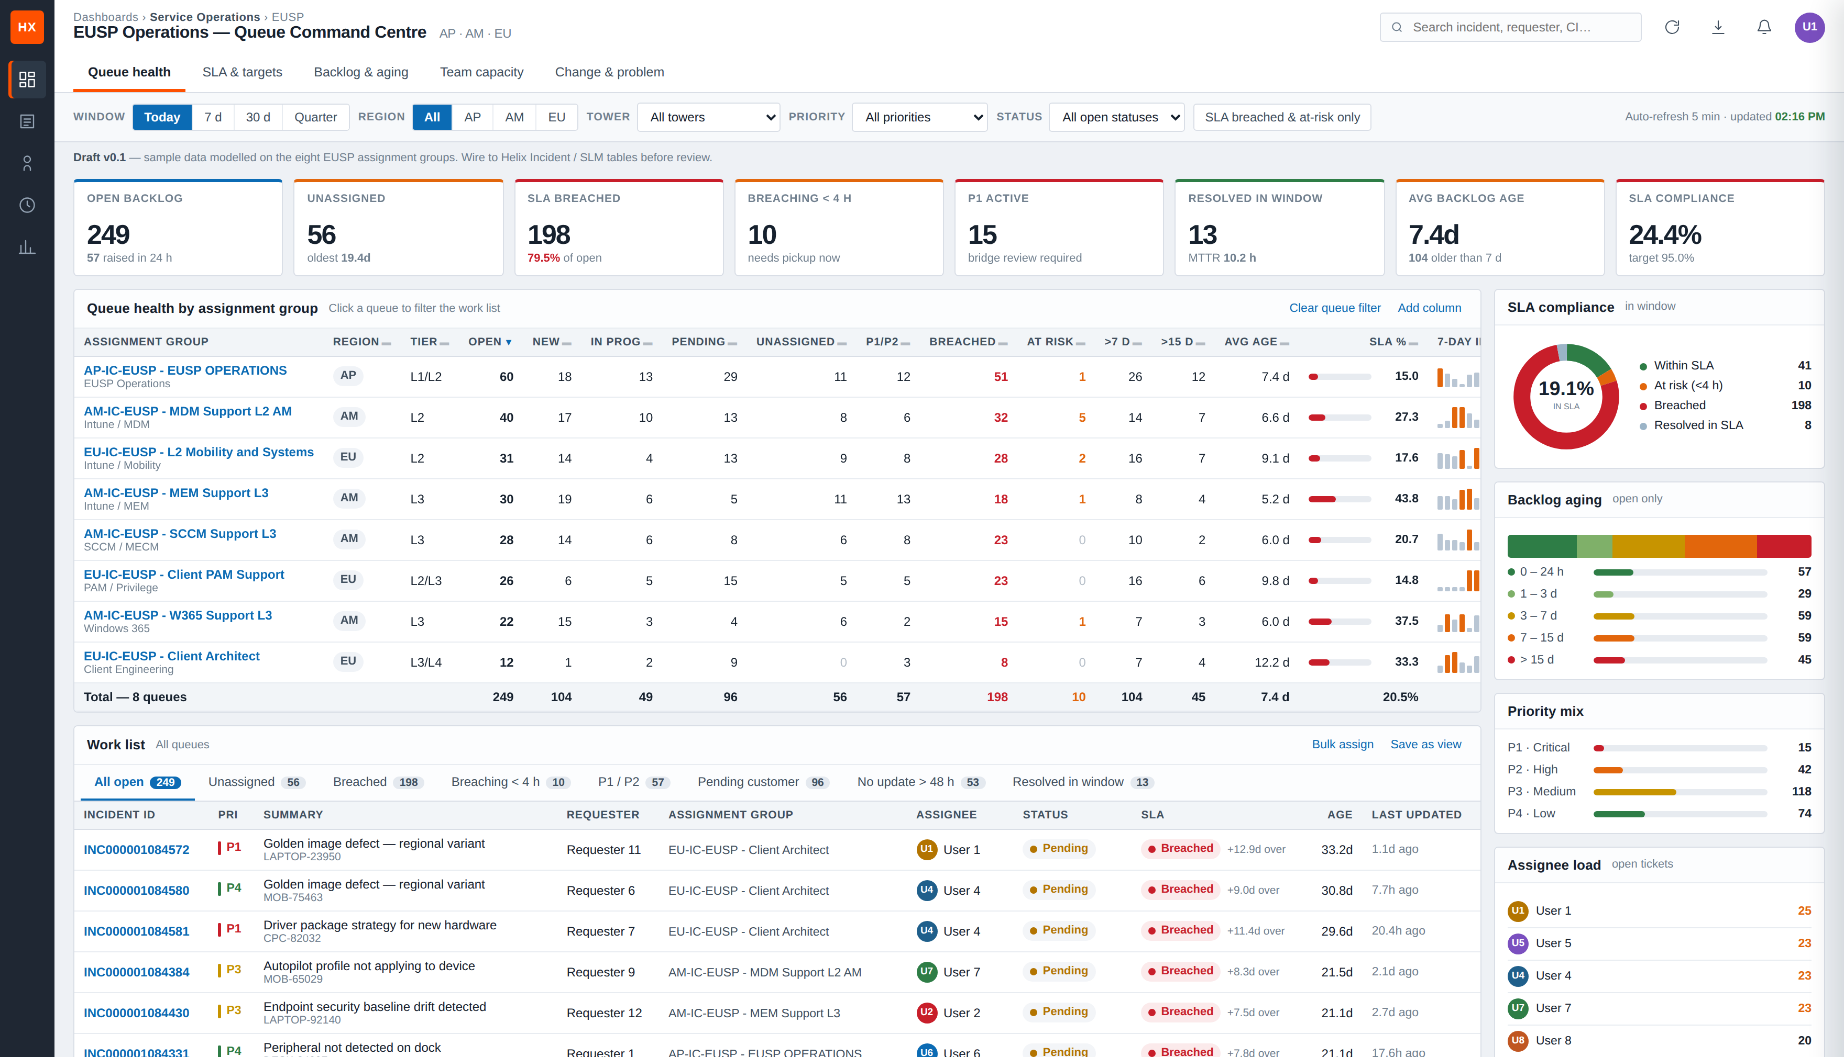
THE CONSOLE
One screen, three zones
1
Health strip
Eight numbers that decide whether today is normal.
2
Queue table
Every assignment group, one row, sorted by whatever hurts.
3
Side panels
SLA, ageing, priority mix and who is carrying the load.
03

Slide 4
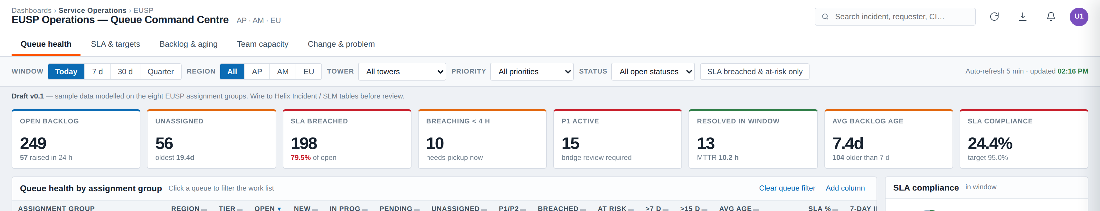
The health strip
ZONE 1
Every tile is a decision, not a statistic — if a number moves, somebody has an action.
Unassigned
SLA breached
Breaching < 4 h
No owner means no clock being watched. Oldest age sits under the number.
Already lost. Drives the recovery note to the service owner.
The only tile that changes what you do in the next hour.
P1 active
Avg backlog age
SLA compliance
Bridge check — should always reconcile with the major incident call.
Slow drift here is how a queue rots without a single breach.
The number that reaches the client. Target 95%.
04

Slide 5
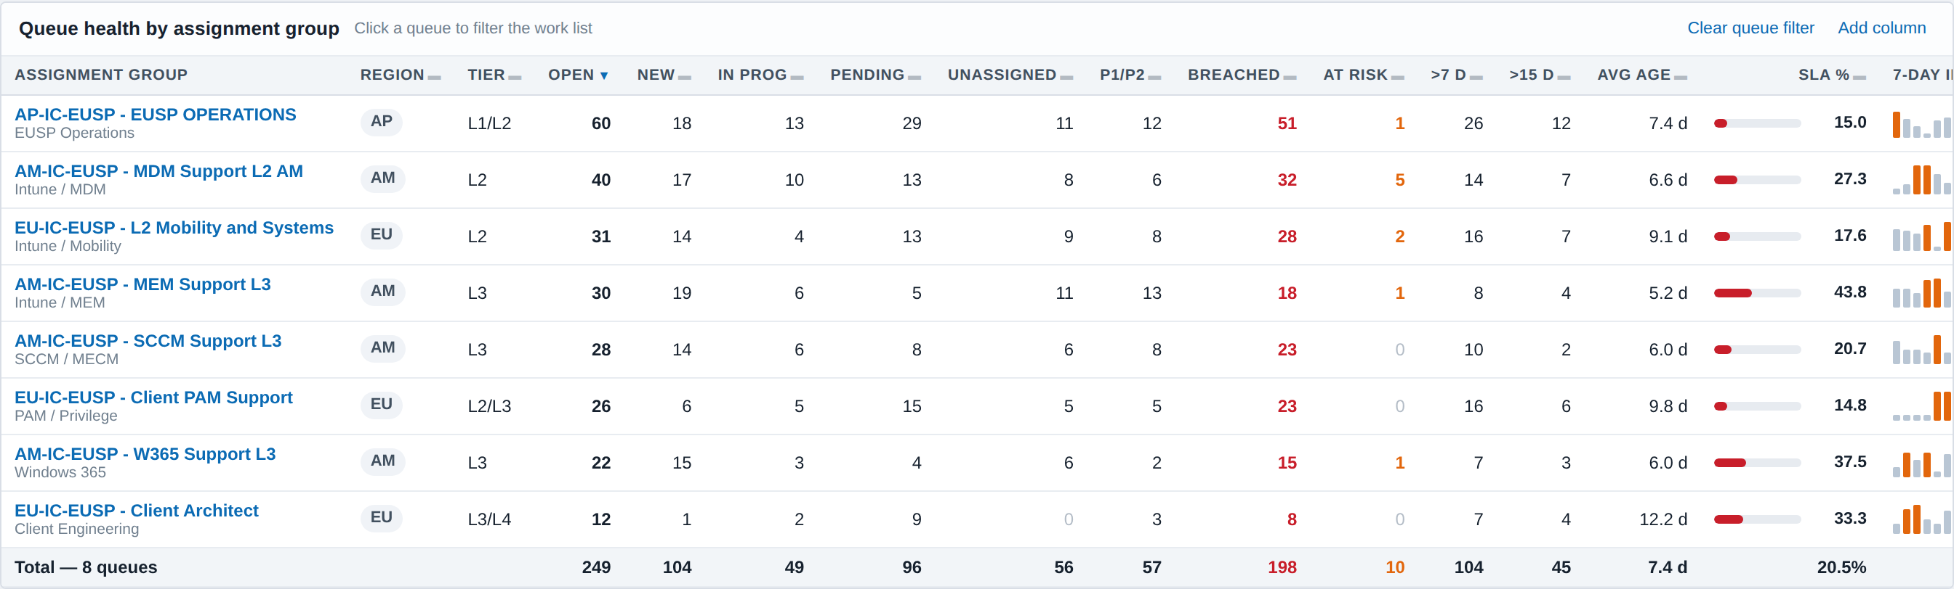
Queue health — the columns we argued for
ZONE 2
Sortable on every numeric column, so the table reorders around whichever problem you are chasing.
Volume | Open · New · In progress · Pending · Resolved
Risk | Unassigned · P1/P2 · Breached · At risk
Backlog quality | > 7 days · > 15 days · Average age
Performance | SLA % bar · 7-day inflow sparkline
Ownership | Queue owner — one named person per row
The two columns people skip
Unassigned-with-oldest-age and no-update-over-48h. Tickets rot there quietly, long before anything shows up as a breach.
05

Slide 6
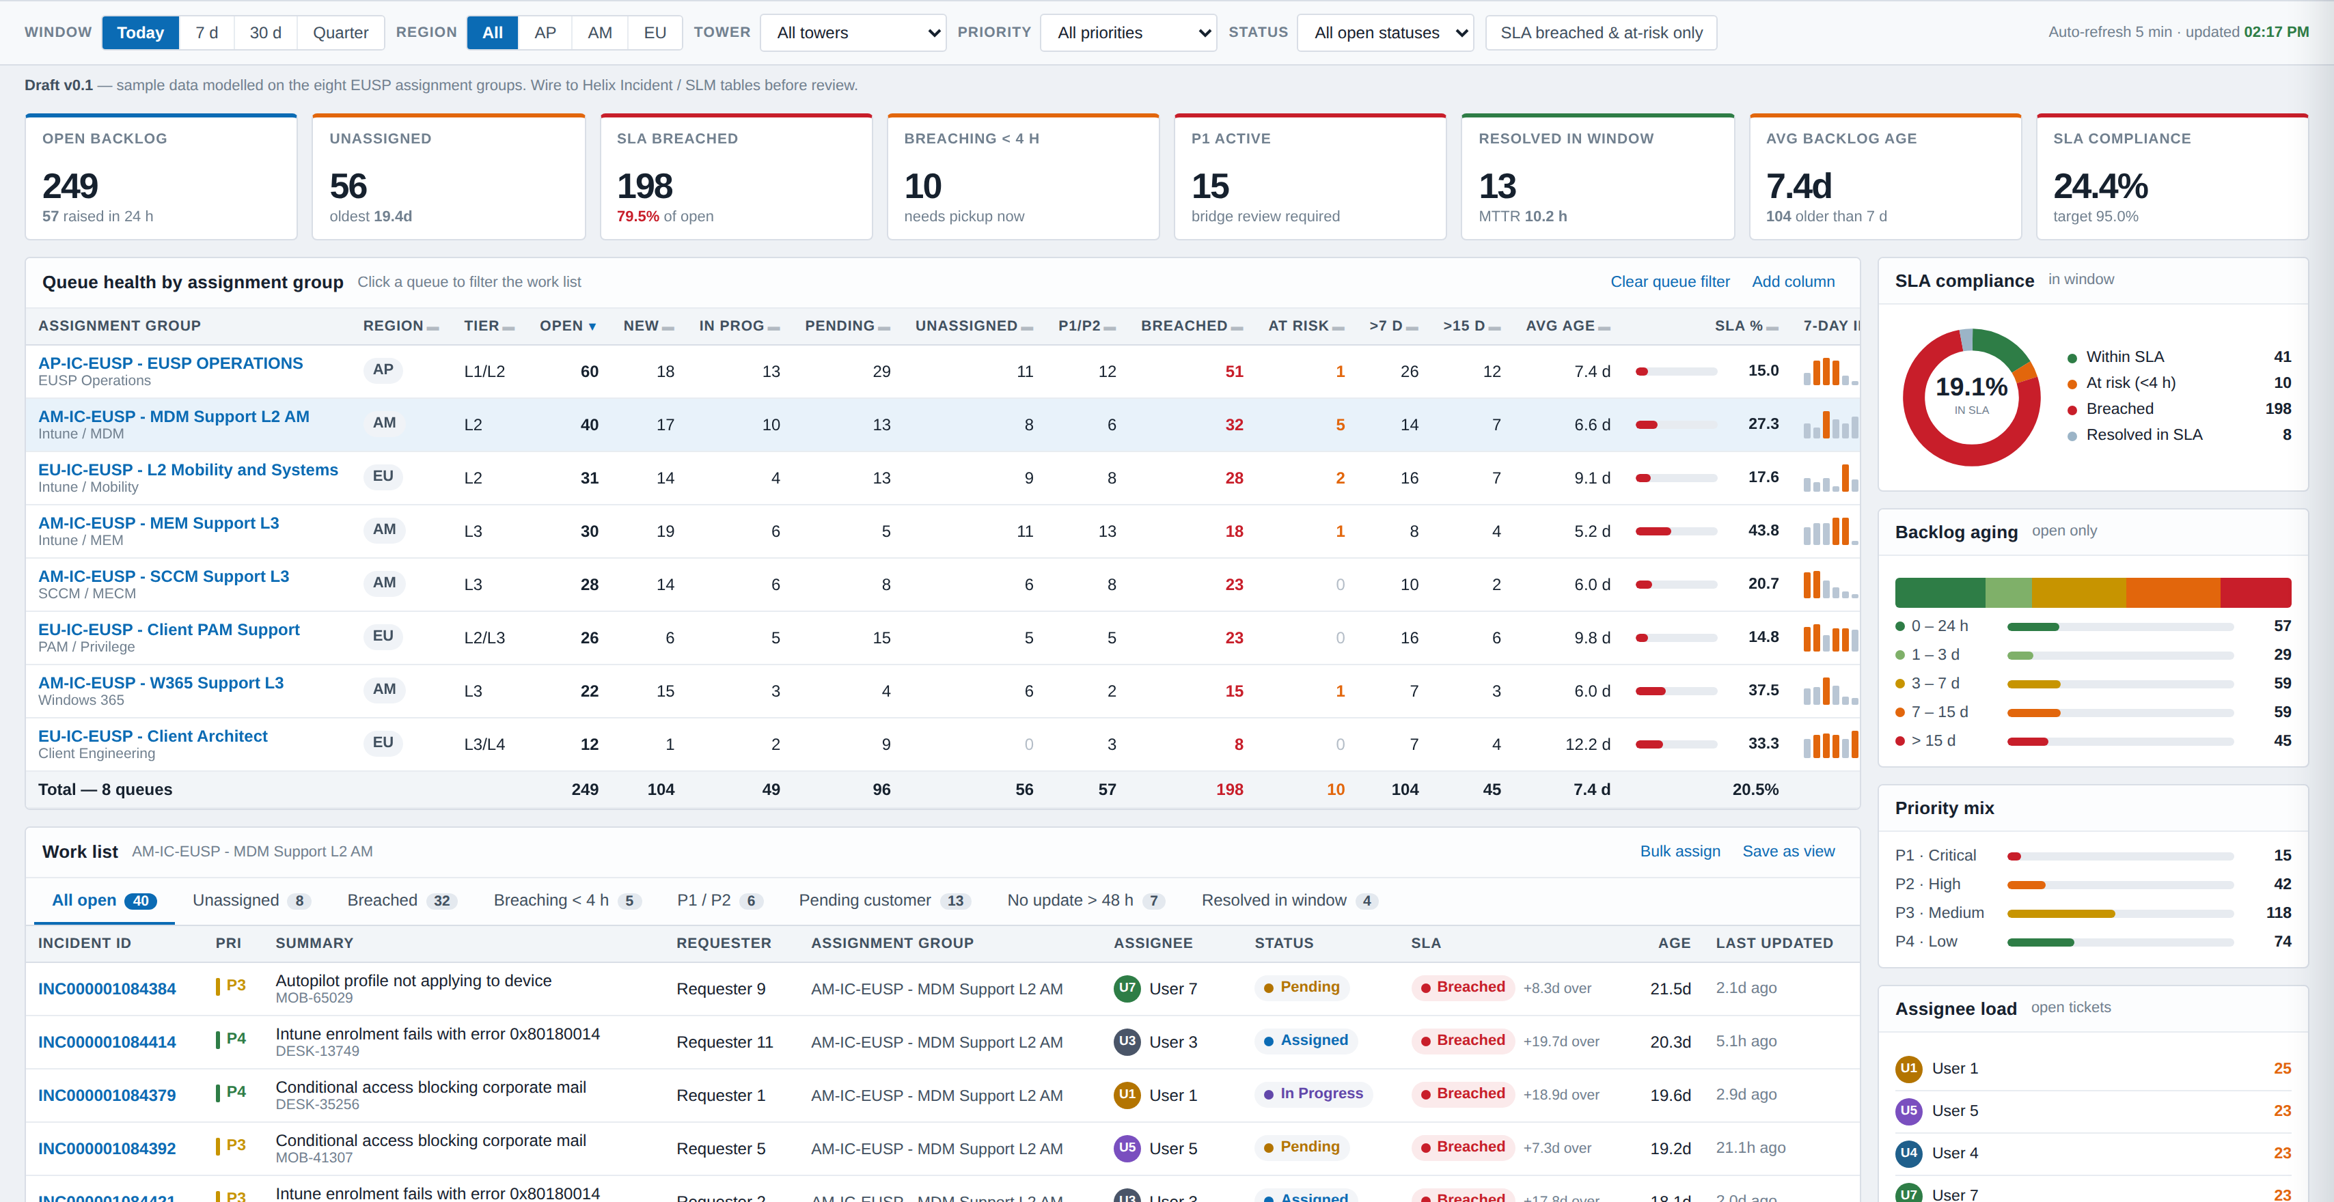
Click a queue, the whole page follows
INTERACTION
Selecting MDM Support L2 AM re-scopes the work list, the tab counts and the side panels to that group only.
Region and tower filters work the same way — nothing opens a second screen, so a stand-up never loses its place.
06

Slide 7
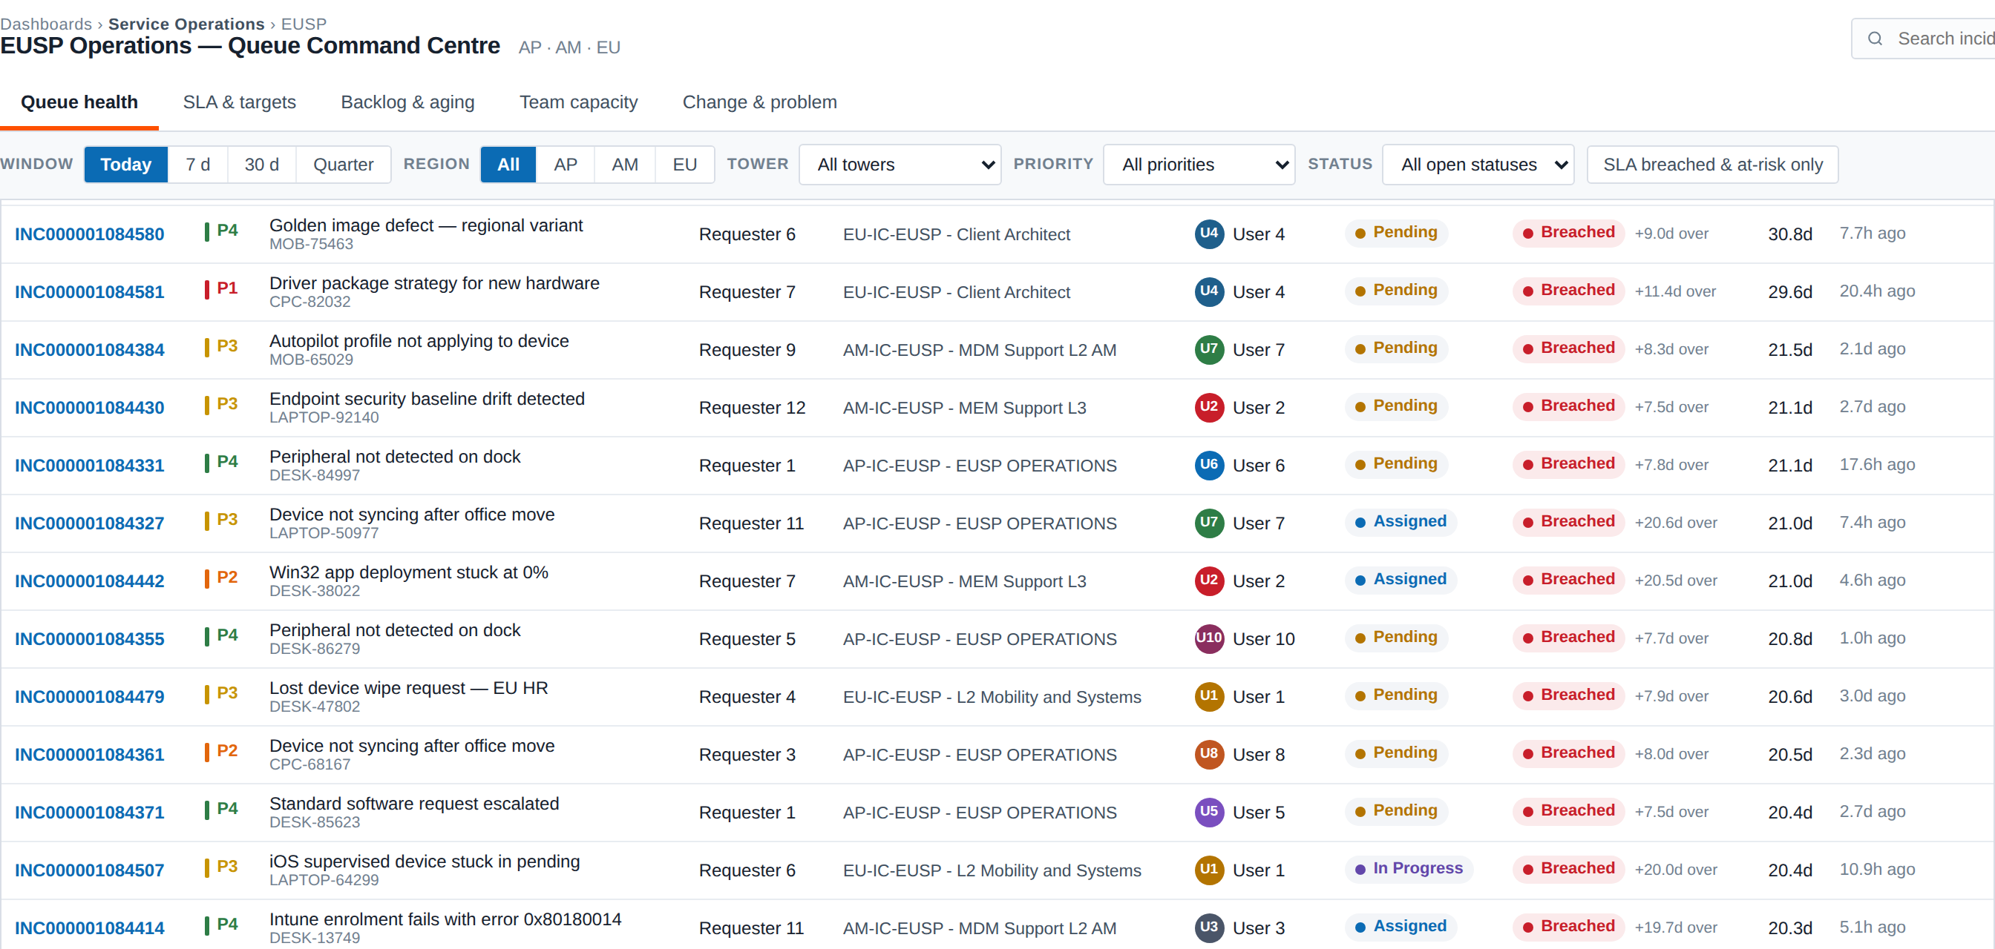
Work list with saved views
ZONE 2b
Eight tabs that match how the team already triages — each one carries a live count.
Tabs
All open
the full backlog in scope
Unassigned
pickup queue for the shift lead
Breached
recovery + client note
Breaching < 4 h
act now
P1 / P2
reconcile with the bridge
Pending customer
chase or auto-close
No update > 48 h
the silent rot list
Resolved in window
quality sampling
Row click opens the incident detail panel with the full activity trail and reassign actions.
07

Slide 8
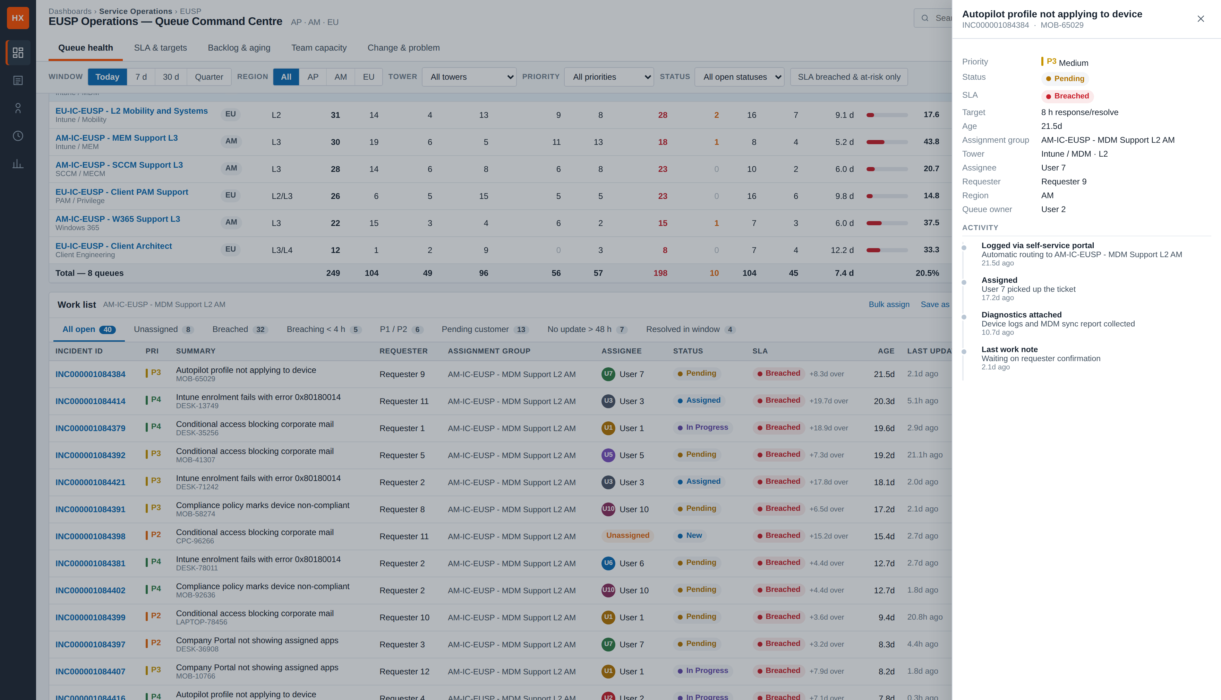
Incident detail without leaving the dashboard
INTERACTION
Enough to triage and reassign; the deep edit still happens in ITSM.
Shown: priority, status, SLA state and target, age, assignment group, tower and tier, assignee, requester, region, queue owner — plus the activity trail from logging to the last work note.
08

Slide 9
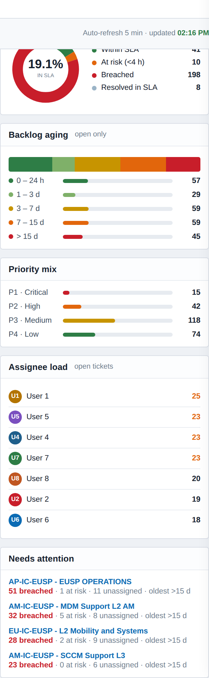
Side panels — the shape of the backlog
ZONE 3
The table tells you how many. These tell you what kind.
SLA compliance
Within · at risk · breached · resolved in SLA, as one donut. This is the figure that goes into the monthly pack.
Backlog ageing
Five buckets from under a day to over fifteen. A fat right-hand tail is the early warning we currently miss.
Priority mix
P1–P4 split. Tells you whether volume is noise or genuine severity.
Assignee load
Top seven by open count, highest flagged. Answers "who is drowning" in one glance.
Needs attention
The queues ranked by breached, at-risk and unassigned combined — the first place to look each morning.
09

Slide 10
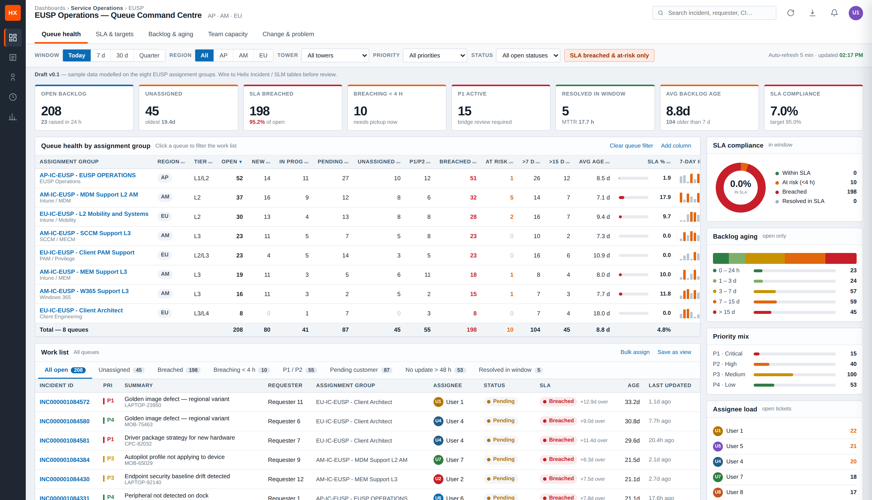
The 09:00 routine, in three clicks
HOW IT GETS USED
Breached and at-risk filter on, all queues — the entire risk picture in one view.
1
Filter to breached and at-risk
One toggle. Every panel re-scopes to work that is already late or about to be.
2
Sort by unassigned
Anything late with no owner is assigned on the call, not after it.
3
Read Needs attention
Confirms which queue gets the extra pair of hands today.
10

Slide 11
Three decisions and three assumptions
BEFORE WE BUILD
Everything above is sample data. These answers turn it into a real Helix view.
Decisions we need from you
Assumptions baked into this draft
Helix Dashboards or Smart Reporting?
Pending stops the clock
Canvas widgets and Smart Reporting are different builds — this changes the effort estimate, not the design.
Modelled at 40% accrual. If SLM does not pause on customer wait, the at-risk counts change materially.
One form or several?
Open backlog ignores the window
Do PAM and Client Architect run through Incident, or through Work Order and Change?
Resolved counts follow the date filter, backlog always shows in full — otherwise "Today" makes the queue look healthy.
SLM service targets per group
SLA means the same thing everywhere
Current model assumes 8 h for L2, 24 h for L3, 40 h for Client Architect, scaled by priority.
If AP measures response and L3 measures resolution, the SLA % column is not comparable and needs splitting in two.
11

Slide 12
NEXT
What happens after this review
01
Confirm the column set
Add or drop columns on this draft before anything is built — cheapest change we will ever make.
02
Pull one week of real data
Same eight groups, real SLM targets, so we can see whether the thresholds are set sensibly.
03
Build in Helix and pilot on AP
One region first. AP Operations has the highest volume, so it will surface the gaps fastest.
04
Roll out to AM and EU
With the queue owners named on each row and the 09:00 routine agreed.
Sample data throughout — placeholder users, no production ticket content or real names are shown.
12

