Slide 1

Working with Azure Redis cache
Shweta Gupta, Senior SDE
shweta.gupta@microsoft.com

Slide 2

Redis Cache : What is it?
Enter Text
In-memory storage
For extremely fast access of data
Suitable for scenarios with extremely high reads
Examples:
Trending posts in a social platform
Headlines
Session management

Slide 3
Redis cache: Properties?
Enter Text
Uses the in-memory RAM storage for storing data
It’s one of the most commonly used caching technologies
Supports multiple data types & features in addition to key-value stores
Redis string – simple key value store
Operations such as increment on values
Ability to assign multiple keys & values (reduce latency)
Lists in Redis
Redis sets
References:
http://redis.io/topics/data-types-intro
Notes:
Increment counter is very useful when you have things like number of visitors. You would like to increment it each time the page loads
Redis lists are implemented as linked lists, they can be used such as show me the latest posts of a user on FB, they can even be capped lists which will only keep the last N items in the list and delete the rest
Sets in Redis are good for things like Shopping cart
OTP confirmation

Slide 4
Enter Text
Demo: Redis Commands
Notes:
https://www.digitalocean.com/community/tutorials/how-to-install-and-configure-redis-on-ubuntu-16-04 – Install redis

Slide 5
Enter Text
Azure Redis Cache as a Service

Slide 6
What does Azure Redis Cache as a Service do
Enter Text
Provides the open source redis cache as a service
Can handle scale out and scale in
Implements clustering/sharding and HA
Also implements Data Persistence
Will work with Redis clients, not requiring change in code.

Slide 7
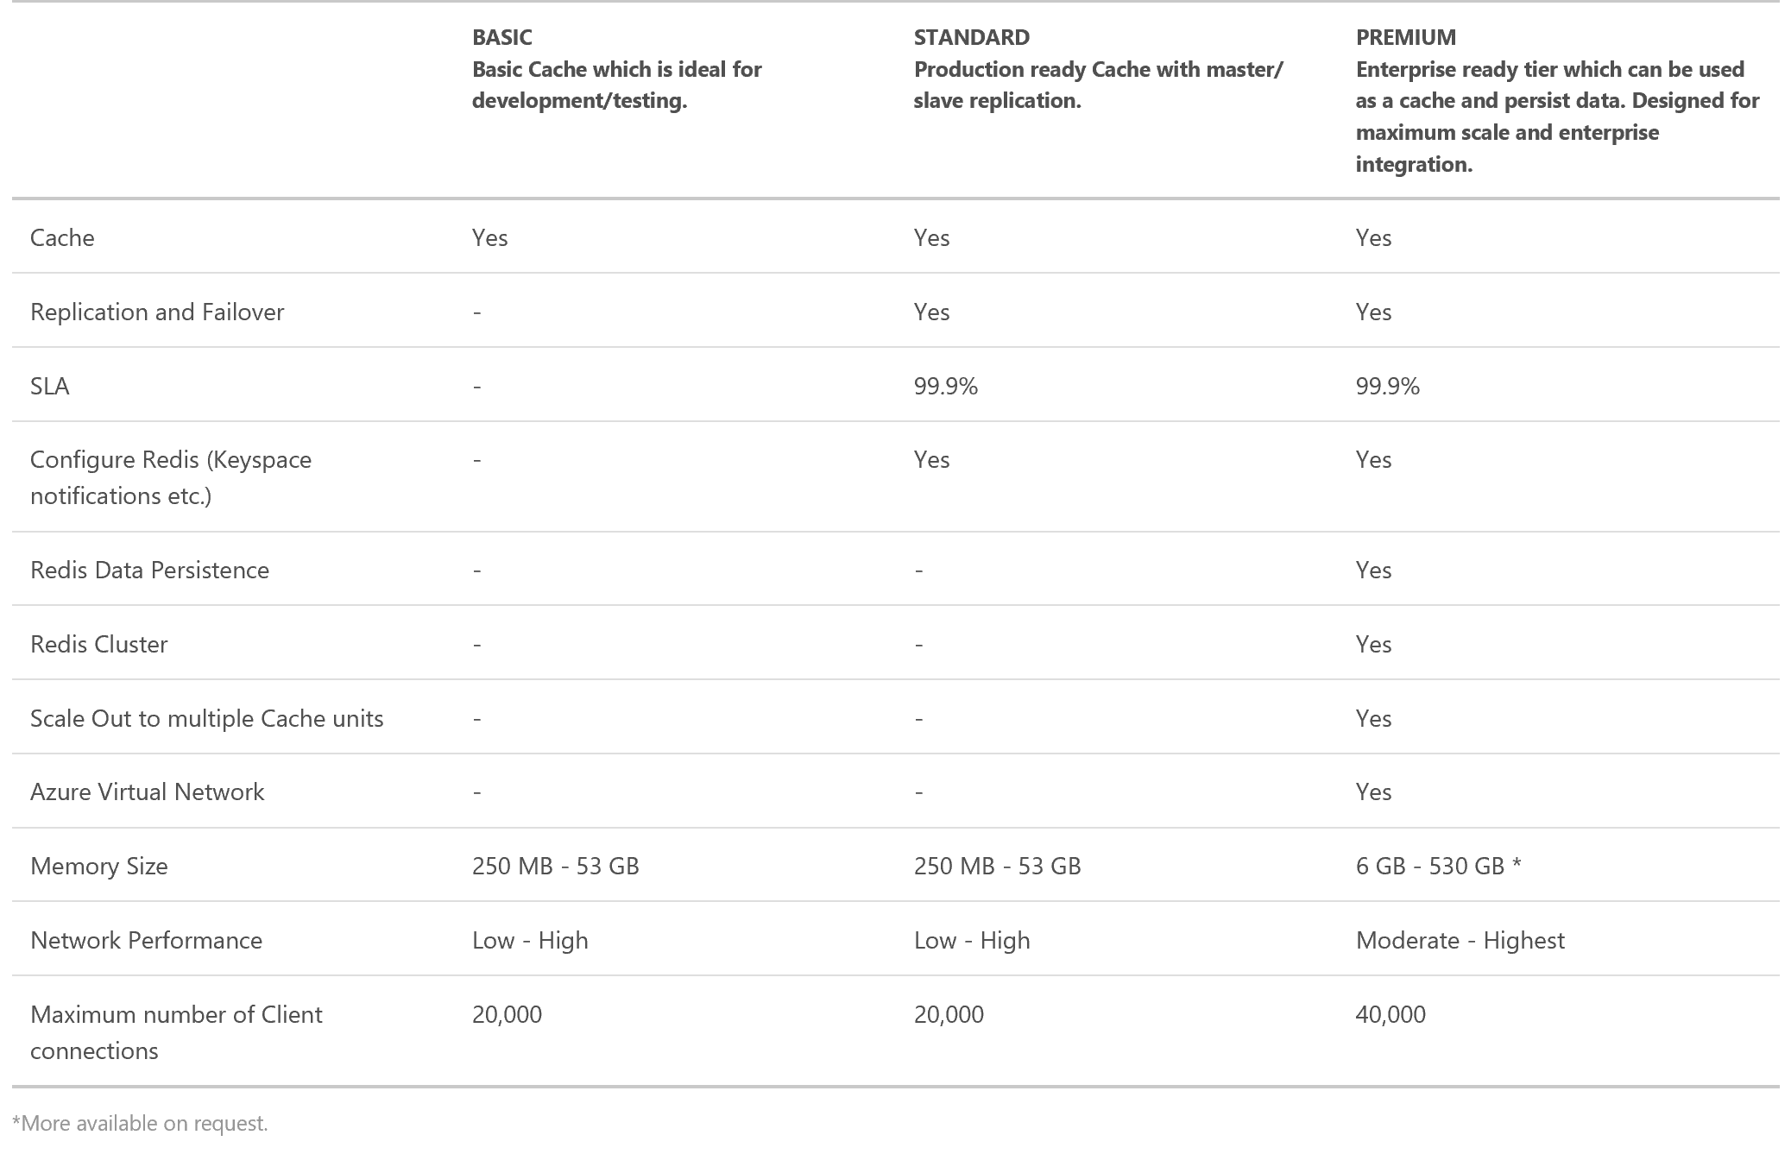
Redis cache tiers
Enter Text

Slide 8
Enter Text
Demo: Creating Redis Cache

Slide 9
Demo: Redis Cache in Use
Enter Text

