Slide 1

Design and Implementation of Signed Binary Multiplier
Course Project
Name : Shweta R Mutalikdesai
USN : 01FE21MVE008
Under the Guidance of
DR SAROJA V SIDDAMAL
School of Electronics and Communication Engineering
KLE Technological University, Hubballi

Slide 2

Outline
Introduction
Application
Block Diagram
Flowchart
Architecture

Slide 3
Introduction
A binary multiplier is a combinational logic circuit used in digital systems to perform the multiplication of two binary numbers.
Compared with addition and subtraction, multiplication is a complex process
In multiplication process, the number which is to be multiplied by the other number is called as multiplicand and the number multiplied is called as multiplier.
Signed binary multiplier used for both positive and negative binary numbers

Slide 4
Applications
Computers
Mobiles
High Speed Calculators
Digital signal processing

Slide 5
Block Diagram
Multiplicand M
Multiplier Q
0
XOR
1
AND
Comparator
0
1
01
10
Complementor
Sign bit
Extension
Multiplier

Slide 6
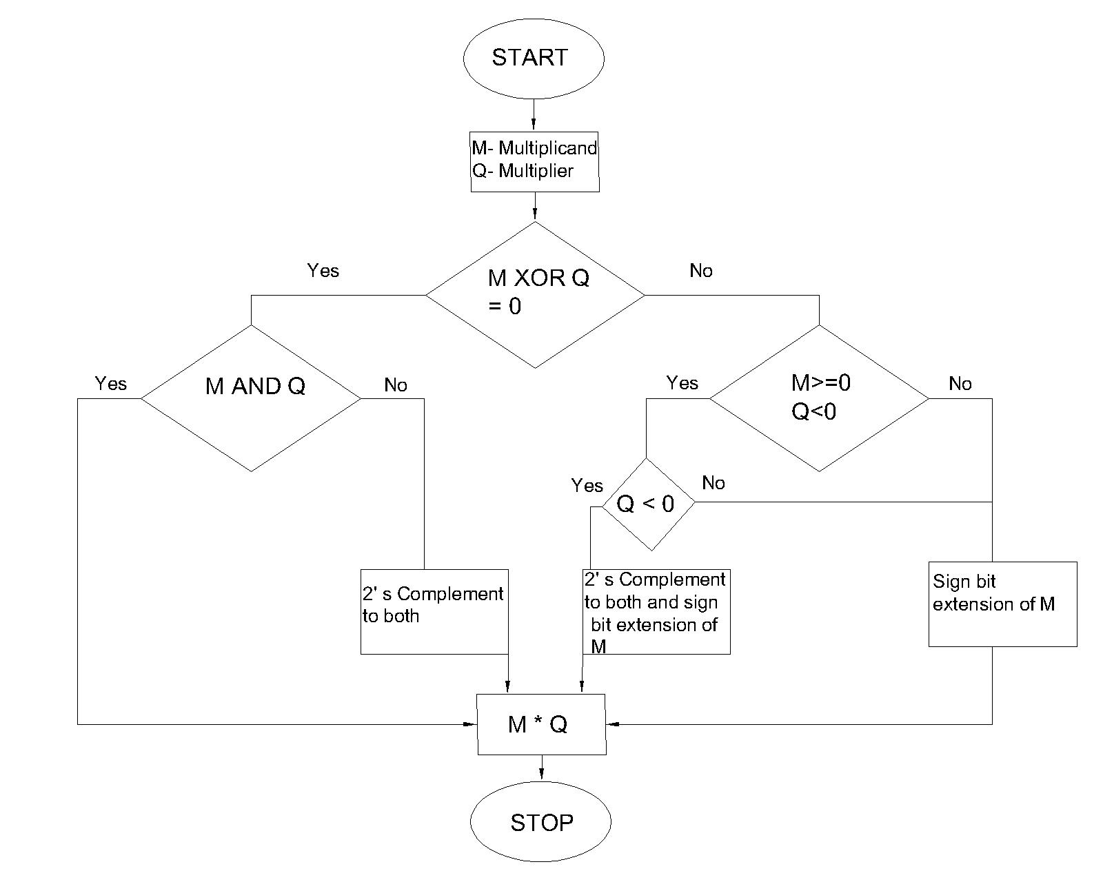
Flowchart

Slide 7
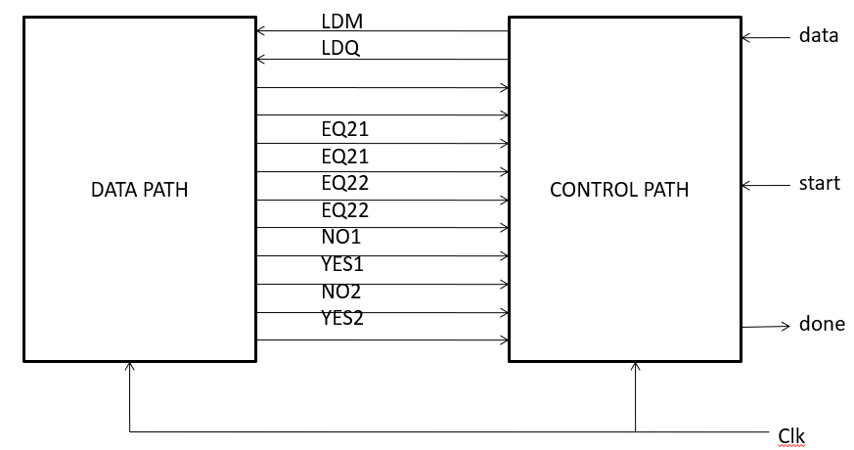
Architecutre

Slide 8
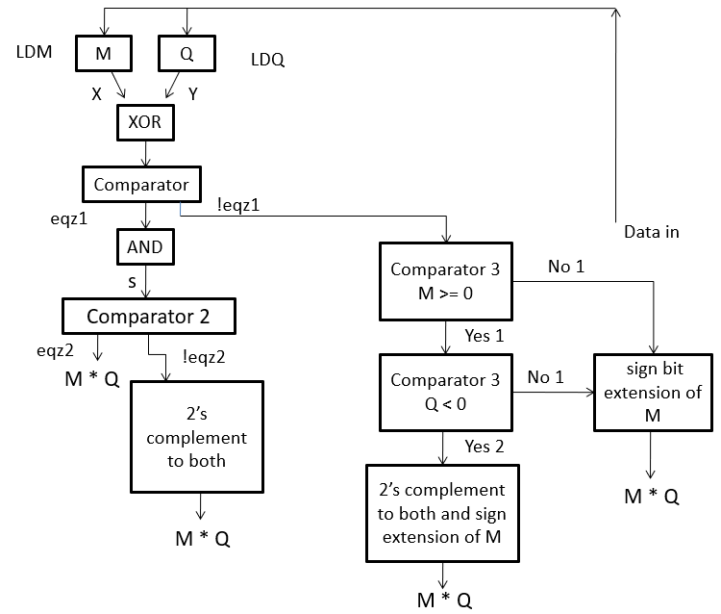
Datapath

Slide 9
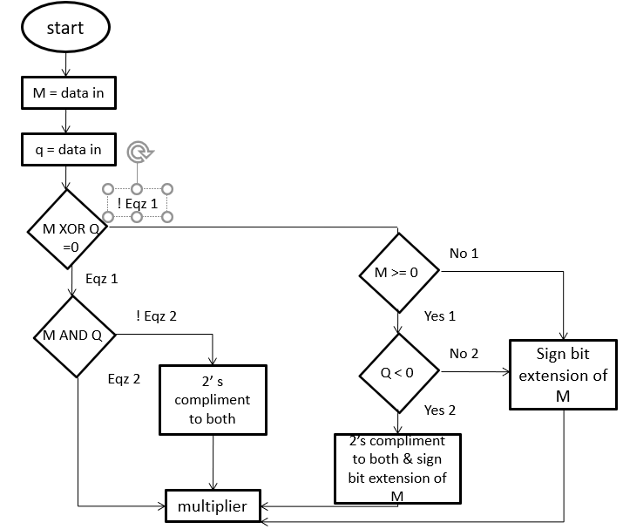
Control Path

Slide 10
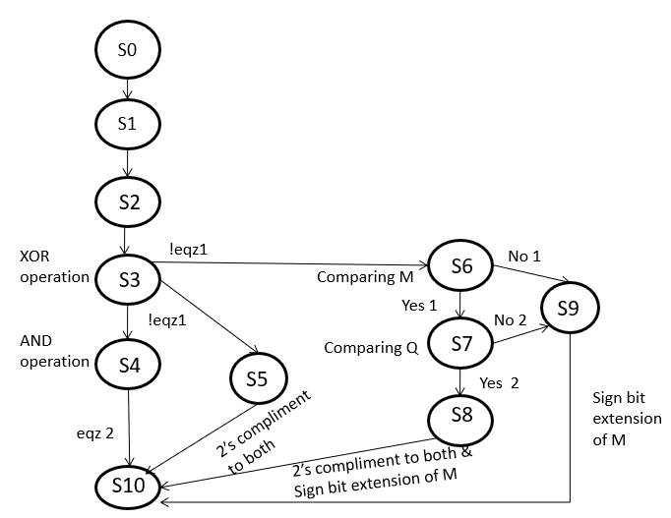
FSM

Slide 11
Thank You

