Slide 1
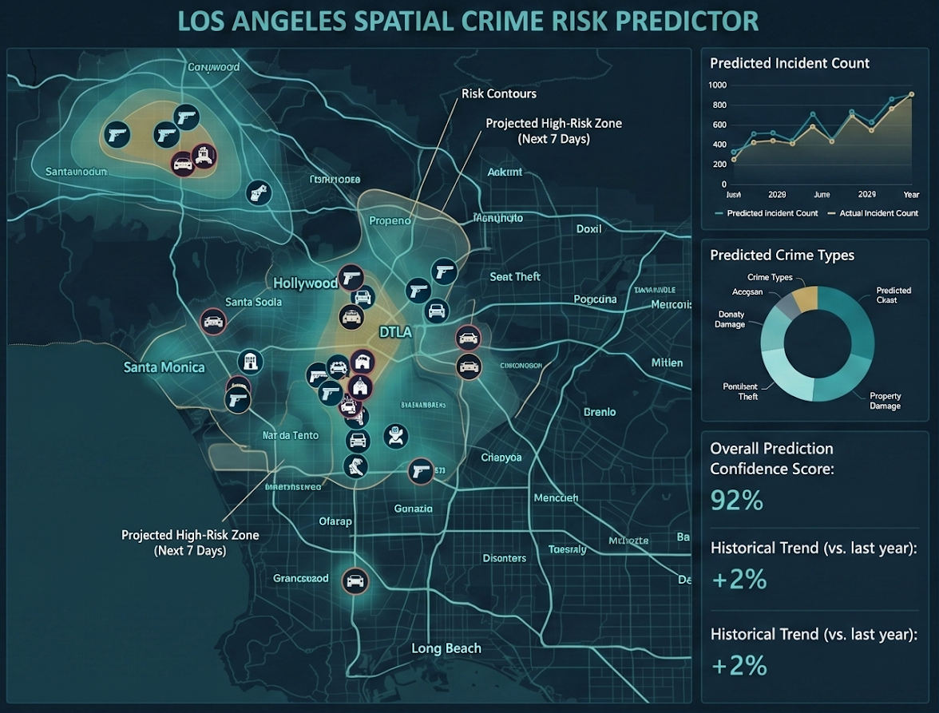
SafeCity Analytics
Predictive Crime Analysis of Los Angeles
Harsh Mahesh Tikone | Dev Desai | Shwetangi Singh
EAS 587: Data-Intensive Computing · Spring 2026 · University at Buffalo

Slide 2
OVERVIEW
What We Built
Phase 1
Phase 2
Phase 3
Phase 4
Data & EDA
ML Models
Spark & Databricks
Presentation
62K LAPD crime records · 10 cleaning operations · 10 EDA analyses
6 algorithms · Crime category, severity, weapon risk, hotspots · MCP server deployed
Databricks Delta Lake · NIBRS integration · Bronze-Silver-Gold pipeline
Visualization · Complete pipeline synthesis
EAS 587 · SafeCity Analytics
2 / 15

Slide 3
Problem Statement
Most crime dashboards describe the past. We predict the future.
🔍 Crime Category Prediction
Given time, location, and context — what type of crime is this? Supports dispatch pre-fill and officer prep.
⚠️ Weapon-Involvement Risk
Does this incident carry elevated weapon risk? Calibrated probability score for officer safety decisions.
📍 Geographic Hotspot Discovery
Which clusters account for highest density? Supports patrol scheduling and resource allocation.
3 / 15

Slide 4
PHASE 1 — DATA & EDA
Data Collection & Cleaning
62,117
28
10
46
LAPD Crime Records
(2024)
Raw Columns
Cleaning Operations
Final Features
Key Cleaning Operations:
Key EDA Findings:
1. Date parsing + Hour / Month / DayOfWeek extraction
Peak crime: 6 PM · Highest day: Friday
2. Victim age=0 → NaN (unknown, not infant)
Vehicle Crime = 46.2% of all incidents
3. 140+ crime codes → 12 semantic categories
Only 5.9% of crimes involve a weapon
4. Crm Cd 2/3/4 removed (98–100% missing)
Central LA: 6,024 crimes (highest area)
5. Reporting delay computed (days to report)
75% of crimes reported within 3 days
Source: LAPD Crime Data from 2020 to Present (data.lacity.org)
4 / 15

Slide 5
PHASE 2 — MACHINE LEARNING
Six ML Algorithms
Algorithm | Type | Target Variable | Key Design Choice
kNN | In-class | Crime Category (13-class) | k=7, StandardScaler
Decision Tree | In-class | Crime Category (13-class) | GridSearchCV tuning
k-Means | In-class | Geographic Hotspots | k=2, silhouette guided
Naive Bayes | In-class | Crime Category (13-class) | ComplementNB selected
Random Forest | Outside class | Crime Category + MCP server | RandomizedSearchCV · balanced weights
Logistic Reg. | Outside class | Weapon Involvement (binary) | Calibrated probability scoring
EAS 587 · SafeCity Analytics · Phase 2
5 / 15

Slide 6
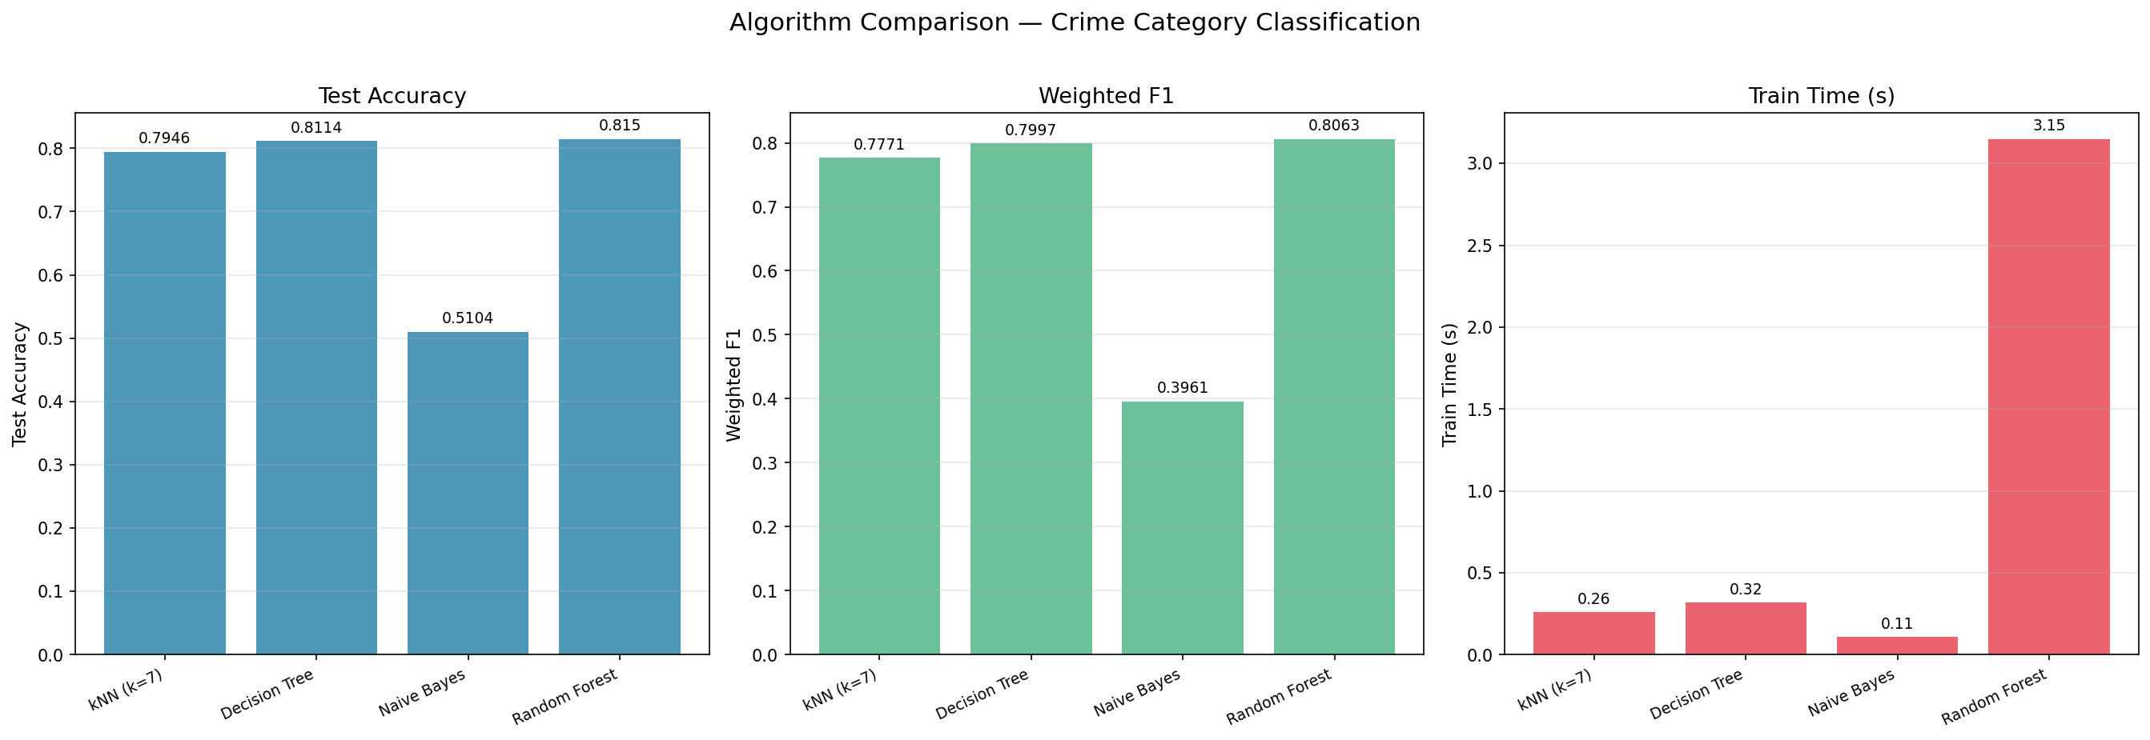
PHASE 2 — RESULTS
Model Performance Summary
79.5%
kNN (k=7)
Crime Category accuracy
(derived label)
81.5%
Best Classifier
Random Forest
crime category
0.886
ROC-AUC
Logistic Reg.
weapon risk
0.546
k-Means
Silhouette score
k=2 clusters
All models trained on 80/20 train-test split with random seed 42
6 / 15

Slide 7
PHASE 2 — DECISION TREE
Decision Tree: Feature Importances
Findings
Premise Category drives the tree (~45%)
Where a crime occurs is the strongest single predictor of its type — land use and patrol district structure dominate.
Severity matters (~28%)
Crime classification level significantly influences tree splits.
Part 1-2 & Reporting Delay carry modest weight (~6-7%)
Supplementary administrative features provide limited additional signal.
Minority classes struggle
Homicide and Arson show F1 ≈ 0. With <20 test samples, even a perfect model can't demonstrate recall.
Accuracy: 82.5% · Weighted F1: 0.809 · 13 crime categories
7 / 15

Slide 8
Geographic Crime Hotspots
k-Means Clustering (k=2, Silhouette = 0.546)
Cluster 0 — West / Coastal
Cluster 1 — Central / Inland
› Districts: West LA, Pacific, Hollywood, Wilshire
› Districts: Central, Newton, 77th St, Southwest
› Top crime: Vehicle Crime (44%)
› Top crime: Vehicle Crime (48%) — slightly higher
› Notable: High Theft rate in commercial zones
› Notable: Higher Assault share vs Cluster 0
› Reporting delay: avg 2.1 days
› Central LA alone: 6,024 incidents (most)
DBSCAN was tried — labeled 60%+ as noise. LA crime is spatially diffuse; k-Means was retained.
8 / 15

Slide 9
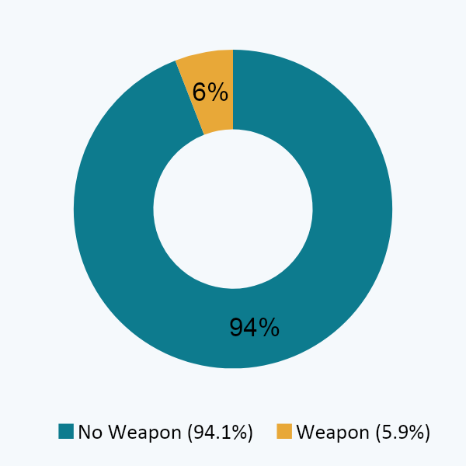
PHASE 2 — WEAPON RISK
Logistic Regression: Weapon-Involvement Risk
ROC-AUC
Why This Matters
0.886
Base rate: 5.9%
Weapon crimes are rare — a hard target. Precision on the weapon class is 0.26.
Calibrated probability
for weapon risk ranking
Probabilities > labels
Officers need a risk score, not a binary guess. Threshold can be tuned by district.
ROC-AUC = 0.886
Model ranks high-risk incidents well — the top 10% of scores capture most weapon cases.
Logistic Regression with L2 regularization · class_weight='balanced'
9 / 15

Slide 10
PHASE 2 — MCP SERVER
MCP: Natural Language → Crime Prediction
How It Works
Exposed Tools
1
Register
predict_crime_category
claude mcp add -s project safecity-crime-predictor -- python3 src/mcp/server.py
Input: area, hour, month, weekend, weapon, premise, time bucket, severity, part, reporting delay
Output: category label + top-3 probability breakdown
2
Model loads
Random Forest (pkl) loaded; auto-retrains from CSV if missing
list_crime_categories
Returns all 13 supported crime category labels
3
User asks Claude
"What crime is likely at 11 PM on a public street in area 13?"
server_health
4
Tool called
Returns model status, feature count, and model path
predict_crime_category → returns category + top-3 probability breakdown
Fallback: server auto-retrains Random Forest from data/processed/crime_data_cleaned.csv if pkl missing
10 / 15

Slide 11
Phase 3: Spark + Delta Lake Architecture
BRONZE
SILVER
GOLD
MLlib
LAPD CSV
(data.gov)
Raw ingestion
bronze_mydata
(Delta table)
Clean + join
silver_lapd_crimes
(LAPD + NIBRS)
Business aggregates
6 Gold tables
by area, time, category
Logistic Regression
Pipeline model
Databricks saved
NIBRS
(FBI)
MCP Inference Server (Phase 2) · src/mcp/server.py · predict_crime_category · list_crime_categories · server_health
11 / 15

Slide 12
PHASE 3 — NIBRS Integration & MLlib Results
8 Databricks Notebooks | Cross-Source Join on CaseNo | 3 NIBRS Insights | Spark MLlib Pipeline Saved
8-Notebook Databricks Pipeline
Insight 1: NIBRS Confirms LA Vehicle Crime Spike
LAPD vehicle crime rate (46.2%) exceeds the national NIBRS baseline. Cross-joining both sources on CaseNo shows the pattern holds independently in federal data — not an artifact of LAPD classification alone.
LAPD Pipeline (Notebooks 01-04)
01 Bronze — raw CSV to bronze_mydata Delta table
02 Silver — clean, transform, derive features
03 Gold — 6 business aggregate Delta tables
04 MLlib — Decision Tree + Naive Bayes (Spark)
NIBRS Pipeline (Notebooks 05-08)
05 Bronze — NIBRS Victims (232K) + Offenses (250K)
06 Silver — left-join LAPD + NIBRS via CaseNo
07 Insights — 3 cross-source statistical analyses
08 MLlib LR — weapon prediction on merged data
Insight 2: Temporal Patterns Agree Across Sources
NIBRS hourly distribution (250K offenses) mirrors LAPD peak at 6 PM. Day-of-week patterns align across both agencies. Two independent sources, same signal — validates Phase 2 temporal features for ML.
Insight 3: Spark MLlib on Merged NIBRS+LAPD Data
Notebook 08 trains a Spark MLlib Logistic Regression on silver_lapd_crimes — adding NIBRS-specific features: DomesticViolence, GangRelated, HomelessVictim. Saved as full VectorAssembler + StandardScaler + LR pipeline to Databricks volumes for reproducible reuse.
Gold Tables: area summary, monthly trends, hourly patterns (weekday/weekend), victim profiles, hotspot features, ML features
Scale: 232K NIBRS victims + 250K NIBRS offenses joined to 62K LAPD records via CaseNo left join
12 / 15

Slide 13
DISCUSSION
Key Insights Across the Pipeline
01 Crime is structurally predictable
02 Weapon risk ranking works; weapon detection does not
82% category accuracy from area, hour, and premise type alone. Most variance is tied to land use and time — not randomness.
ROC-AUC 0.886 means the model ranks incidents by risk well. But with only 5.9% positive rate, binary precision is 0.26. Use thresholds, not hard labels.
03 LA crime geography is east-west, not cluster-dense
04 Shared preprocessing prevents silent bugs
k=2 beats finer granularity. The coastal vs. inland split is real and stable. DBSCAN failed because crime is diffuse — not point-clustered.
A single preprocess.py module across all six models eliminated per-script encoding drift and made the Spark pipeline reproducible.
13 / 15

Slide 14
Limitations & Future Work
Current Limitations
Next Steps
Single year (2024) — no seasonal or trend analysis possible
→ Multi-year data
2020–2024 LAPD records would unlock seasonal trends and year-over-year baselines.
48.5% unknown victim demographics limits demographic modeling
→ Hierarchical crime taxonomy
Replace flat 13-class labels with a hierarchy — enables shared structure between related crimes.
13-category label scheme loses fine-grained crime distinctions
→ Spark Structured Streaming
Connect MCP server to live LAPD API feed for near-real-time dispatch inference.
→ Fairness audit
Evaluate model predictions for disparate impact across victim descent groups.
14 / 15

Slide 15
SafeCity Analytics
End-to-End Crime Prediction Pipeline
81.5%
0.886
0.546
Crime Category
Accuracy (RF)
Weapon Risk
ROC-AUC (LR)
Cluster
Silhouette
Any Questions ?
Complete pipeline: raw CSV → EDA (Ph.1) → 6 ML models + MCP server (Ph.2) → Spark/Databricks (Ph.3)
6 ML models covering classification, clustering, and risk scoring
Random Forest deployed as MCP server callable from Claude Code
NIBRS cross-source validation confirms LA vehicle crime above national baseline
EAS 587 · Data-Intensive Computing · Spring 2026 · University at Buffalo

