Slide 1
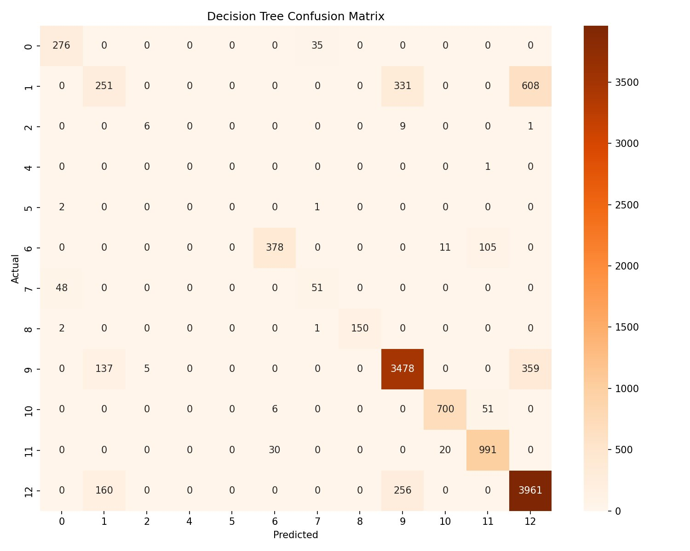
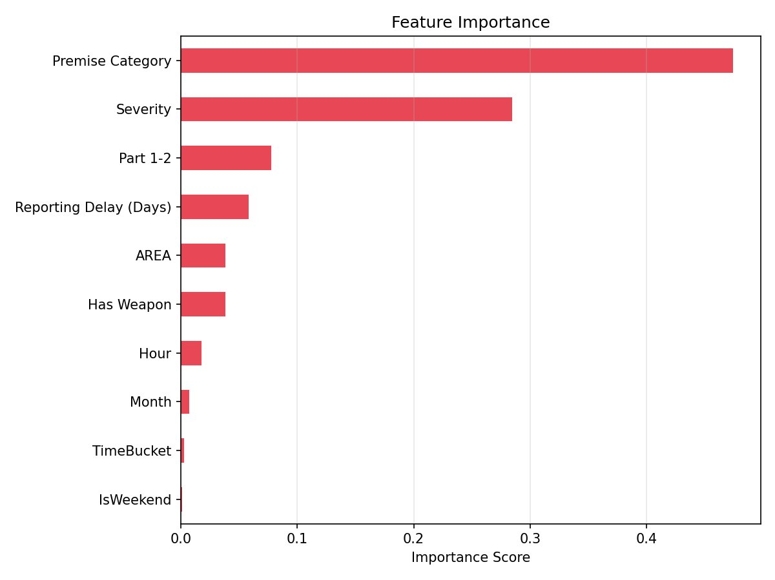
SAFECITY PHASE 2
Random Forest — Crime Category Prediction
81.5%
0.812
Severity
12
Test Accuracy
Weighted F1
Top Feature
Classes
150 trees, optimal
Macro F1: 0.641
25% importance
Crime categories
Confusion Matrix
Feature Importance

Slide 2
MCP Deployment Experience
Model Context Protocol • SafeCity Crime Predictor
Random Forest
Model (.pkl)
server.py
MCP Server
stdio_server()
Transport
Claude
Tools
✓ What Worked
✗ Challenges & Fixes
Pickle bundle (model + encoders + feature names) loaded cleanly
predict_crime_category tool exposed 10 input params with validation
Top-3 probability rankings gave nuanced, useful output
list_crime_categories tool aided discoverability from Claude
stdio transport required zero networking config — just worked
mcp package not on PATH — solved with pip install mcp
MODEL_PATH was relative; needed absolute path resolution via Path(__file__)
Boolean inputs (is_weekend, has_weapon) required explicit int() cast
Claude sometimes passed string '1'/'0' instead of integers — added validation
Rare crime classes (Drug Offense, Child Abuse) predicted with low recall in RF

Slide 3
KEY INSIGHTS & SURPRISE FINDINGS
What the Data Revealed
🎯 kNN: Near-Perfect Severity
🗺️ K-Means: Only 2 Geo-Clusters
k=3 achieved 99.8% accuracy predicting crime severity (High/Low/Medium). Severity is almost entirely deterministic from other features — not a useful standalone target.
Despite LA's complexity, k=2 gave the best silhouette score (0.546). The city splits into north (San Fernando Valley) vs south-central/coastal — a surprisingly clean divide.
⚠️ Naive Bayes Fails on Multi-Class
🔫 Premise & Area Drive Weapon Risk
NB accuracy dropped to 51% vs RF's 81.5%. It collapsed predictions into 3-4 dominant classes. Independence assumption is violated by correlated crime features.
LR with AUC=0.886 found Premise Category and AREA are the top predictors of weapon involvement — location matters more than time of day for weapon-related crimes.
SafeCity Phase 2 • March 13 Workshop • LAPD Crime Data Analysis

