Slide 1
RespiraEdge
On-Device Edge AI for Autonomous Respiratory Distress & Apnea Detection
Presenter: Shwetanjali Gautam | Domain: Embedded Systems, Edge AI & Medical IoT

Slide 2
Executive Summary: Cloud vs. Edge AI
The Problem with Cloud-Based Health IoT:
• High Latency: Round-trip delays prevent instant response during acute respiratory events.
• Privacy Risks: Transmitting sensitive patient bio-signals over public networks.
• Connectivity Dependency: System failure during network outages or poor reception.
The RespiraEdge Solution:
• 100% On-Device Neural Network running directly on an ESP32 microcontroller.
• Sub-millisecond latency (200 to 400 microseconds execution time).
• Autonomous local closed-loop actuation with zero cloud dependency.

Slide 3
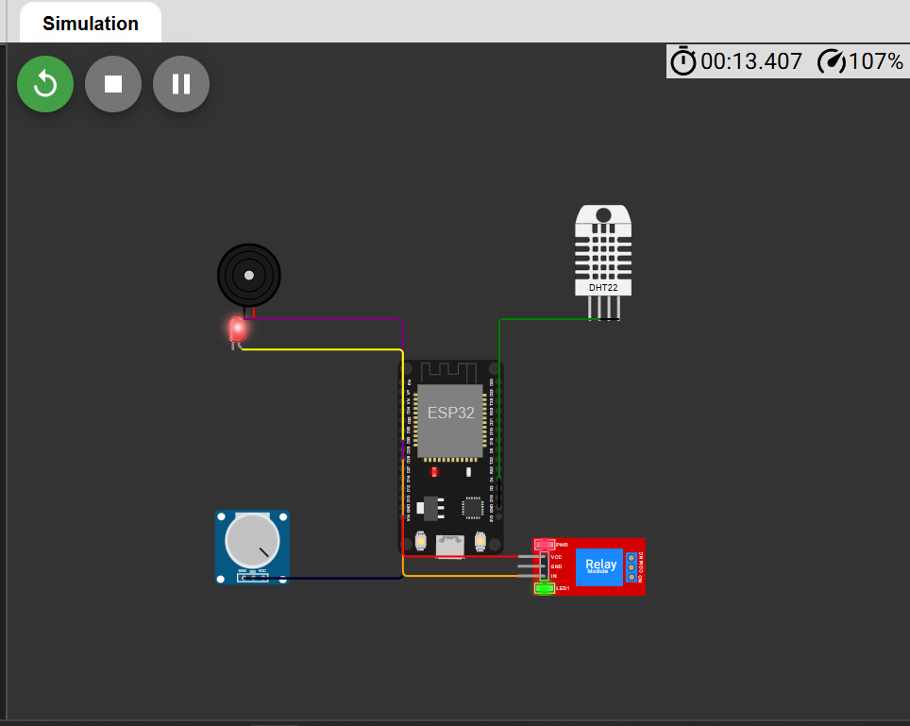
Hardware Circuit Layout & Pin Connections
Component | Pin | Technical Function
DHT22 Sensor | GPIO 4 | Monitors ambient humidity (%) & temp (°C)
Potentiometer | GPIO 36 | Simulates continuous audio RMS energy stream
Relay Module | GPIO 25 | Actuates emergency humidifier / valve
Piezo Buzzer | GPIO 26 | Audible alarm indicator for distress states
Red LED | GPIO 33 | Visual alert indicator

Slide 4
On-Device Neural Network Engine
• Offline Model Training (RespiraEdge.ipynb): Multi-layer feedforward ANN trained in Python.
• C Weight Export (model_weights.h): Weights & biases converted to static C floating-point matrices.
• Embedded Inference (sketch.ino): Execution via forward propagation: y = ReLU(W · x + b).
• Network Topology: 4 Feature Inputs → 16 Neurons (ReLU) → 8 Neurons (ReLU) → 3 Classes.
• Class Outputs: [0: Normal State] | [1: Wheezing Distress] | [2: Apnea Event]

Slide 5
Performance Metrics & Future Roadmap
Key System Metrics:
• Inference Speed: Sub-millisecond execution time (200-400 µs per prediction).
• Data Privacy: Bio-signals processed 100% locally with zero transmission.
• Hardware Overhead: Cost-effective design operating on standard ESP32 MCU.
Future Scope:
• Digital Microphone Integration: Replace potentiometer with INMP441 MEMS mic via I2S.
• INT8 Quantization: Convert float weights to fixed-point integers for faster execution.
• BLE Alerts: Broadcast Bluetooth Low Energy signals to notify local health responders.

