Slide 1
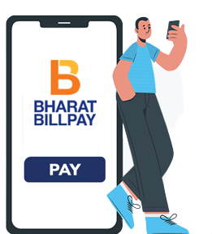



India Uses EgPaid to Pay more than 1000+ Bills & Recharge More than 20 Services.
Guaranteed Reviews For Your Every Payment
Pay for Services like FASTag, Subscription, Metro Cards, Besides the Regulars like Mobile, DTH Recharge, LPG Booking, Electricity, Gas, Insurance & Water with the EgPaid & Get Guaranteed Reviews For Your Every Payment

