Slide 1


Hate Speech/Toxic Comment Detection
INDIAN INSTITUTE OF TECHNOLOGY KANPUR
SHWETANK SINGH-201422 (shwetanksr20@iitk.ac.in)
NISTHA SHAH-201358 (nistha20@iitk.ac.in)
AKASH KUMAR SHARMA-201261 (pawan20@iitk.ac.in)
Shivani Gupta-201412 (shivi20@iitk.ac.in)

Slide 2
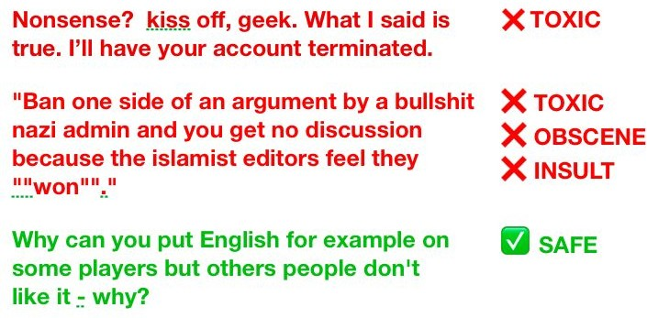
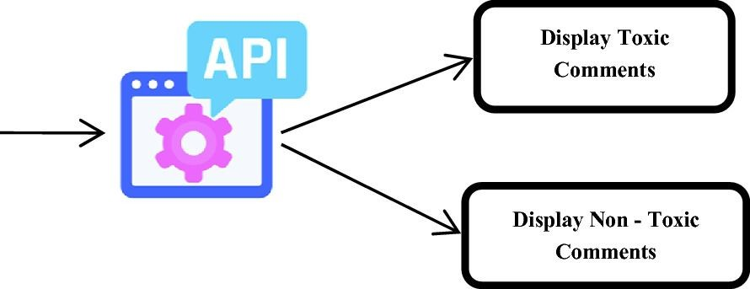
Overview
Detection and Flagging of comments containing text which may incite violence, spread hate and induce negativity.

Slide 3
Introduction
The project Hate Speech / Toxic Comment Detection aims at:
Online bullying has become a serious issue in recent years.
The threat of abuse and harassment online means that many people stop expressing themselves.
Toxic comments spread negativity, racial harassment and depression
Removing hate speech makes easy for everyone to express their opinions freely over the internet.

Slide 4
Motivation & Applications
Social networking: Message or tweet can be reported to the support team.
Online meetings/webinars: Message can be hidden from attendees and shown only to the moderators.
Chatbot training: The model can give large negative feedback for any insulting reply towards the user.
Threatening messages: Directly reported to concerned authorities for immediate actions.

Slide 5



Conclusion and Scope of Improvement
Structure of Presentation
Description of the Problem Statement and Challenges
Preprocessing of data into machine readable format
Problem
Visualisation
Preprocessing
Training
Conclusion
Cleaning and Visualisation of the dataset
Training the model using various methods

Slide 6
Problem Description
Statement
Given any text or paragraph containing a few lines in natural language, the objective is to classify it as belonging to one or more of the following categories: clean, obscene, threatening, insulting, toxic, severely toxic and identity hate.
Clean
OUTPUT
Obscene
Threatening
Text / Paragraph (natural language)
INPUT
ONE OR MORE OF THESE CLASSES
Model
Insulting
Toxic
Severely Toxic
Identity Hate

Slide 7
Problem Description
Multi-class classification problem
Multi-label classification problem
Seven different classes: Clean, obscene, threatening,
insulting, toxic, severely toxic, identity hate.
Any text or paragraph can be abusive in multiple ways: it can be both threatening & insulting to someone
Model will output the probability of text to belong to each category.
Based on certain threshold (which can be tuned as hyperparameter), the text can be classiﬁed to be belonging to a category / set of categories.

Slide 8
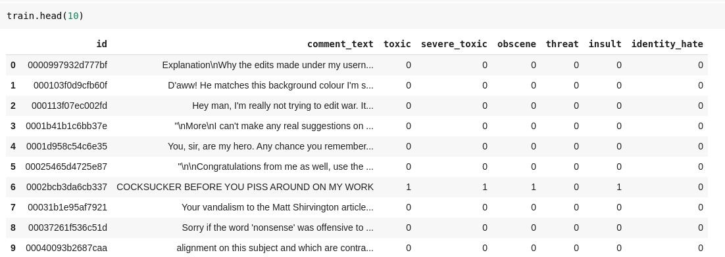

Dataset
Dataset is made publicly available by Conversation AI.

Slide 9
Labels
The dataset has been labeled on a crowdsourced annotation platform.
Different users may have different opinions about a comment (judgement bias).
Some offensive ‘ASCII arts’ which may or may not be labelled as toxic by users depending on how it was rendered.
Some extremely long comments got labelled to toxic without any signiﬁcant reason.
“Give us your address and we'll come and kill you” : Not marked as toxic!

Slide 10
Challenges
Noisy Data: Real world dataset from Internet users. Full of slangs, contractions, non-english or meaningless words and spams.
Unbalanced Dataset: Large number of comments are clean. Unclean samples are relatively rare and with six classes of toxicity problem is further aggravated.
Memory Issues: More than 1 lakh training samples - difﬁcult to store and process in internal memory at a time.

Slide 11
Solution Approach
Dataset
Conversational AI
Data Cleaning & Visualization
Get qualitative high-level insights into the data
Data Pre-processing
Remove punctuations, URLs, stop words, etc.
Binary Relevance
Classifier Chains
Training the model
Support Vector Machines
Logistic Regression
Data Post-processing
Reason out the possible source of errors
Naïve Bayes

Slide 12
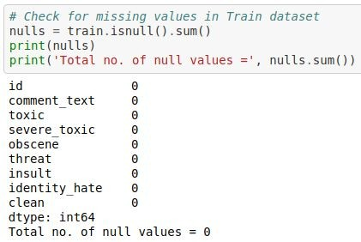
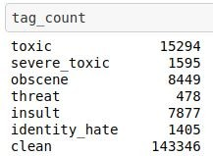

Data Cleaning & Visualization
Checking for missing or null values.
Adding extra column for ‘clean’ comments.

Slide 13
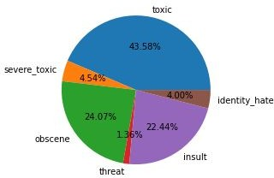
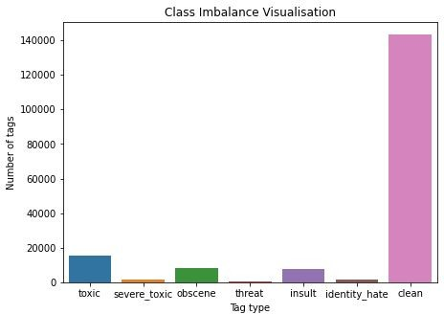
Data Cleaning & Visualization
Class Imbalance: The toxicity is not spread evenly across all the classes. Out of all the hate tags, ‘toxic’ tags are 43.58%, whereas ‘threat’ tags are 1.36%.
Clean comments are
~140k out of the
~160k total comments.

Slide 14
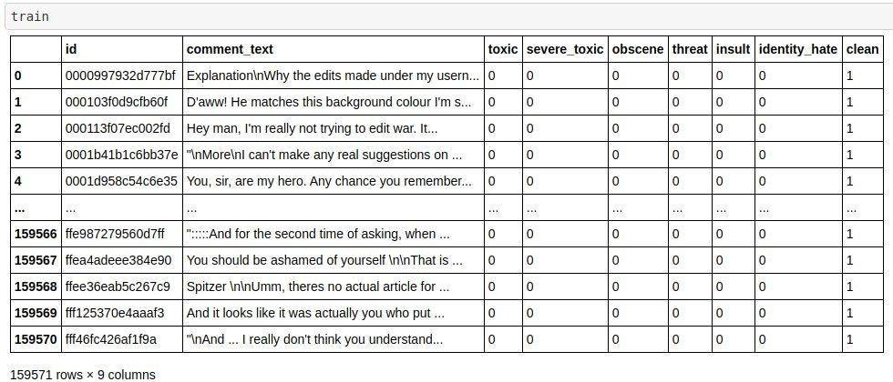
Data Cleaning & Visualization

Slide 15
Data Cleaning & Visualization
Comments obtained are from random users on internet
Dataset is noisy. No ﬁxed standard of writing across all the comments
Dataset must be cleaned before further steps to obtain meaningful results
Convert everything to lower case letters.
Remove URLs/Hyperlinks, user handles and tags.
Remove contractions in English language.
Remove words with numbers and special characters.

Slide 16
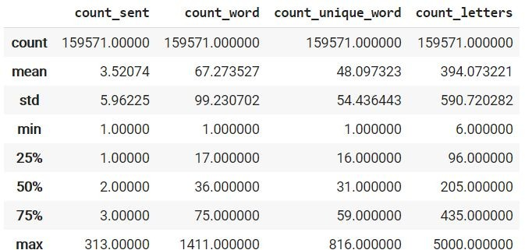
Data Cleaning & Visualization
How long are comments?

Slide 17
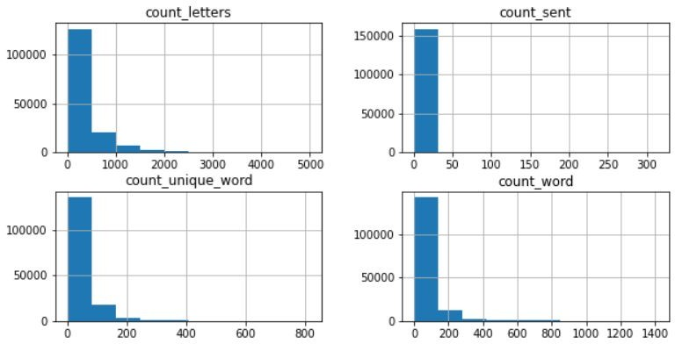
Data Cleaning & Visualization
How long are comments?

Slide 18
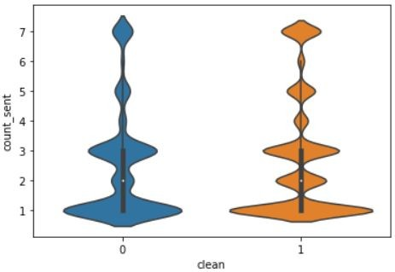
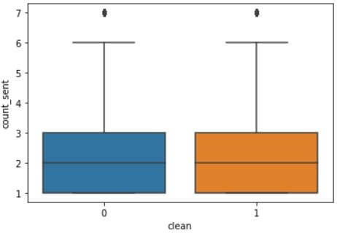
Data Cleaning & Visualization
Are longer comments more toxic?
Violin Plot
Box Plot
No signiﬁcant correlation between length & toxicity is observed.

Slide 19
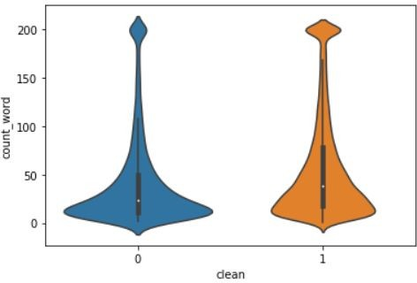
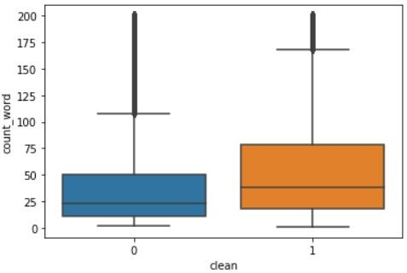
Data Cleaning & Visualization
Are longer comments more toxic?
Violin Plot
Box Plot
Slight correlation is observed. Lesser words increase the chances of toxicity.

Slide 20
Data Cleaning & Visualization
Are spammers more toxic?
A cursory look at comments reveal many comments which look like spam.
EPIC FAIL! | EPIC FAIL | EPIC FAIL! | EPIC FAIL EPIC FAIL! ...
EPIC FAIL! | EPIC FAIL | EPIC FAIL! | EPIC FAIL EPIC FAIL! ...
How to classify spammers?
Though spam detection is a wide area of research in its own we can use a very simple approach which sufﬁce for our application.
Take comments with lot of repeated words (i.e. very less % of unique words).

Slide 21
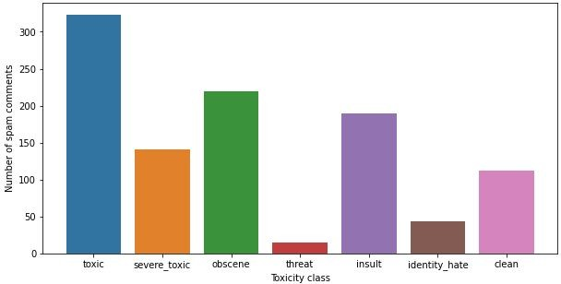
Data Cleaning & Visualization
Are spammers more toxic?
Bar Plot
Lesser percentage of unique words increases the chances of toxicity.

Slide 22
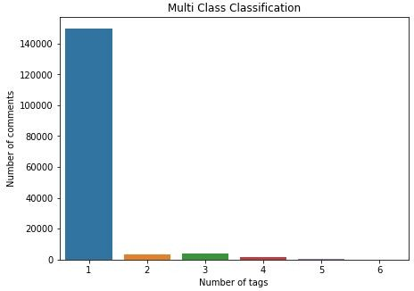
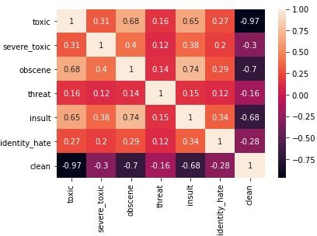
Data Cleaning & Visualization
Multi-class classiﬁcation: A lot of comments have only one tag, yet there do exist some comment having 5 or 6 hate tags.
Heatmap of the correlation between the tags.

Slide 23
Data Cleaning & Visualization
[18:00 3/7/2010]: Hey man!!, I'm
really not trying to edit war. It's just that this guy is constantly removing relevant information and talking to me through edits instead of my talk page. He seems to care more about the formatting than the actual info. (@172.16.254.1)
hey man i am really not trying to edit war it is just that this guy is constantly removing relevant information and talking to me through edits instead of my talk page he seems to care more about the formatting than the actual info
DATA CLEANING
COMMENT
CLEANED COMMENT

Slide 24

Data Preprocessing
Cleaned Data
out, what, most, any, off,
too, have, more, or, the,
ours, both, whom, and, of,
aren, her, does, from, if, not,
own, this, it, a, it's, hers,
why, who, now, been, me, ...
Data Preprocessing
STOP WORDS
Machine Readable Format

Slide 25
Data Preprocessing
Conversion of cleaned data to machine readable format.
Stop Words
Commonly used words which don’t add any meaning to the text.
E.g.: ‘is’, ‘are’, ‘this’, ‘at’, etc.

Slide 26
Encoding Text Data
Count vectoriser and TF-IDF vectoriser:
Used for text feature extraction
Transform text → meaningful representation of numbers
To ﬁt Machine Learning algorithm for prediction.
Tokenizing, counting, normalizing are used to extract features from text.
Tokenizing: Text → split into tokens & assigning integer value to each token.
Counting: counting occurence of token in document
Normalizing: Diminishing those tokens that occur in most of the documents.

Slide 27
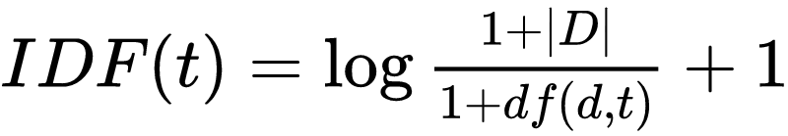
Encoding Text Data
TF-IDF vectoriser:
Reduces impact of tokens that occur in most of the documents.
Value of a term in vector increases proportionally to frequency of words in document
If the token appears in most of the documents, then that term is penalized.
Term Frequency - TF(t, d): Number of times a term ‘t’ appears in document ‘d’.
Inverse Document Frequency - IDF(t): Inverse of document frequency DF(t) - number of documents that contain a term t.

Slide 28

Encoding Text Data
TF-IDF vectoriser:
TF(t, d): High frequency of term in document increases weight of TF-IDF (local parameter).
IDF(t): Low document frequency of term in whole corpus increases weight of TF-IDF (global parameter).
TF-IDF: Considers both local and global impact of a word in vocabulary.
Performs better than Count Vectorizer for feature extraction.

Slide 29
Encoding Text Data
TF-IDF Vectorizer
Compares no. of times word appears in document with no. of documents containing that word.
Assigns the value by consideringoverall document of words,penalizing the words having highdocument frequency.

Slide 30
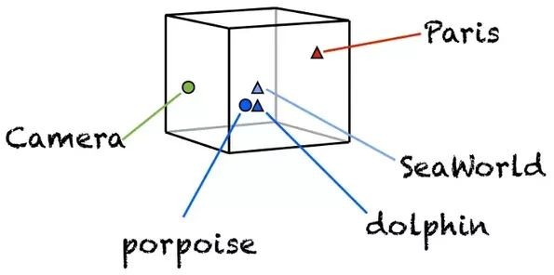
Word Embeddings
Learned representation for text where words that have the same meaning have a similar representation.
Low-dimensional and dense. Number of features is much smaller than than size of vocabulary.
Vector values are learned in a way that resembles a neural network.

Slide 31
Pretrained Embeddings
Unstructured textual data needs to be processed into some structured, vectorized formats which can be understood and acted upon by machine learning algorithms.
Obtained by unsupervised training of a model on a large corpora of text.
Captures the syntax and semantic meaning of a word by training on a large corpora.
Increases efﬁciency of the model.
Several pre trained word-embeddings are present namely, Word2Vec, FastText, Glove.

Slide 32
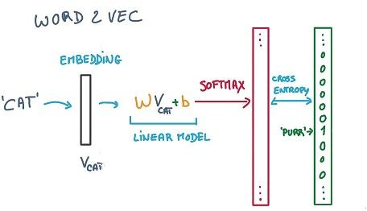
Word2Vec
Statistical method for efﬁciently learning a standalone word embedding from a text corpus.
King - Man + Woman = Queen
Two popular models are SkipGram and CBOW.

Slide 33
Word2Vec
CBOW Model
Learns the embeddings by predicting the current word based on its context.
Trains faster and works better for frequent words.
SkipGram Model
Learns by predicting the surrounding words given a current word.
Works well with small data and can represent rare words.

Slide 34
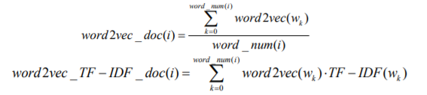
Tf-Idf weighted Word2Vec
In text processing, different features have different influences on the text. For example, the features related to the theme and structure of the text are more important than the general features. Therefore, it is necessary to weight the feature items of the text.
In the Word2vec word vector method, the usual method for processing features to obtain the vector representation method of text is weighted average or TF-IDF method

Slide 35

Text Representation:
First calculate the word weight of each text through the improved TF-IDF algorithm
Second, use the Word2vec model to train the text and get the word vector for each text.
Finally, use word weights and word vector weights to get word vectors for each word.
The weighted word vector is added to get a new vector representation, weight_{R(di)} , of the document d_{i}

Slide 36
The text needs to be pre-processed before text classification, including text segmentation and removal of stop words, etc. Stopwords mainly include characters that are used infrequently and have no practical meaning.
A large number of experiments have shown that removing the stopwords in the text can improve the text classification effect.
Experimental results show that the improved TF-IDF algorithm has a higher classification accuracy compared with the traditional TF-IDF algorithm.

Slide 37
Naïve Bayes
Training Models
Naïve Bayes classifier is a probabilistic classifier based on Bayes’ theorem, which assumes that each feature makes an independent and equal contribution to the target class.
NB classifier performs well on large datasets having high dimensionality. NB classifier is conducive for real-time applications and is not sensitive to noise.
NB classifier processes the training dataset to calculate the class probabilities P(y_{i}) and the conditional probabilities, which define the frequency of each feature value for a given class value divided by the frequency of instances with that class value.

Slide 38
Results:
In our model, after performing Naïve Bayes algorithm we achieved:
Mean training accuracy of approximately 93.25%
Mean validation accuracy of approximately 93.32%
Mean validation F1 score of 0.3728

Slide 39
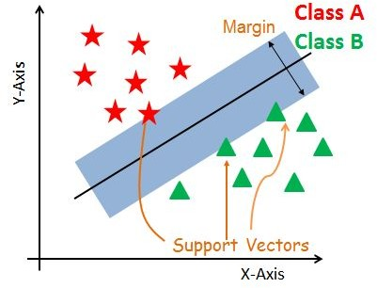
Support Vector Machines
Constructs a Maximum Marginal Hyperplane that best divides the dataset into classes.
Hyperplane: decision plane that separates a set of objects belonging to different class.
Support Vectors: Data points which are closest to the hyperplane.
Margin: gap between the two lines on closest class points.

Slide 40
Support Vector Machines
Generates optimal hyperplane iteratively to minimize the error.
Objective: Find hyperplane with maximum possible margin between support vectors.
Can be used for both linearly separable as well as non-linearly separable data.

Slide 41

Logistic Regression
Logistic regression is a process of modeling the probability of a discrete outcome given an input variable.
Logistic regression is a transformation of a linear regression using the sigmoid function.
The formula of Logistic regression is as follows:
The logistic function applies a sigmoid function to restrict the y value from a large scale to within the range 0–1.

Slide 42
Problem transformation
Transforms the problem into separate single class classiﬁcation problem.
Methods Used - Binary Relevance, Classiﬁer Chains
Binary Relevance: Each label is treated as separate single class classiﬁcation problem.
Classiﬁer Chains: First classiﬁer is trained on the input, then subsequent classiﬁers are trained on input + all previous classiﬁers in the chain.

Slide 43
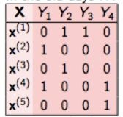
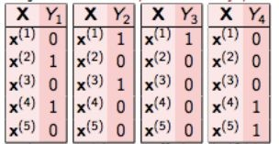
Problem transformation
Binary Relevance:
Four different single-class classiﬁcation problem
Drawback: Doesn’t consider correlation between the labels, treats every target variable as independent.

Slide 44
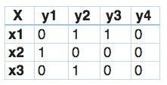
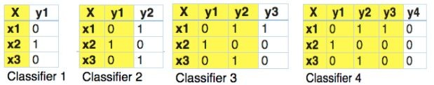
Problem Transformation
Classiﬁer Chains:
Four different single-label problem Yellow: input space, White: target variable
Forms chains in order to preserve label correlation.
Generally performs better than binary relevance when correlation between labels is involved.

Slide 45
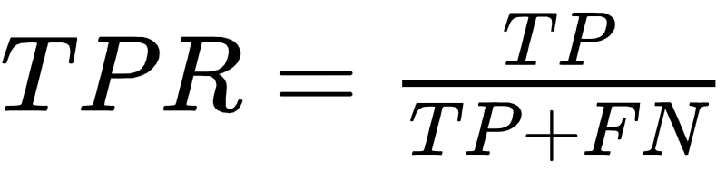
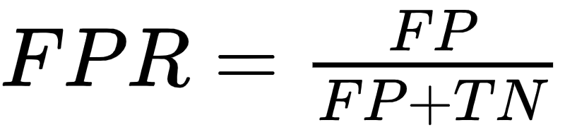
Receiver Operating Characteristic
An ROC curve is a graph showing the performance of a classiﬁcation model at
all classiﬁcation thresholds.
This curve plots two parameters:
True Positive Rate (TPR) : Fraction of positive data points classiﬁed as positive.
False Positive Rate (FPR) : Fraction of negative data points classiﬁed as positive.

Slide 46
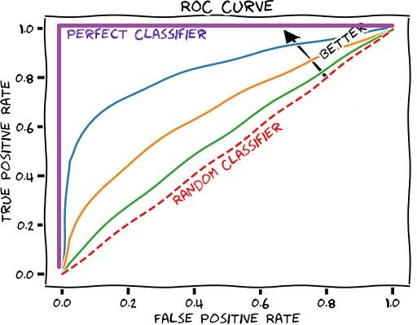
Receiver Operating Characteristic
An ROC curve plots TPR vs. FPR at different classiﬁcation thresholds.
Lowering the classiﬁcation threshold classiﬁes more items as positive, thus increasing both False Positives and True Positives.

Slide 47
Area Under the ROC Curve
AUC measures the entire two-dimensional area underneath the entire ROC curve from (0,0) to (1,1).
More the area under curve better the classiﬁer!
AUC provides an aggregate measure of performance across all possible classiﬁcation thresholds.
AUC can be interpreted as the probability that the model ranks a random positive example more highly than a random negative example.
AUC ranges in value from 0 to 1. A model whose predictions are 100% wrong has an AUC of 0.0; one whose predictions are 100% correct has an AUC of 1.0.

Slide 48
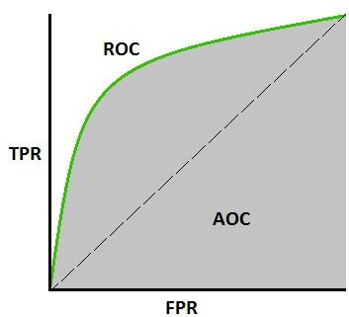
Area Under the ROC Curve
AUC is desirable for the following two reasons:
AUC is scale-invariant. It measures how well predictions are ranked, rather than their absolute values.
AUC is classiﬁcation-threshold-invariant. It measures the quality of the model's predictions irrespective of what classiﬁcation threshold is chosen.

Slide 49
Results and Comparison
Model | Mean AUC_ROC Score
Support Vector Machines (Binary Relevance) | 0.6375
Support Vector Machines (Classifier Chain) | 0.6529
Logistic Regression (Binary Relevance) | 0.6446
Logistic Regression (Classiﬁer Chains) | 0.6446

Slide 50
Conclusion and Further Works
Classical Models like SVM and Logistic Regression fail to achieve high AUC_ROC score.
Further Improvements can be achieved by experimenting with complicated neural networks and use of state of the art Transformers.

Slide 51
Thank You!

