Slide 1

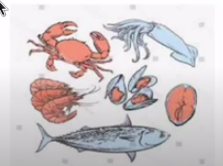
FISHERY
Culture of aquatic organisms like fish,prawn crab,etc
Raising and harvesting through
aquaculture

Slide 2
Pisciculture
Pisciculture is only the culture of fish.
It includes breeding, rearing and harvesting
of fishes for food purpose

Slide 3
Types of fish culture
CULTURE
CAPTURE
When fishes are breeded and cultured in a controlled method
then it is called culture method.
Only capturing of fishes form natural source i.e., pond, river and ocean.

Slide 4
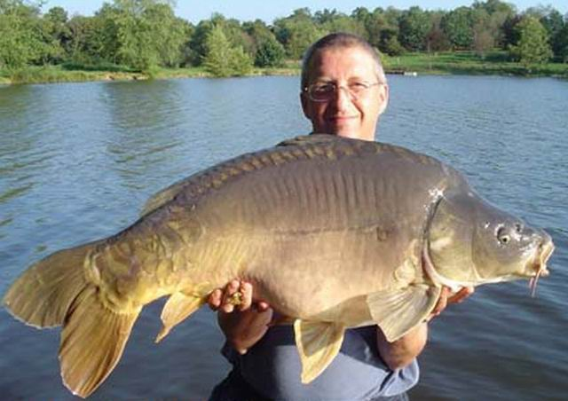
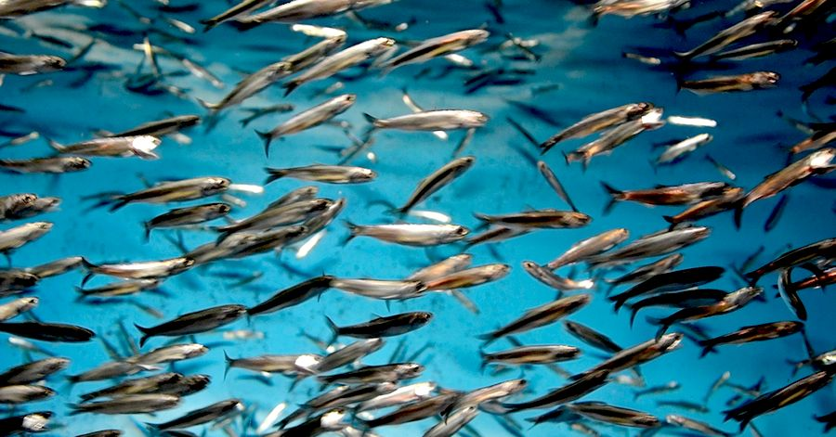
On Basis of Area
INLAND:-
1) Fresh water
2) Brackish
Marine:-
1) Coastal
2) Deep sea

Slide 5
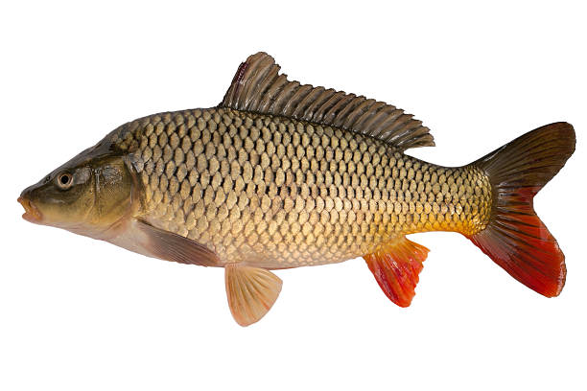
CARP
Fresh water fish.
Triangular head without scale.
Scale present throughout the body.
No accessory respiratory organ.
No teeth present in the jaw.
Air bladder is present in the body.
Example- Rohu, Katla.

Slide 6
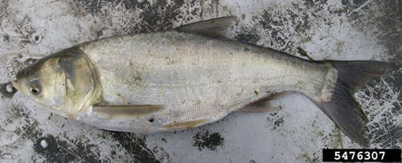
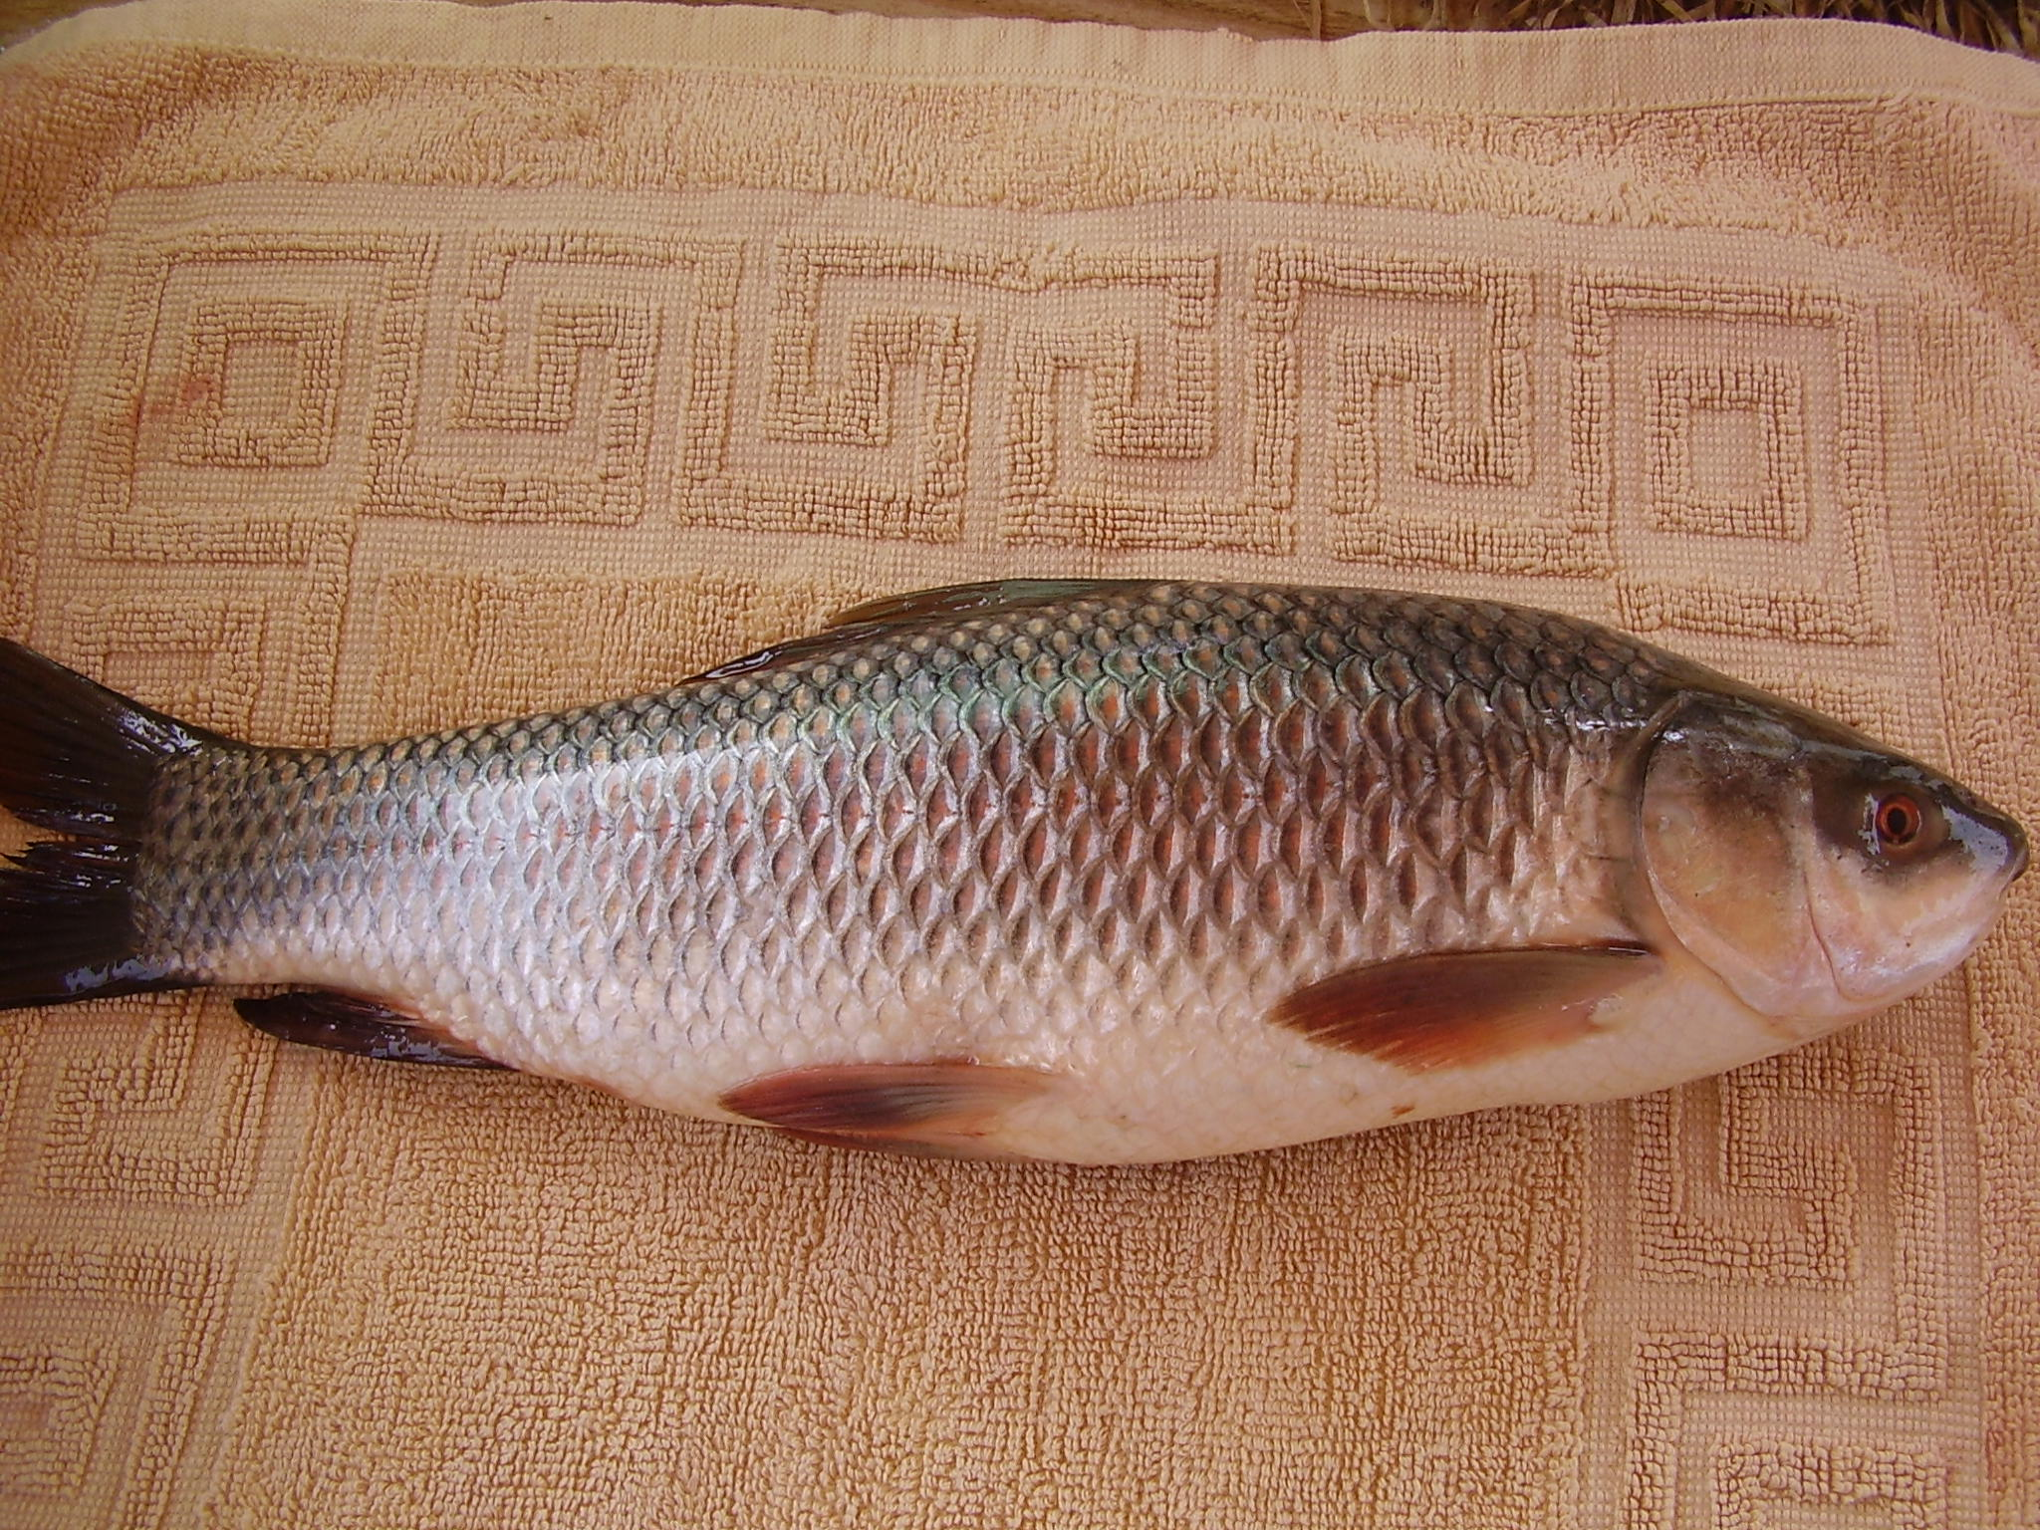
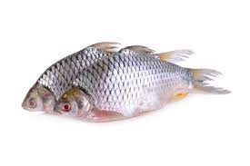
Types of Carp
INDIGENOUS
EXOTIC CARP
1)Major carp.
Example-Rohu, Catla, Mrigel
2)Minor carp
Example-puti(glass barb), Bata(labeo bata).
Grows quickly, can
accommodate indian
climate. Example-Sliver
carp,American rohu,
Common carp
Silver Carp
Rohu
Putti

Slide 7
Process of Fish Culture
Natural
INDUCED BREEDING

Slide 8
Natural process-Egg to adult fish
Collection of dimpona from natural water bodies.
(Dimpona are fertillized egg.)
Rearing them in tank
Feeding till they are mature
Harvest

Slide 9
Significance of induced breeding
Breeding in captive conditions.
Benefits are as follows-
Ecosystem protection
Out of season Production.
Genetic improvement

Slide 10
STEPS IN INDUCED BREEDING
Collection of healthy fishes -2male, 1 female
Injection of extract of Freshly prepared Pictutary gland.
Allow them to release egg and sperms
Fertilization occur and dimpona produced t.e; fertilized egg

Slide 11
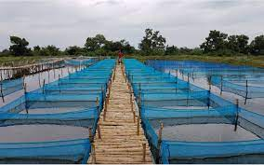
Tanks of Hapas
DIMPONA
DHANIPONA
CHARAPONA
AUDULT
Hatching hapa
Rearing hapa
Storage hapa
Harvest

