Slide 2
https://mongoose-os.com/docs/cloud/aws.md https://medium.com/@gomaketeam/connecting-the-esp32-devkitc-and-aws-iot-using-mongoose-os-part-i-11fecd2d86d5
1. Mos flash esp32
2. mos wifi SSID PWD
3. mos aws-iot-setup --aws-region YOUR_AWS_REGION
Before this command make sure to visit for ceritificates
http://docs.aws.amazon.com/cli/latest/userguide/cli-chap-getting-set-up.html
D:\Knowledgebase\awscli>set path=%path%;D:/Python37;D:/Python37/DLLs;

Slide 3
set path=%path%;D:/Python37;D:/Python37/DLLs;D:/Python37/Scripts;
Add CLI TO PATH

Slide 4
Before performing step3 make sure awscli set up is done and aws credentials are stored at local store
Error
Error: failed to generate certificate: failed to obtain certificate from AWS: AccessDeniedException: User: arn:aws:iam::800820290373:user/rahul is not authorized to per
eateCertificateFromCsr on resource: *
status code: 403, request id: 1b5d7996-a62d-11e8-8d1b-977365a0105b
https://forum.mongoose-os.com/discussion/1422/provision-an-aws-whith-esp32-devkit-board

Slide 5
Worked after setting the Policy on User
>mos aws-iot-setup --aws-region ap-south-1 --aws-iot-policy mos-default

Slide 6
Check aws iot console. You will find device

Slide 7
Mos ui
Select device port and click select
In the Step 2 section, select esp32. DO NOT HIT THE FLASH BUTTON. We have already flashed our device in a previous step.

Slide 8
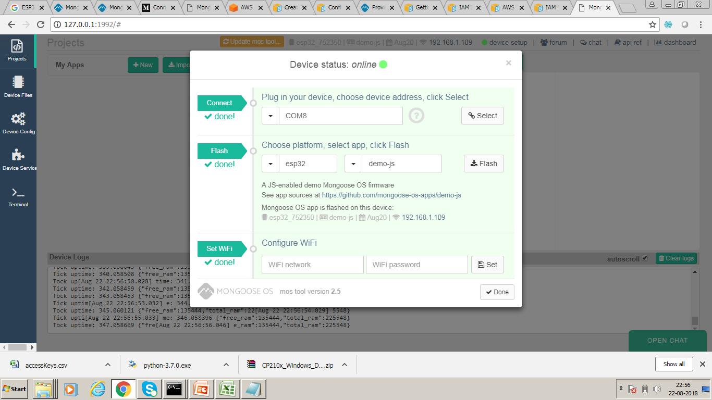

Slide 9


Slide 10
AWS Config
/devices/' + ‘esp32_752350’+ '/events

Slide 11
Register Device with Dashboard
mos config-set dash.enable=true dash.token=d83b3d1d08c0130bbcad39db

Slide 12
Upload from here
https://mongoose-os.com/dashboard/#account
https://github.com/mongoose-os-libs/ota-shadow

Slide 13
Shadow to be used
{ "desired": { "ota": { "fw_version": "2.0", "ota_url": "https://mongoose-os.com/dashboard/ota/github_shwetaopengts/fw.zip", "ota_code": 2, "ota_message": "Update applied successfully", "on": true, "url": "https://mongoose-os.com/dashboard/ota/github_shwetaopengts/fw.zip" } }, "reported": { "ota": { "fw_version": "1.0", "fw_id": "20180831-015841", "mac": "30AEA4752350", "device_id": "esp32_752350", "app": "ota-shadow", "arch": "esp32", "message": "idle", "status": 0, "is_committed": false, "commit_timeout": 300, "partition": 1, "progress_percent": 0, "ota_url": "https://s3.ap-south-1.amazonaws.com/neuralfirmware/fw.zip", "ota_code": 1, "ota_message": "Update applied successfully", "url": "https://mongoose-os.com/dashboard/ota/github_shwetaopengts/fw.zip" } }, "delta": { "ota": { "fw_version": "2.0", "ota_url": "https://mongoose-os.com/dashboard/ota/github_shwetaopengts/fw.zip", "ota_code": 2, "on": true } }}

