Slide 1


Shweta Prasad

Slide 2
Introduction
The Indian Premier League (IPL) is a professional Twenty20 cricket league in India that has gained immense popularity since its inception in 2008. Founded by the Board of Control for Cricket in India (BCCI), the IPL has become one of the most-watched and highly anticipated sporting events in the country. The league typically takes place during March, April, and May of every year, featuring twelve teams representing different cities in India.
The IPL follows a round-robin format, where each team plays against every other team in the league. The top four teams in the points table qualify for the playoffs, which consist of two qualifiers, an eliminator, and a final match. The team that wins the final match is crowned the IPL champion.
One of the unique features of the IPL is the player auction, where teams bid for players from around the world to build their squads. This has led to the participation of international cricket stars alongside Indian players, creating a diverse and competitive league.
Over the years, the IPL has witnessed numerous thrilling matches, record-breaking performances, and the emergence of young talents. It has also significantly contributed to the growth and popularity of Twenty20 cricket worldwide.

Slide 3
Data Visualisation Goals
Analyze the performance of each team, and player and provide insights about the best-performing team and best-performing player.
Create an interactive Dashboard that helps provide a summary of the performance of each cricket player and cricket team over the past years.
Key Metrics to Consider –Metrices For Team Performance, Metrics For Player Performance, Season Wise Analysis, Venue-Wise Analysis, Player Comparison and Rankings, Match Results and Margins, Impact Of Toss Decision and Tournament Progression

Slide 4
Dataset Selected
IPL Matches 2008-2020.csv – This dataset provides detailed information regarding the cricket match, place where the match was conducted, the match schedule of different teams, information about the winning team per match, and other important details that will help us understand the statistics of each team.
IPL Ball-by-Ball 2008-2020.csv – This dataset provides match-level details such as runs scored in each match, best player of the match, best bowler of the match, and other important details that will help us understand the statistics of each player.
Data Cleaning(EDA) Has been Done on Jupyter Notebook(Python) .

Slide 5
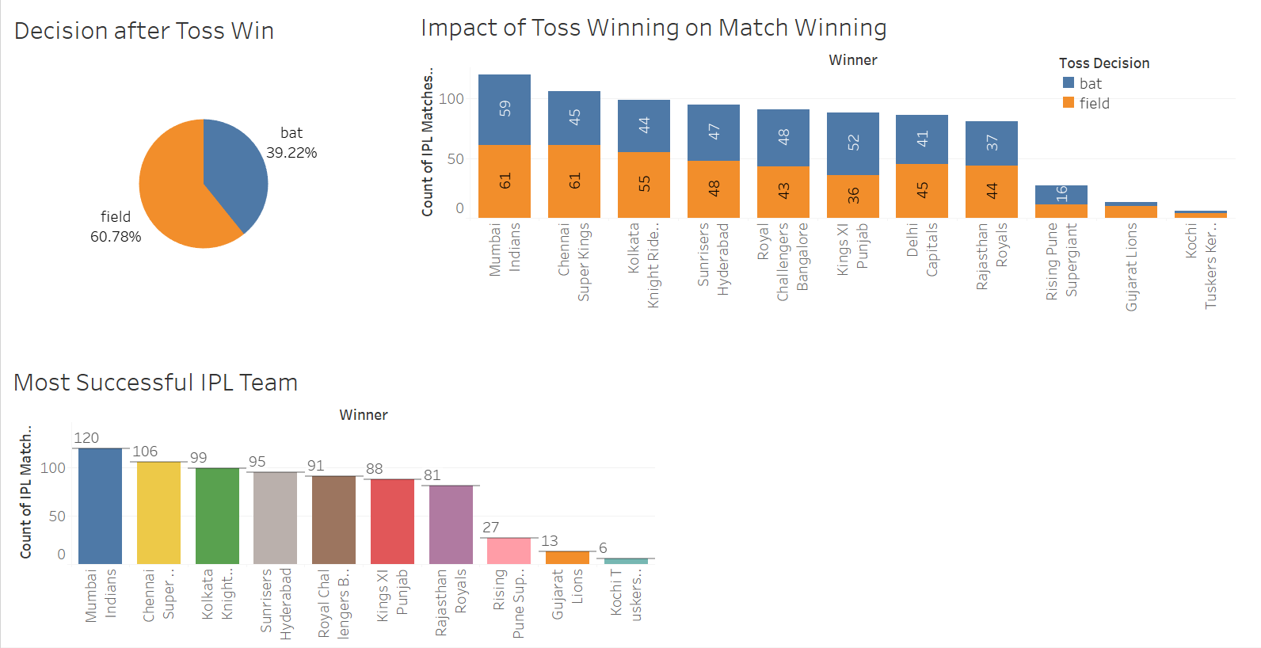
Insight No. 1 – Does winning the toss for the game lead to winning the game?
Here Are the Insights -
1)Pie chart for Decision after Toss Win
2)Graphs- showing the Impact of Toss Winning On Match.
Toss winning plays a crucial role in deciding the winner of the match
After carefully observing and analyzing the data we found out that, the most common decision after winning the toss was “Field”. Most of the teams would select to “field” first
These teams who select to “field” first tend to win the match most of the time. This can be seen by the trend displayed in the below chart
The most successful teams have been the ones who have elected to “field” first

Slide 6
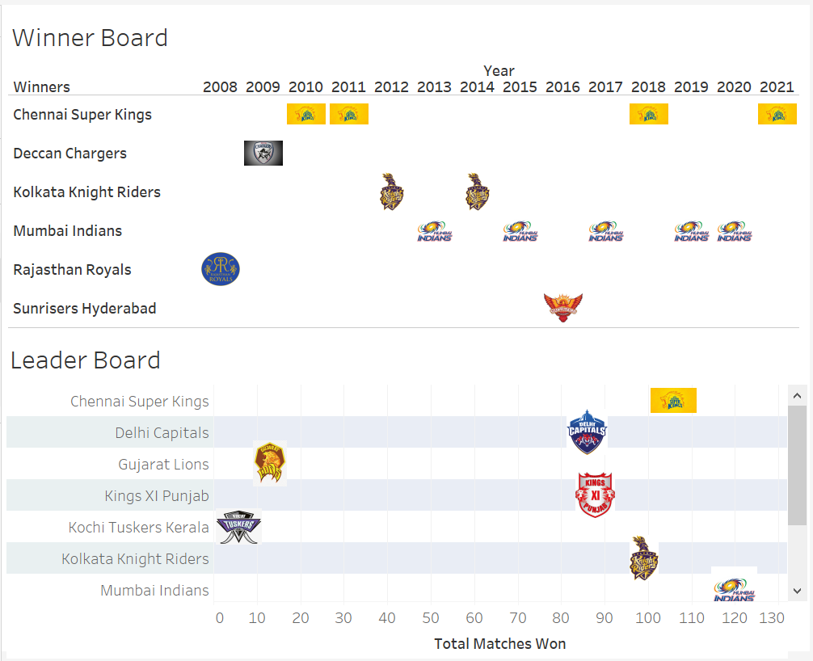
Insight No. 2 - Which team has won the most number of games and tournaments?
Insight:
The Winner Board shown in the below chart displays which team has won the IPL in a particular year. As we can see, team Mumbai Indians won the IPL tournament 5 times from 2008 to 2021, thereby winning the greatest number of times compared to other teams. Team Chennai Superkings follows next on the chart after winning the IPL tournament 4 times.
The Leader Board shown in the below chart displays the total number of matches won by a particular team. This shows that team Mumbai Indians leads the board and team Chennai Superkings follows it.

Slide 7
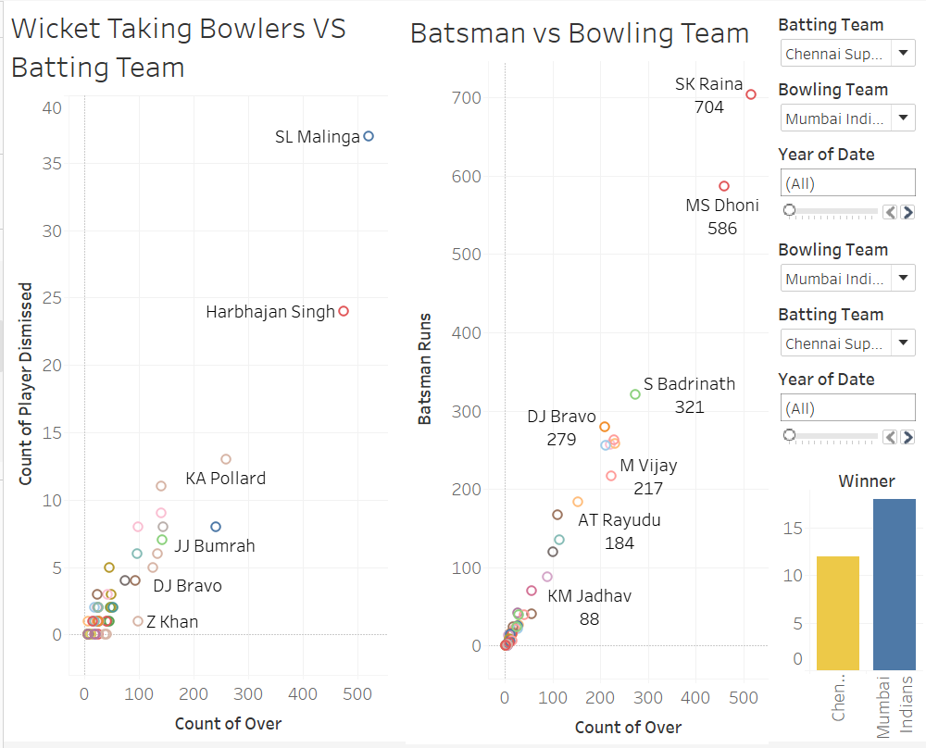
Insight No. 3 - Mumbai Indians v/s CSK team statistics
Insights:
BestBowlers of Mumbai Indians against Chennai Superkings.
Best batsmen of Chennai Superkings against Mumbai Indians

Slide 8
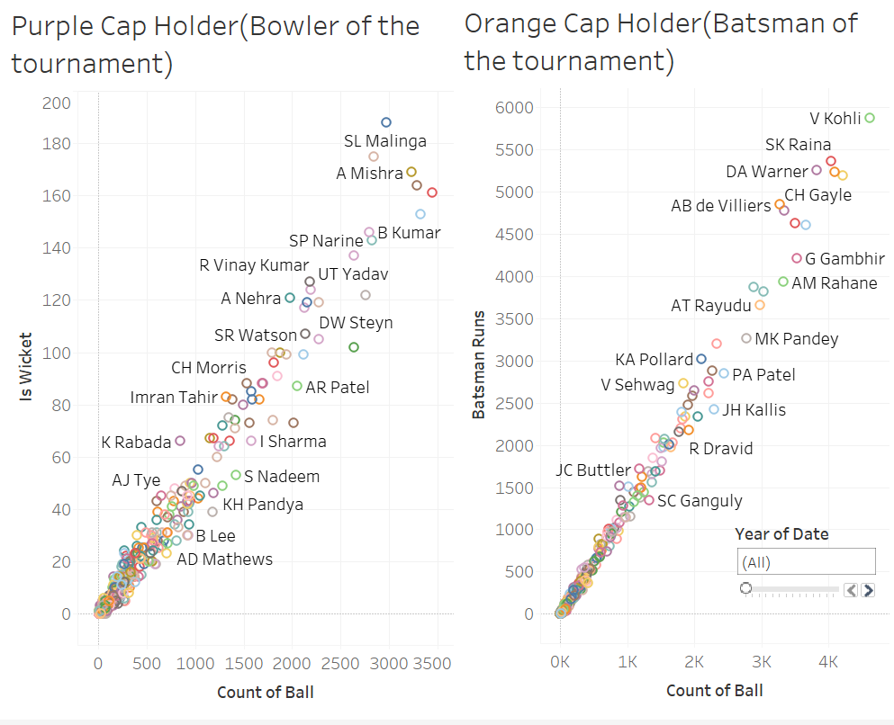
Insight No. 4 - Who are the best batsmen and best bowler of the tournament?
Insights:
As we can see bowlers who have taken maximum wickets in the tournament and can be named as purple cap for the whole tournament
We can see that the TOP-performing batsman for the full season we can see that V.Kohli emerges as the best batsman and can be named as orange cap.

Slide 9
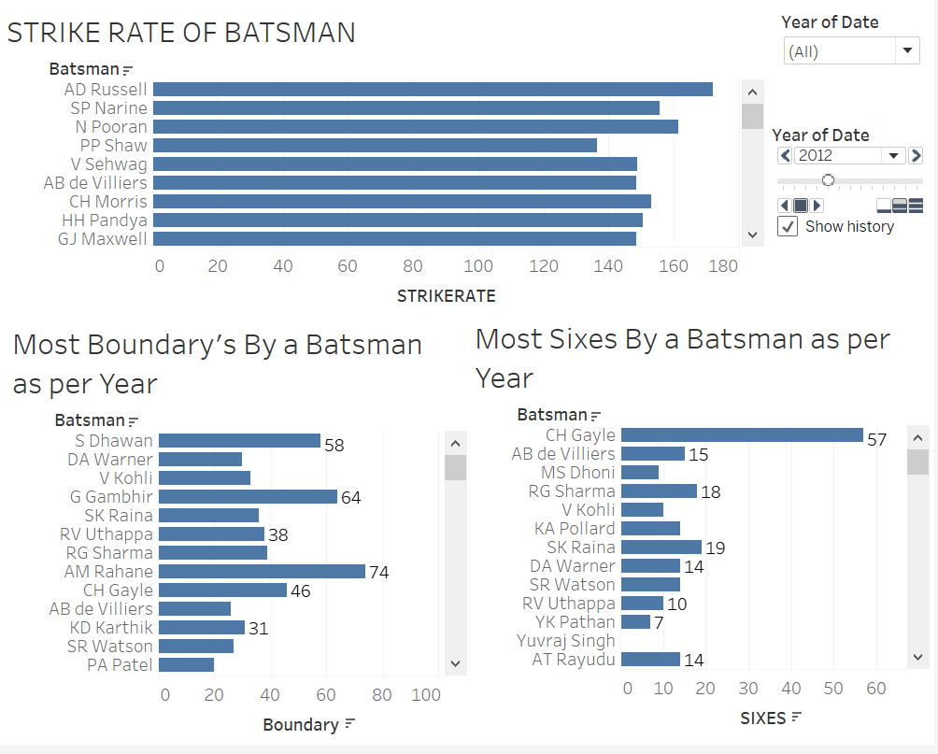
Insight No. 5 - Relationship between Strike rate and Boundaries or Sixes
Insights:
We can see from the below chart that If a Batsman has the best Strike rate it does not mean that he has scored the most boundaries or sixes. Runs can be made with running as well and still, a batsman can attain the best strike rate.

Slide 10
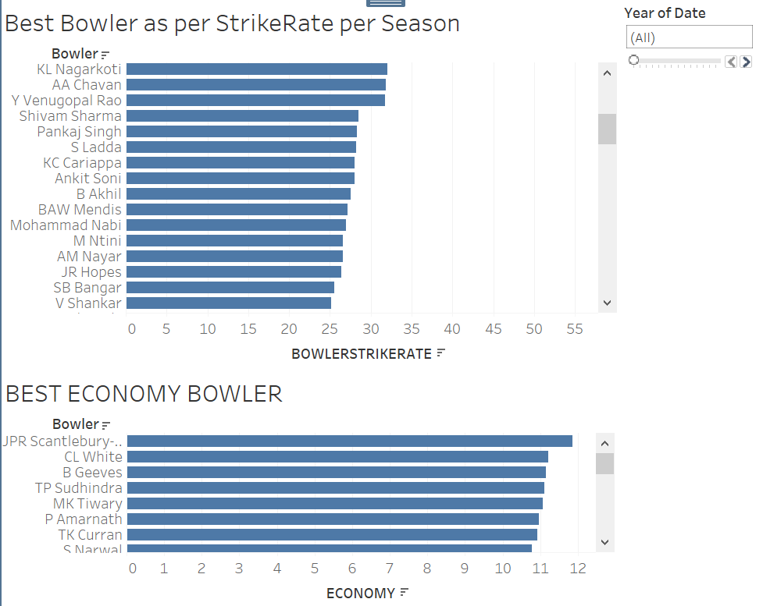
Insight No. 6 - Relationship Between Bowlers strike rate and Bowlers Economy
Insights:
We can see from the below chart that if a bowler has the best strike rate, which is best when it is the lowest, it does not mean that he has the best economy rate. The economy can be achieved without having the best strike rate.

Slide 11
Conclusion
Player performance analysis for better recommendation in future tournaments
Key metrics that decide the winning of a team in the tournament
Identify top-performing players in various aspects of the game (e.g., highest run-scorers, leading wicket-takers, best fielders) to inform team selection and strategy.
Encourage teams to focus on building a well-balanced squad with a mix of experienced players and emerging talents, considering both individual skills and team dynamics
By leveraging the insights gained from player performance analysis and identifying key winning factors for teams in the IPL dataset, stakeholders can make informed decisions and implement effective strategies to enhance their performance in future tournaments.

Slide 12


