Slide 1
Supply Chain Analysis 0n Target Retail Corp.
Presentation by:
Chintakuntla Bharat Kumar
Shweta Prasad
Keerthi Chatti

Slide 2
Introduction
Target competes in the retail industry alongside major players like Walgreens,Walmart & CVS offering a diverse range of products and services to cater to customers everyday needs. The analysis approach that we used comparing Target with its competitors is cash conversion cycle(CCC) which is an essential tool for making decisions and optimizing the operations because it reflects the business’s operating cycle which is a time metric that expresses the time it takes for the company to sell its inventory and collect receivables to payoff the firm’s payables. CCC is calculated using three ratios which are DIO,DSO,DPO. By calculating these 3 ratios collectively within the CCC framework, business gain a comprehensive understanding of their cash conversion cycle. A shorter CCC signifies that a company is swiftly converting its investments into cash, which can then be reinvested or unitlized for various operational needs.

Slide 3
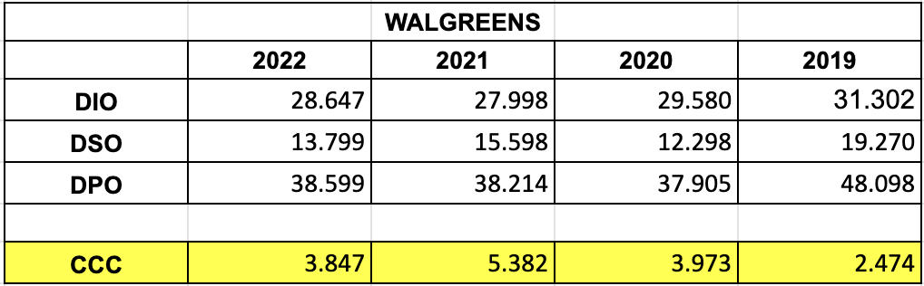
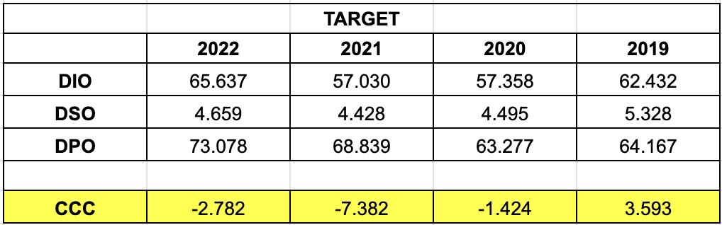
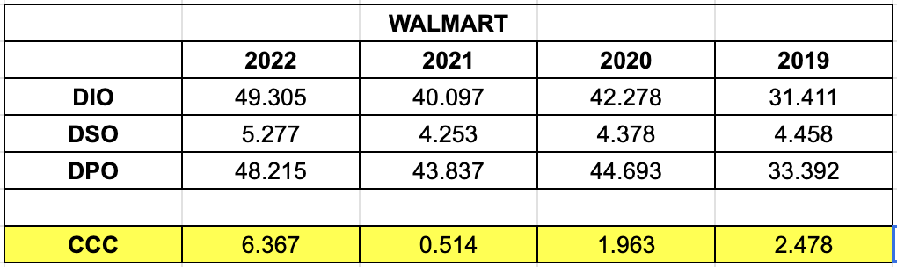
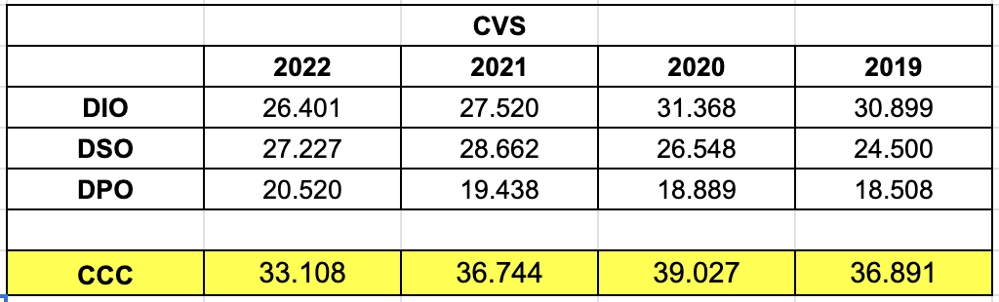
Comparative Analysis
Reference for financial data: SEC EDGAR 10‑K filings / annual reports (Target, Walmart, CVS, Walgreens).
Use official filings to compute DIO/DSO/DPO and CCC (avoid paywalled sources).

Slide 4
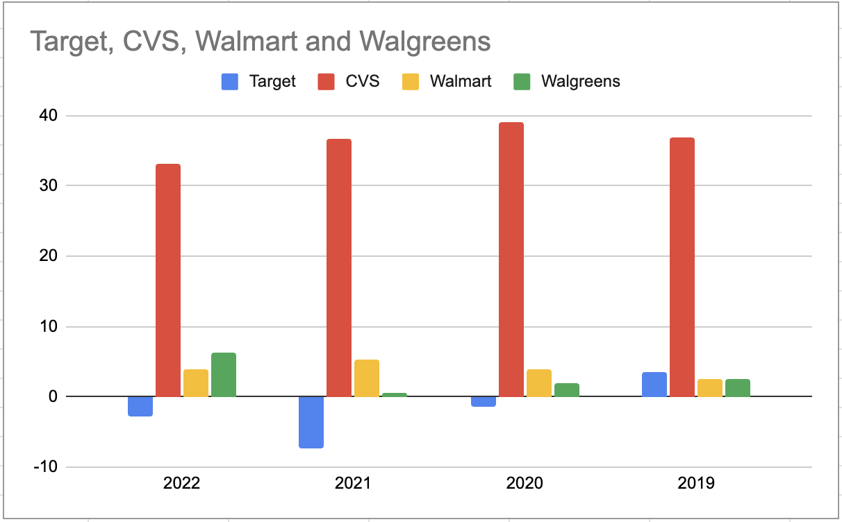

Slide 5
Cash Conversion Cycle Analysis
The CCC analysis using the ratios gives us a better understanding of the effectiveness of a firm’s inventory management on year-by-year performance. The nearest CCC value to 0 of any company explains that the company is better at converting the investment in inventory into quick cash.
It appears that Target generally has Higher DIO and lower DSO compared to CVS, Walmart, and Walgreens.
Walmart has the better CCC from 2019 to 2022 which means Walmart is efficiently converting its inventory and receivables into cash compared to Target, CVS & Walgreens.
CVS has the higher CCC comparatively which means the CVS would take longer to convert its inventory and receivables into cash. This indicates the potential inefficiencies in inventory management or slower account receivables.

Slide 6
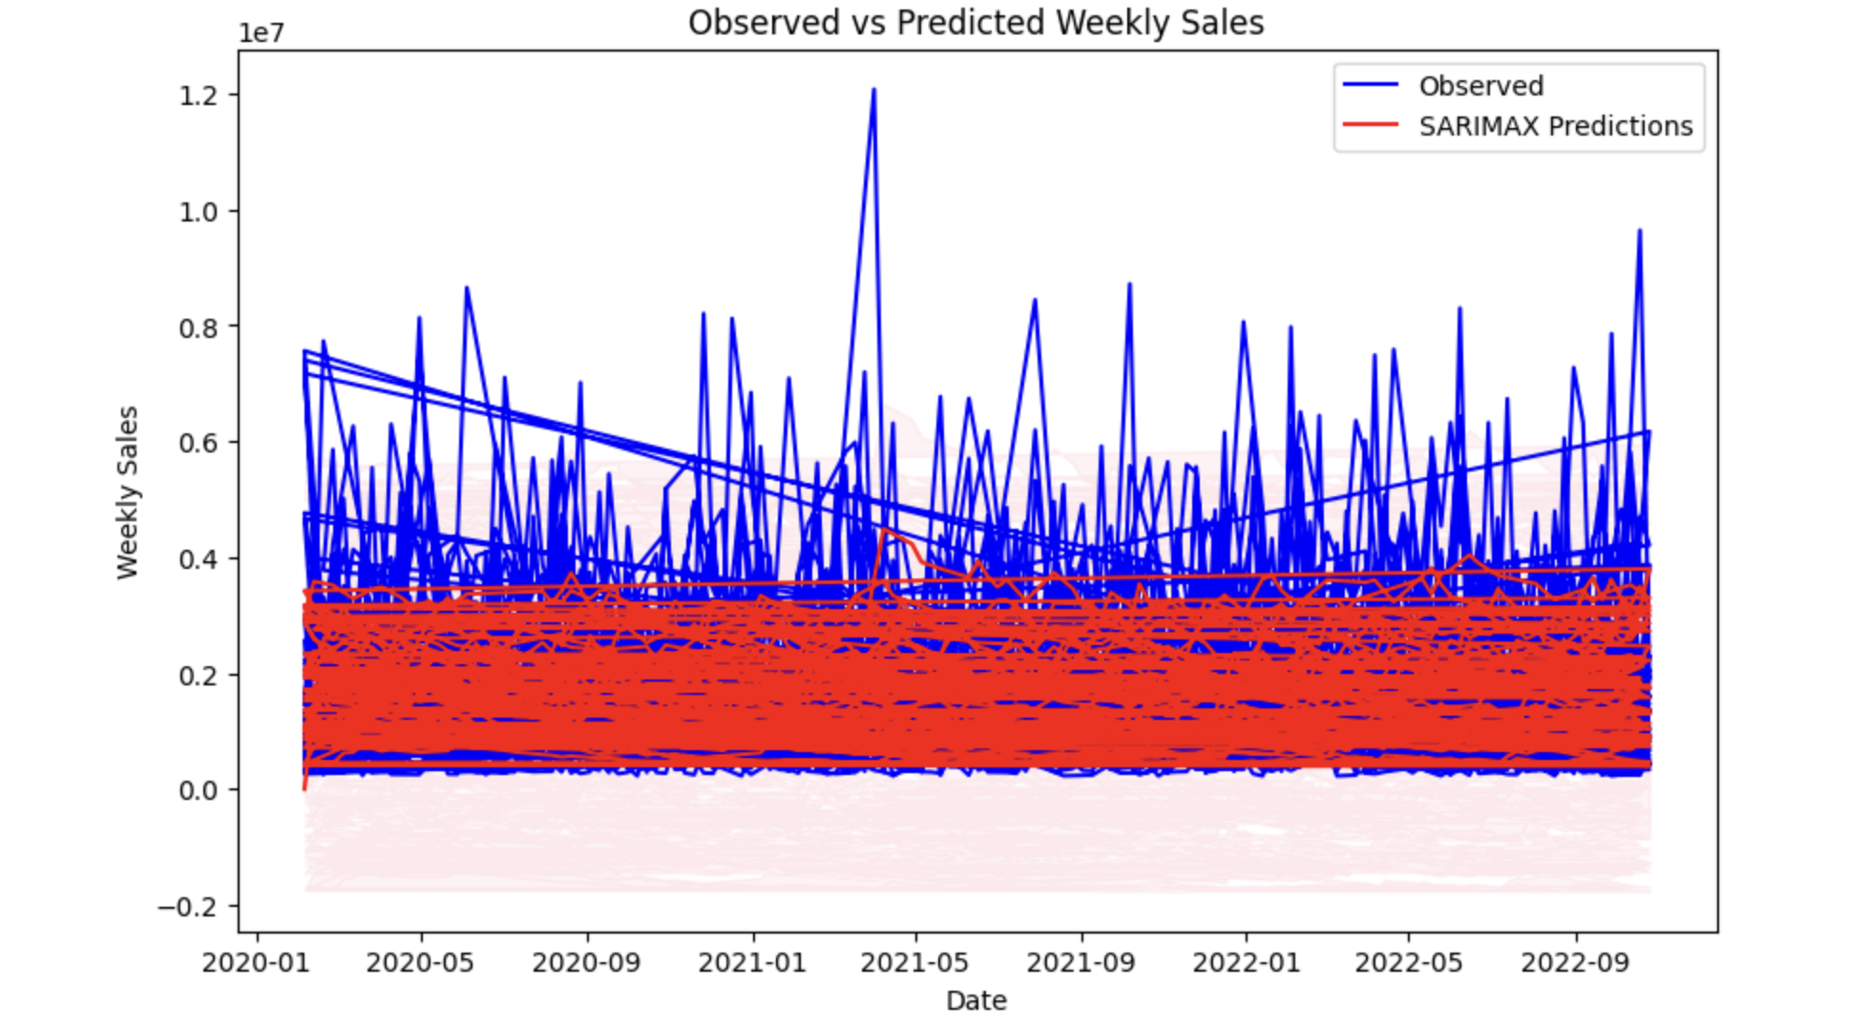
Demand Forecasting Sales
The model here shows the sales data using the method called SARIMAX. It predicts future sales based on past sales patterns. The plot shows the actual sales data and the model’s prediction. This helps business understand their sales trends and make better decisions about inventory and planning. It shows that there was a higher sales in the year 2021 in the month of may comparatively.

Slide 7
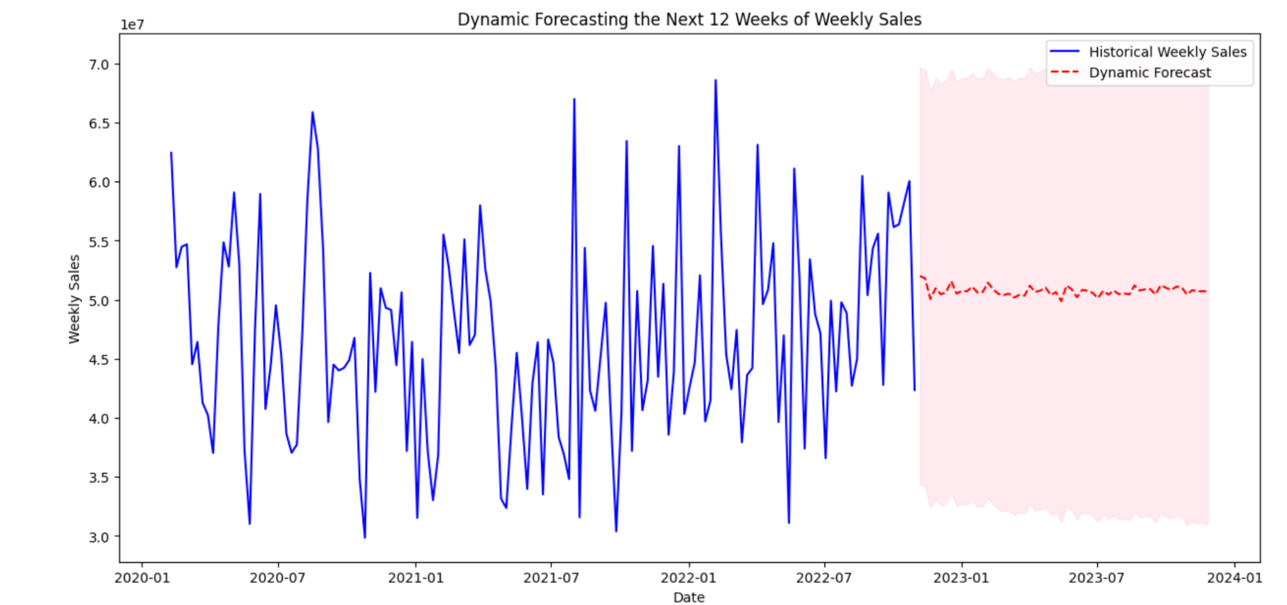
Demand Forecasting Sales for next 12 weeks.

Slide 8
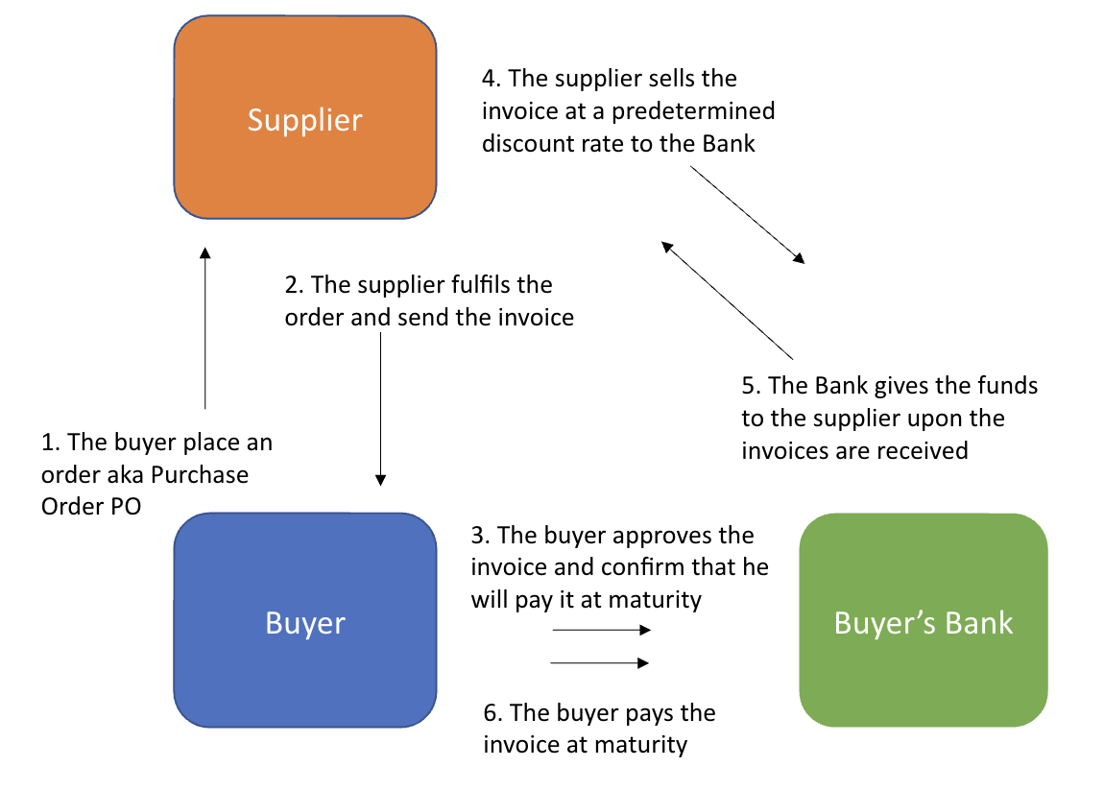
Reverse Factoring Analysis
Implementing Reverse Factoring Analysis could potentially help target even with a lower average cost of debt. Reverse factoring primarily aims to optimize cash flow, working capital management, and by extending payment terms with suppliers through reverse factoring, Target can improve its cash flow position which could offset the cost of debt and enhance overall financial performance. Overall target low cost of debt provides a favorable backdrop for entering into a reverse factoring program to maintain its competitive edge in the market.

Slide 9
THANK YOU

