Slide 1
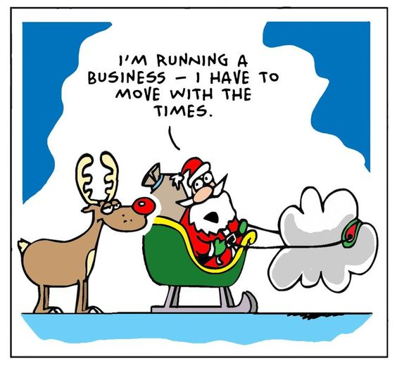
CLOUD COMPUTING

Slide 2
What is cloud computing
Cloud computing is a technology that allows you to access and use computer resources (like servers, storage, databases, software, and more) over the internet, typically from a service provider, rather than owning and managing these resources locally. This enables users to easily scale their IT infrastructure, store data, and run applications without the need for extensive on-premises hardware and maintenance.

Slide 3
Working Models
Deployment Model
Service Model
Public Cloud
Private Cloud
Hybrid Cloud
Infrastructure as service (IaaS)
Platform as Service(PaaS)
Software as Service(SaaS)

Slide 4
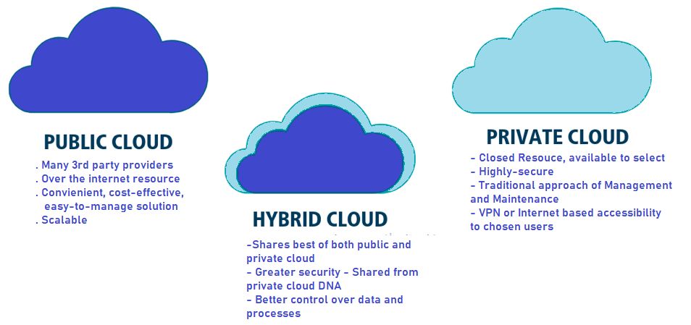
Deployment Models

Slide 5
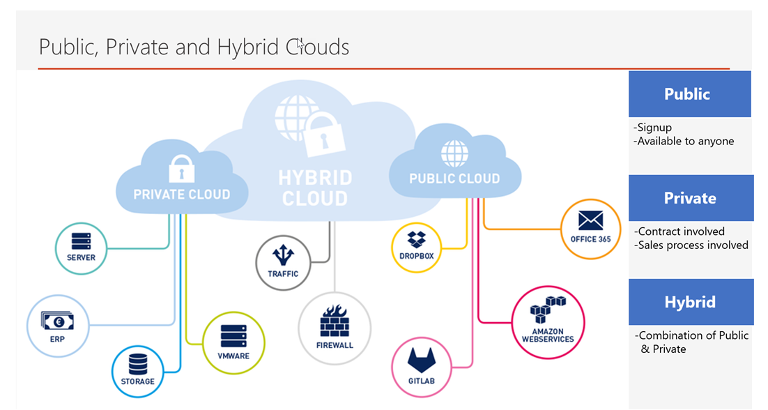
Examples

Slide 6
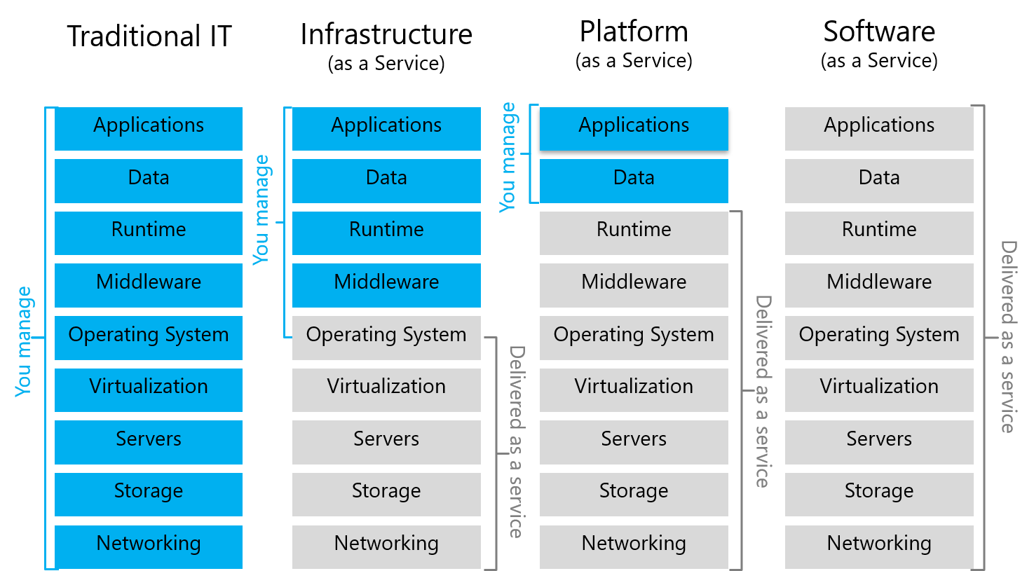
Service Model

Slide 7
Advantages

