Slide 1
MSIS 5633
INJURY SEVERITY ANALYSIS
Presented By :
Shweta Parida
Divya Peddapeta
Philip Anderson
Abhishek Bhale
Notes:
P

Slide 2

SUMMARY
Motor vehicle crashes are incidents that happen every day within the US.
Our objective is to investigate which risk factors have the greatest correlation to a driver’s injury severity level within a vehicle crash.
We will be dissecting data and testing different machine learning models in order to to determine which combination of variables and model methods can prove to be most accurate.
While following the Cross Industry Standard Process for Data Mining (CRISP-DM)

Slide 3
BUSINESS UNDERSTANDING
Analyzing the factors that contribute to injury severity within a vehicle crash can create multiple business opportunities within a variety of industries.
Industry Examples: Manufacturers, Insurances, Construction Companies and State Legislature.
In this study we dissect which key variables have the greatest effect on a driver’s injury severity in motor vehicle accident.
In turn, companies will be able to reassess safety measures for their vehicles, provide better coverage and develop better infrastructure for their roadways and traffic stops.
Notes:
Executive Summary, Business Understanding (P)
The problem that we are trying to solve is predicting the injury severity in car crashes.
We want to find the level of injury severity that people suffer from when they are involved in a car crash.
We are trying to solve this problem based on the accident data, the vehicle data, and the persons data.

Slide 4
DATA UNDERSTANDING
Source:
Crash Reporting Sampling System (CRSS)
National Highway Traffic Safety Administration (NHTSA)
SAS File Datasets:
Distract: All reported distractions prior to crash.
Vehicle: All in-transport vehicle data
Person: All motorist and non-motorist involvement data
Accident: All geographic and other crash data involving 1 or more vehicles
Dependent Variable = Injury Severity (Scale 1-9)
1-2 = low severity
3-4 = high severity
*All other variables are either not reported or show no injury.
Notes:
The data related to different crashes in America for the year 2018 is captured. It includes data on the accident, the details of the person and the details of the vehicle. The data that is captured here is directly from an item on the police crash report or by interpreting the information that was provided in the crash report. It was obtained from the review of the crash diagrams, the police officers' written summary of the crash or with combinations of data elements on the report.
We have 4 SAS data files - Accident, Distract, Person & Vehicle, that give us the details of car crashes that took place in the US for the year 2018. The datasets are a combination of different data types. Following are the different data files that we have and their details:
The Distract Data file has 11 columns with 86131 records, which includes information related to the distraction due to which the driver caused the accident and the location of the incident. Here, the primary keys are CASENUM (case number) & VEH_NO (Vehicle number).
The Vehicle Data file has 87 columns with 86105 records, which give information about vehicle details like its age, type, model year, surface condition of the road, traffic control devices, and other related data. Here, the primary keys are CASENUM (case number) & VEH_NO (Vehicle number).
The Person Data file has 54 columns with 130230 records, which provides details regarding the people involved in the crash like their age, seat position, the severity of their injuries, and other similar data. Here, the primary keys are CASENUM (case number), VEH_NO (Vehicle number) & PER_NO (PersonId).
The Accident Data file has 51 columns with 48443 records, which gives information like the total number of vehicles in the accident, the number of persons involved in an accident, the time during which the accident happened, weather & light conditions, manner of the collision, harmful events, and other related variables. Whether there was alcohol involved in the crash, the location of the car relative to the junction. Here, the primary key is CASENUM (case number).
Our Dependent variable is in numeric format. It has values from 0 to 9, where 1, 2 value stands for low injury severity and 3, 4 value stands for high injury severity. All the other variables are either not reported or show no injury. Hence, to convert it into a binary format we are grouping the values 1 and 2 as low, and 3 and 4 values as high.
Now, the dependent variable is in binary string format and can be used directly for set-based models like Decision Tree and Random Forest. For the number-based model, we will convert it into binary numeric variables 1 and 0 using the Rule Engine.

Slide 5
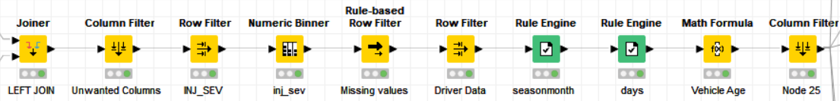
DATA PREPARATION
Data preprocessing nodes used are
Notes:
The data related to different crashes in America for the year 2018 is captured. It includes data on the accident, the details of the person and the details of the vehicle. The data that is captured here is directly from an item on the police crash report or by interpreting the information that was provided in the crash report. It was obtained from the review of the crash diagrams, the police officers' written summary of the crash or with combinations of data elements on the report.
We have 4 SAS data files - Accident, Distract, Person & Vehicle, that give us the details of car crashes that took place in the US for the year 2018. The datasets are a combination of different data types. Following are the different data files that we have and their details:
The Distract Data file has 11 columns with 86131 records, which includes information related to the distraction due to which the driver caused the accident and the location of the incident. Here, the primary keys are CASENUM (case number) & VEH_NO (Vehicle number).
The Vehicle Data file has 87 columns with 86105 records, which give information about vehicle details like its age, type, model year, surface condition of the road, traffic control devices, and other related data. Here, the primary keys are CASENUM (case number) & VEH_NO (Vehicle number).
The Person Data file has 54 columns with 130230 records, which provides details regarding the people involved in the crash like their age, seat position, the severity of their injuries, and other similar data. Here, the primary keys are CASENUM (case number), VEH_NO (Vehicle number) & PER_NO (PersonId).
The Accident Data file has 51 columns with 48443 records, which gives information like the total number of vehicles in the accident, the number of persons involved in an accident, the time during which the accident happened, weather & light conditions, manner of the collision, harmful events, and other related variables. Whether there was alcohol involved in the crash, the location of the car relative to the junction. Here, the primary key is CASENUM (case number).
Our Dependent variable is in numeric format. It has values from 0 to 9, where 1, 2 value stands for low injury severity and 3, 4 value stands for high injury severity. All the other variables are either not reported or show no injury. Hence, to convert it into a binary format we are grouping the values 1 and 2 as low, and 3 and 4 values as high.
Now, the dependent variable is in binary string format and can be used directly for set-based models like Decision Tree and Random Forest. For the number-based model, we will convert it into binary numeric variables 1 and 0 using the Rule Engine.

Slide 6
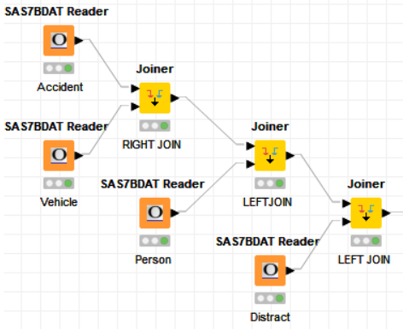
DATA PREPARATION
Joiner node

Slide 7
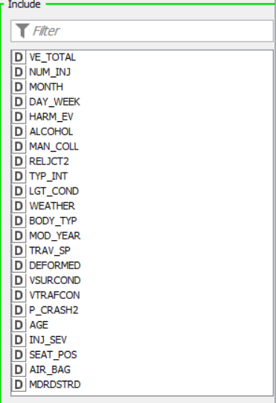
DATA PREPARATION
Column Filter

Slide 8
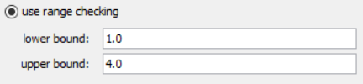
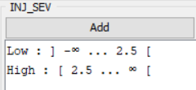
DATA PREPARATION
Row Filter and
Numeric binner
for INJ_SEV

Slide 9
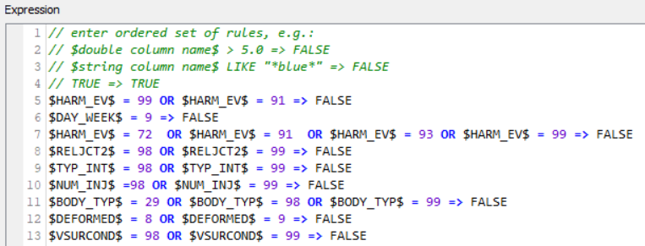
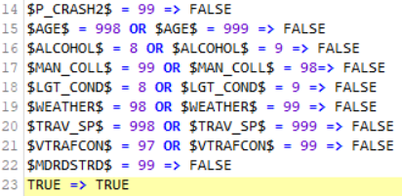
DATA PREPARATION
Rule-based Row filter
to remove missing values

Slide 10
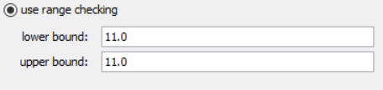
DATA PREPARATION
Row Filter
for SEAT_POS

Slide 11
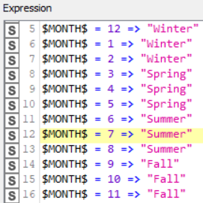
DATA PREPARATION
Rule Engine
for Aggregation of Data

Slide 12

DATA PREPARATION
Math Formula
for Vehicle Age

Slide 13
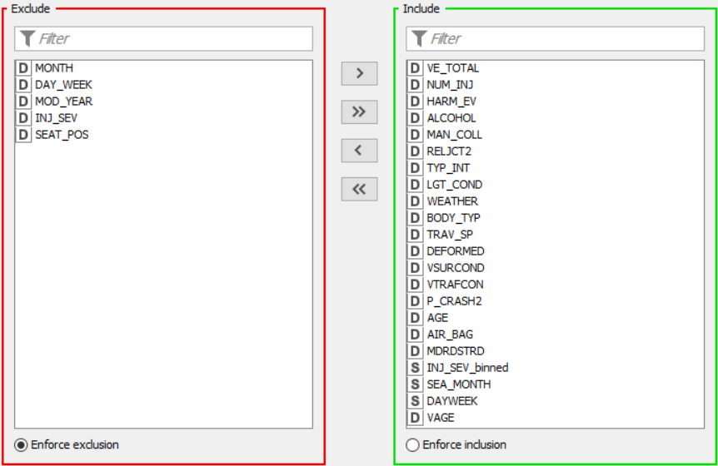
DATA PREPARATION
Column Filter

Slide 14
PREDICTIVE MODELS
Decision Trees
Naïve Bayes
Random Forest
Artificial Neural Network
Logistic Regression
K-Nearest Neighbor

Slide 15
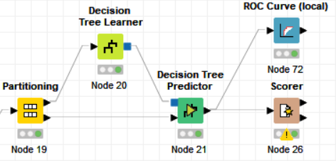
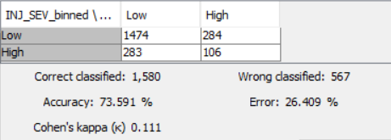

DECISION TREE
Predictive model which is represented in the form of branches and leaves.
The goal is to encapsulate the training data in the smallest possible tree
Notes:
What the model does?
Confusion Metrix
Accuracy Metrix (Accuracy, Sensitivity, Specificity)
Prediction Accuracy (ROC Curve)

Slide 16
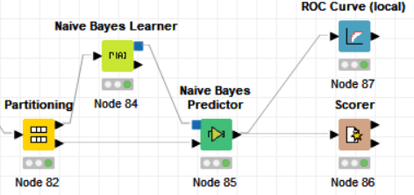
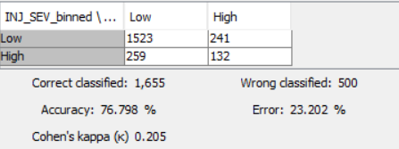

NAÏVE BAYES
Simple technique for constructing classifiers
Naïve Bayes classifiers are highly scalable, requiring several parameters linear in the number of variables (features/predictors) in a learning problem.
Notes:
(D)

Slide 17
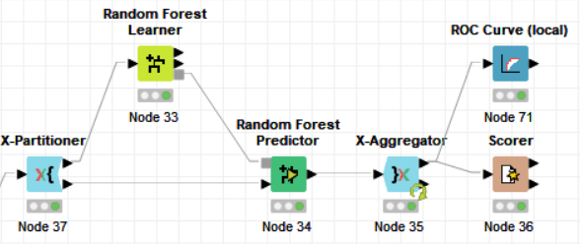
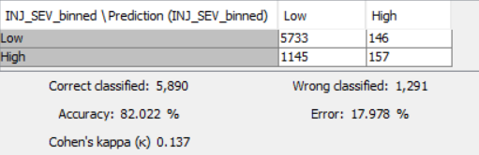

RANDOM FOREST
Builds multiple decision trees and merges them together to get a more accurate and stable prediction

Slide 18
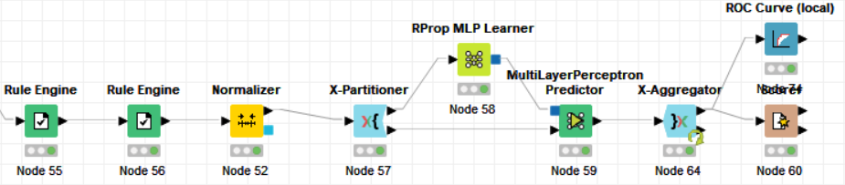
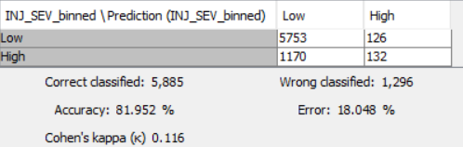

ARTIFICIAL NEURAL NETWORK
Computing systems vaguely inspired by the biological neural networks that constitutes human brains.

Slide 19
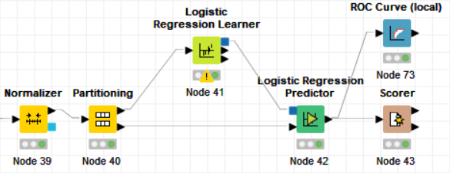
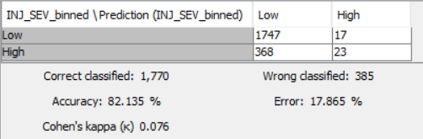

LOGISTIC REGRESSION
Statistical model that uses a logistic function (linear regression) to model a binary dependent variable.

Slide 20
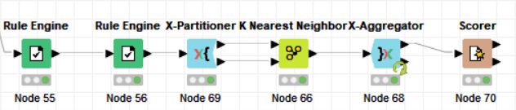
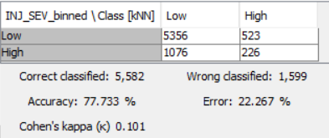

K-NEAREST NEIGHBOR
Assumes that similar things exist in close proximity i.e., similar things are near to each other.
Notes:
(D) assumes that similar things exist in close proximity. In other words, similar things are near to each other.

Slide 21
EVALUATION
Scoring Metrics | DT | NB | RF | ANN | LR | kNN
Accuracy | 73.6% | 76.8% | 82.08% | 81.95% | 82.13% | 77.73%
Sensitivity | 83.8% | 86.3% | 97.5% | 97.9% | 99% | 91.1%
Specificity | 83.8% | 33.8% | 12.1% | 10.1% | 5.9% | 17.4%
Notes:
(S)

Slide 22
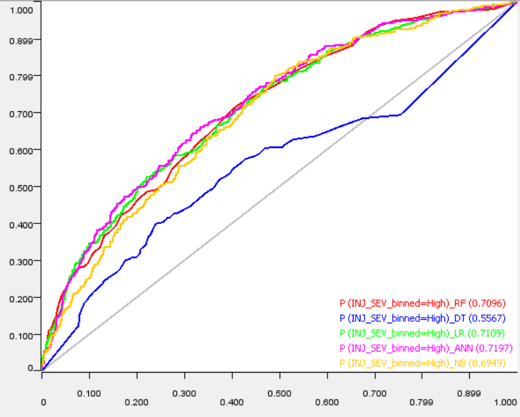
COMPARISON ANALYSIS
Notes:
ROC-AUV graph & explanations (S)

Slide 23
DEPLOYMENT
Perpetual Discovery
Lawmakers
Enact/Improve laws
Data-driven initiative/strategies
Medical Organizations
Emergencies & Medications
Quality of Care, Productivity & Efficiency
Insurance Companies
Medical Claims & Coverages
Healthcare Policies
Notes:
Lawmakers, medical organizations, policy holders (S)

Slide 24
CONCLUSION
Data Preparation
Time consuming
Logistic Regression Model
Best fitting for Injury Severity Analysis (Accuracy = 82%)
Accuracy decrement due to SMOTE
Naïve Bayes
Notes:
Which one is the preferred predictive model (S)

Slide 25
THANK YOU

