Slide 1
PrepR Session 2
Before the session, download two files:
1.Download the exercises_session2.Rmd file from http://www.github.com/shwetaramdas/prepR/
And open it in Rstudio
2. From the same link, download expressionpd.txt. Download this file in the same folder as the exercise2.Rmd file
Slides adapted from Matt Paul and Dan Navarro
Questions: shwetar@pennmedicine.upenn.edu

Slide 2
Recap
Data Types in R
Variable
Vector
Data Frame

Slide 3
R Markdown files
R Scripts: a series of commands to perform a task/set of tasks
R Markdown:
An ecosystem for compiling documents with code embedded in the document (a record of your analysis)
Can add comments
Dynamically runs code
Notes:
Dynamically generates output—so may not be appropriate for very large data/operations.

Slide 4
Lists and matrices (very briefly!)

Slide 5
Matrices
Matrices are (like data frames) organised into rows and columns, but all of the values must be the same type (e.g., all numbers)... they’re handy for numerical computations

Slide 6
Matrices
Matrices are (like data frames) organised into rows and columns, but all of the values must be the same type (e.g., all numbers)... they’re handy for numerical computations
> matrix(
data=1:20,
nrow=4,
ncol=5 )
 | [,1] | [,2] | [,3] | [,4] | [,5]
[1,] | 1 | 5 | 9 | 13 | 17
[2,] | 2 | 6 | 10 | 14 | 18
[3,] | 3 | 7 | 11 | 15 | 19
[4,] | 4 | 8 | 12 | 16 | 20

Slide 7
Lists
Lists are bundles of variables, but they aren’t organised into “case by variable” structures... in fact, there’s no analog of “cases” at all.They’re handy for handling complex data sets

Slide 8
Lists
Lists are bundles of variables, but they aren’t organised into “case by variable” structures... in fact, there’s no analog of “cases” at all.They’re handy for handling complex data sets
> list(
age = 25, name =
c("Matt,
"Paul"),
isNerd
= TRUE )
Notice that I’m mixing data of different types and different lengths? “age” is numeric and has two elements,“name” is character with one element, and “isNerd” is logical with one element.
Lists let you do this.

Slide 9
Lists
Lists are bundles of variables, but they aren’t organised into “case by variable” structures... in fact, there’s no analog of “cases” at all.They’re handy for handling complex data sets
> list(
age = name =
25,
c("Matt"
"Paul"),
isNerd = TRUE )
$age [1] 25
Notice that I’m mixing data of different types and different lengths? “age” is numeric and has two elements,“name” is character with one element, and “isNerd” is logical with one element.
Lists let you do this.
$name
[1] "Matt"
"Paul"
$isNerd [1] TRUE

Slide 10
Installing and loading packages

Slide 11
Packages
•
What is a package?
•
•
A collection of R functions and data sets that someone has contributed to the R “ecosystem”
Packages extend the functionality of R: most of the value to R comes from the 5000+ packages out there

Slide 12
Packages
•
What is a package?
•
•
A collection of R functions and data sets that someone has contributed to the R “ecosystem”
Packages extend the functionality of R: most of the value to R comes from the 5000+ packages out there
•
Where do they come from?
•••
Most packages are distributed “centrally” via CRAN (comprehensive R archive network)
There are lots of mirrors of CRAN.
You can also get packages in other ways (not discussed)

Slide 13
Installing packages
install.packages("ggplot2")
source("http://www.bioconductor.org/biocLite.R") biocLite(”affy")
Library(“ggplot2”)
library(“affy”)

Slide 14

Try it yourself (Exercise 1.3.1)

Slide 15
Importing data from text files (CSV)

Slide 16
read.delim("~/pipelines/workshop/driving.csv”, sep=“,”,
header=T, stringsAsFactors=F)
Other common options for sep are
“\t” (tab-delimited), “\s” (whitespace-delimited)

Slide 17
Loading a workspace (.Rdata) file

Slide 18
Workspace files
•
The primary file format used by R is .Rdata
•
•
It is a saved workspace
It contains whatever data sets, variables, functions etc that the workspace included when the file was created

Slide 19
Workspace files
•
The primary file format used by R is .Rdata
•
•
It is a saved workspace
It contains whatever data sets, variables, functions etc that the workspace included when the file was created
•
How to load an .Rdata file?
•
•
Use the load() function manually
Open using the Rstudio menus

Slide 20
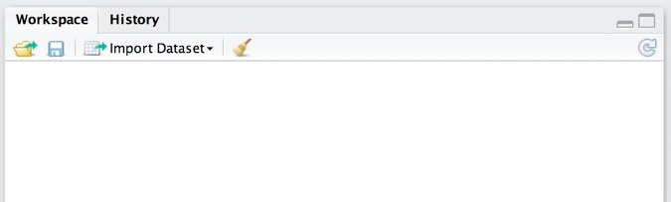
Rstudio method for loading .Rdata files
This is the “file open” button

Slide 21
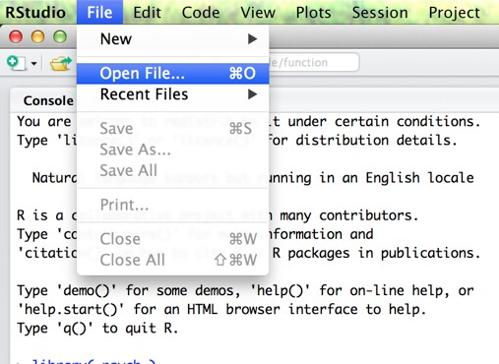
Rstudio method for loading .Rdata files
You can also use the File menu to do the same thing if you want to...

Slide 22
And the data file is now loaded...
load("~/Work/Research/Rbook/csiro_workshop/datasets/toydata.Rdata")
A command like this will appear in the R console (this command is what actually loaded the file)

Slide 23
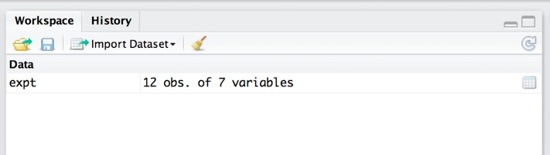
And the data file is now loaded...
load("~/Work/Research/Rbook/csiro_workshop/datasets/toydata.Rdata")
And the variable(s) that are stored in the file are now listed in the workspace

Slide 24
What does it mean to have data loaded?
•
Loading means that you’ve copied the variables in the .Rdata file into your R workspace
•
You can now use these variables for your analysis
•
Deleting or changing variables in the workspace does not change the contents of the .Rdata file
•
•
i.e. R doesn’t do “autosave” or anything of the sort This is a good thing!

Slide 25
Saving a workspace file

Slide 26
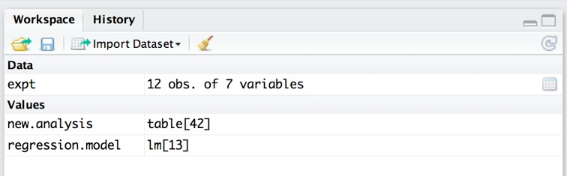
Suppose you’ve done some work and you want to save the workspace...
I must have done something, there’s all this new stuff in the workspace!

Slide 27
The save button is your friend

Slide 28
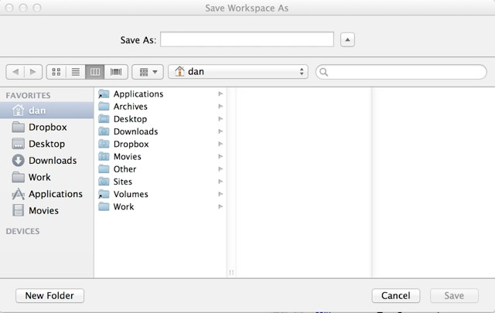
Again, it opens a system-specific dialog:

Slide 29
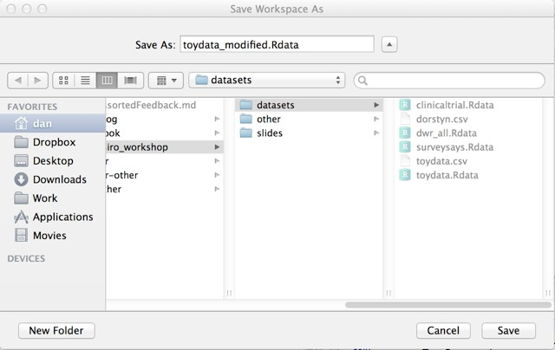
Browse, type a filename, and click save

Slide 30
Now the file is saved
save.image("~/Work/Research/Rbook/csiro_workshop/ datasets/toydata_modified.Rdata.RData")
Again, the actual save command shows up in the R console

Slide 31
Try it yourself (Exercise 1.3.2, 1.3.3)

Slide 32
An Introduction to R
2.1 Descriptive statistics
Dan Navarro (daniel.navarro@adelaide.edu.au) School of Psychology, University of Adelaide
ua.edu.au/ccs/people/dan CSIRO R Workshop, 28-Nov-2013
Adapted from

Slide 33
Central tendency

Slide 34
Central tendency
•
Commands:
•
•
Calculate means using mean() Calculate medians using median()
> mean( expt$age ) [1] 25.25
> median( expt$age ) [1] 25

Slide 35
What if there are missing data?
•
Sometimes there are missing data
•
•
These are represented as NA values
Different functions handle NA values differently

Slide 36
What if there are missing data?
•
Sometimes there are missing data
•
•
These are represented as NA values
Different functions handle NA values differently
•
What is the mean of 3, 4, 5 and NA?
•
•
Pragmatic answer: ignore the missing data, and calculate the average of 3,4 and 5... i.e., mean = 4
Cautious answer: we don’t know the missing value, so we don’t know the mean either... i.e. mean = NA

Slide 37
What if there are missing data?
> age <- c(
> mean( age [1] NA
32, 19, NA, 64 )
)
By default, mean() gives the conservative “don’t know” answer

Slide 38
What if there are missing data?
> age <- c( 32, 19, NA, 64 )
> mean( age ) [1] NA
> mean( age, na.rm=TRUE ) [1] 38.33333
But we can force it to be a pragmatist: tell R to remove the NA values by specifying na.rm=TRUE
(the na.rm argument shows up in quite a lot of functions)

Slide 39
Calculating a trimmed mean
Sometimes the mean isn’t a compelling measure of central tendency, but we’d prefer not to resort to the median because the sample size is so small
> | score | <- | c( | 3, | 2, | 1, | 5, | 7,
 |  |  |  | 12, | 3, | 1, | 4, | 10000 | )
> mean( score ) [1] 1003.8

Slide 40
Calculating a trimmed mean
> score <- c( 3, 2, 1, 5, 7,
12, 3, 1, 4, 10000 )
> mean( score ) [1] 1003.8
> mean( score, trim=.1 ) [1] 4.625
This gives the 10% trimmed mean, a more robust measure of central tendency than the mean

Slide 41
Try it yourself (Exercise 2.1.1)

Slide 42
Spread

Slide 43
Spread
•
•
•
•
Standard deviation: sd() Range: range() Interquartile range: IQR() Specific quantiles: quantile()
> sd( expt$age ) [1] 3.250874
> range( expt$age ) [1] 19 30
> IQR( expt$age ) [1] 4.25
> quantile( expt$age, probs=c(.05,.25,.5,.75,.95)) 5% 25% 50% 75% 95%
20.10 23.75 25.00 28.00 29.45

Slide 44

Try it yourself (Exercise 2.1.2)

Slide 45
Tabulating and cross-tabulating categorical variables

Slide 46
Tabulating using table()
> table( expt$treatment )
Frequency table for the treatments
control
4
drug1
4
drug2
4

Slide 47
Tabulating using table()
> table( expt$treatment ) control drug1 drug2
4 4 4
> table(
expt$treatment,
expt$gender )
We can get a cross tabulation simply by listing more variables in the input
 | male | female
control | 2 | 2
drug1 | 2 | 2
drug2 | 2 | 2

Slide 48
> table( expt$age,
, , = male
expt$treatment,
expt$gender )
19 | control 0 | drug1 0 | drug2 0
21 | 0 | 0 | 0
23 | 0 | 1 | 0
24 | 0 | 1 | 0
25 | 1 | 0 | 1
26 | 0 | 0 | 0
28 | 1 | 0 | 1
29 | 0 | 0 | 0
30 | 0 | 0 | 0
Adding a third variable gives a three way cross-tabulation
, , = female
19 | control 0 | drug1 1 | drug2 0
21 | 0 | 0 | 1
23 | 0 | 0 | 0
24 | 0 | 0 | 0
25 | 1 | 0 | 0
26 | 1 | 0 | 0
28 | 0 | 0 | 0
29 | 0 | 1 | 0
30 | 0 | 0 | 1

Slide 49


Tabulating using table() and sort()
> sort( table( driving$errors_time2 ) )
> sort( table( driving$errors_time2 ), decreasing=T )

Slide 50

Try it yourself (Exercise 2.1.3)

Slide 51
Correlating two variables

Slide 52
Correlations
> cor( expt$happy, expt$sad ) [1] -0.7331656
Pearson correlation

Slide 53
Correlations
> cor( expt$happy, expt$sad ) [1] -0.7331656
> cor( expt$happy, expt$sad, method="spearman" ) [1] -0.7075317
Spearman correlation

Slide 54
Correlations
> cor( expt$happy, expt$sad ) [1] -0.7331656
> cor( expt$happy, expt$sad, method="spearman" ) [1] -0.7075317
> cor( expt$happy, expt$sad, method="kendall" ) [1] -0.5343667
Kendall’s tau

Slide 55
Try it yourself (Exercise 2.1.4)

Slide 56
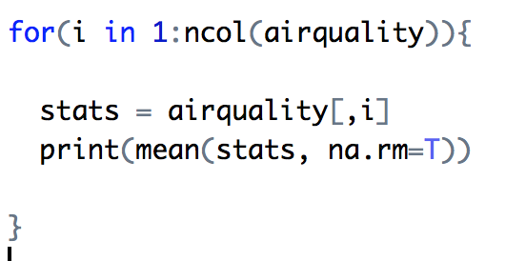
For loops
Sometimes you will want to run the same analysis on several variables at one time (e.g. standard deviation of gene expression for 1000 genes)
Instead of typing each analysis out separately for each gene/variable, its much more convenient to iterate through your data using a for loop

Slide 57
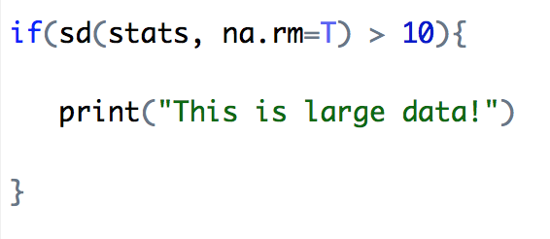
Conditional statements
The backbone of computer programming is the ability to code choices based on specific conditions in your software and analyses
“If the variance of the data is greater than X, we will remove the data”
“If the mean of the data is within a certain range, we will print and store the data”

Slide 58
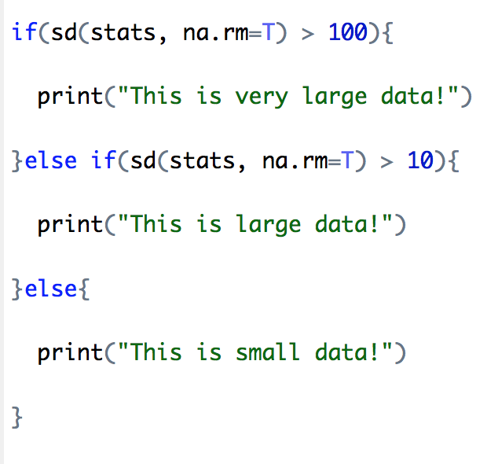
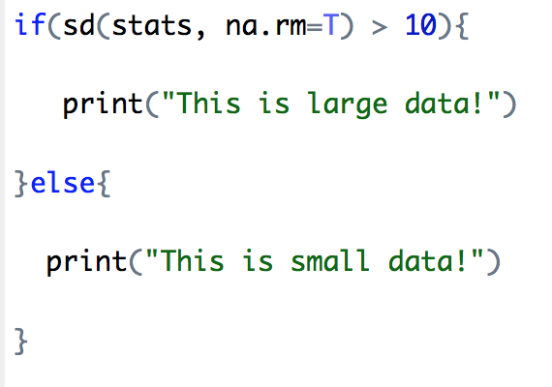
Conditional statements
If statements are very powerful and allows different forking of our analysis using else statements

Slide 59
Try it yourself (Exercise 2.1.5)

Slide 60
Comparing two means with t-tests

Slide 61
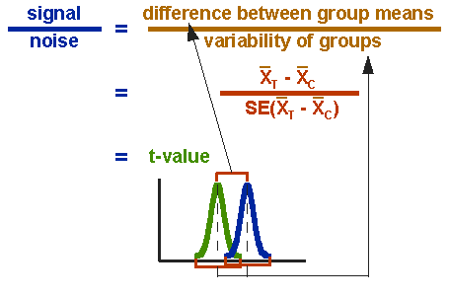
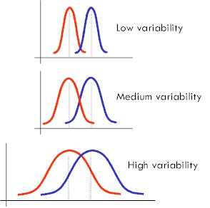
Comparing two means using t.test()
•
The t.test() function
•
•
•
Runs several different kinds of t test Handles data formatted in different ways
I’ll only show a few of the more important ones

Slide 62
Independent samples t-test
t.test(
hormone
~ gender,
data
= expt )
Formula stating that:
hormone is the outcome (DV)
gender is the predictor (IV)

Slide 63
Independent samples t-test
t.test(
hormone
~ gender,
data
= expt )
Tells R to look for these variables inside the data frame expt

Slide 64
> t.test(
hormone
~ gender,
data
= expt )
Welch
Two Sample t-test
data:
hormone
by gender
df = 7.49, p-value
t = 0.6852,
= 0.5138
alternative
hypothesis: true
difference
in means
is not equal to 0
95 percent
confidence 44.42211
interval:
-24.25544
sample
estimates:
mean in
group female
48.63333
mean
in group male
38.55000

Slide 65
Independent samples t-test without assuming equality of variances
> t.test(
hormone
~ gender,
data
= expt )
Welch
Two Sample t-test
data:
hormone
by gender
df = 7.49, p-value
t = 0.6852,
= 0.5138
alternative
hypothesis: true
difference
in means
is not equal to 0
95 percent
confidence 44.42211
interval:
-24.25544
sample
estimates:
mean in
group female
48.63333
mean
in group male
38.55000

Slide 66
Reminds us what variables we ran the test on
> t.test(
hormone
~ gender,
data
= expt )
Welch
Two Sample t-test
data:
hormone
by gender
df = 7.49, p-value
t = 0.6852,
= 0.5138
alternative
hypothesis: true
difference
in means
is not equal to 0
95 percent
confidence 44.42211
interval:
-24.25544
sample
estimates:
mean in
group female
48.63333
mean
in group male
38.55000

Slide 67
Test statistic, degrees of freedom, p-value
> t.test(
hormone
~ gender,
data
= expt )
Welch
Two Sample t-test
data:
hormone
by gender
df = 7.49, p-value
t = 0.6852,
= 0.5138
alternative
hypothesis: true
difference
in means
is not equal to 0
95 percent
confidence 44.42211
interval:
-24.25544
sample
estimates:
mean in
group female
48.63333
mean
in group male
38.55000

Slide 68
Two sided test
> t.test(
hormone
~ gender,
data
= expt )
Welch
Two Sample t-test
data:
hormone
by gender
df = 7.49, p-value
t = 0.6852,
= 0.5138
alternative
hypothesis: true
difference
in means
is not equal to 0
95 percent
confidence 44.42211
interval:
-24.25544
sample
estimates:
mean in
group female
48.63333
mean
in group male
38.55000

Slide 69
Confidence interval for the difference between the two means
> t.test(
hormone
~ gender,
data
= expt )
Welch
Two Sample t-test
data:
hormone
by gender
df = 7.49, p-value
t = 0.6852,
= 0.5138
alternative
hypothesis: true
difference
in means
is not equal to 0
95 percent
confidence 44.42211
interval:
-24.25544
sample
estimates:
mean in
group female
48.63333
mean
in group male
38.55000

Slide 70
The group means
> t.test(
hormone
~ gender,
data
= expt )
Welch
Two Sample t-test
data:
hormone
by gender
df = 7.49, p-value
t = 0.6852,
= 0.5138
alternative
hypothesis: true
difference
in means
is not equal to 0
95 percent
confidence 44.42211
interval:
-24.25544
sample
estimates:
mean in
group female
48.63333
mean
in group male
38.55000

Slide 71
Variations on the t-test
> # one-sided
>
test
t.test(
hormone
~ gender,
data
= expt,
alternative
= "greater" )
The alternative argument has three options...
“two.sided”
“greater”
“less”

Slide 72
Variations on the t-test
> # one-sided
>
test
t.test(
hormone
~ gender,
data
= expt,
alternative
= "greater" )
> # Student
>
t-test
(assumes
~ gender,
equal data
variance)
t.test(
hormone
= expt,
var.equal
= TRUE )
This tells R that you’re happy to trust the equal variance assumption

Slide 73
Other kinds of t-tests

Slide 74
Paired samples t-test
> quickdata <- data.frame(
id = c("s1","s2","s3","s4","s5"), time1 = c(2,3,5,9,11),
time2 = c(1,4,7,9,13)
)
I need some data appropriate for a paired samples test... manually specify a data set with 5 people tested on something at two time points

Slide 75
Paired samples t-test
> quickdata <- data.frame(
id = c("s1","s2","s3","s4","s5"), time1 = c(2,3,5,9,11),
time2 = c(1,4,7,9,13)
)
> quickdata
id time1 time2 1 s1 2 1
2 s2 3 4
3 s3 5 7
4 s4 9 9
5 s5 11 13
... and here it is!

Slide 76
Paired samples t-test
> t.test(
quickdata$time1,
quickdata$time2,
paired=TRUE )
Paired t-test
data:
quickdata$time1
and quickdata$time2
t = -1.372,
df = 4, p-value
= 0.242
alternative
hypothesis:
true
difference in
means
is not equal to 0
95 percent
confidence interval: 0.8189318
-2.4189318
sample
estimates:
mean of
the differences
-0.8

Slide 77

Try it yourself (Exercise 2.2.1)

Slide 78
One sample t-test
> t.test(
x = expt$hormone,
mu = 50 )
One Sample t-test
expt$hormone
data:
t =
-0.8928,
df = 11,
p-value
= 0.3911
alternative
hypothesis:
true mean
is not
equal
to 50
95 percent
confidence
interval:
27.79325
59.39009
sample
estimates: x
mean of
43.59167

Slide 79
Nonparametric tests:
one and two sample Wilcoxon

Slide 80
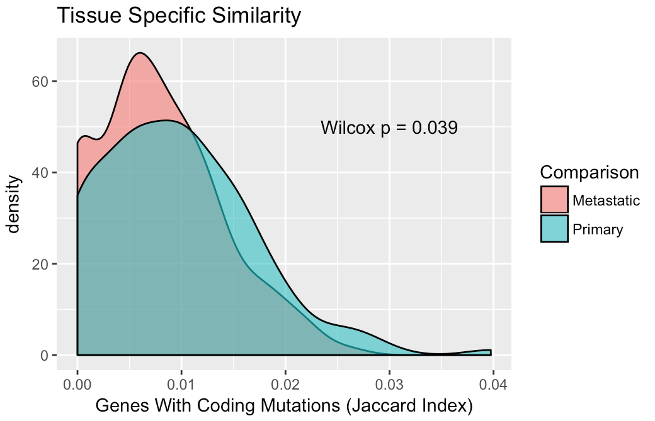
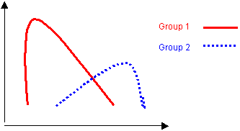
(Two-sample) Wilcoxon rank sum test
> wilcox.test( hormone ~ gender, data = expt )
Wilcoxon rank sum test
data:
W = 11,
hormone by gender p-value = 0.3095
alternative hypothesis: true location shift is not equal to 0
The syntax for this is basically the same thing as what we did for an independent samples t-test

Slide 81
Chi-square test
Tests significant differences between observed and expected values
How likely it is that any observed difference between the sets arose by chance.
Commonly used application in biology: Are the two variables we are testing independent?
Is a SNP associated with disease status?
 | Disease | Non-diseased
A
a

Slide 82
ANOVA

