Slide 1
StellarEscrow
Trustless milestone-based payments for the global freelance economy.
BUILT ON STELLAR • POWERED BY SOROBAN

Slide 2
STELLAR ESCROW PITCH DECK
The Freelance Payment & Trust Gap
Payment Delays
29% of freelancers experience chronic payment delays.
Clients hold leverage, leaving freelancers with zero protection after work is submitted.
Heavy Payout Fees
Cross-border payments cost 5% to 10% in currency conversion and wire transfer fees.
Traditional banks and payment networks exploit remote builders.
Clearing Delays
International wire clearings take 3 to 7 business days.
Slow liquidity cycles restrict cash flows for digital creators.
Marketplace Cut
Upwork & Fiverr extract up to 20% in platform commissions.
Middlemen capture the value created entirely by independent talent.

Slide 3
STELLAR ESCROW PITCH DECK
Trustless Milestone-Based Escrows
✔ Milestone-Locked Funds
Clients secure payments upfront directly inside an on-chain smart contract escrow. Freelancers verify the capital is locked before starting work.
✔ Automatic Payout Releases
Upon task completion and client approval, the escrowed funds instantly unlock on-chain, eliminating middleman dependency.
✔ Zero Brokerage Commissions
No platform commissions or escrow service cut. Value transfers directly from Client to Freelancer, trustlessly.
1. Client Deposits XLM
Locks project milestone amount into the Soroban contract.
2. Secure Soroban Escrow
Contract holds funds securely on-chain. Work is submitted.
3. Automated Release
Client approves the milestone, triggering auto-payment transfer.

Slide 4
STELLAR ESCROW PITCH DECK
Why Build on Stellar & Soroban?
Extreme Efficiency
• 3-5 Second Payouts: Settles transactions near-instantly compared to days via traditional banking networks.
• Fractional Fees: Transaction costs are less than 1/10,000th of a cent, avoiding Ethereum's gas fee surges.
• High Scalability: Built to handle global retail payment throughput natively.
Ecosystem Anchors
• Direct Fiat Access: Stellar Anchors allow direct USD/Euro stablecoin to local bank conversions.
• Global Reach: Enables localized remittance and withdrawal rails across 180+ countries.
• Embedded Compliance: Supports regulated assets and identity hooks natively on-chain.
Soroban Smart Contracts
• Secure Execution: Rust-based WebAssembly (Wasm) architecture provides sandboxed safety.
• Minimal Fees: State archive storage costs are optimized, keeping smart contract state fees low.
• Modular Escrows: Highly extensible milestone dispute resolution logic can be implemented.

Slide 5
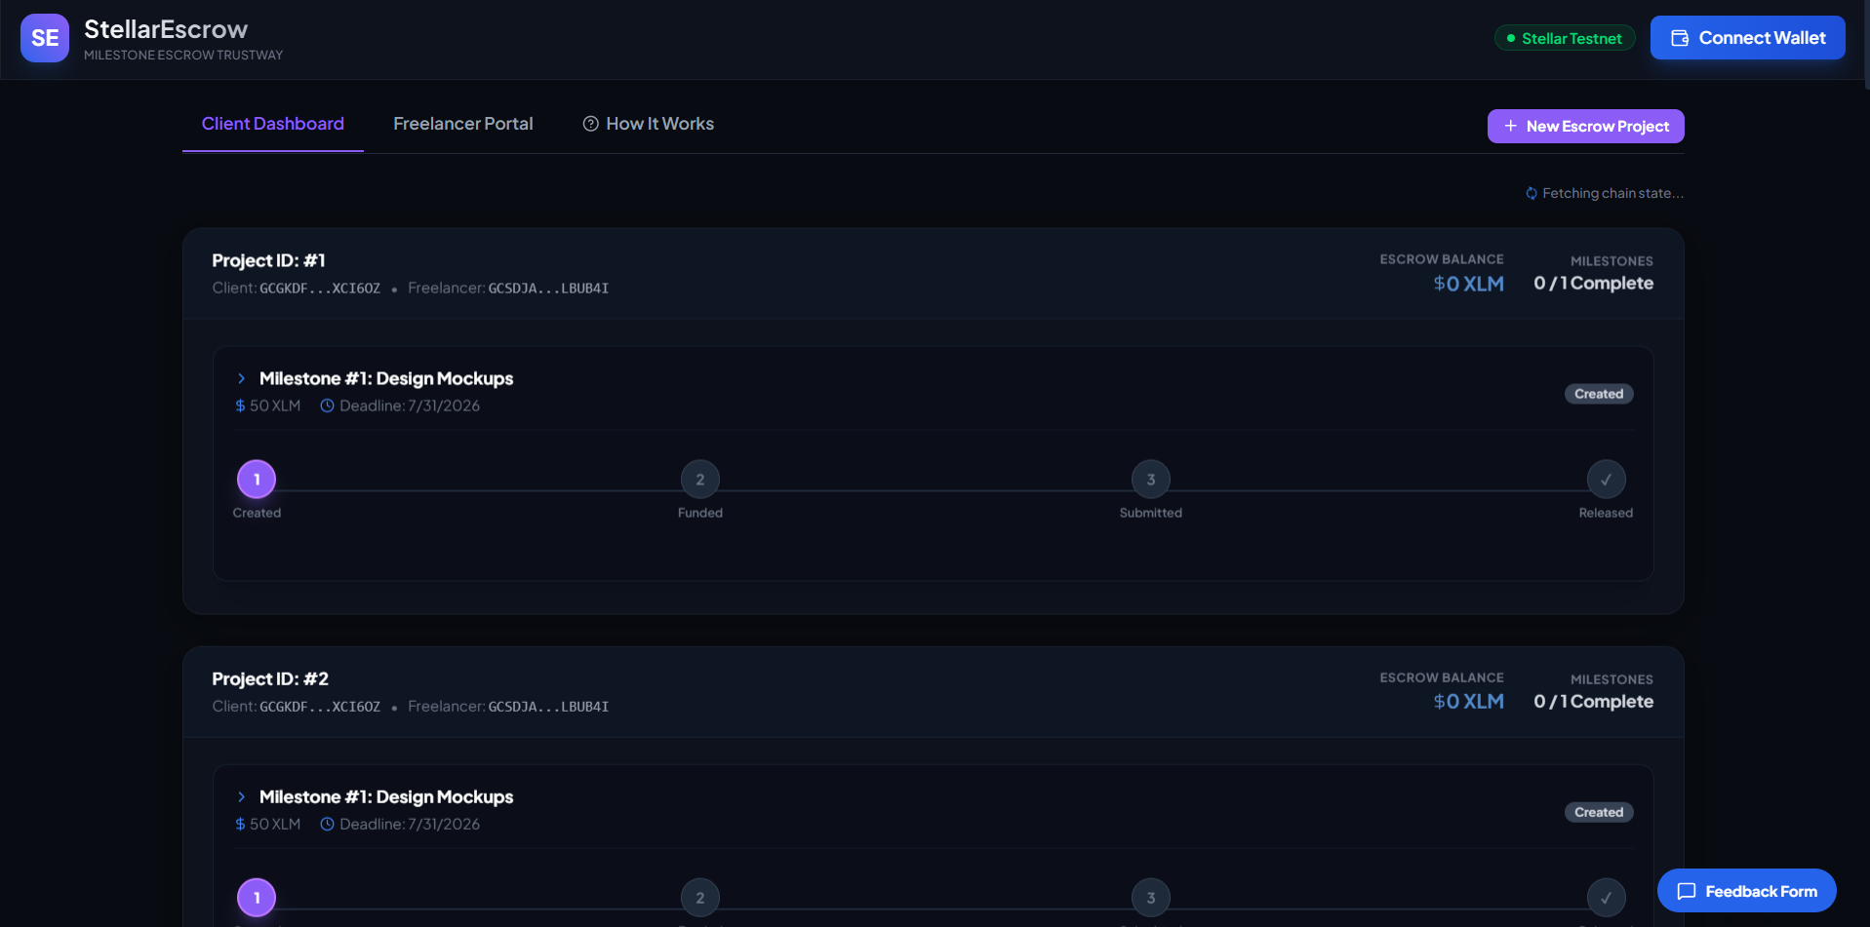
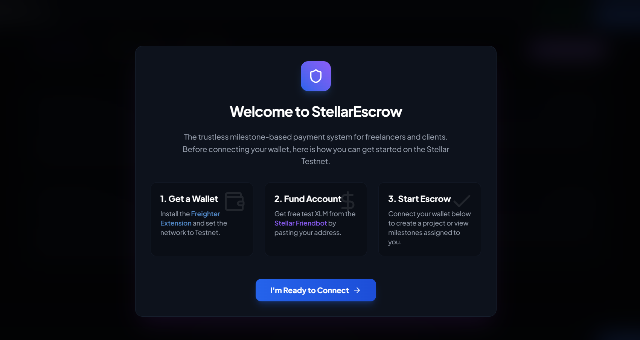
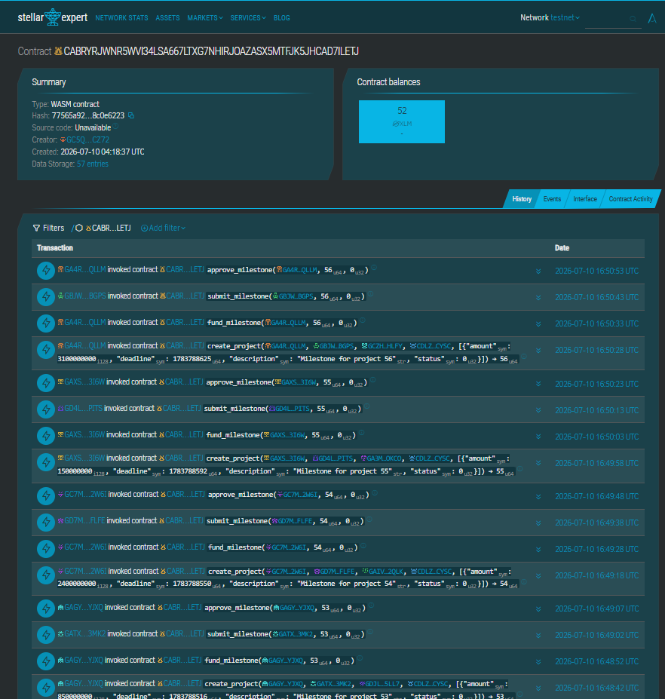
STELLAR ESCROW PITCH DECK
Intuitive Web3 User Experience
1. Dashboard Overviews
The client/freelancer sees active escrow milestones, on-chain balances, and custom visual statuses.
2. Guided Onboarding
Interactive tutorial directs first-time Web3 users to install Freighter and get test XLM from Friendbot.
3. Verified Telemetry
Integrated event trackers monitor active user funnels and Soroban ledger transactions live.

Slide 6
STELLAR ESCROW PITCH DECK
Decentralized Architecture Overview
1. React Frontend
• Tailwind CSS for UI layout
• Glassmorphic design system
• Context API state management
2. Wallet Connect
• StellarWalletsKit SDK
• Freighter browser extension
• Secure transaction signing
3. Soroban Escrow
• Rust Smart Contract
• Milestone state mapping
• State-locked escrow balance
4. Stellar Ledger
• Decentralized ledger
• Fast consensus
• Public audit explorer
⚡ STABILITY & TELEMETRY LAYER: Real-time user event indexing via PostHog. Frontend exceptions captured and logged in real-time by Sentry to ensure 99.9% client-side uptime.

Slide 7
STELLAR ESCROW PITCH DECK
Market Opportunity: Global Freelance Economy
A Massively Expanding Global Market
• Market Size: Projections reach $455 Billion by Mastercard gig economy studies.
• Remote Work Adoption: The transition to remote-first collaboration has amplified cross-border hiring.
• Transaction Overhead: Over $100 Billion is spent annually in bank fees and marketplace cuts.
• Maturing Rails: Web3 wallet usage and native currency adoption are hitting mainstream thresholds.
The Cross-Border Payment Bottleneck
• High Friction: Global transfers face currency conversion markups, regulatory delays, and intermediary banking cuts.
• Trust Bottleneck: Escrows are either highly expensive (marketplaces extracting 20%) or non-existent.
• Opportunity: StellarEscrow offers trustless security for the same price as fractions of a cent, removing intermediary margin extraction entirely.

Slide 8
STELLAR ESCROW PITCH DECK
Testnet Validation & Metrics
55+
Onboarded Testnet Users
72+
On-Chain Transactions Logged
4.8 / 5
Average User Satisfaction Score
🗣️ KEY USER INSIGHT
"Having milestone funds locked transparently on-chain gives freelancers immediate peace of mind before writing a line of code, while clients love only paying for verified, complete deliverables."

Slide 9
STELLAR ESCROW PITCH DECK
Go-To-Market & Growth Strategy
Freelance Communities Integration
Targeting freelance subreddits, Discord channels, and LinkedIn contract networks.
Grassroots marketing focused on non-payment horror stories and heavy marketplace cuts.
Pilot Agency Programs
Onboarding boutique software development and design agencies as power users.
Focus on agency clients who value structured milestone billing.
Built-in Viral Invite Loop
When a client creates a project, the freelancer receives an email invite link to claim it.
Dual-sided onboarding: each user introduces another to the platform.
Educational Content Funnel
Writing clear, jargon-free guides on Web3 utility for traditional remote workers.
Hiding blockchain complexity beneath clean, familiar interfaces.

Slide 10
STELLAR ESCROW PITCH DECK
Product Roadmap & Future Milestones
Phase 1: Testnet MVP
• Complete milestone escrow contract
• StellarWalletsKit interface
• Onboarded 50+ real testers
• Sentry + PostHog integrated
Phase 2: Anchor Connect
• Stellar Anchor integrations
• Local banking on/off-ramps
• Support for fiat stablecoins
• Regulated identity profiles
Phase 3: Escrow DAO
• Multi-arbitrator dispute resolution
• Decentralized juror pools
• Subscription payment options
• Retainer lock contracts
Phase 4: Mainnet Payouts
• Mainnet contract deploy
• Viral growth loop incentives
• Integration with global invoice apps
• Scale to $10M+ transaction volume

Slide 11
STELLAR ESCROW PITCH DECK
Ecosystem Integration & Ask
The Ask: Growth & Mainnet Support
• Ecosystem Funding: Development grant to subsidize initial mainnet fee reserves.
• Design Partners: Boutique agencies to test fiat on-ramp integrations.
• Feedback & Reviews: Join our testnet trials to refine smart contract escrow usability.
Ecosystem Integration Opportunities
• Invoice Software API: Plug trustless escrows directly into standard billing systems.
• Freelance Marketplace Plugins: Add 'Pay via StellarEscrow' buttons to external platforms.
• Stellar Network Alignment: Drive transaction volume and anchor utility on Stellar Testnet and Mainnet.

Slide 12
Join the Payments Revolution
Built on Stellar. Powered by Soroban.
Live Demo: stellar-escrowlevel-5.vercel.app • GitHub: github.com/shwetasharma44044-eng/StellarEscrowlevel-5
Contact: contact@stellarescrow.com

