Slide 1
JOB FRAUD
DETECTION
Predicting whether a job listing is a scam or not
Presented By: Shweta Sharma

Slide 2
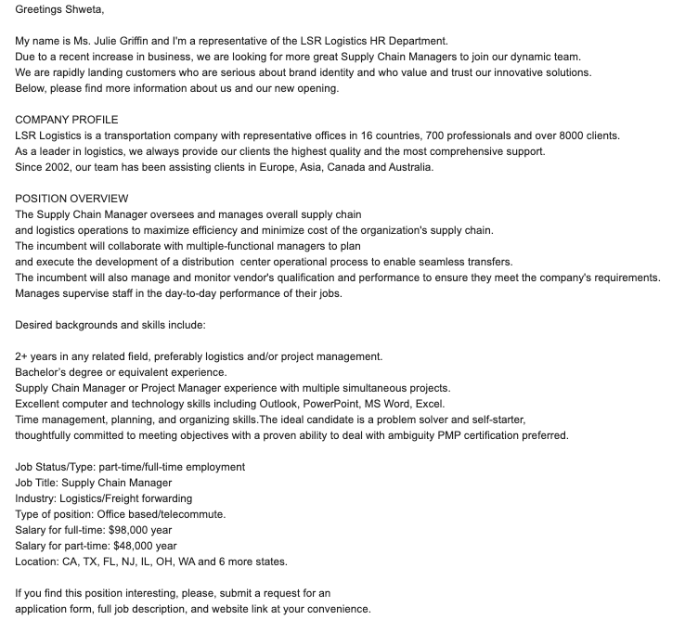
MOTIVATION
GOSTUDIO
Flagging a fraud job listing is important for
users’ experience and companies’ trust.

Slide 3
DATA
Data Source: The Employment Scam Aegean Dataset (EMSCAD)
17880 job listings with 18 features.
Mix of string, binary, nominal and HTML fragments.
Highly imbalanced dataset.

Slide 4
01
04
EDA
Model Selection
02
05
Data Cleaning
Analysis
03
06
Baseline Model
Conclusion
Demonstrates and understanding of the data
Presents results from different models.
Describes which features were selected, cleaned and why.
Hyper parameters tuning and results from best model.
Presents results of baseline model

Slide 5
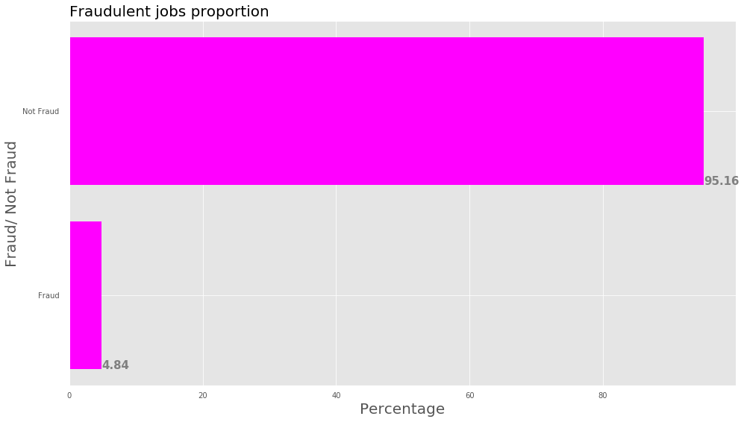
Distribution of jobs
Not Fraud
Fraud

Slide 6
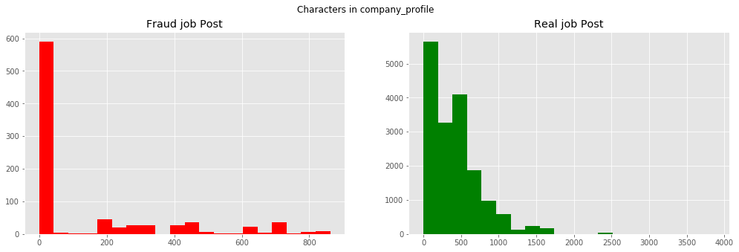
Number of Characters

Slide 7
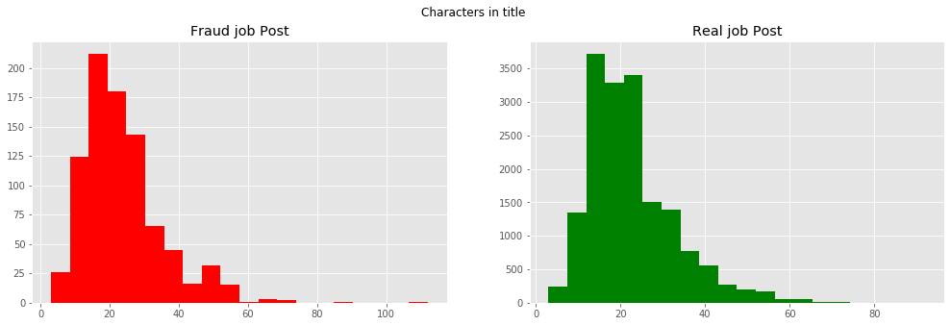
Number of Characters

Slide 8
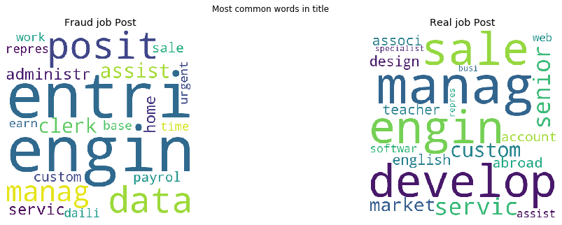
WordClouds :)

Slide 9
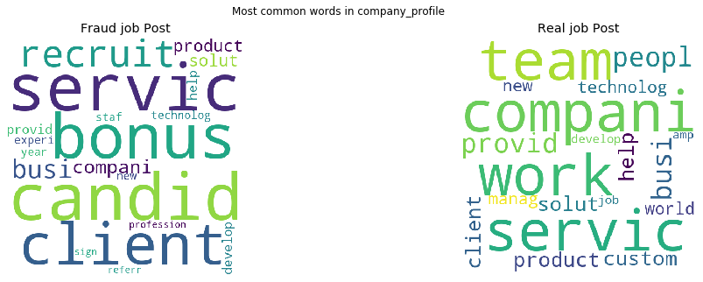
Company Profile

Slide 10
DATA CLEANING
Handling Nans
Removing HTML Tags
Wider categorical buckets

Slide 11
BASELINE MODEL/ RESULTS
PRECISION: 0.060
RECALL: 0.058
F1 SCORE: 0.059

Slide 12
Prepping data for testing
Under/ Over/ SMOTE Sampling
Imbalanced Dataset
SPLIT DATA
Fit and Predict
Chose not to balance

Slide 13
FIRST ROUND
CATEGORICAL FEATURES
Industry
Salary
Location
Telecommuting
Questions
Company Logo
2 Categories
Education
Experience
Employment Type

Slide 14
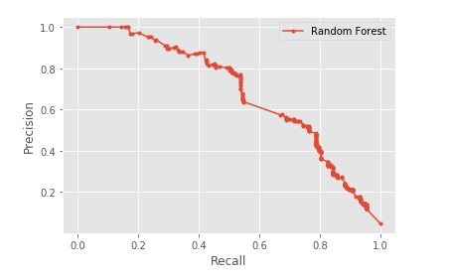
Results
AUC | 0.685
Precision score | 0.806
Recall score | 0.503
F1 score | 0.619

Slide 15
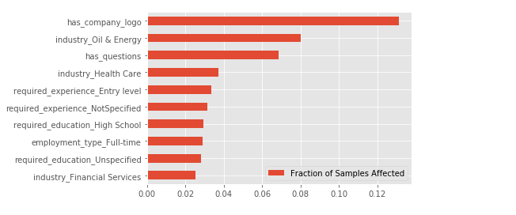
Important Features

Slide 16
NLP

Slide 17
PreProcessing for NLP
Clean Text
Stemming, Lemmatize
Vectorize
Did not get rid of numbers
Max_features = 2000

Slide 18
RESULTS
Logistic Regression
Gradient Boosting
Classifier
LSTM
Precision: 0.869
Recall:0.538
F1 Score: 0.664
AUC: .742
Precision: 0.901
Recall:0.529
F1 Score: 0.664
AUC: .789
Precision: 0.507
Recall:0.617
F1 Score: 0.529

Slide 19
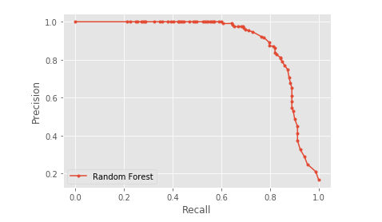
RANDOM FOREST CLASSIFIER
Precision: 0.870
AUC: .897
Recall: 0.815
F1 Score: 0.842

Slide 20
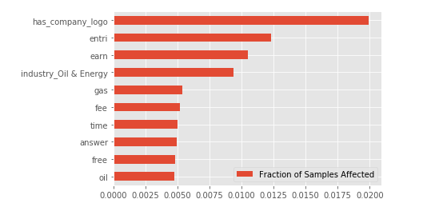
Important Features

Slide 21
AN APP IS A GOOD IDEA!!

Slide 22

THANKS!
Does anyone have any question?
Email
Linkedin
Github

