Slide 1



AI Studio
Internship Project
Shweta Shukla • 13/07/2026
Project on a multimodal, privacy-first local AI workspace built for offline-first development and secure experimentation.
Notes:
1

Slide 2
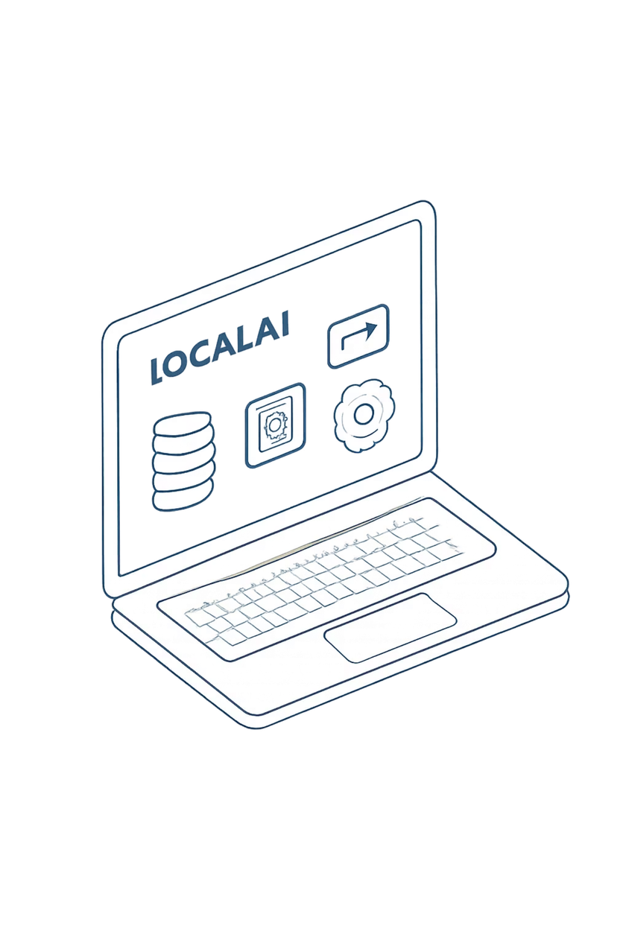



Vision & Scope
Build a unified local AI ecosystem — "AI Studio" — that enables secure multimodal workflows on-device. Reduce reliance on cloud APIs by orchestrating models locally (Ollama), emphasiz ing user privacy, reproducibility, and offline experimentation for developers and researchers.
Privacy-first
All inference and data processing occur on the host machine; no external data leakage.
Modular
Independent modules (chat, vision, parsing, retrieval) that plug into a common bus.
Practical & Local
Optimized for local latency profiles and modest hardware (laptop/desktop).
Notes:
2

Slide 3
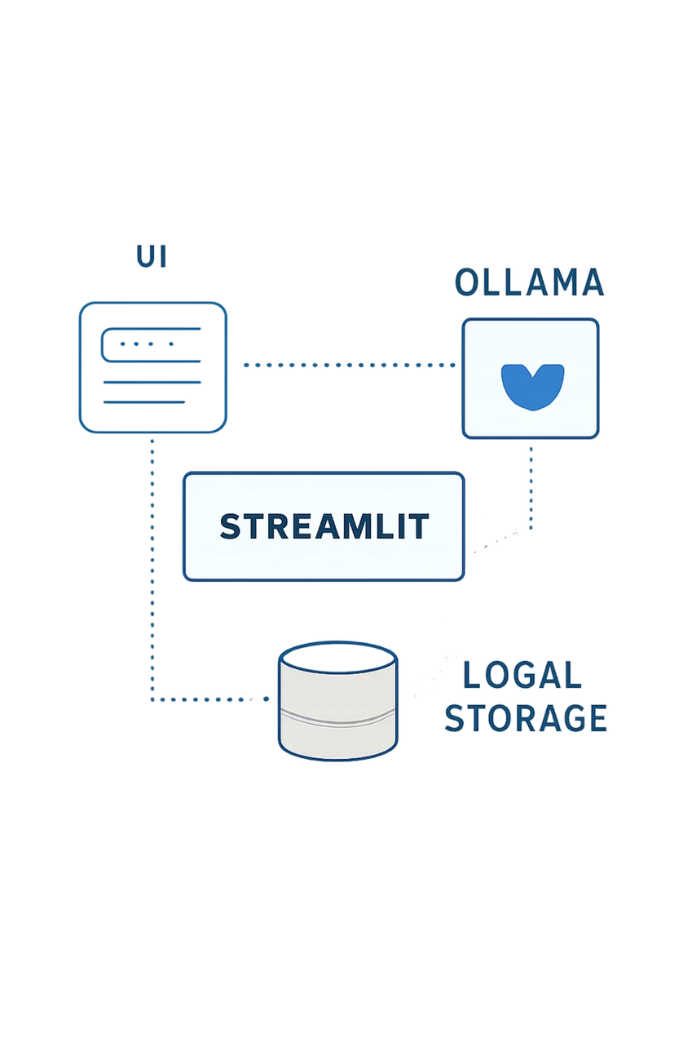



The Engine — Technical Foundation
Core stack and architecture implemented to date:
1
Streamlit UI
Reactive frontend, componentized pages, state managed via session state and custom caching layers for attachments.
2
Ollama
Local LLM orchestration and model management — prompt routing, persona handling, and isolation per session.
3
Plugin Bus
Modular API for adding new processors (vision, parsers, extractors) with well-defined interfaces.
4
Local Storage & RAG
Vector store prototypes (FAISS) with encrypted local blobs for metadata and document chunks.
Notes:
3

Slide 4
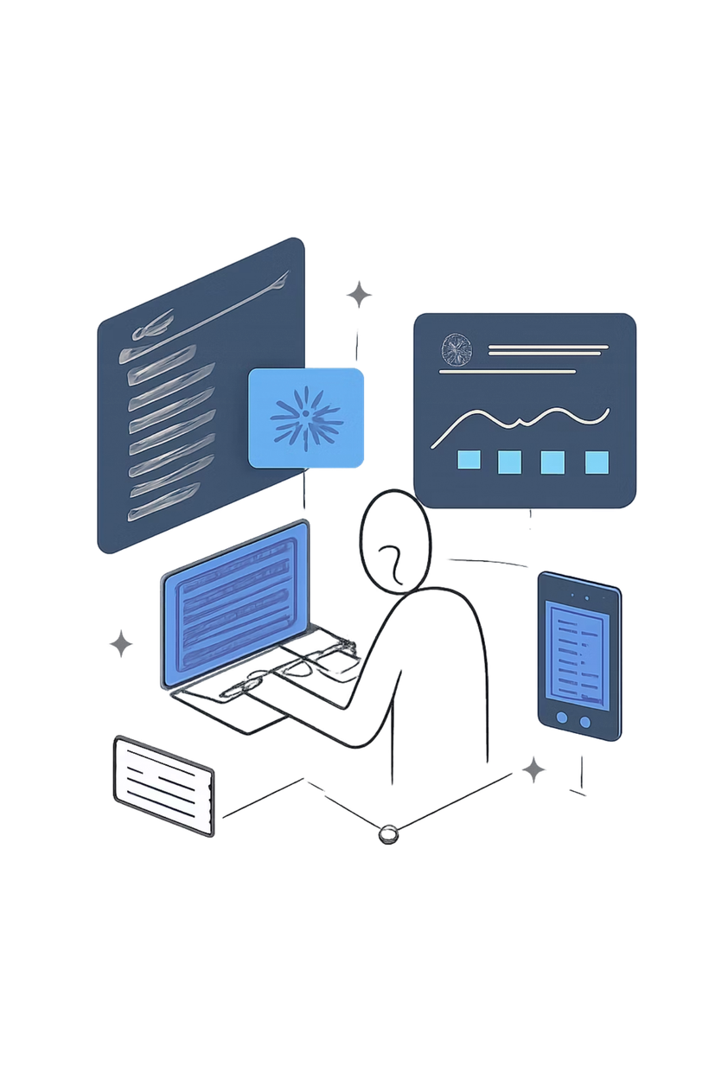
Milestone 1 — The Core Interface
Completed a polished, multilingual dashboard with responsive navigation and custom CSS that emulates a dark-mode development environment.
Internationalization
UI strings externalized; language toggles implemented (English + fallback locales).
Navigation
Left rail with collapsible sections, keyboard shortcuts, and session-aware routing.
Styling
Custom CSS for dark mode, color accents using theme palette (#a2b9f9 primary), and accessible contrast ratios.
Notes:
4

Slide 5



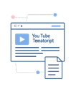
Milestone 2 — Completed Modules
Key functional modules delivered and tested end-to-end on local hardware.
Control Center
Style Lab
Data Vault
Study Sheets
Local chat client with persona-based prompting, history isolation per project, and streaming response support via Ollama.
Vision AI integration and on-device image generation pipeline for rapid interior design mockups and concept exploration.
PDF/text ingestion, OCR fallback, structured parsing, and chunked vectorization for retrieval.
YouTube transcript extraction, summarization, and auto-flashcard generation for rapid study workflows.
Notes:
5

Slide 6
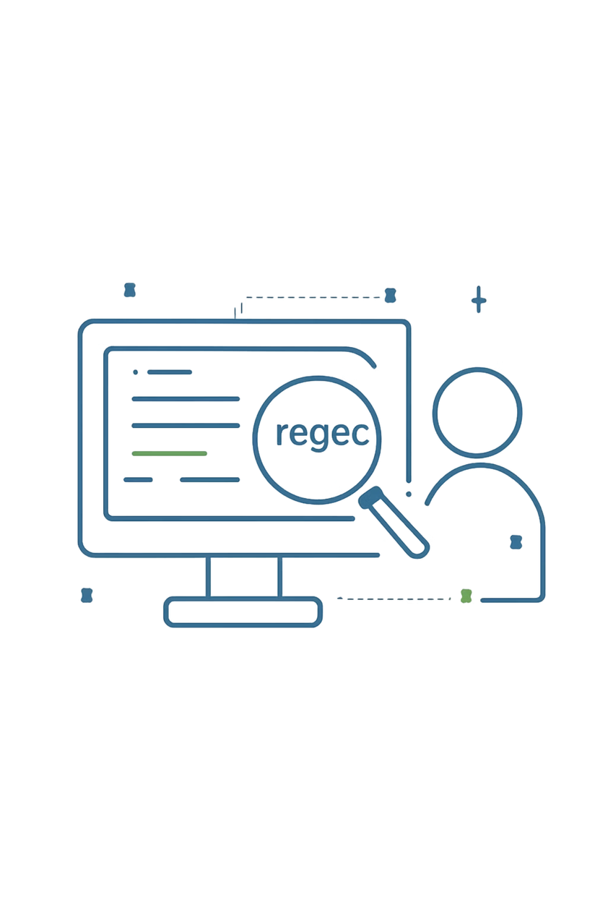
Deep Dive — Technical Problem Solved
Problem: AI responses sometimes embedded raw Mermaid.js or noisy markup which broke front-end renderers and caused layout instability.
01
02
Solution Approach
Engineering Details
Implemented a robust, layered scraper using compiled regex + token-aware trimming to reliably extract and sanitize Mermaid blocks while preserving diagram fidelity.
Pre-parse with conservative regex, validate with bracket/keyword matching, fallback to whitespace-preserving sanitizer, and then render via a safe iframe sandbox.
03
Outcome
Stabilized UI rendering, eliminated XSS risks from malformed markup, and improved UX for shared diagram previews.
Notes:
6

Slide 7
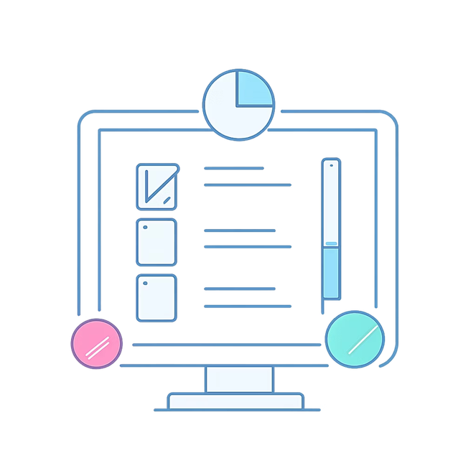

Current Status — Work in Progress
[Done] Local LLM integration (Ollama routing, session isolation)
[Done] Multimodal UI/UX design and module scaffolding
[In Progress] Audio/WAV processing pipeline (transcription + diarization)
[In Progress] Advanced RAG for large documents (scalable chunking + FAISS tuning)
Next test run scheduled on a 16GB laptop to measure end-to-end latency and memory footprint.
Notes:
7

Slide 8
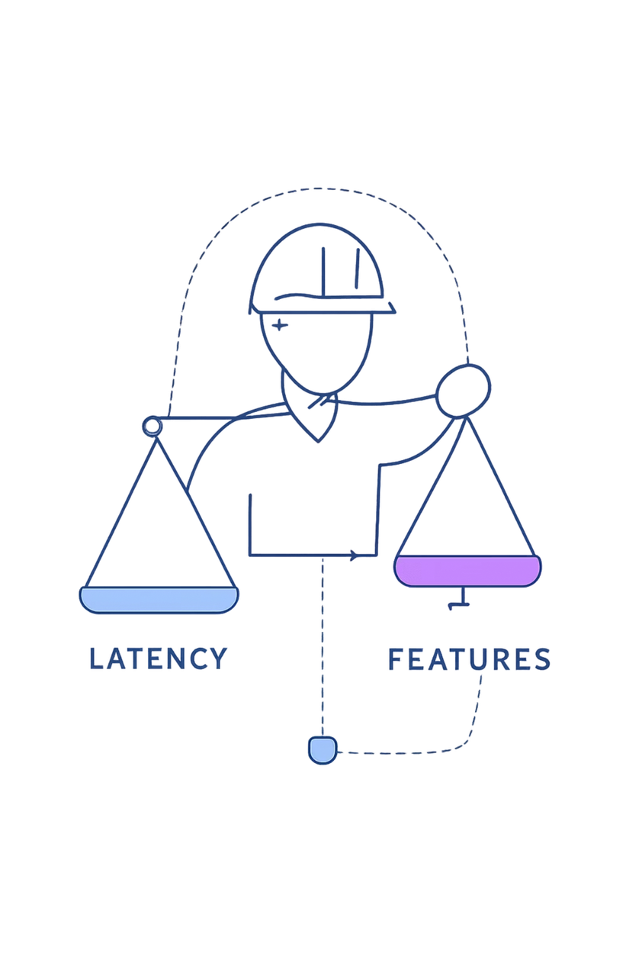
Challenges & Learning Curves
Local Model Latency
Mitigation: batching, streaming partial responses, and lightweight quantized models for interactive use.
Diverse File Formats
Mitigation: layered parsers (PDF→OCR→text), standardized chunking, and file-type validation steps.
State Management in Streamlit
Mitigation: robust session-state patterns, explicit save/restore hooks, and ephemeral caches for large artifacts.
Notes:
8

Slide 9
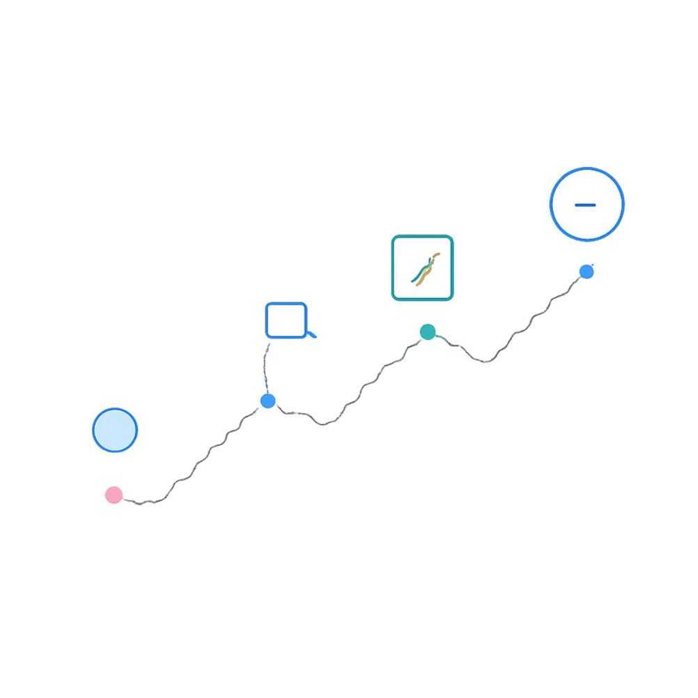
Roadmap — Next Phase (4 weeks)
Finish audio pipeline: reliable transcription + speaker
diarization.
2.Advance RAG: chunk overlap tuning, hybrid retrieval, and
relevance feedback loop.
3.Performance: memory profiling, model quantization, and
lazy-loading heavy assets.
4.Vision-to-Design: refine prompts, add multi-shot image
refinement loop.
5.Integration tests & user flows: end-to-end scenarios with
sample datasets.
Focus this sprint: reduce median response latency by 30% while preserving output quality.
Notes:
9

Slide 10
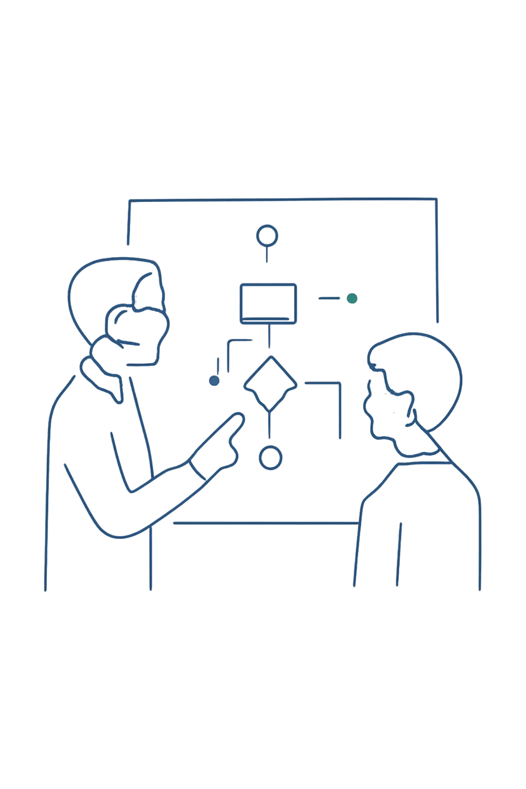
Conclusion
Summary: Core UI, Ollama-based local LLM orchestration, and four functional modules are implemented. Future work includes audio processing, RAG scalability improvements, and performance optimization.
THANK YOU!
Notes:
10

