Slide 1
Predicting Body Mass Index, Gender, and Age from Facial Images
Shweta Sampath Kumar

Slide 2
Agenda
01
02
03
04
05
Problem Satement →
Data →
Methodology →
Model →
Product Demo →

Slide 3
Problem Statement
Problem Statement
Accurate prediction of BMI, gender, and age from facial images is challenging due to the extraction of relevant features, limited labeled datasets, and the need for user-friendly real-time prediction.
Solution
Leverage state-of-the-art computer vision and deep learning techniques to develop an efficient and accurate predictive model. Surpass existing performance metrics and advance the field of facial attribute prediction for practical implementation.

Slide 4
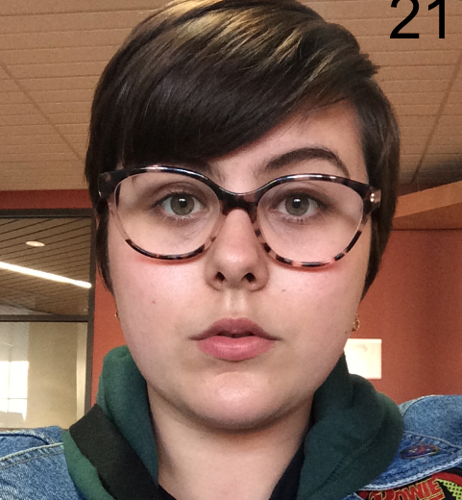

Data – VisualBMI & UTKFace
4,206 →
Rows of data with image name, BMI and gender (Visual BMI)
3,963 →
MTCNN detected the face, cropped and resized the image
Images available (VisualBMI)
2,805→
Images detected having a face and cropped successfully (VisualBMI)
20,000→
Images for training on Age (UTKFace)

Slide 5
Methodology
Comparative analysis: Compared various deep learning models like VGGFace, ResNet and FaceNet for BMI estimation, age estimation, and gender prediction.
Model | RMSE
Basic Neural Network (without pre-trained model) | 8.0559
VGG16 | 5.53067
VGG16 + SVR | 7.51748
ResNet | 7.39233
FaceNet | 7.34731

Slide 6
Methodology
VGGFace models: Trained individual VGGFace models with incremental unfreezing for optimal performance as VGGFace was the best performing model.
Specific architecture: Designed a specialized VGGFace architecture for gender prediction and utilized linear activation for BMI and age estimation.
Penalty mechanism: Introduced a penalty to incentivize precise BMI and age predictions.
Training process: Monitored RMSE and trained models for 50 epochs to balance convergence and overfitting.
Tailoring VGGFace: Optimized the VGGFace model for accurate BMI, age, and gender prediction from facial images.

Slide 7
Model
 | RMSE
Number of layers frozen from the bottom | BMI | Age
0 | 3.1015 | -
1 | 2.8932 | -
2 | 1.7409 | 2.2066
3 | 2.0169 | 2.3484
4 | 1.8854 | -

Slide 8
Model
Findings
Implications
Comparative analysis of different VGGFace configurations based on RMSE and accuracy metrics.
BMI Estimation: Best performance with 2 frozen layers (RMSE: 1.7409).
Age Estimation: Improved accuracy as more layers were unfrozen (RMSE: 2.0169 with 3 frozen layers).
Gender Prediction: Accuracy increased with fewer frozen layers (0.9352 with 3 frozen layers).
Not evaluated: Age estimation with 4 frozen layers, gender prediction with 4+ frozen layers.
VGGFace model showed effectiveness in BMI estimation, age estimation, and gender prediction.
Progressive reduction of frozen layers improved performance.
Optimal configurations: 2 frozen layers for BMI, 3 frozen layers for age and gender.

Slide 9
PRODUCT DEMO

Slide 10
Thanks!

