Slide 1
Zomato Analysis
Presented by – Shweta Suman
EmpId- 189141
Senior Analyst
(Batch – BI With MS Azure)

Slide 2
Table of Contents:
1. Introduction
1.1 Mission And Vision
2. Core Competency
3. Data Analysis Report
3.1 Analysing Data
3.3 Results

Slide 3
Introduction
Started In- July 2008, Delhi NCR.
Founded By: Deepinder Goyal, Pankaj Chaddah
Initially named- “FoodieBay”
In November 2010 it was renamed as “ZOMATO”
Parent Company - Info edge
Sector - Food & Restaurant guide and Delivery

Slide 4
Introduction Contd:
Tagline/ Slogan - Discover great places to eat around you Using Awesome Backgrounds and get home delivered your favorite savories.
USP - Content is what sets Zomato apart – The restaurant & nightlife guide with menus, pictures and map locations.
Target Group - All Smartphone Users

Slide 5
Mission And Vision:
Mission
Our mission is to ensure nobody has a bad meal .They do this by – Helping people discover great places around them , building amazing experiences around dining , Enabling restaurants to create amazing experiences .
Vision
Zomato is used by millions every day to decide where to eat in over 10,000 cities across 23 countries. In a few years, we should be able help point you to a great place to eat no matter what part of the world you're in.

Slide 6





Core Competency
Key Resources
Key Activities
App/Website Platform
Customer Service
User and restaurant Database
Restaurant Advertising
Field teams
Data Analysis

Slide 7
Tools and Softwares
Since dataset is quite large, we are opting Databricks Community and PowerBI for Analysis.
First dataset is validated and transferred to Community edition of Databricks so that analysis can be made.
Backup is kept so that if we lose data we can easily retrieve it back.

Slide 8
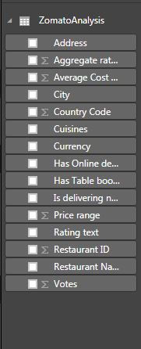
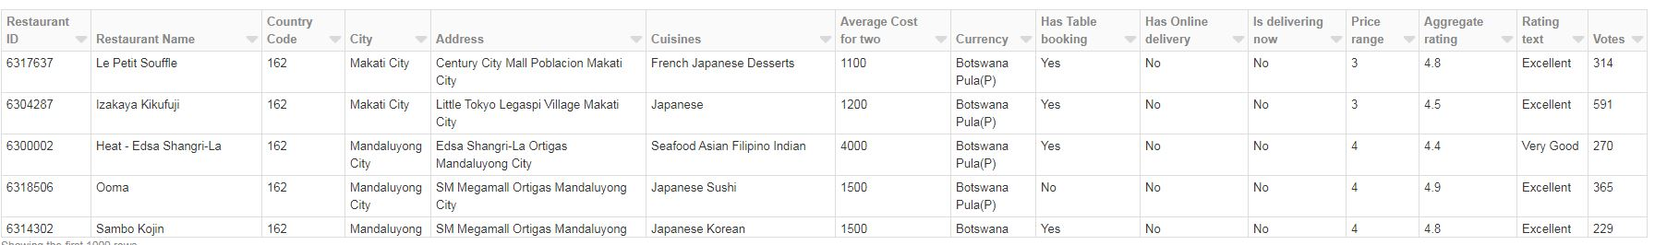
Zomato Dataset:
Total 15 columns
Sample Dataset is like-

Slide 9
Fields Present in data
Restaurant ID - Identification Number
Restaurant Name - Name Of the Restaurant
Country Code - Country Identification Number
City - City Name of the Restaurant
Address - Restaurant Detailed Address
Cuisines - Types Of Cuisines Served
Avg Cost - Average Cost if two people visit the Restaurant
Has Table booking - Can we book tables in Restaurant? Yes/No
Has Online delivery - Can we have online delivery ? Yes/No
Is delivering now - Is the Restaurant delivering food now? Yes/No
Price range - Categorized price between (1-4)
Aggregate rating - Categorizing ratings between (1-5)
Rating text - Different Rating like Excellent, Very Good ,Good, Avg, Poor, Not Rated
Votes - No. Of Votes received by restaurant from customers.

Slide 10
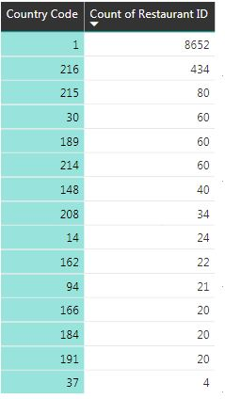
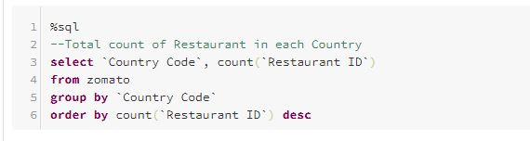
Analizing Dataset
Count Restaurant in each country using sql query
Table shown is output

Slide 11
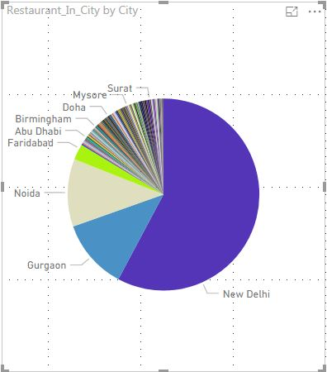
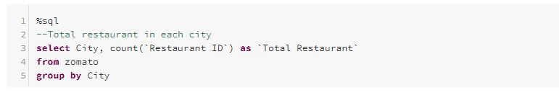
Count of Restaurants in each city:
Query shows Count of restaurant in each city

Slide 12
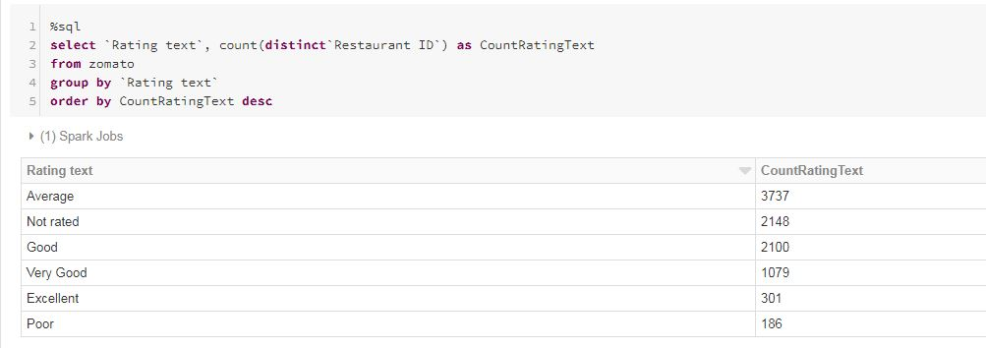
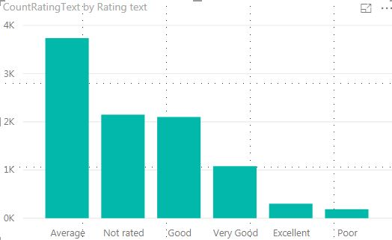
Rating wise Count
Query shows count of restaurant falls under each RatingText category

Slide 13


Count of Online delivery and Has Table booking:
Table 1: Count of Restaurant having Online delivery available? Yes/No
Table 2: Count of Restaurant having Has table booking? Yes/No
Table 1
Table 2

Slide 14
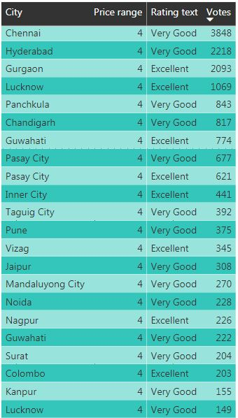
Sort by highest Voted Restaurant and price Range
City wise highly voted restaurant
Price Range > 4
Aggregate Rating >4

Slide 15
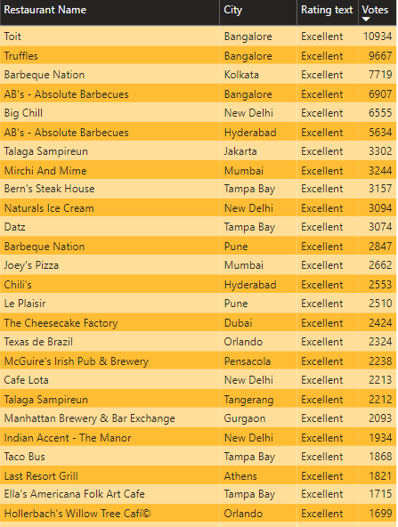
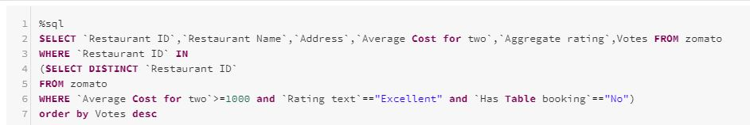
Nested Query Operation
Finding details of restaurant having Excellent Rating and currently open for booking
Order by highly voted Restaurant

Slide 16
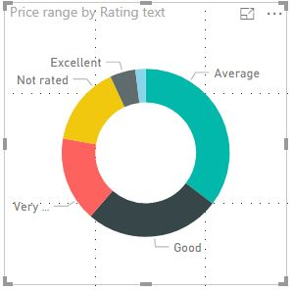
Price Range vs Rating Text
Most of the price range falls under Average Rating group
Less restaurants are underrated

Slide 17
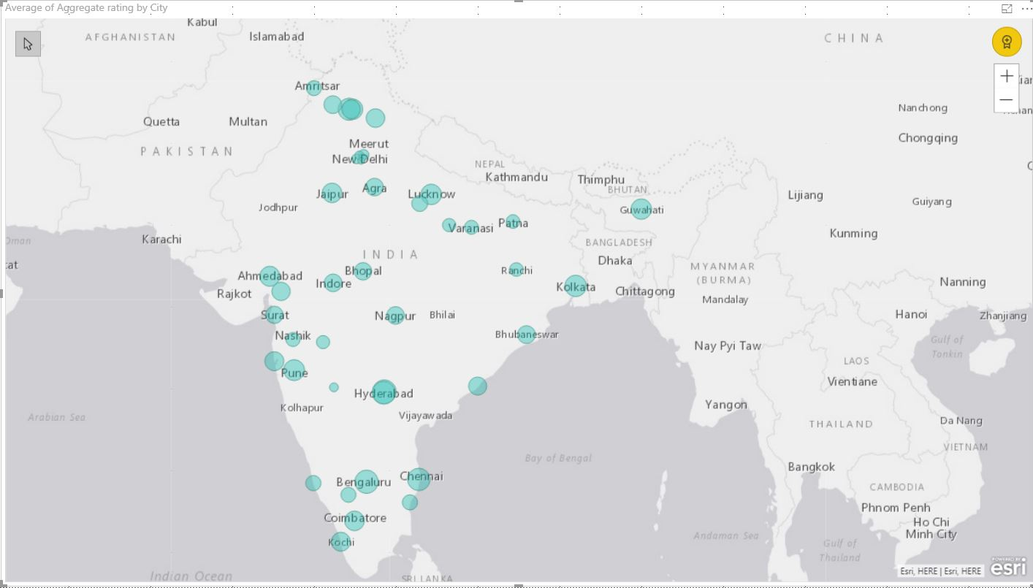
City wise Average Aggregate Rating In India

Slide 18
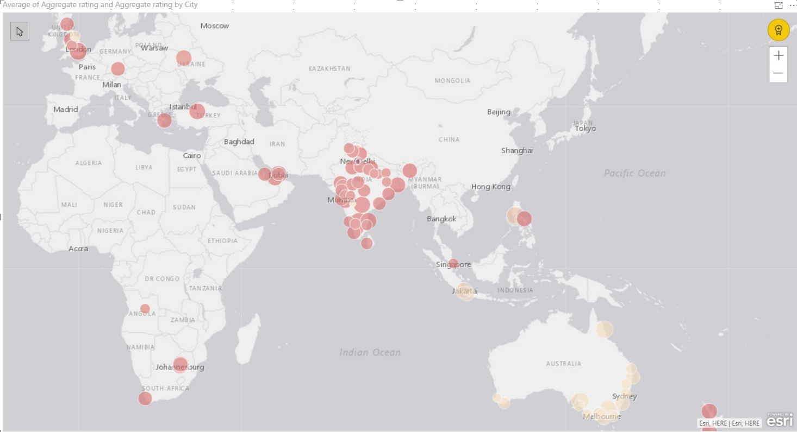
City wise Average Aggregate Rating In World

Slide 19
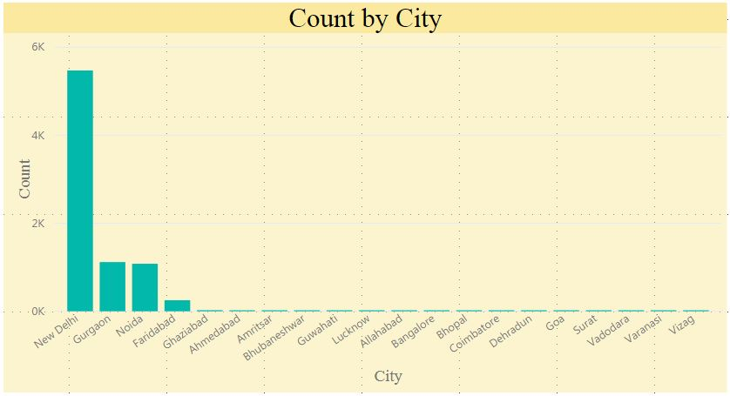
Restaurant Count by city In India

Slide 20
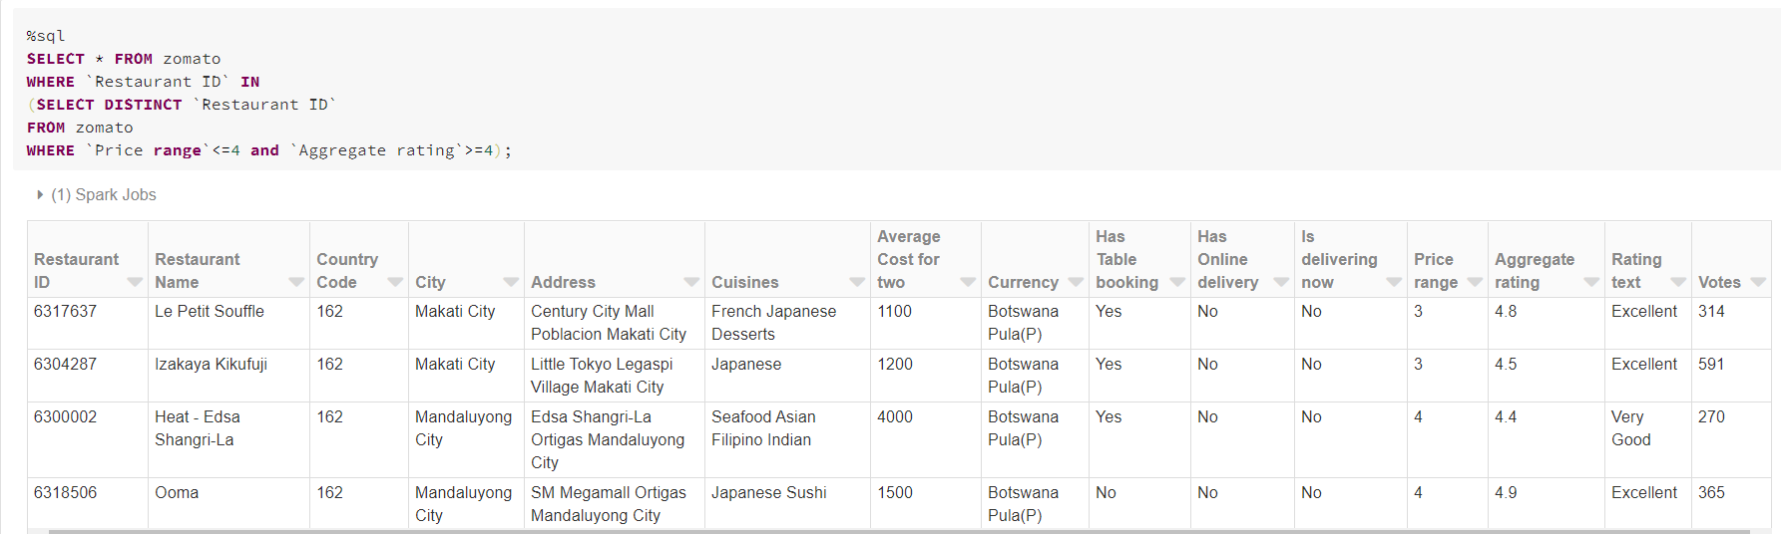
Conditional Queries
Finding Details of Restaurant which are cheaper and good Aggregate Rating

Slide 21
Results
Using the Analysis done in this project, customer can choose the best rated restaurant in the city.
Low rated restaurant can improve its service by seeing in which portion it is lagging from other high rated Restaurant.
The basic need of these type of analysis is how business can be improved.
In the Zomato dataset, there are various restaurants which are underrated. So ordering food from those restaurants may impact the business of the Zomato. So using this, Zomato can decide weather it is right to take particular restaurant to Zomato or not.

Slide 22
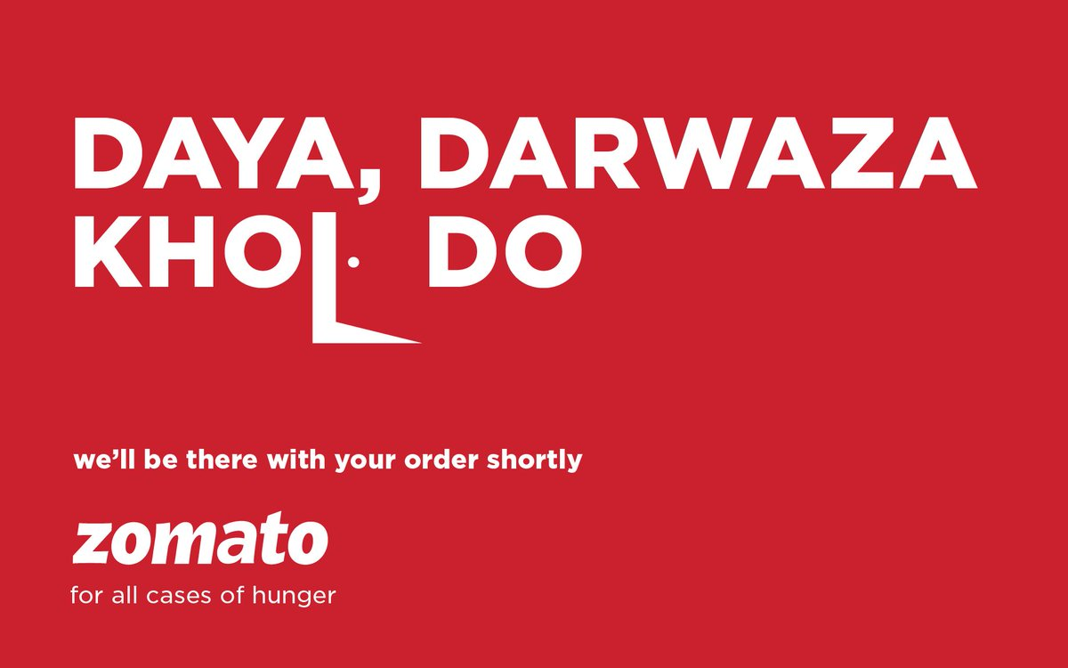
Thank You
Thank You

